Slide 1

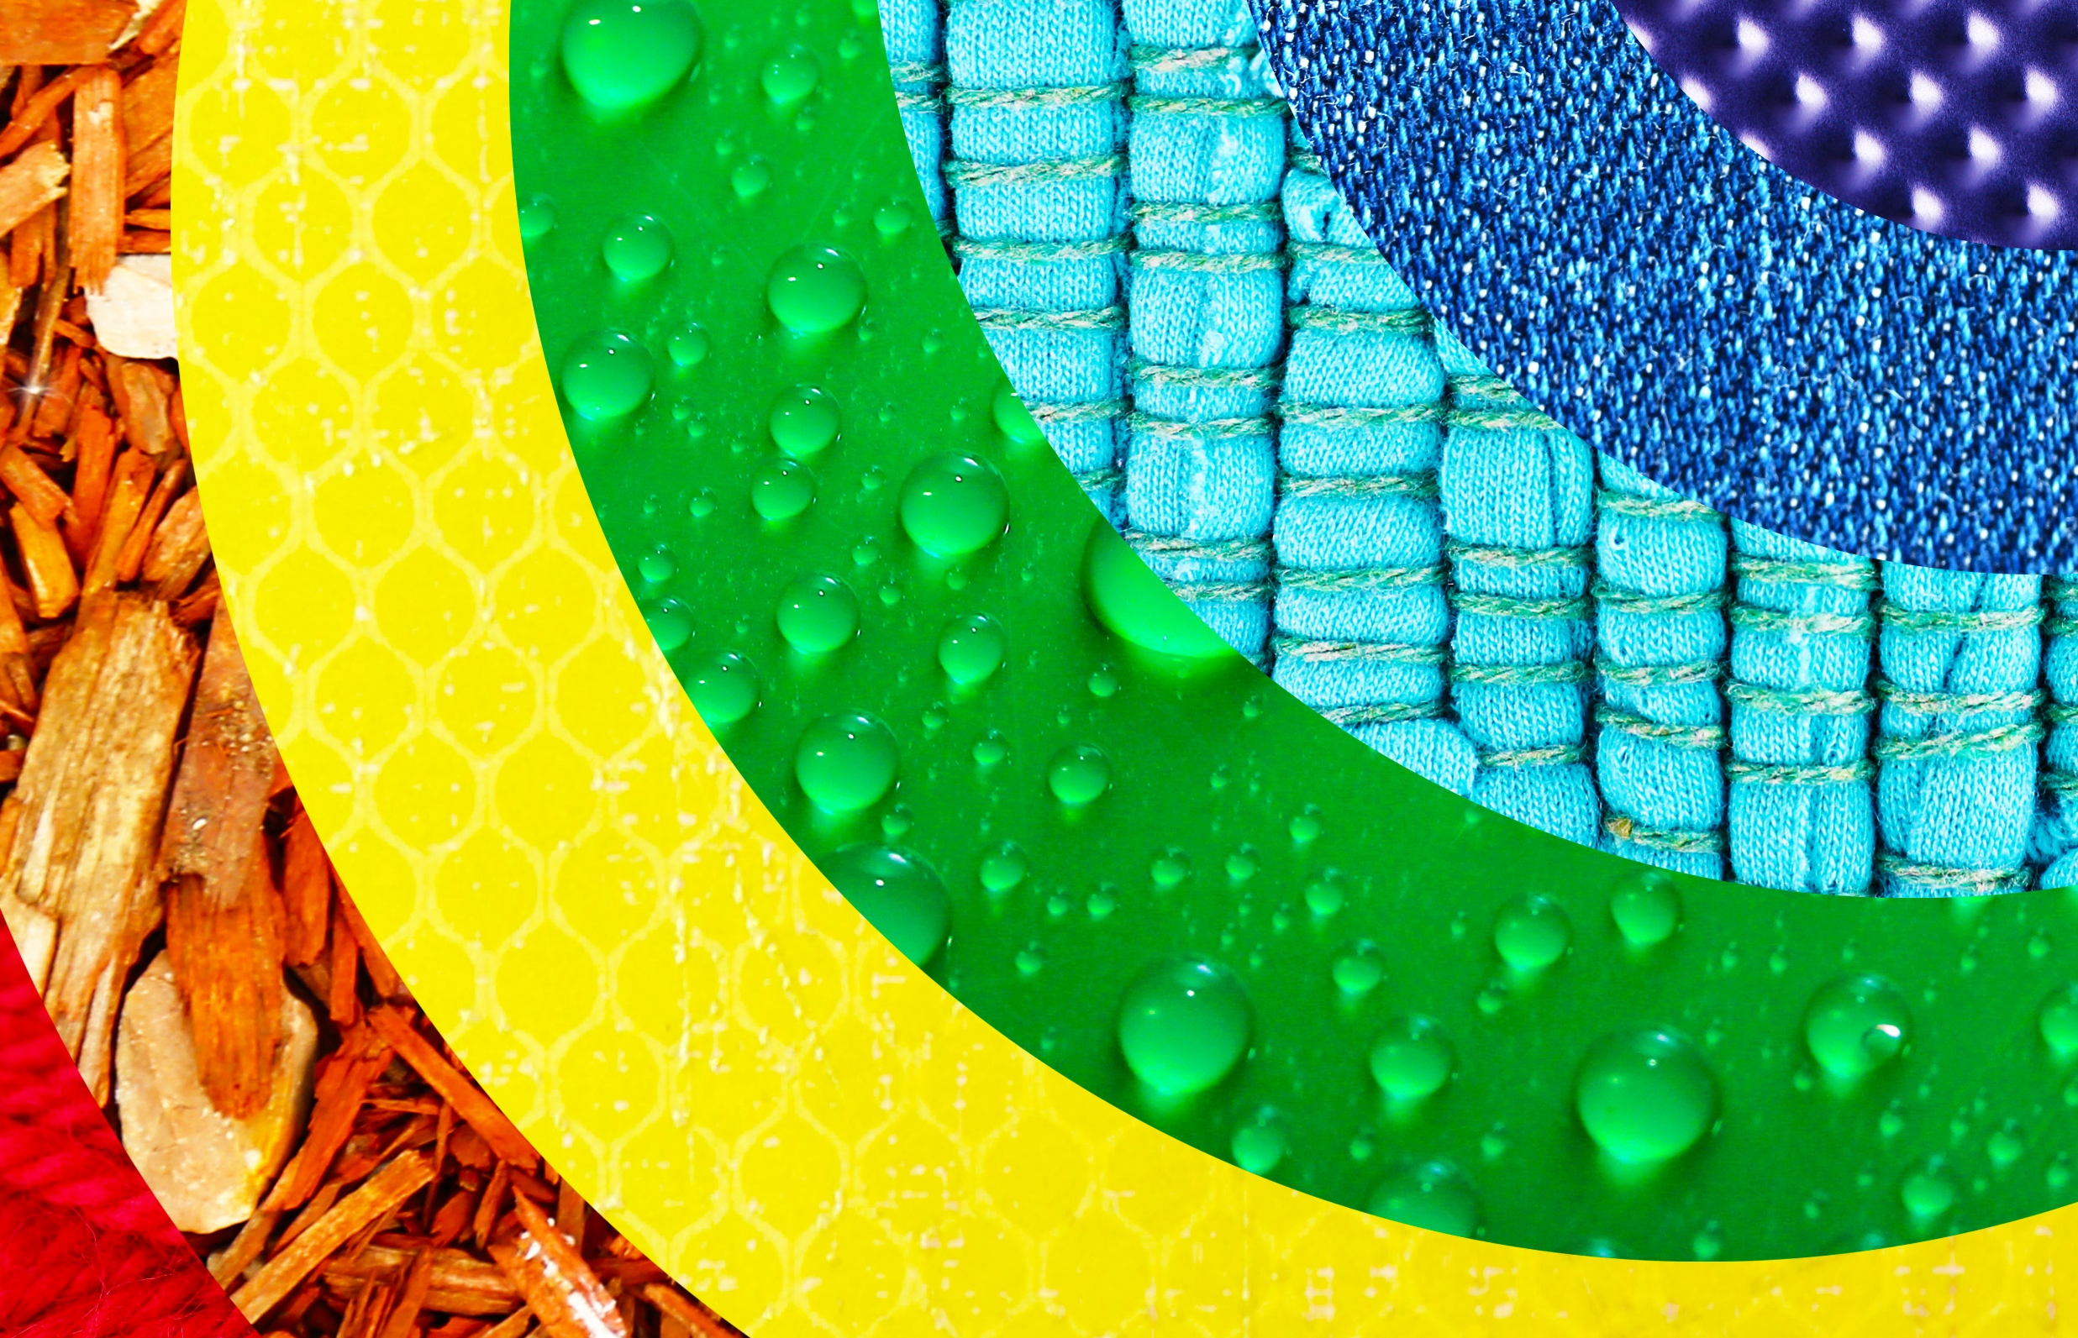


Plants
For parents
Thank you for supporting your child’s learning in science.
Before the session:
There are 6 main activities. They do not have to be done on the same day. In fact, to support your child’s attention levels, each activity has been broken down into 20-30 minute chunks so could be broken over a few days.
Please read the slides to know which activity to do, what your child is learning and what you need to get ready.
The activities are hands on and evidence can be shown by taking photos.
During the session:
Share the learning intention on slide 2.
Slide 11 has a glossary of key terms.
Reviewing with your child:
The slides give examples of what your child may produce.
How seeds and bulbs grow and what
they need to be healthy
Year 2
Ages 6-7

Slide 2
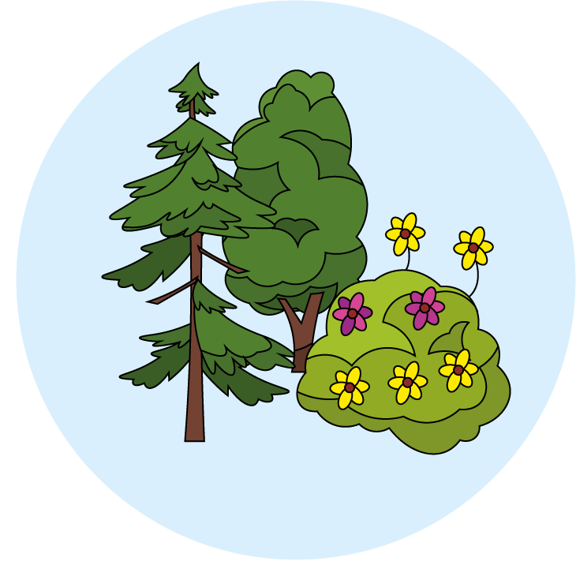
Plants
Logo for section to sit inside roundel
How seeds and bulbs grow and what they need to be healthy
Key Learning:
Plants may grow from either seeds or bulbs. These then germinate and grow into seedlings which then continue to grow into mature plants. These mature plants may have flowers which then develop into seeds, berries, fruits etc.
Seeds and bulbs need to be planted outside at particular times of year and they will germinate and grow at different rates. Only indoor bulbs are likely to grow in Spring/Summer e.g. amaryllis, hyacinth. Some plants are better suited to growing in full sun and some grow better in partial or full shade.
Plants also need different amounts of water and space to grow well and stay healthy.
Activity 1 – Review what your child knows from the year 1 objectives and discuss what they would like to find out about how plants grow.
Activity 2 – Compare and sorts seeds and bulbs by doing observational drawings.
Activity 3 – Observe over time by planting seeds and bulbs. Do they grow at the same rate and if you change where and what the seeds get, does that affect the growth?
Activity 4 – Plant seeds and grow them healthily to contribute to a meal.
Activity 5 – Odd one out. Look at the three pictures and see what vocabulary your child uses to explain their reasons.
Activity 6- Review the table you started in activity 1 and see what your child has learned.
You will need:
Plant pots
A variety of seeds and bulbs
Soil
I can…
observe and describe how seeds and bulbs grow into mature, healthy plants.
find out and describe how plants need water, light and a suitable temperature to grow and stay healthy.
2

Slide 3
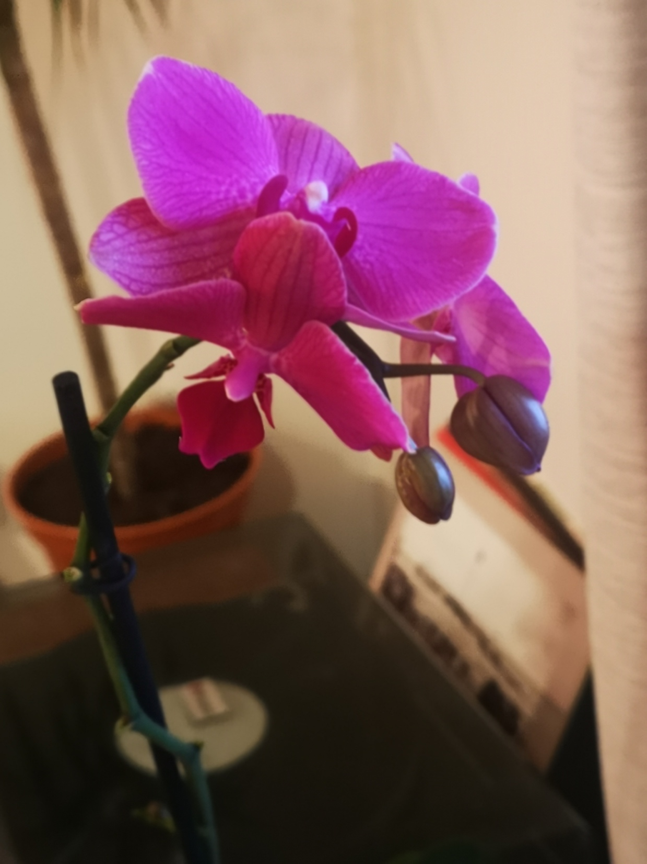
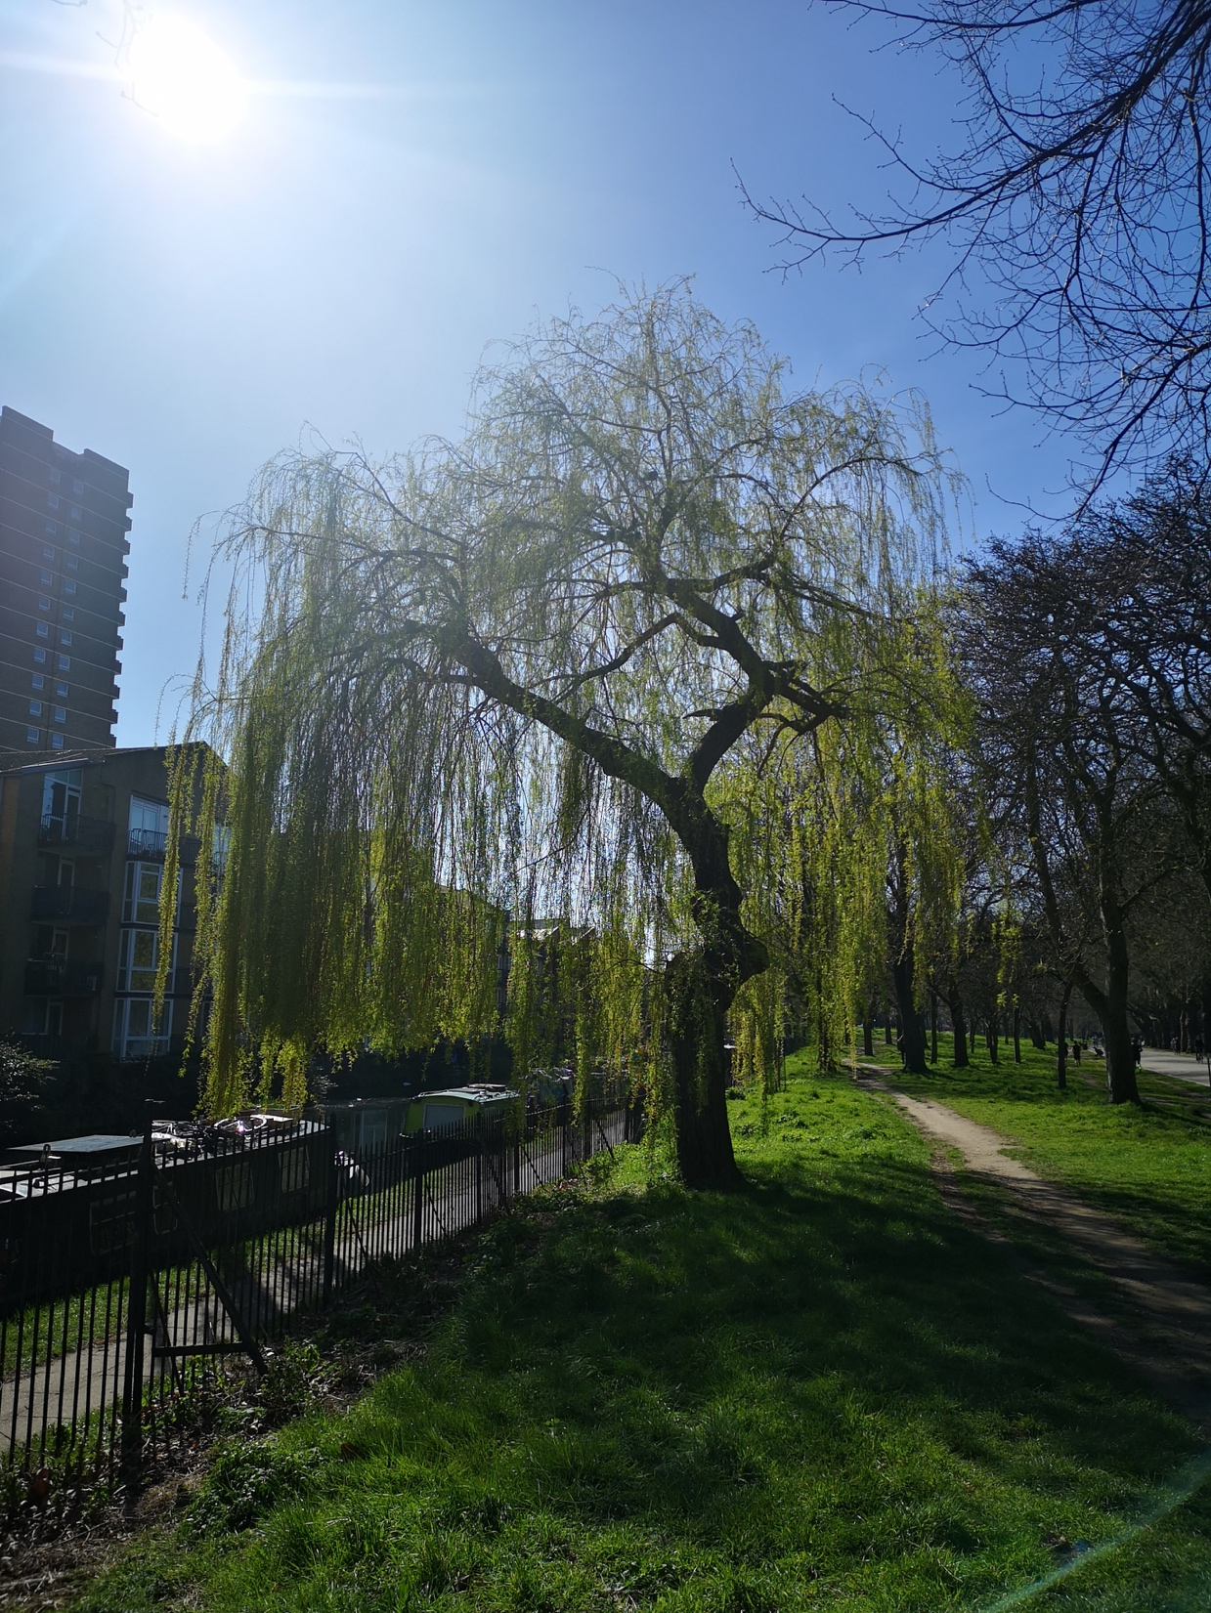
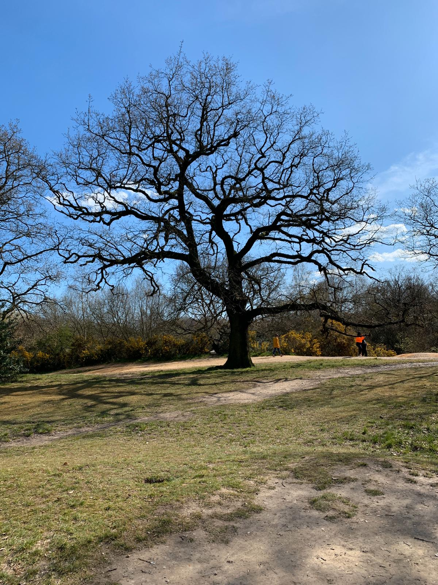
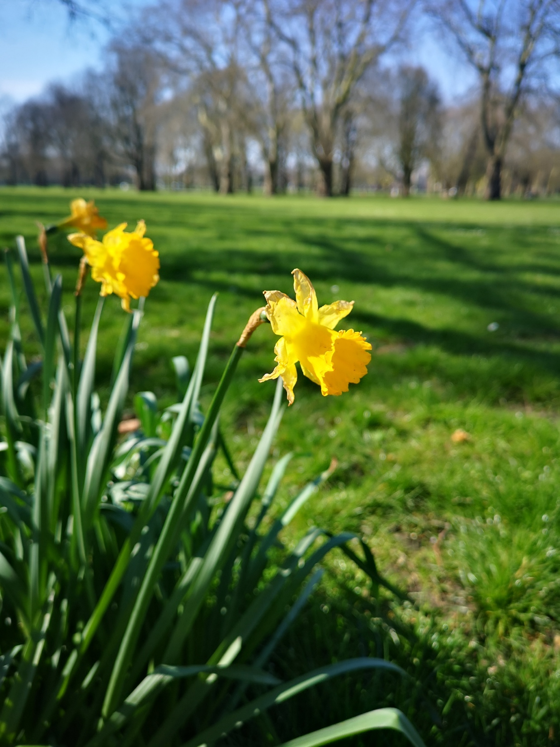
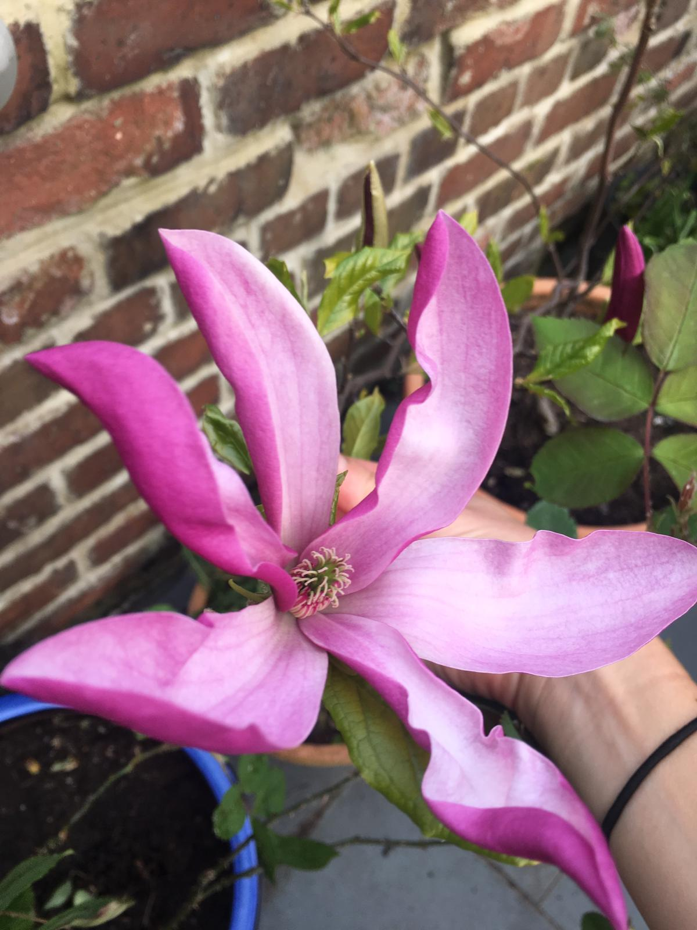
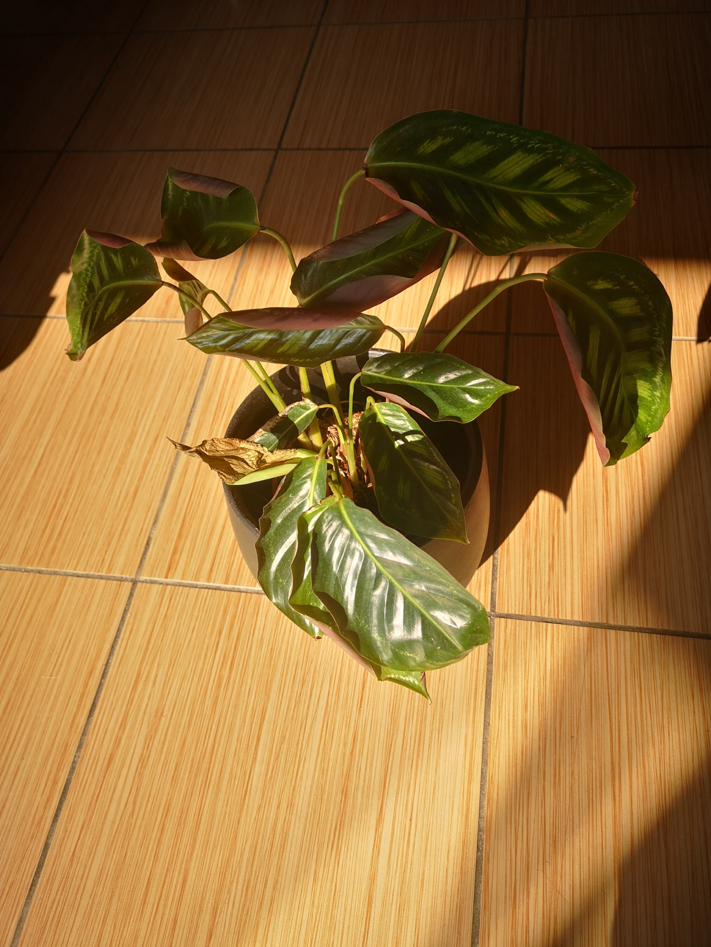
Think, talk, review….
Logo for section to sit inside roundel
What do the children already know about plants? (30 minutes)
Activity 1:
Recap Year 1 objective - Identify and describe the basic structure of plants and trees.
Show your child the pictures on this slide. Do they know what plants the pictures show?
Which are trees? How do you know?
Point and name the different parts of the plants and describe what they are like.
Vocabulary: Leaf, flower, blossom, petal, fruit, berry, root, seed, trunk, branch, stem, bark, stalk, bud
Learning outcome: Identify and describe the basic structure of plants and trees.
3

Slide 4
Activity 1:
Ask your child what they already know about plants and how they grow healthily.
Discuss and write down all of the things they know already and any questions they would like to find out the answers to.
Note:
Don’t worry if you, as the adult, don’t know the answer to the questions - explain that you can learn together and research the answer, like scientists constantly have to also do.
Year 1 vocabulary: Leaf, flower, blossom, petal, fruit, berry, root, seed, trunk, branch, stem, bark, stalk, bud
Year 2 vocabulary to listen out for: light, shade, sun, warm, cool, water, grow, healthy
Learning outcome: to identify parts of a plant and how they grow.
What do you already know? | What questions do you have?
You can write this together in one colour and review it at the end to see what you now know, that you didn’t before. This is a useful assessment of your child’s learning.
4

Slide 5
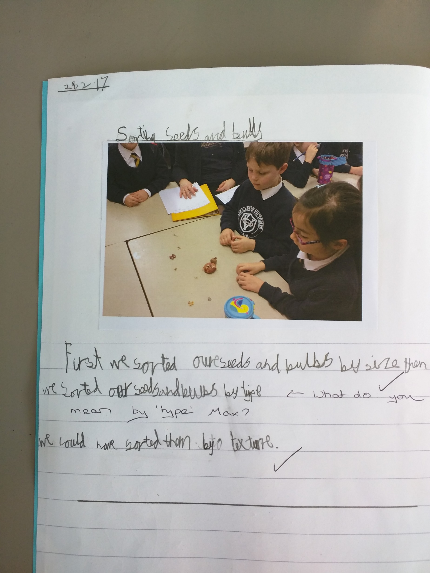
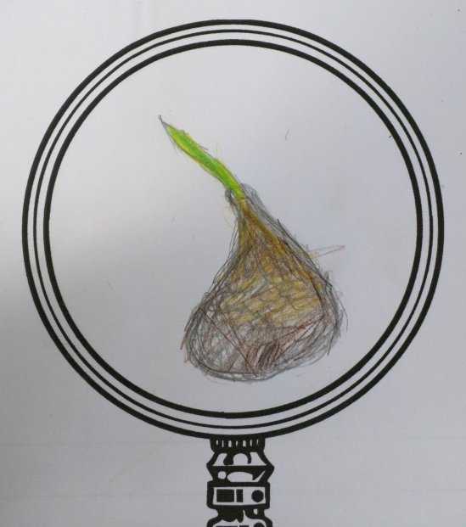
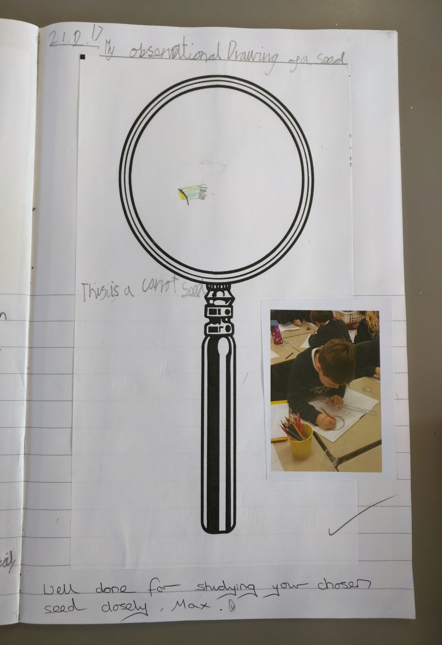
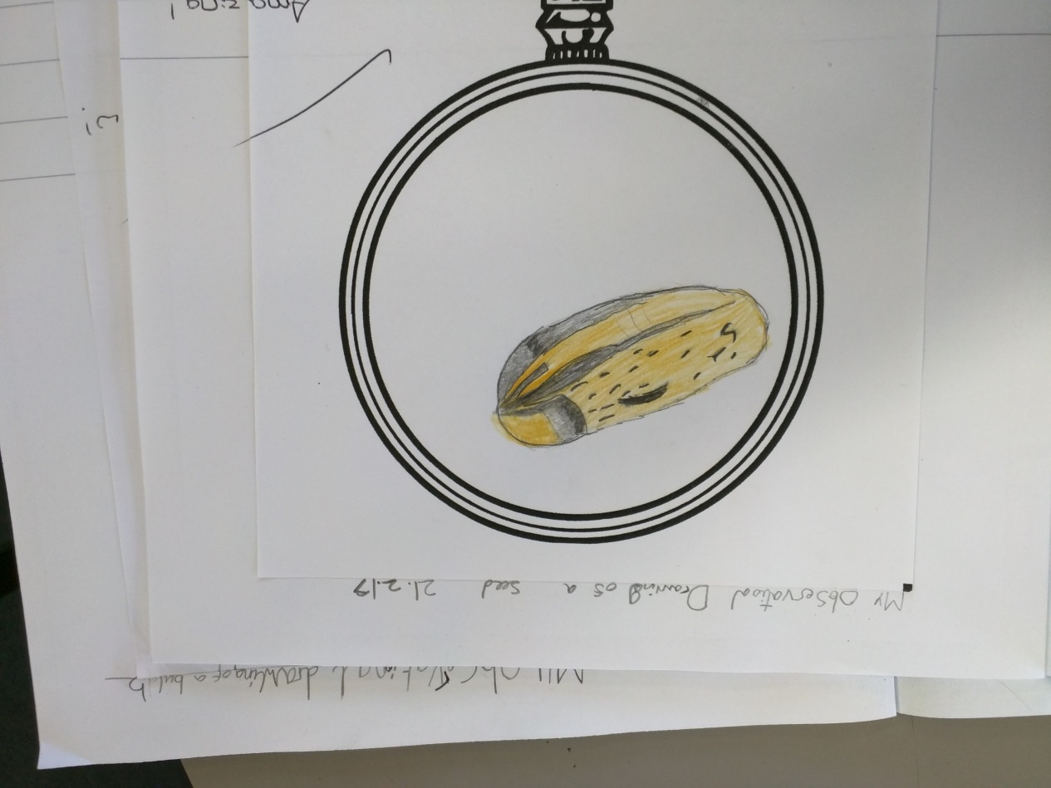
Explore, think, talk….
Logo for section to sit inside roundel
What do the children already know about seeds and bulbs? (30 minutes)
Instructions for Activity 2:
Give your child a variety of seeds and bulbs to sort. Do not tell them what they are - allow your child to make their own comparisons first.
Note: At this point, any way that your child sorts the seeds and bulbs is valid, but encourage them to explain their reasons for sorting them in that way.
After, do some observational drawings, looking closely at the seeds and bulbs. This will help your child compare, later.
Learning outcome: compare and sort seeds and bulbs.
Observational drawings.
5

Slide 6
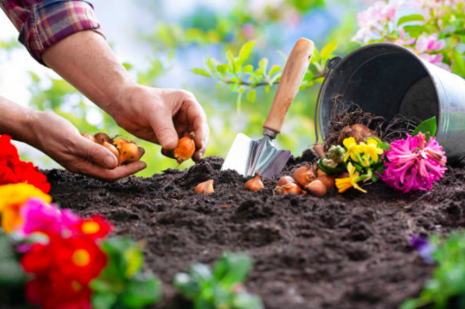
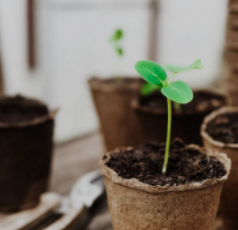
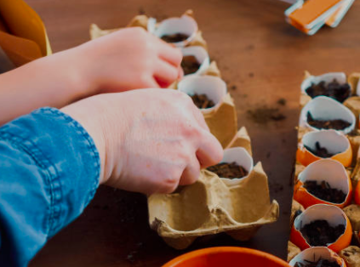
Explore, talk, observe
Logo for section to sit inside roundel
Make comparisons between plants as they grow.
(10-20 minutes)
Activity 3: Make close observations and measurements of their plants growing from seeds and bulbs.
Collect some bulbs, seeds, soil and plant pots and allow your child to plant them. They will be attempting to grow plants that are strong and healthy.
Ask them:
What do they think this plant will need, in order to grow healthily? (light, shade, sun, warm, cool, water)
Encourage your child to check on their plant regularly e.g. your child will check and water the plant if the soil looks dry or if the leaves or stem are looking pale, finding a lighter place in the room to help it grow.
Experiment:
Discuss and compare the growth of different types of bulbs and seeds.
.
If you can’t find plant pots, you can use food containers or egg shells for seeds.
6

Slide 7
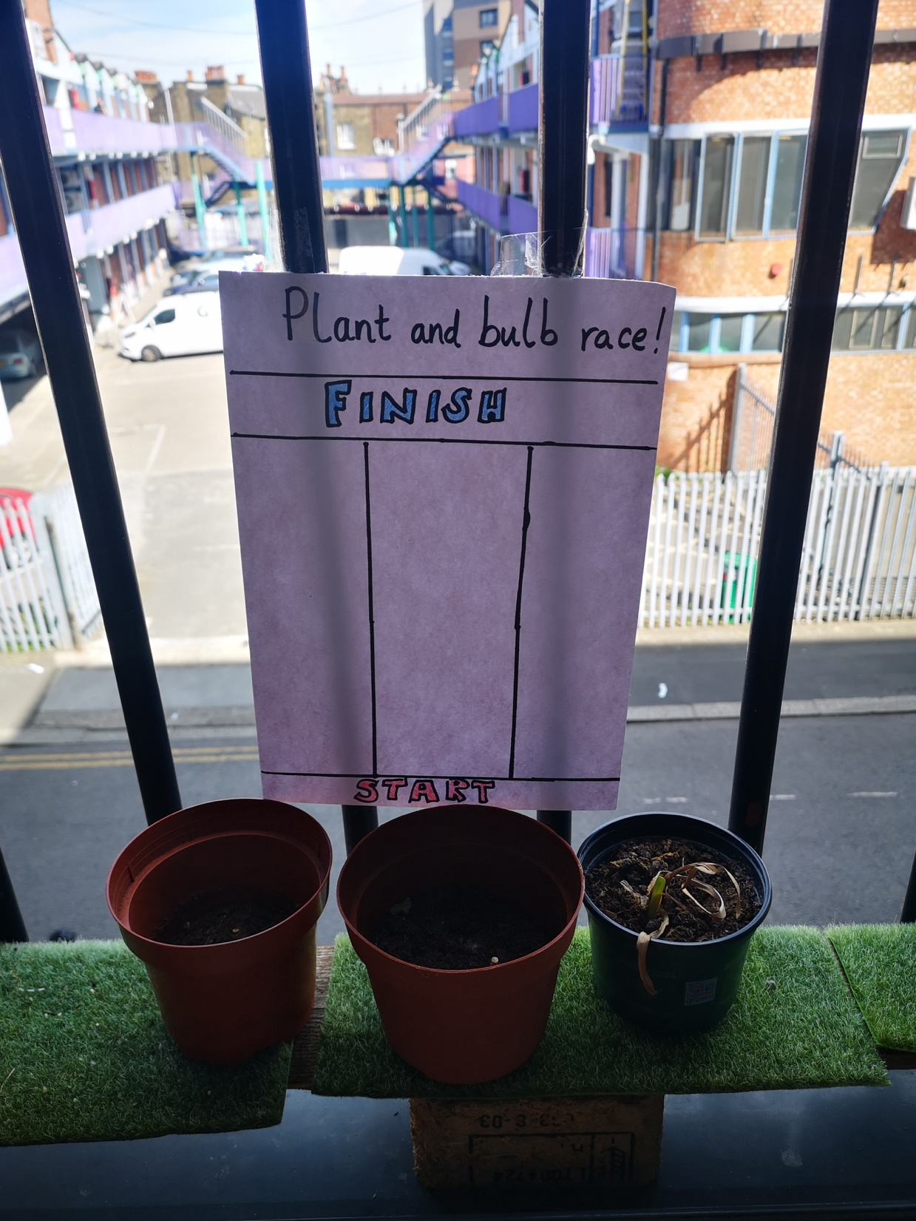
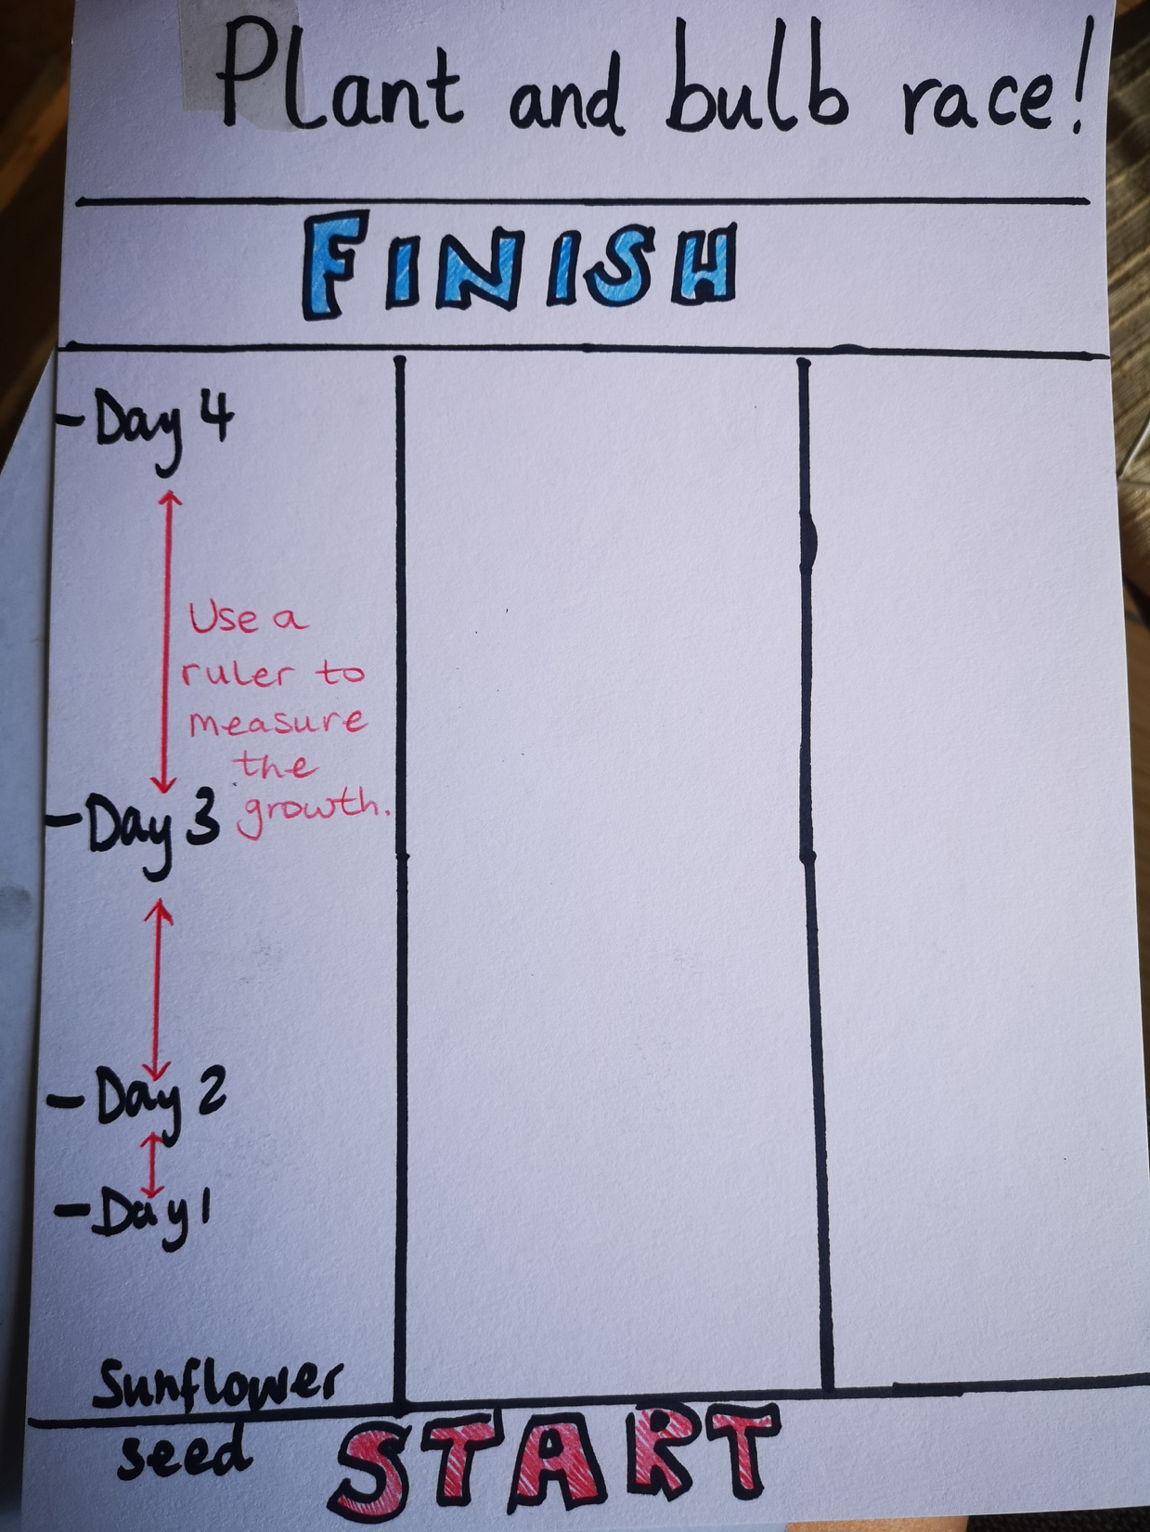
Explore, talk, observe
Make comparisons between plants as they grow.
Logo for section to sit inside roundel
(Over time - will depend on the seeds/bulbs planted)
Activity 3:
Make comparisons between plants as they grow by:
Measuring them each day, from germination, by marking their height and see if the rate of growth changes or increases steadily.
Note: Seeds and bulbs do not need light to germinate but they do need some warmth.
Follow the link for ways to link writing outcomes to the fairy tale of Jack and the Beanstalk: https://www.science-sparks.com/jack-and-the-beanstalk-experiments/
This example is not an accurate time scale and all seeds will vary.
7

Slide 8
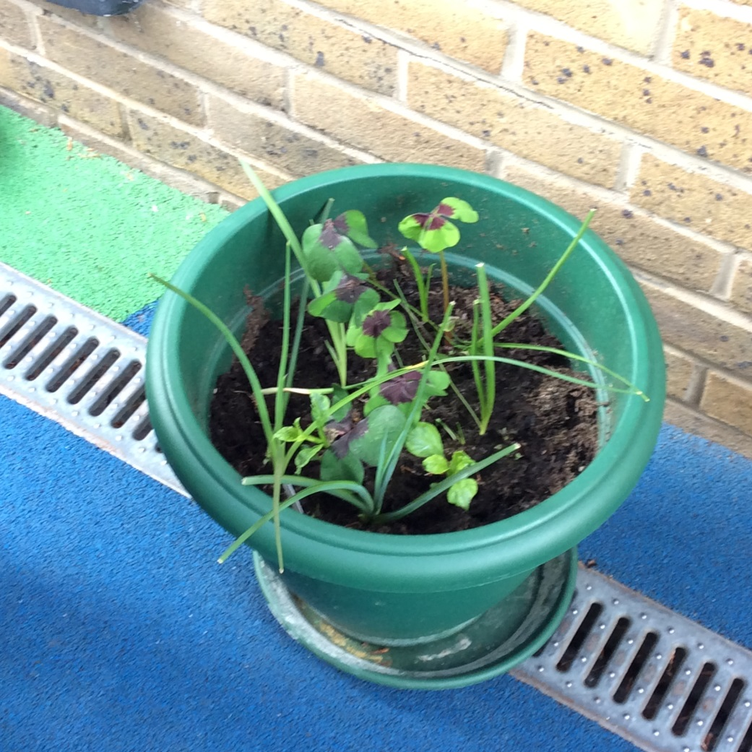
Explore, talk, extend
Logo for section to sit inside roundel
Grow seeds that produce something edible.
(Over time - will depend on the seeds planted)
Practical Activity 4:
Once you have learned how to look after a plant and understand what it needs to grow strong and healthy, extend your growing to something that you can use in a meal.
You could grow:
Herbs to go in a salad (basil, chives, dill)
Bell peppers
Tomatoes
Cucumber
All of these suggestions are suitable for the summer months (June/July)
Note: Seedlings grow differently according to the light level. A range of seeds and plants grow to maturity at different rates across the year so check the packaging to see what will grow in summer months.
8

Slide 9
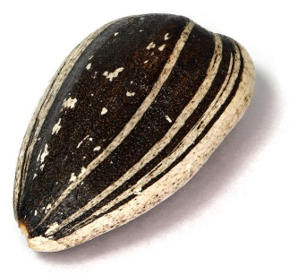
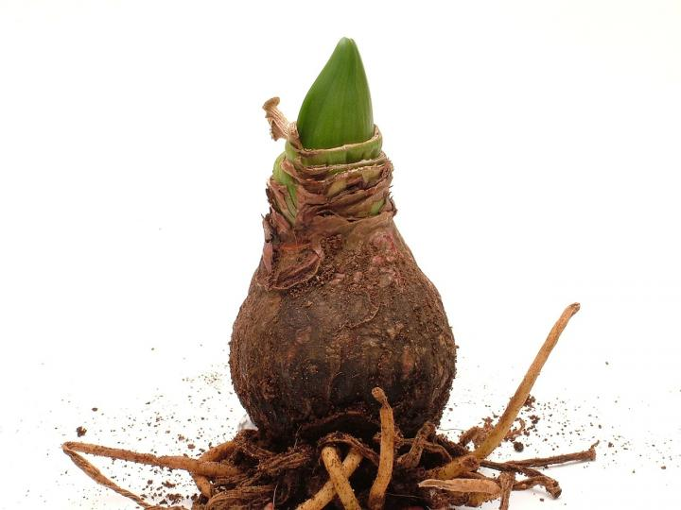
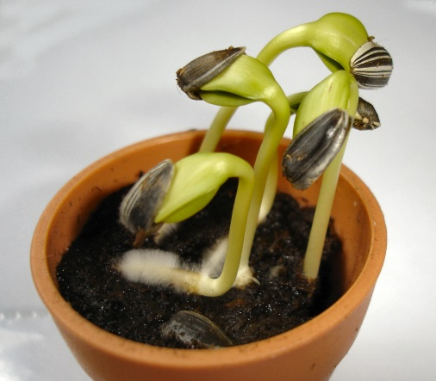
Apply scientific understanding
Use what you have learned to find the odd one out.
Logo for section to sit inside roundel
(10 minutes)
Practical Activity 5:
Play odd one out using these three pictures. How many different odd one outs can they think of?
9

Slide 10
Activity 6:
Review the learning from activity 1. Ask your child what they NOW know, after the activities.
2. Write this in a different colour, to the ‘what you already know’ column, to show you and your child all the things you have learned.
3. Look at the questions you thought of at the start and review if you now know the answers and tick them if you do.
Maybe you now have some new questions you would like to find the answers to.
4. Together, use the internet to research and find out the answers to any questions left unsolved.
Learning outcome: assess what your child now knows about plants and how they grow.
What do you already know? Plants need water to grow Seeds can grow in soil Seeds and bulbs grow at different rates You can eat some plants Plants need warmth to grow | What questions do you have?
Show and celebrate the work you have done and all the new learning you have achieved by looking at the table.
10

Slide 11
Glossary of terms
Germinate: When a seed/bulb begins to grow and put out shoots.
Shoots: The new growth from germination that grows upward is a shoot and is where leaves will develop.
Healthy: Healthy plants have firm leaves, well-formed flowers and fruit, and well-developed root systems.
Maturity: The point when the plant is ready to fruit or flower.
Seedlings: A young plant developing from a seed.
Leaf: Flat, blade-like structure that comes off from the stem or branch of a plant.
Flower: Has petals that produce perfume and colour to attract insects.
Bud: The undeveloped shoot, leaf, or flower.
Root: The part of a plant that grows downward.
Seed and bulb: A part of the plant which can grow into a new plant.
11

