Slide 1

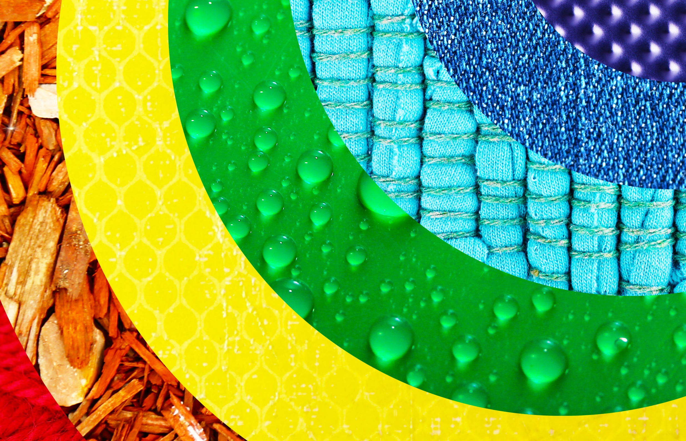


Every day materials
For parents
Thank you for supporting your child’s learning in science.
Before the session:
There are 4 main activities. They do not have to be done on the same day. In fact, to support your child’s attention levels, each activity has been broken down into 20-30 minute chunks so could be used over 4 days.
Please read the slides to know which activity to do, what your child is learning and what you need to get ready.
The activities are hands on. Take photographs so that learning can be shared and discussed.'
During the session:
Share the learning intentions on slide 2.
There are optional extension and review tasks
Slide 10 has a glossary of key terms.
Reviewing with your child:
Slides 4, 5, 7 and 8 give examples of what your child may produce.
Find objects around the house and classify them by material and then by property.
Year 1 Ages 5-6

Slide 2
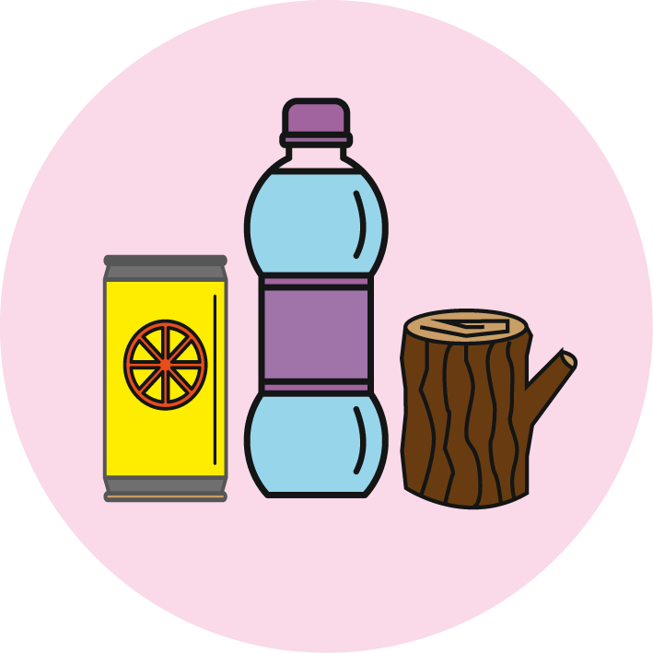
Every day materials
Logo for section to sit inside roundel
What are objects in the home made of?
(can the children group materials into certain groups based on their properties)
Key Learning
Distinguish between an object and the material from which it is made.
Identify and name a variety of everyday materials, including wood, plastic, glass, metal, water, and rock.
Describe the simple physical properties of a variety of everyday materials.
Compare and group together a variety of everyday materials on the basis of their simple physical properties.
Activities: (Slides 3-7) approx 2 hours
Activity 1- Children start by creating groups of objects from around the house.
Activity 2- After, ask them to sort the objects into more specific groups (plastic, metal, rock, glass, wood, water, paper, fabric etc).
Activity 3- Understand the properties of materials.
Activity 4- Group the objects into different properties.
Go further- Find objects with more than one material or create your own Venn diagrams to show how objects can have more than one property.
Practical investigation
You will need:
plastic, metal, rock, glass, wood, water, paper, fabric, camera, scrap paper, properties of materials word mat (slide 6).
I can…
Identify the material an object is made of.
Describe the properties of different materials.
2

Slide 3
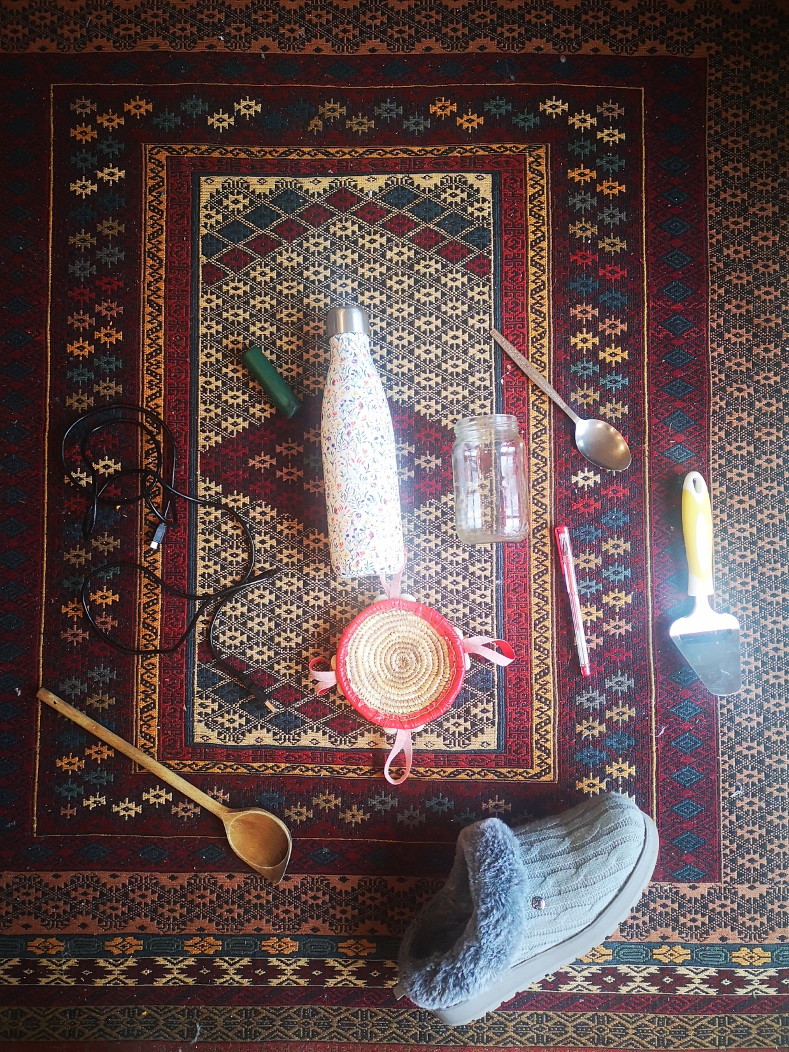
Explore, think, talk….
Logo for section to sit inside roundel
What do the children already know about materials? (20 minutes)
Instructions for Activity 1:
Ask your child to find 10 objects of their choice but explain that they must try to collect items that are different from one another.
Vocabulary to listen out for (but not share, yet):
Plastic, rock, metal, glass, wood, water, clay, hard, soft, stretchy, stiff, bendy, floppy, waterproof, absorbent, breaks/tears, rough, smooth, shiny, dull, see-through, not see-through
Note:
The children may have their own unique way of describing the object. This is GREAT! We want to encourage all language to begin with- based on what the gaps are, you can tailor the language. (See page 4)
Learning outcome: I can explain why I have grouped materials in certain ways. (At this point, try not to be specific about materials, you want to see what your child already knows.)
When they have collected 10 items, ask them to sort them in different ways. (You can model an example if your child is unsure- see page 4)
3

Slide 4
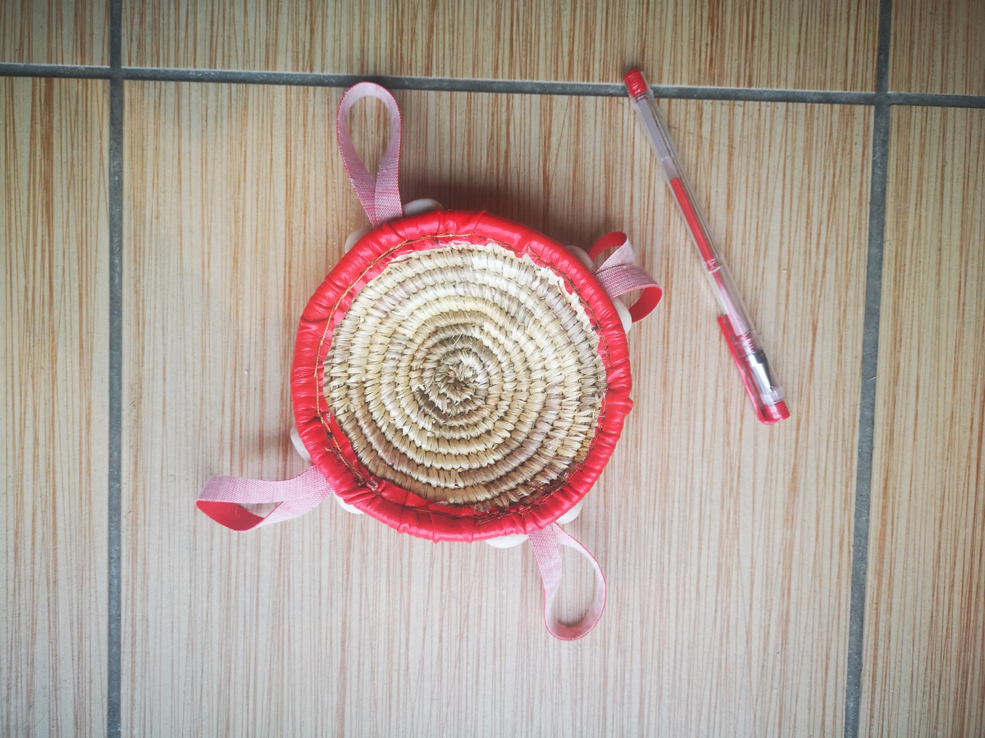
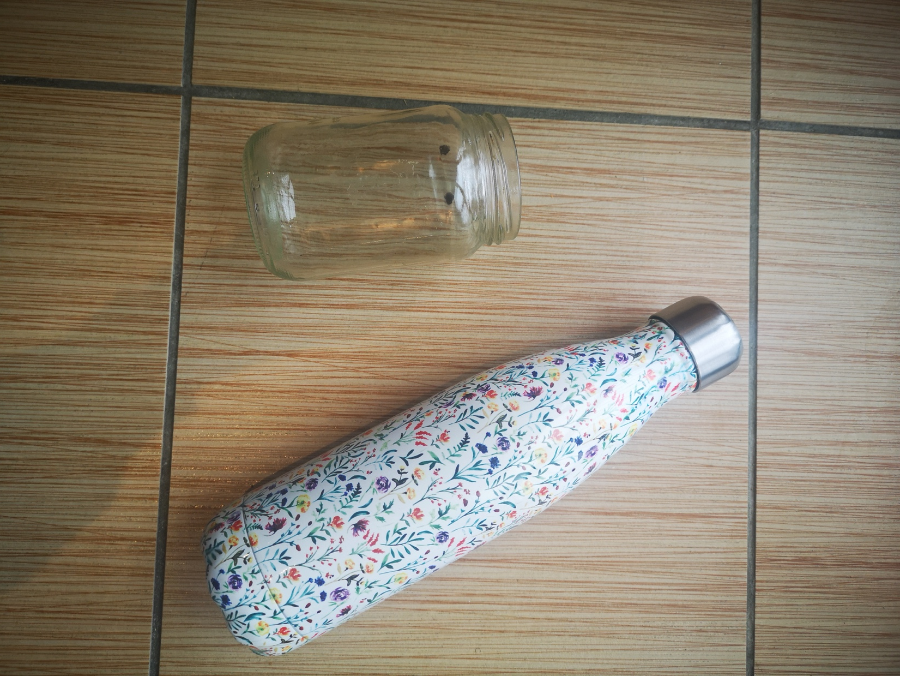
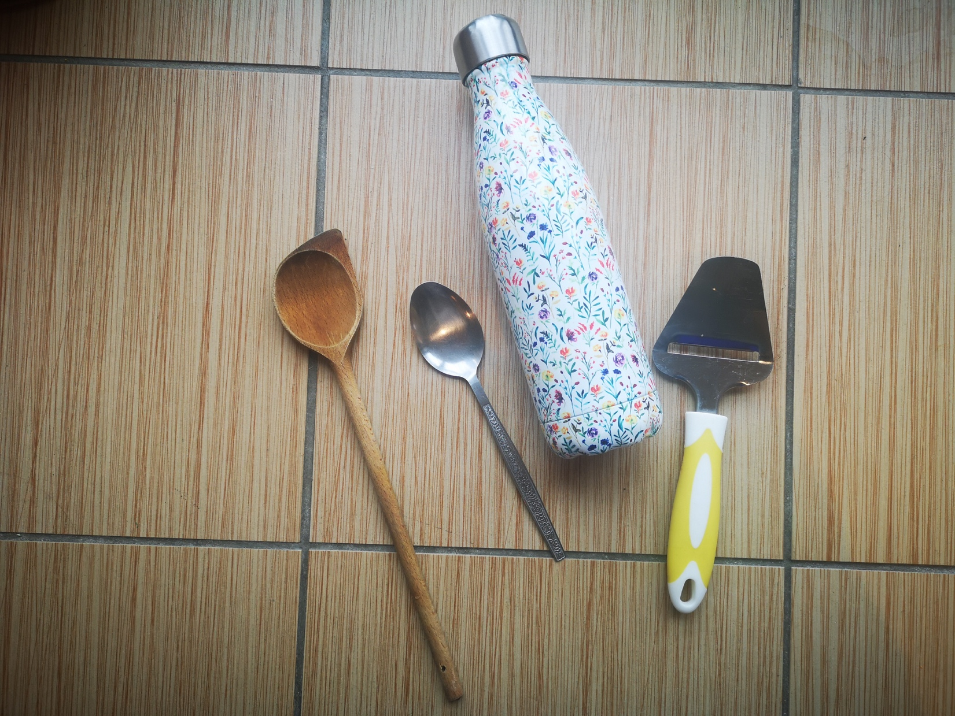
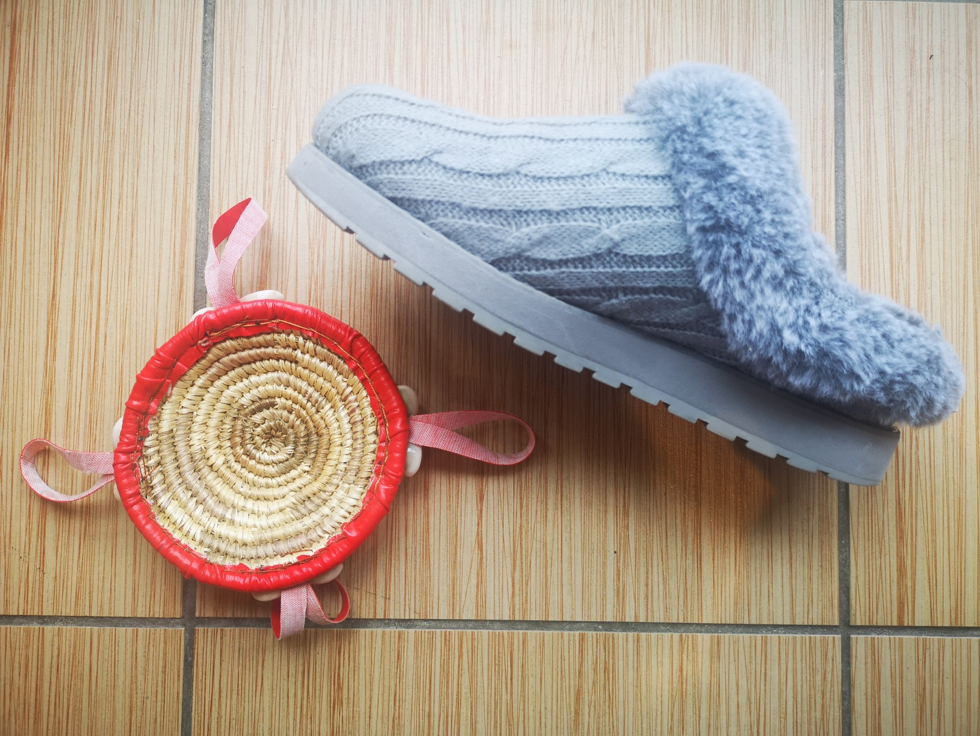
Instructions for Activity 1:
Simple descriptions like:
“They are both red” and “They are used in the kitchen” have a place in early grouping of items.
“They are hard” and “They have bumpy bits” show an understanding of texture (rough) and feel (hard/strong). This is a good starting point and tells you what vocabulary to focus on.
Note:
From this information, I can see that the child has not identified materials (plastic, rock, metal etc.)
Learning outcome: I can reason why I have grouped materials in certain ways. (At this point, try not to be specific about materials, you want to see what your child already knows.)
“They are both red”
“They are hard”
“They have bumpy bits”
4
“They are used in the kitchen”

Slide 5
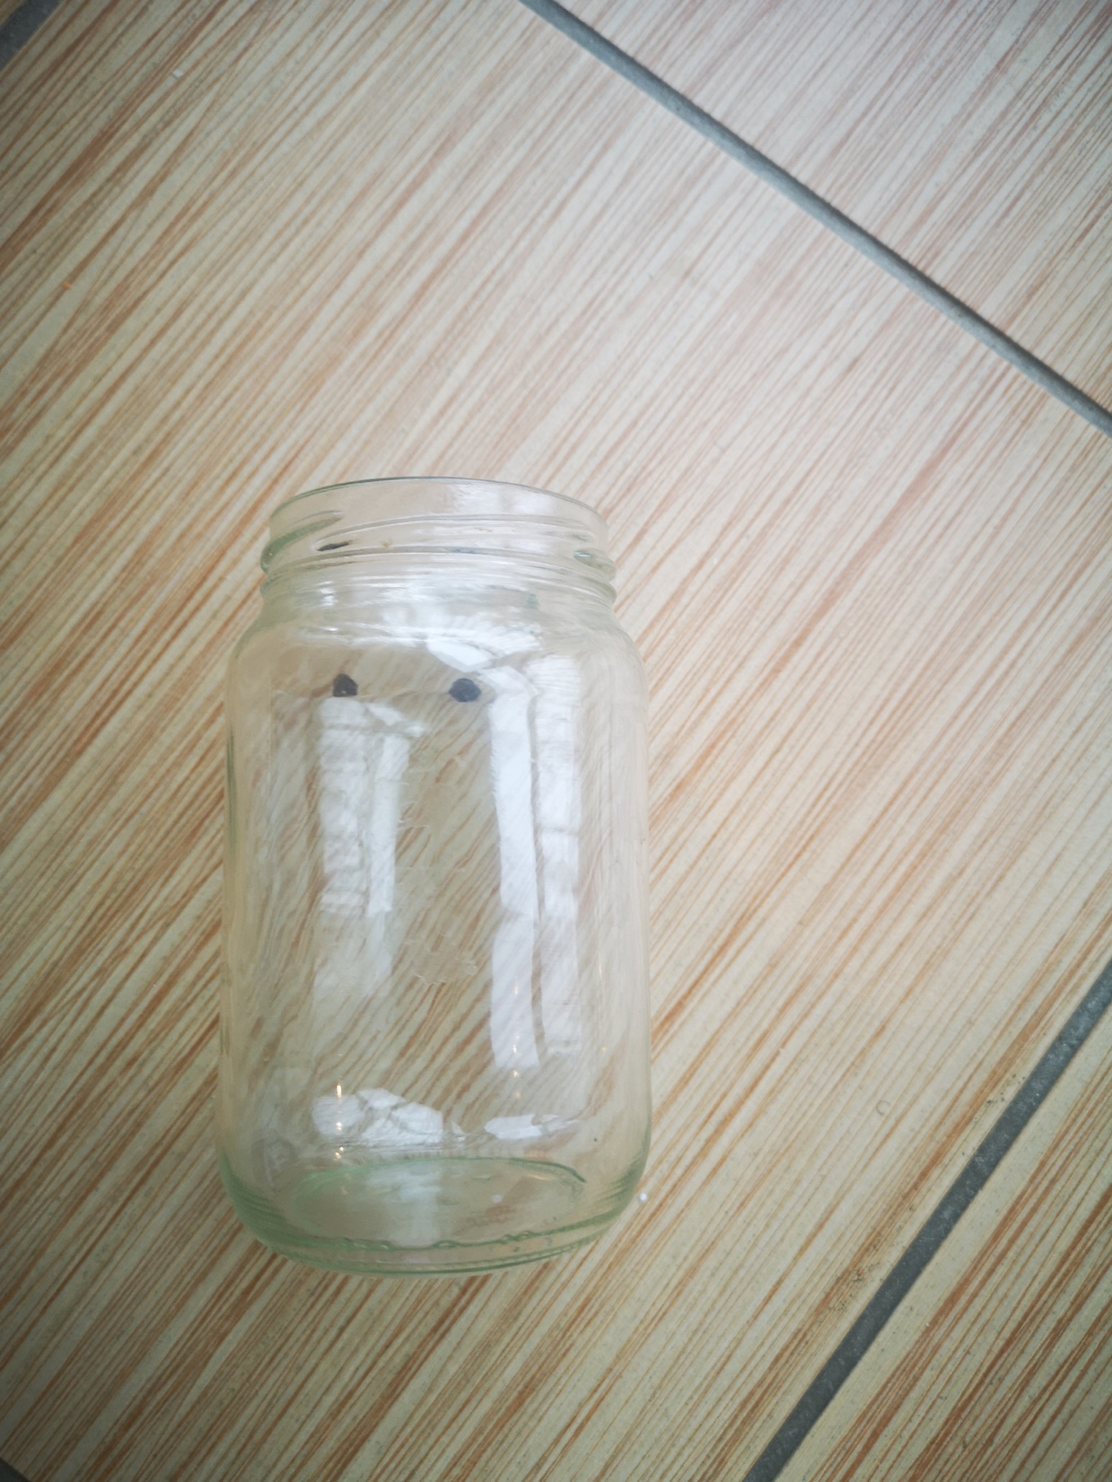
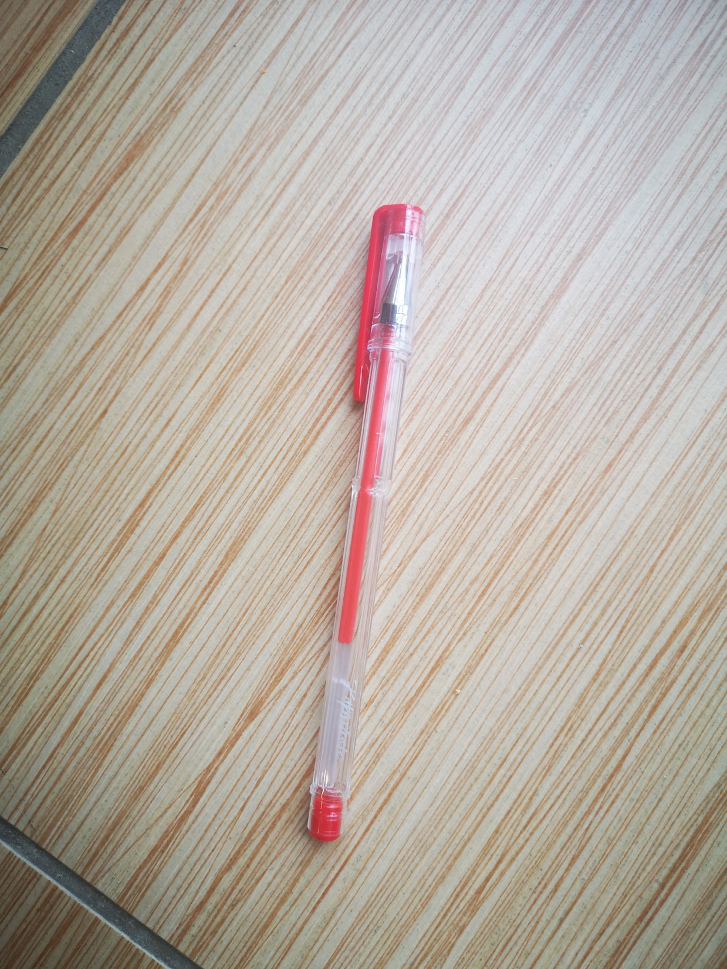
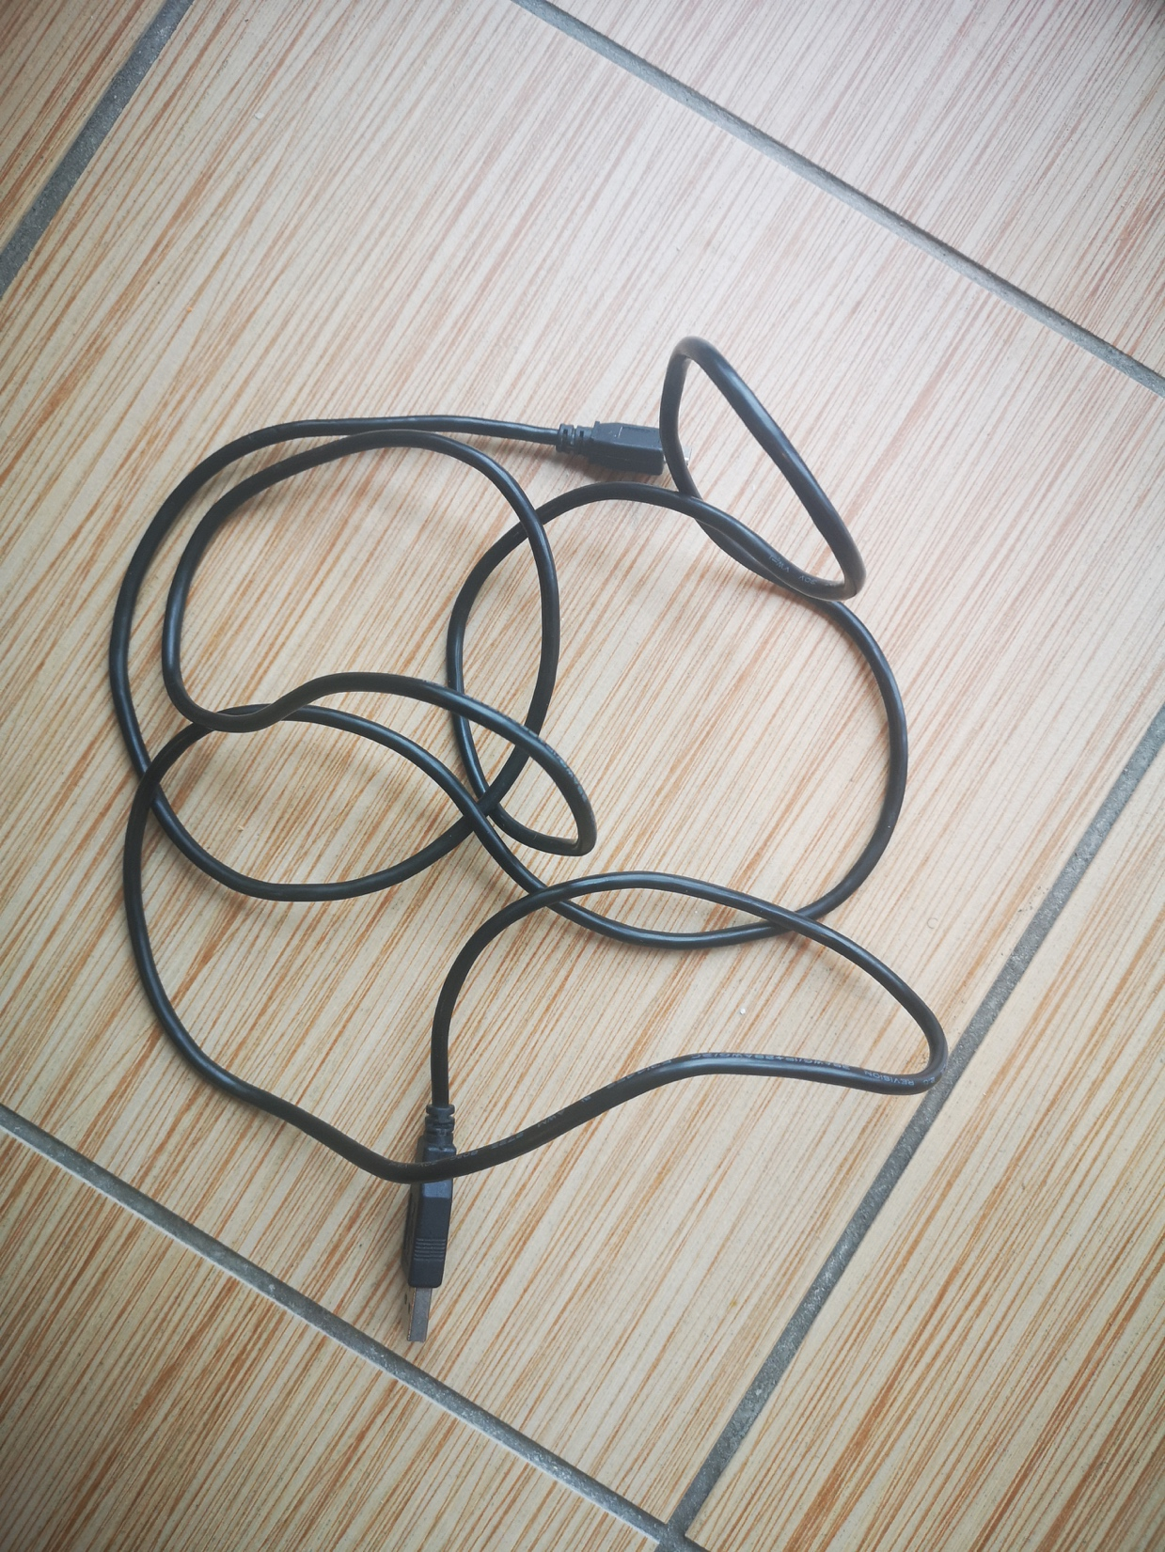
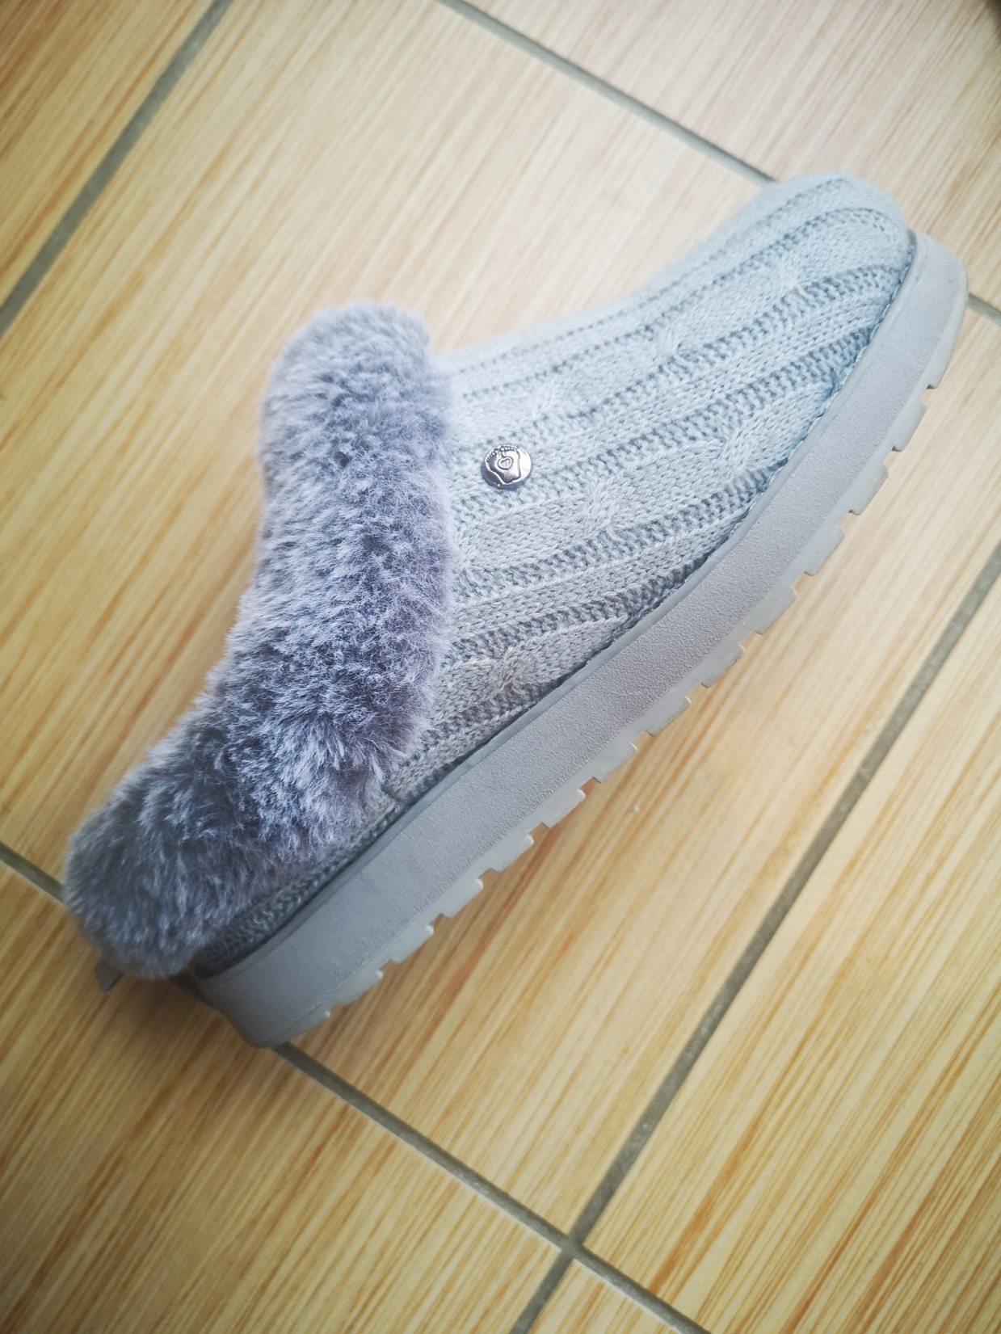
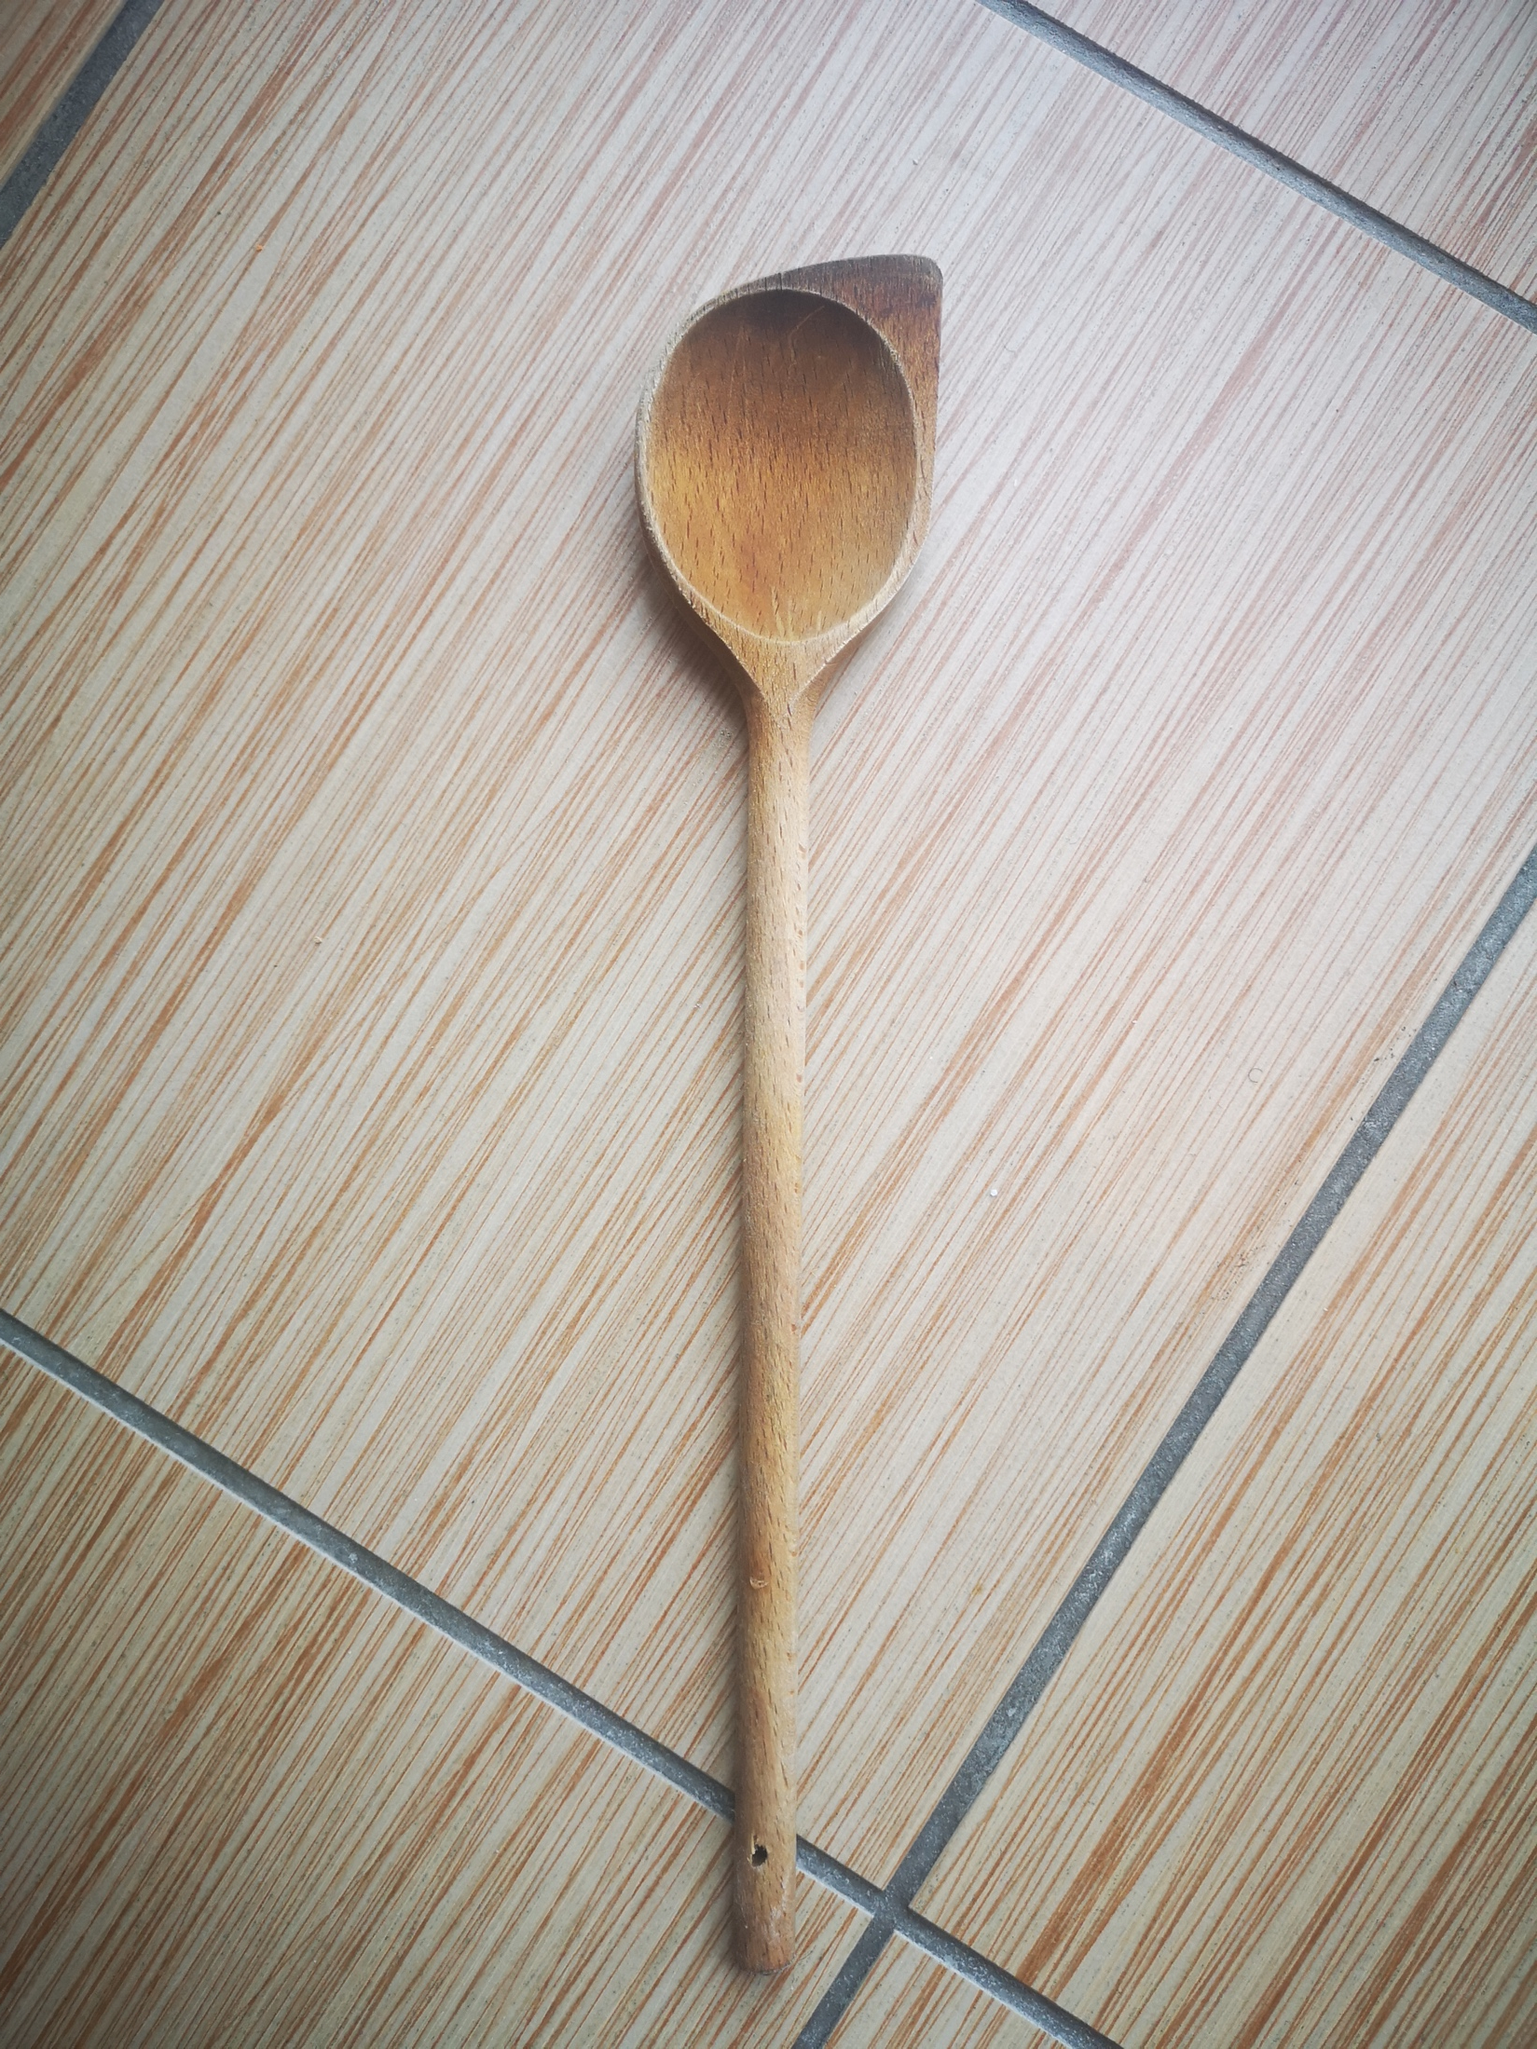
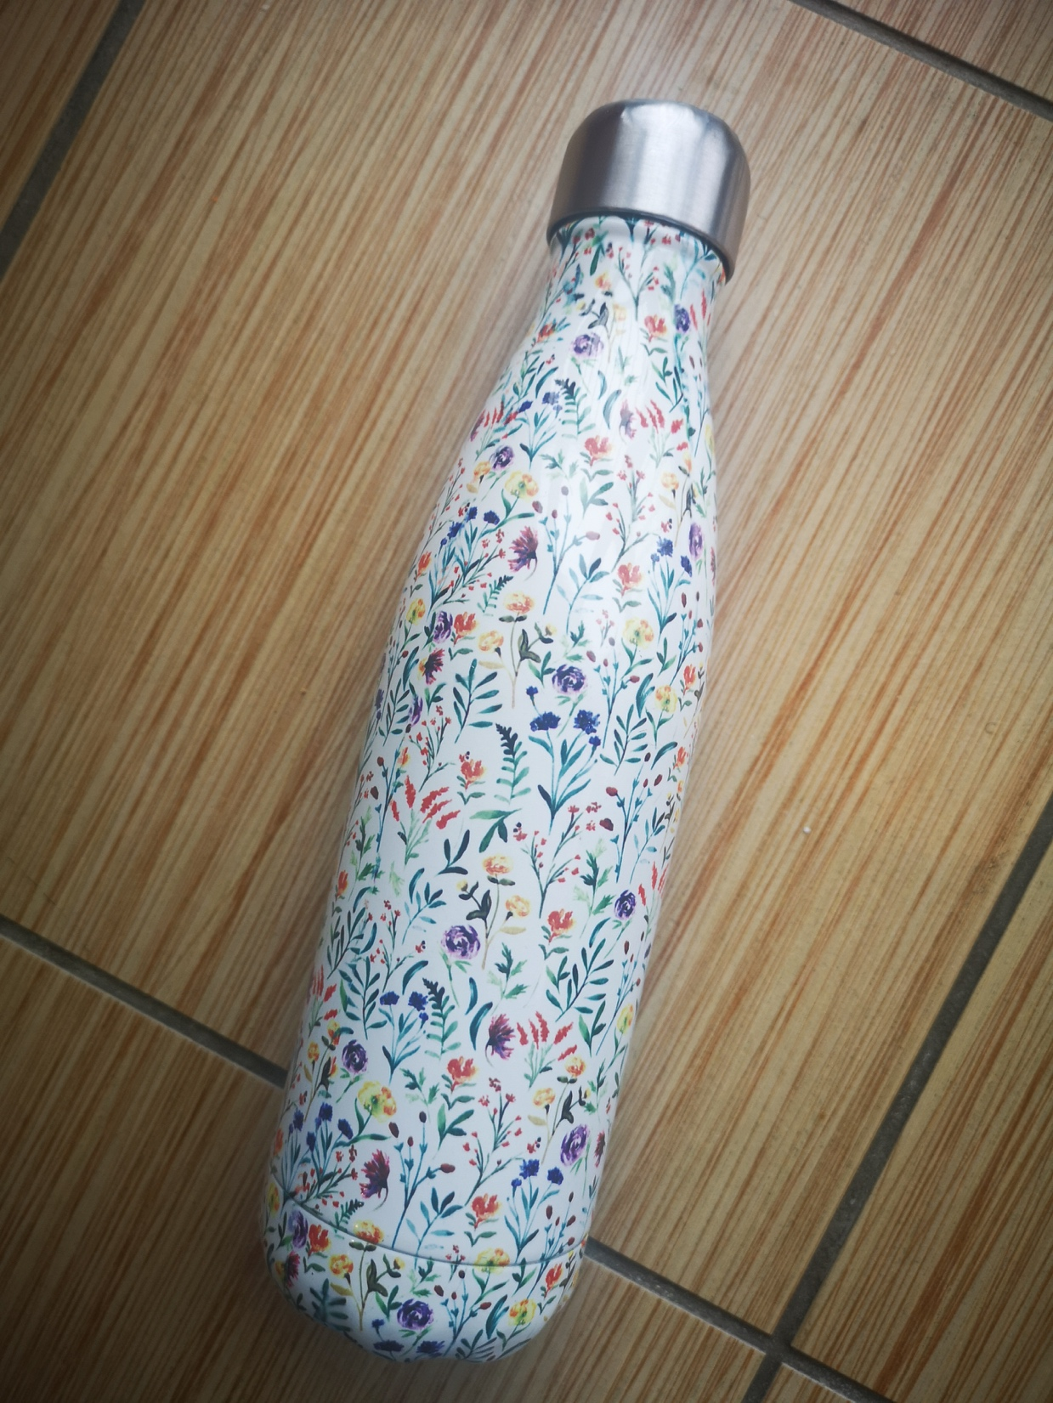
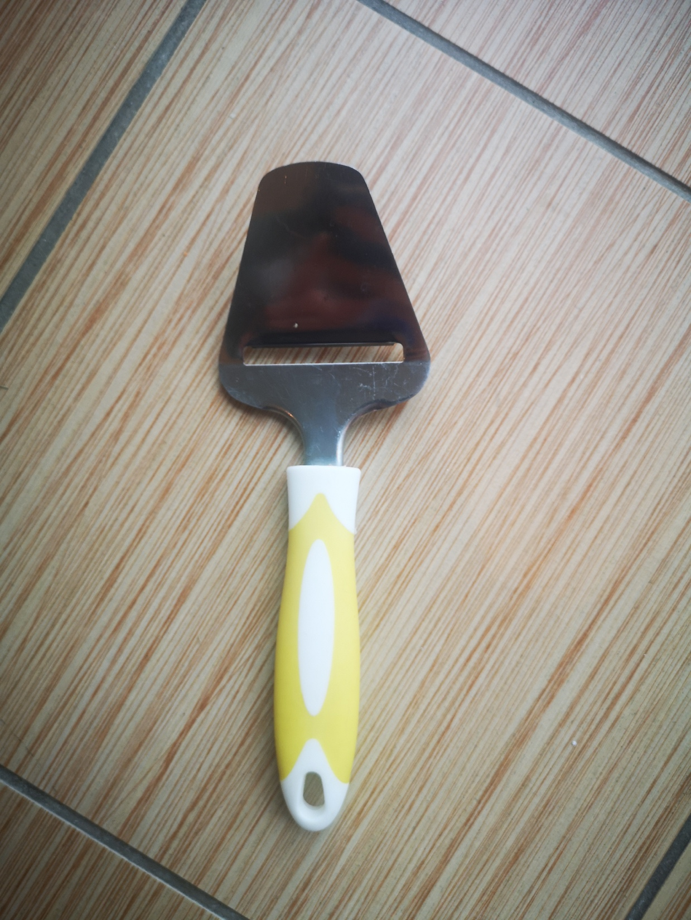
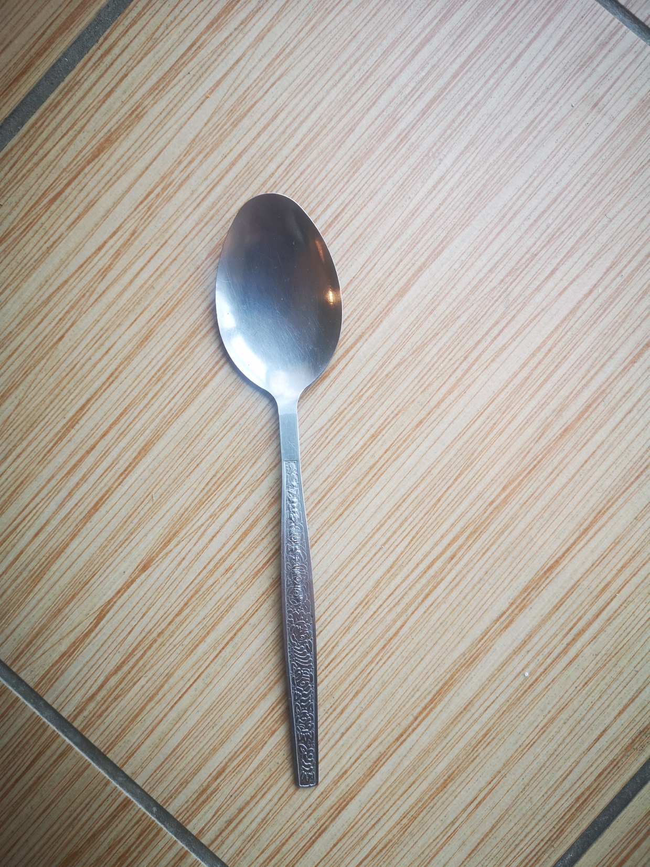
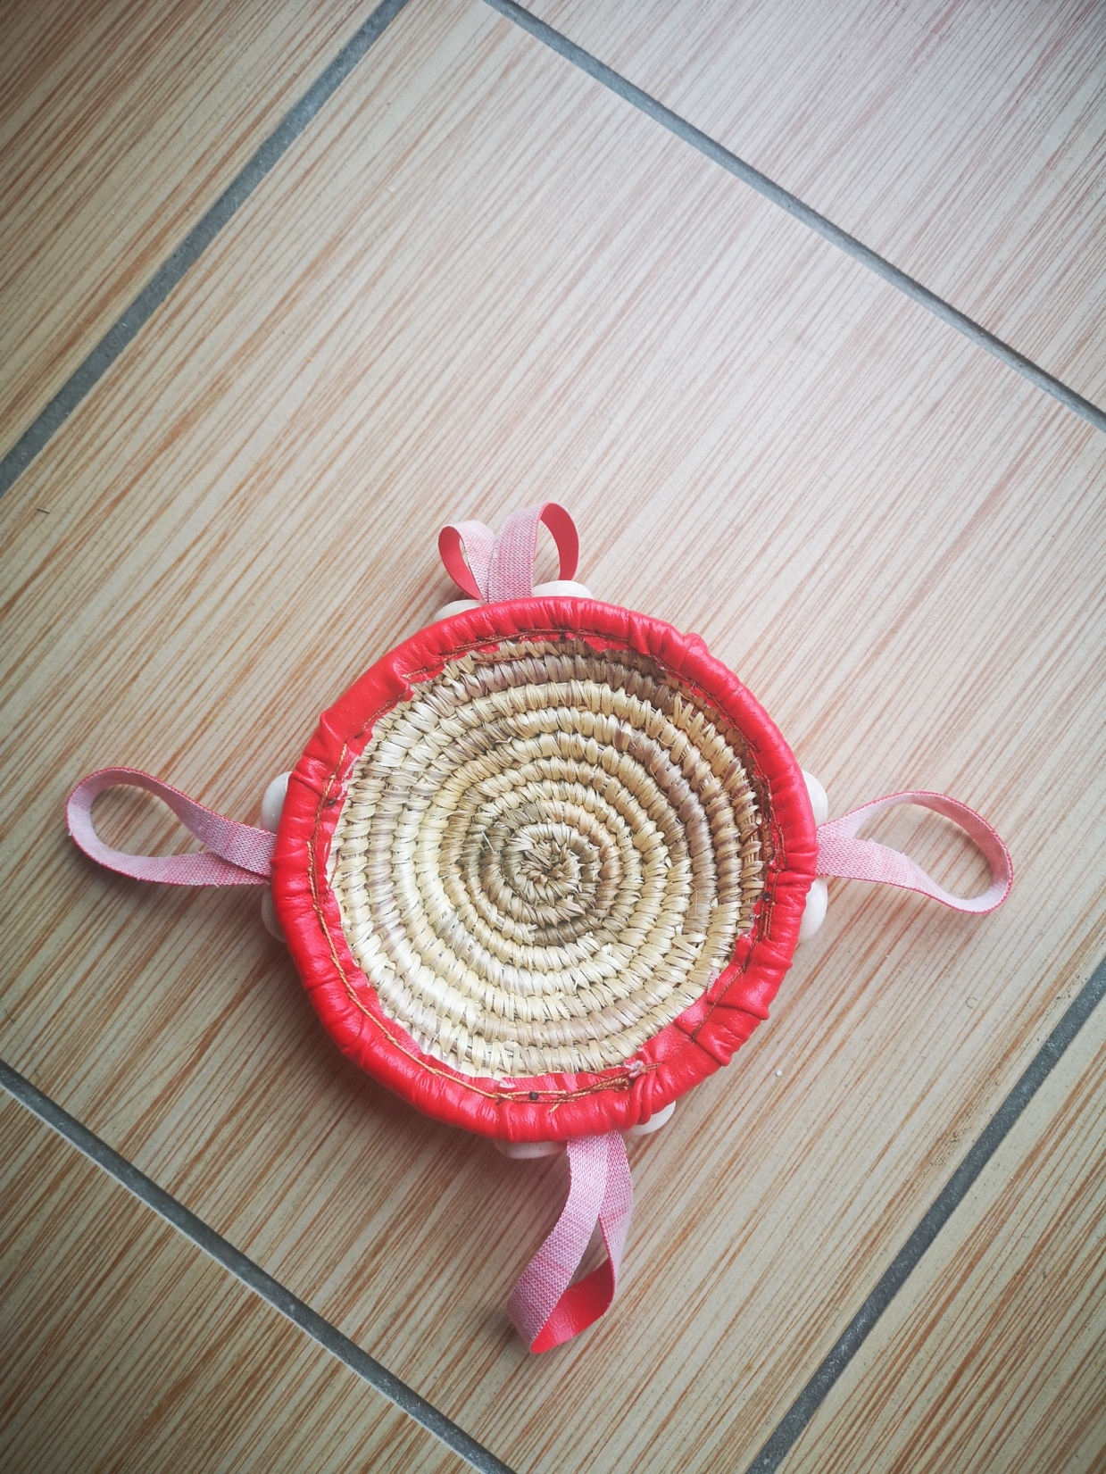
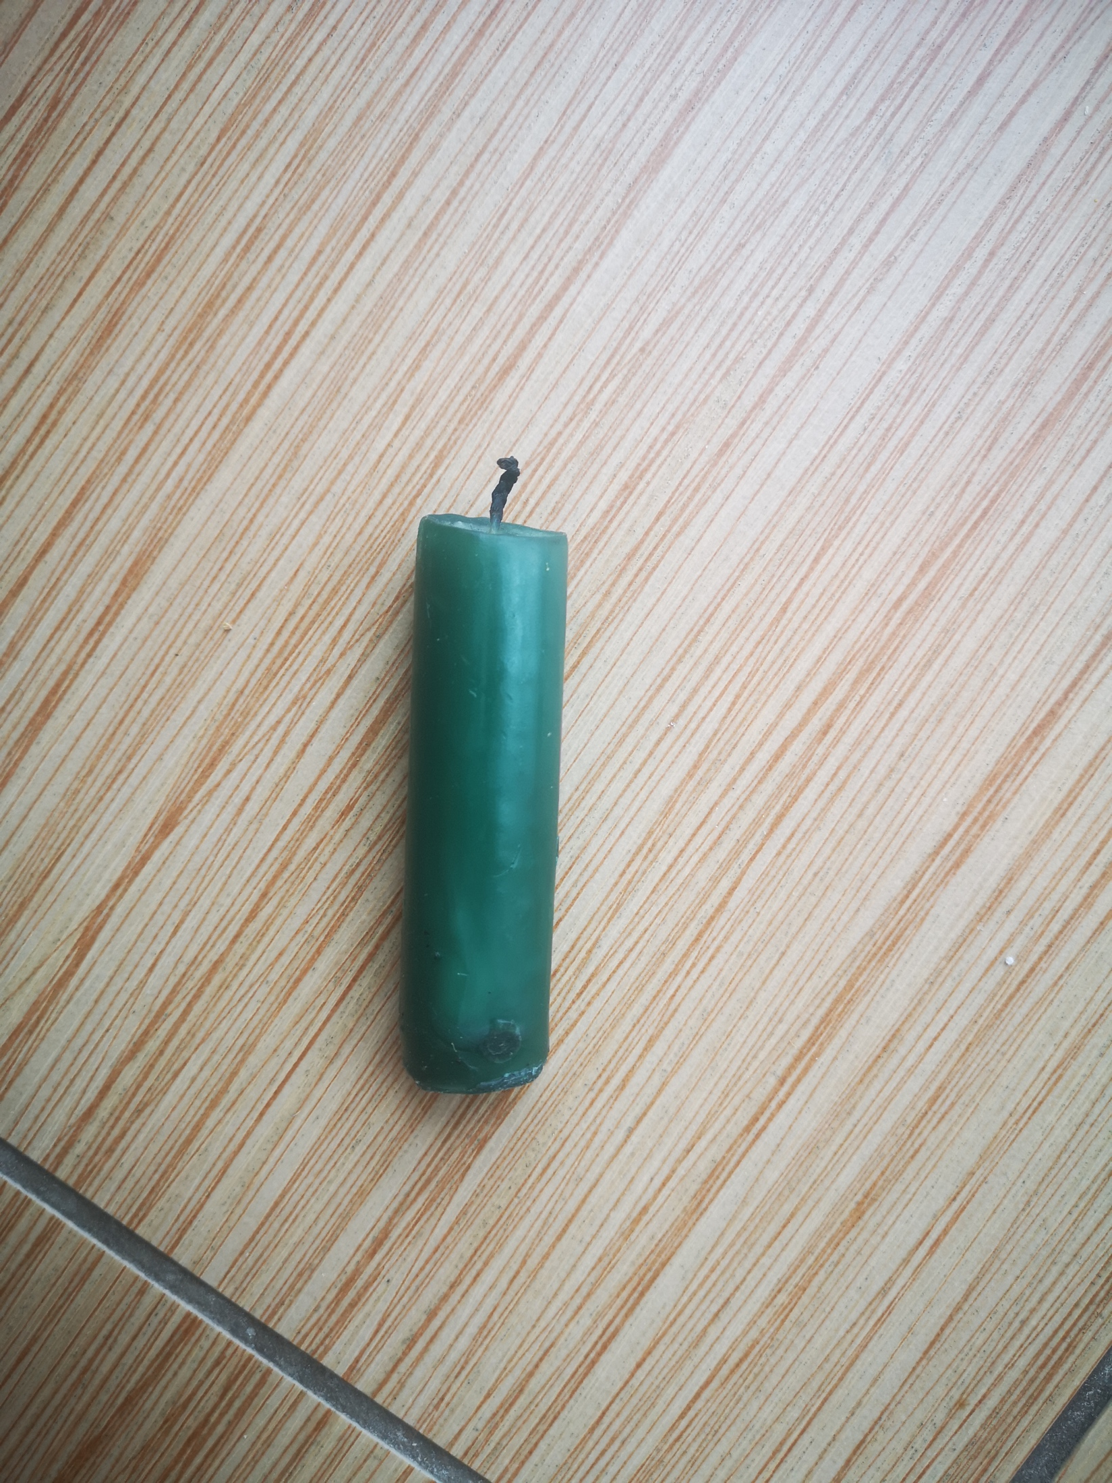
Review, think, talk….
Logo for section to sit inside roundel
Can the children identify materials? (20 minutes)
I can identify materials.
Together, identify the objects based on their materials and group them
Instructions for Activity 2:
Look back at the 10 items and ask them what they think they are made of.
Vocabulary:
plastic, rock, metal, glass, wood, water, fabric.
Glass
Plastic
Fabric
Wood
Metal
You may have some objects that you’re unsure about. That’s ok- you can research together.
(e.g. wax candle and wicker basket)
Big question:
‘How do you know the spoon is made of metal?’.
Move onto activity 3
5

Slide 6
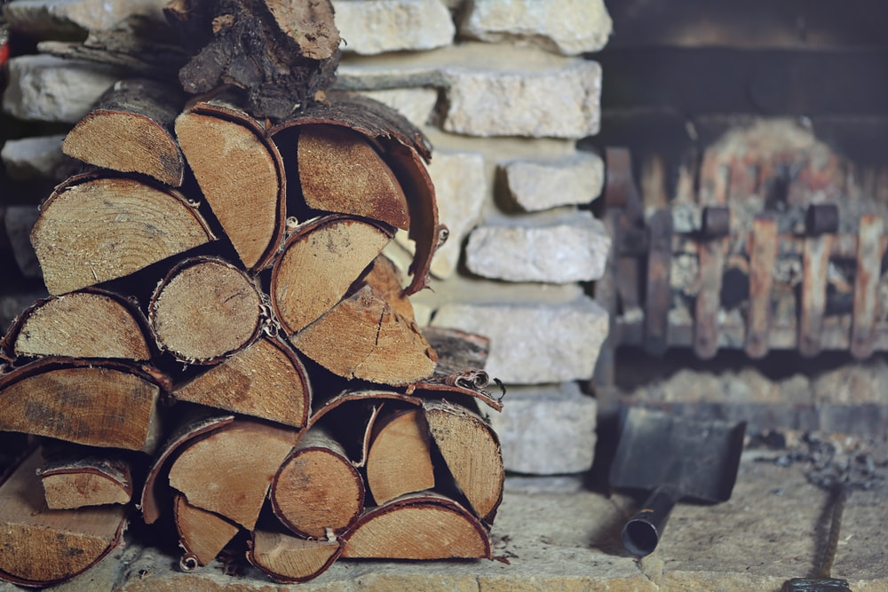
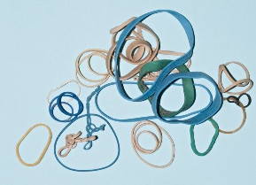
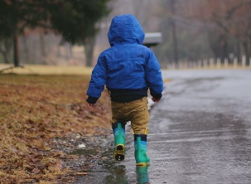
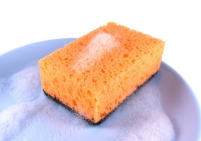
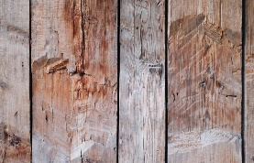
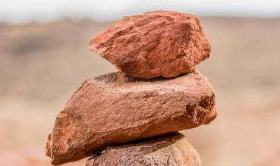
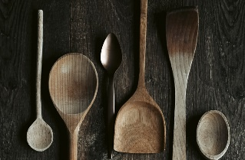

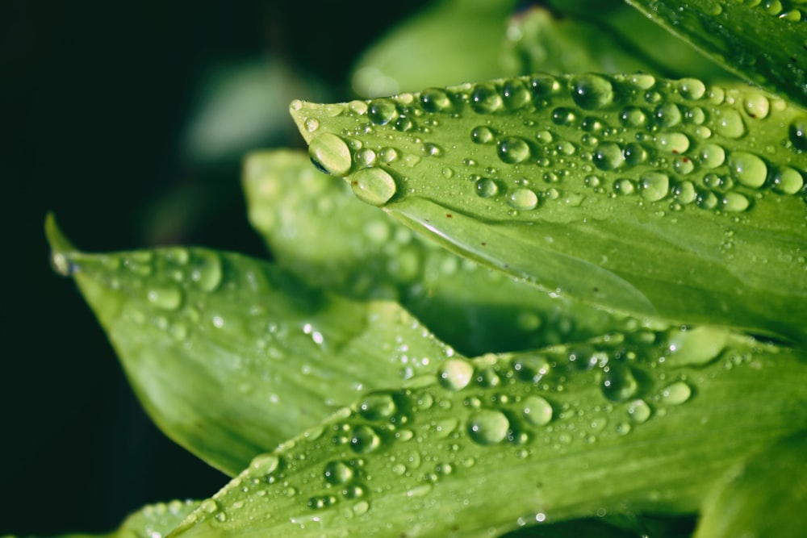
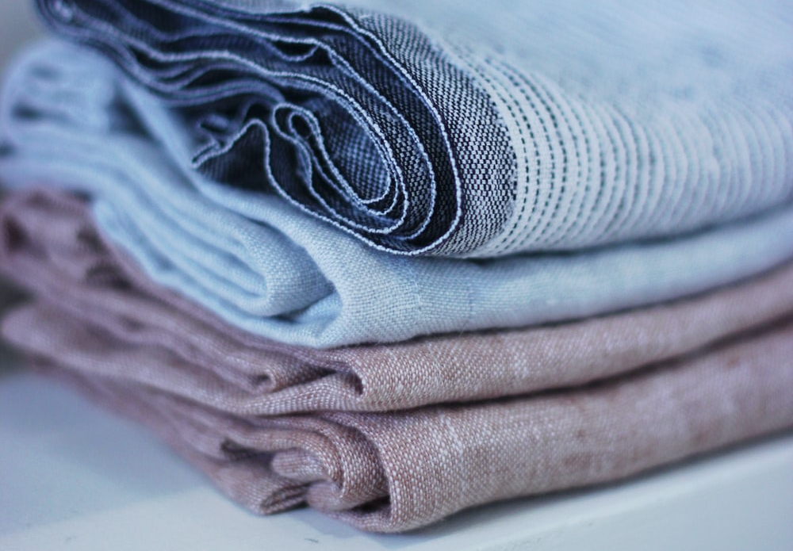
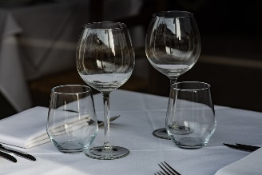

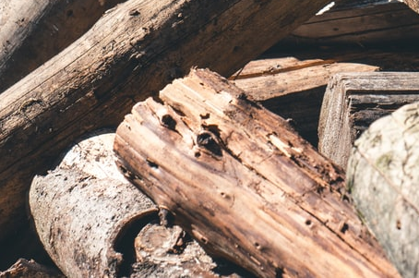
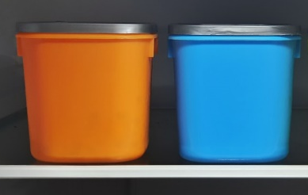

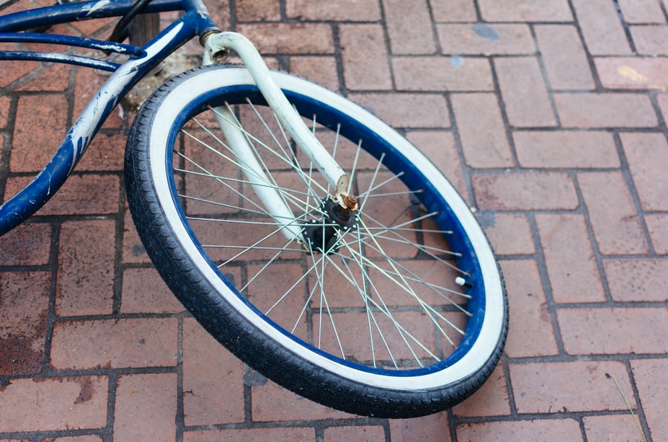
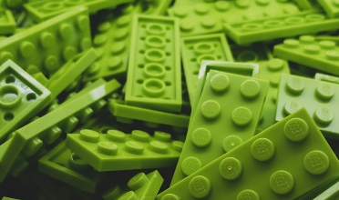
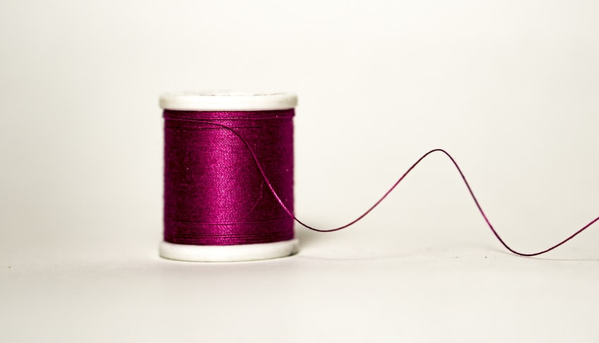
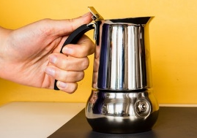
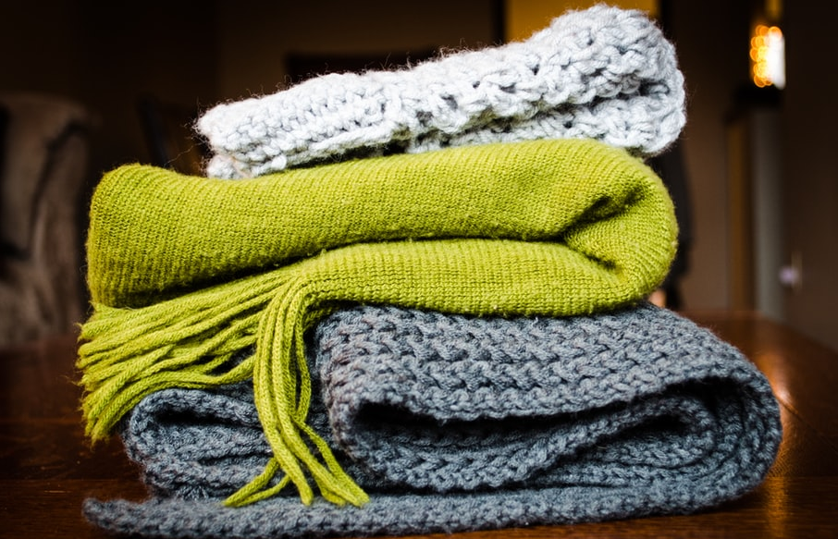
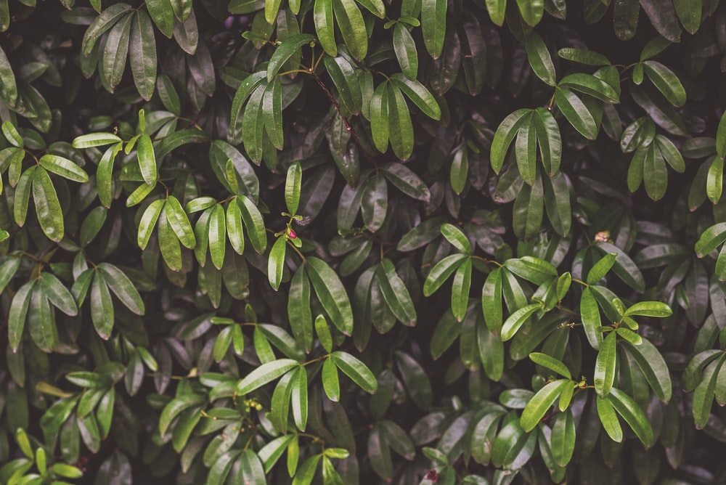
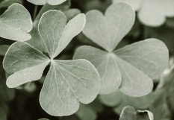
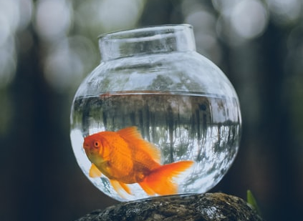
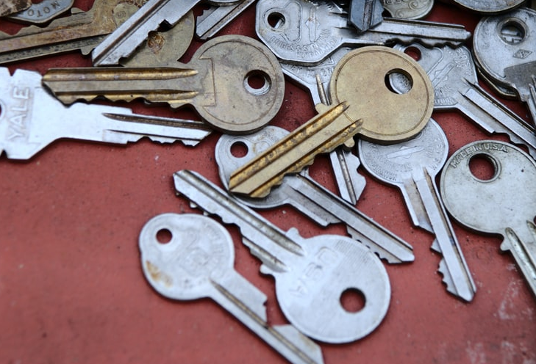
Activity 3- Look at these key words and explain what they mean. (10 minutes)
materials
stretchy
waterproof
absorbent
wood
rock
not bendy
stiff
not absorbent
fabric
glass
water
bendy
rough
smooth
not see through
rubber
plastic
hard
soft
shiny
dull
see through
metal
6

Slide 7
Review, think, talk….
Logo for section to sit inside roundel
Identify properties of materials (20 minutes)
Instructions for Activity 4:
Look back at your objects and ask your child to group by a certain property. Take a photo of each grouping, with a title indicating the property.
Vocab:
hard, soft, stretchy, stiff, bendy, floppy, waterproof, absorbent, breaks/tears, rough, smooth, shiny, dull, see-through, not see-through
not bendy
bendy
You can use scrap paper to write the title of the groupings.
7

Slide 8
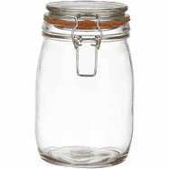
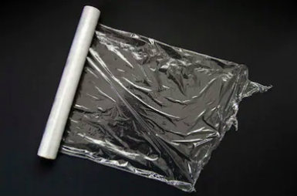
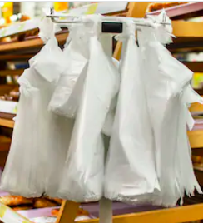
Explore, talk, extend
Logo for section to sit inside roundel
What objects around the house have more than one material?
(20 minutes)
I found a mason jar in my kitchen
What materials is it made from?
Why do you think it is made of these different materials?
Your child can explore their surroundings to find an object with more than more material.
Alternatively, your child can go further by sorting their objects using two properties. An item can be both strong and opaque. Equally, some may be neither (e.g. cling film.)
Strong
Opaque
Both
8

Slide 9
Big Question
What if….(Discussion point)
Logo for section to sit inside roundel
(5-10 minutes)
Start by asking:
What do they know about glass?
What objects are already made from it and which ones aren’t?
Point to an item in the room and ask them the practicalities of it being made of glass.
Listen out for the properties of glass vocabulary and the explanations of why this may not suit all objects.
Repeat this Big Question with other materials or ask your child to create one for you and have a debate.
BIG QUESTION
What would life be like if everything was made of glass?
9

Slide 10
Glossary of terms
Materials: Objects are made from one or more materials. Examples of materials include wood, glass, metal, rubber, plastic and fabric.
Properties: A property of an object or material is a feature that makes it suitable for a particular use.
Absorbent: An absorbent material is able to soak up liquid easily.
Not see through: Light cannot pass through- you cannot see through it.
See through: Light can pass through - you can see through it.
Stiff: A stiff object cannot be easily bent out of shape.
Group: Objects can be grouped together based on a common feature or their similarities.
Venn diagram: A Venn diagram is an illustration of the relationships between and among sets or groups of objects that share something in common.
10

