Slide 1

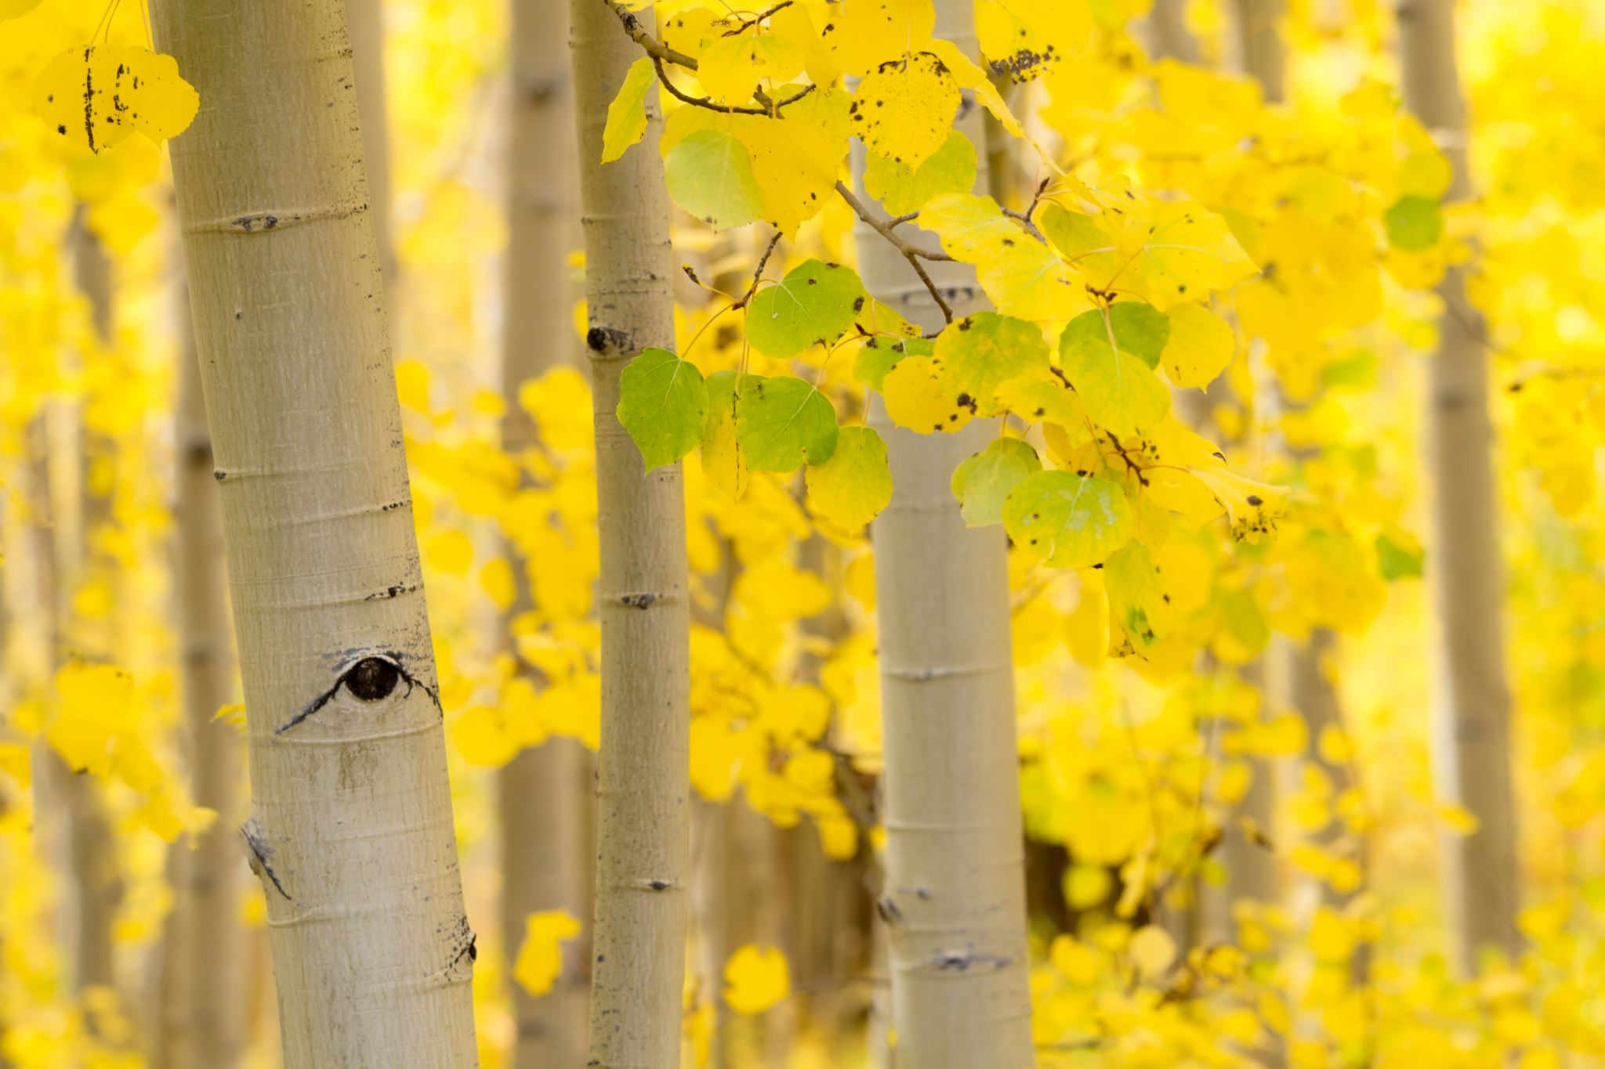


Plants
For parents
Thank you for supporting your child’s learning in science.
Before the session:
There are 7 main activities. They do not have to be done on the same day. In fact, to support your child’s attention levels, each activity has been broken down into 20-30 minute chunks so could be broken over a few days.
Please read the slides to know which activity to do, what your child is learning and what you need to get ready.
The activities are hands on and evidence can be shown by taking photos.
During the session:
Share the learning intention on slide 2.
Slide 10 has a glossary of key terms.
Slide 11-13 have optional printable resources.
Reviewing with your child:
The slides give examples of what your child may produce.
Identify the parts of a plant
Year 1 Ages 5-6

Slide 2
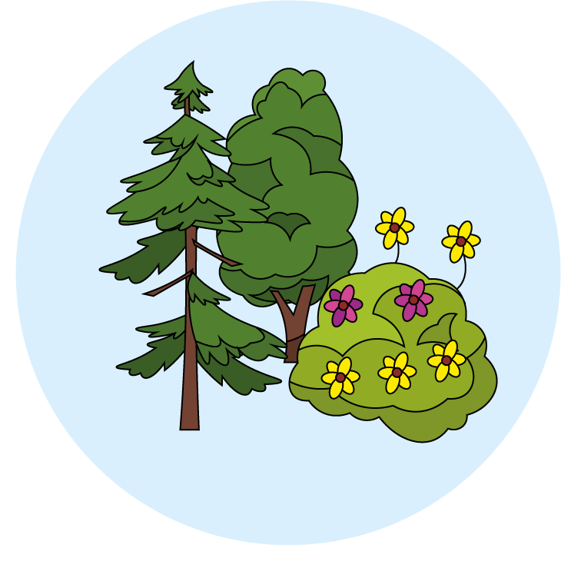
Plants
Logo for section to sit inside roundel
What are the parts of plants?
(Can the children identify and compare parts of plants?)
Key Learning:
Plants have common parts, but they vary between the different types of plants.
Growing locally, there will be a vast array of plants which all have specific names. These can be identified by looking at the key characteristics of the plant.
Some trees keep their leaves all year while other trees drop their leaves during autumn and grow them again during spring.
Activities: (Slides 3-9) approx 2 hours
Activity 1 - Pre-assess what the children know about parts of plants.
Activity 2 - Sort pictures of plants.
Activity 3 - Identify and label parts of a plant and tree.
Activity 4 - Identify local plants and trees using ID cards and an plant app.
Activity 5 - Make observational drawings of seeds.
Activity 6 - Plant seeds and observe them growing over time.
Activity 7 - Listen to ‘seasonal’ music.
You will need:
Seeds and a flower pot or garden space.
Leaf ID printout and/or plant ID app (see slide 6).
I can…
identify and describe the basic structure of a variety of common flowering plants, including trees.
identify and name a variety of common wild and garden plants, including deciduous and evergreen trees.
2

Slide 3
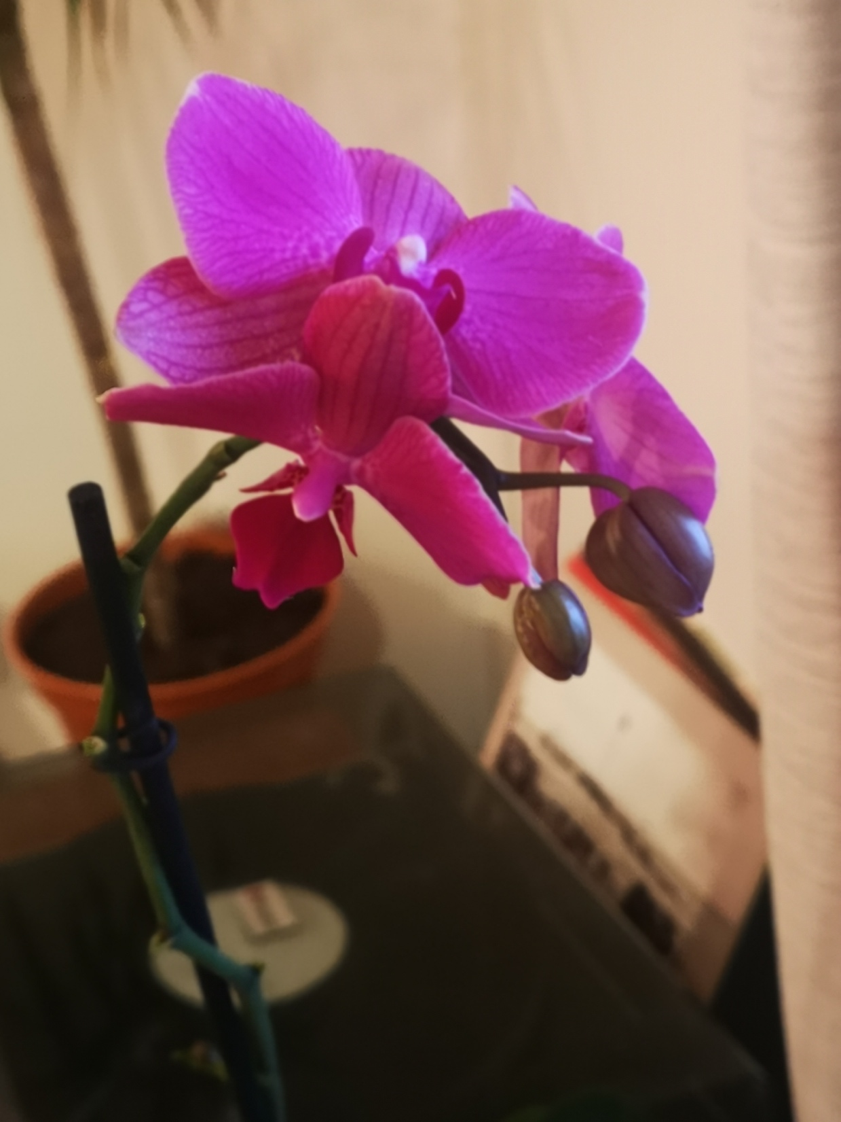
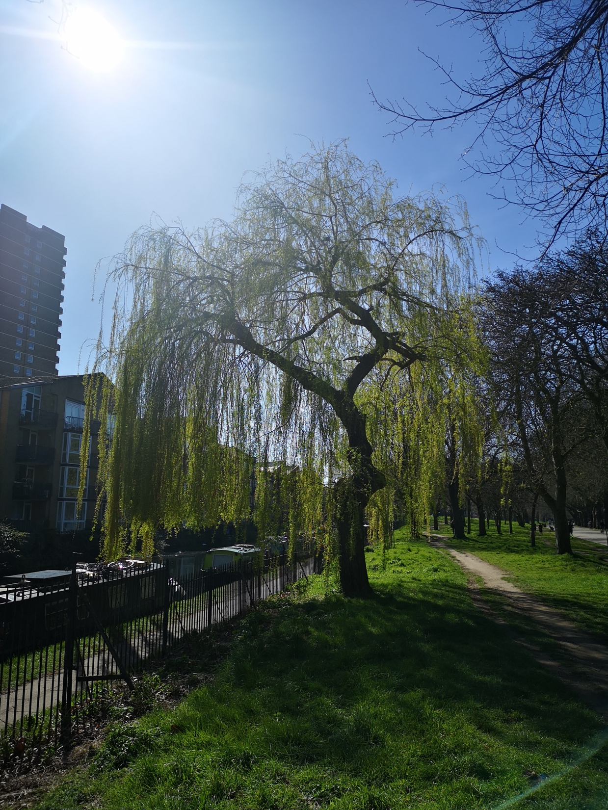
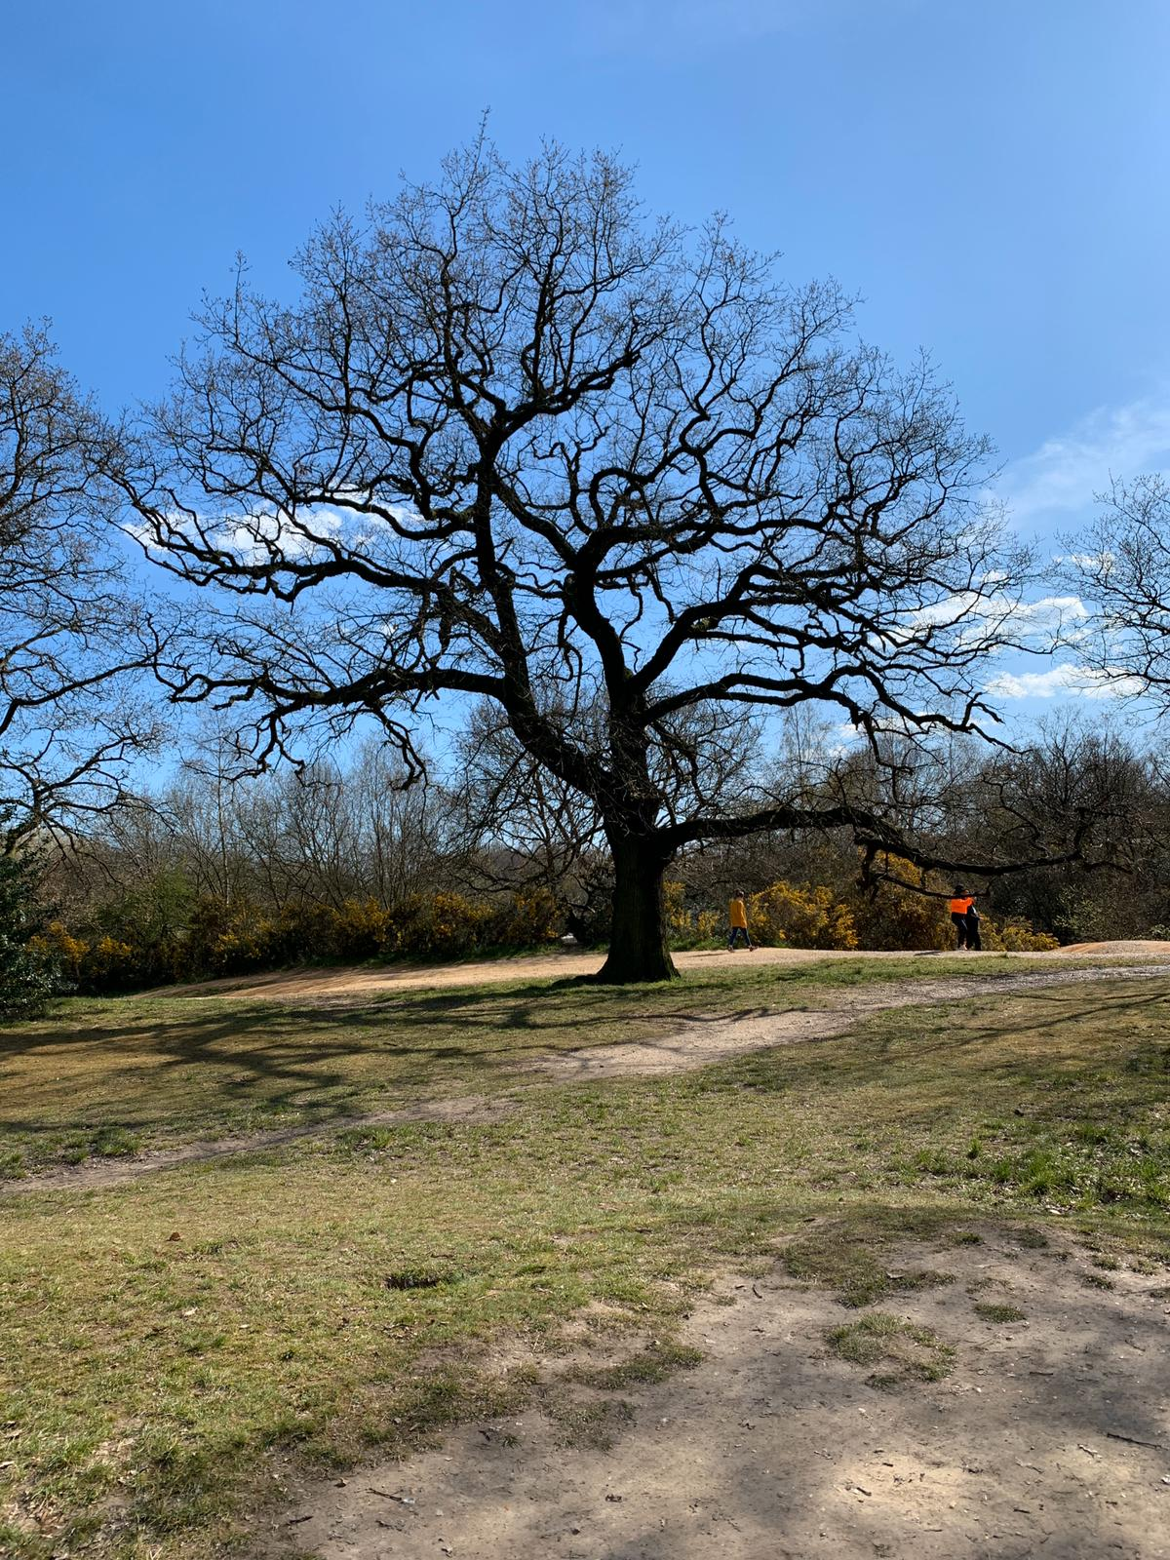
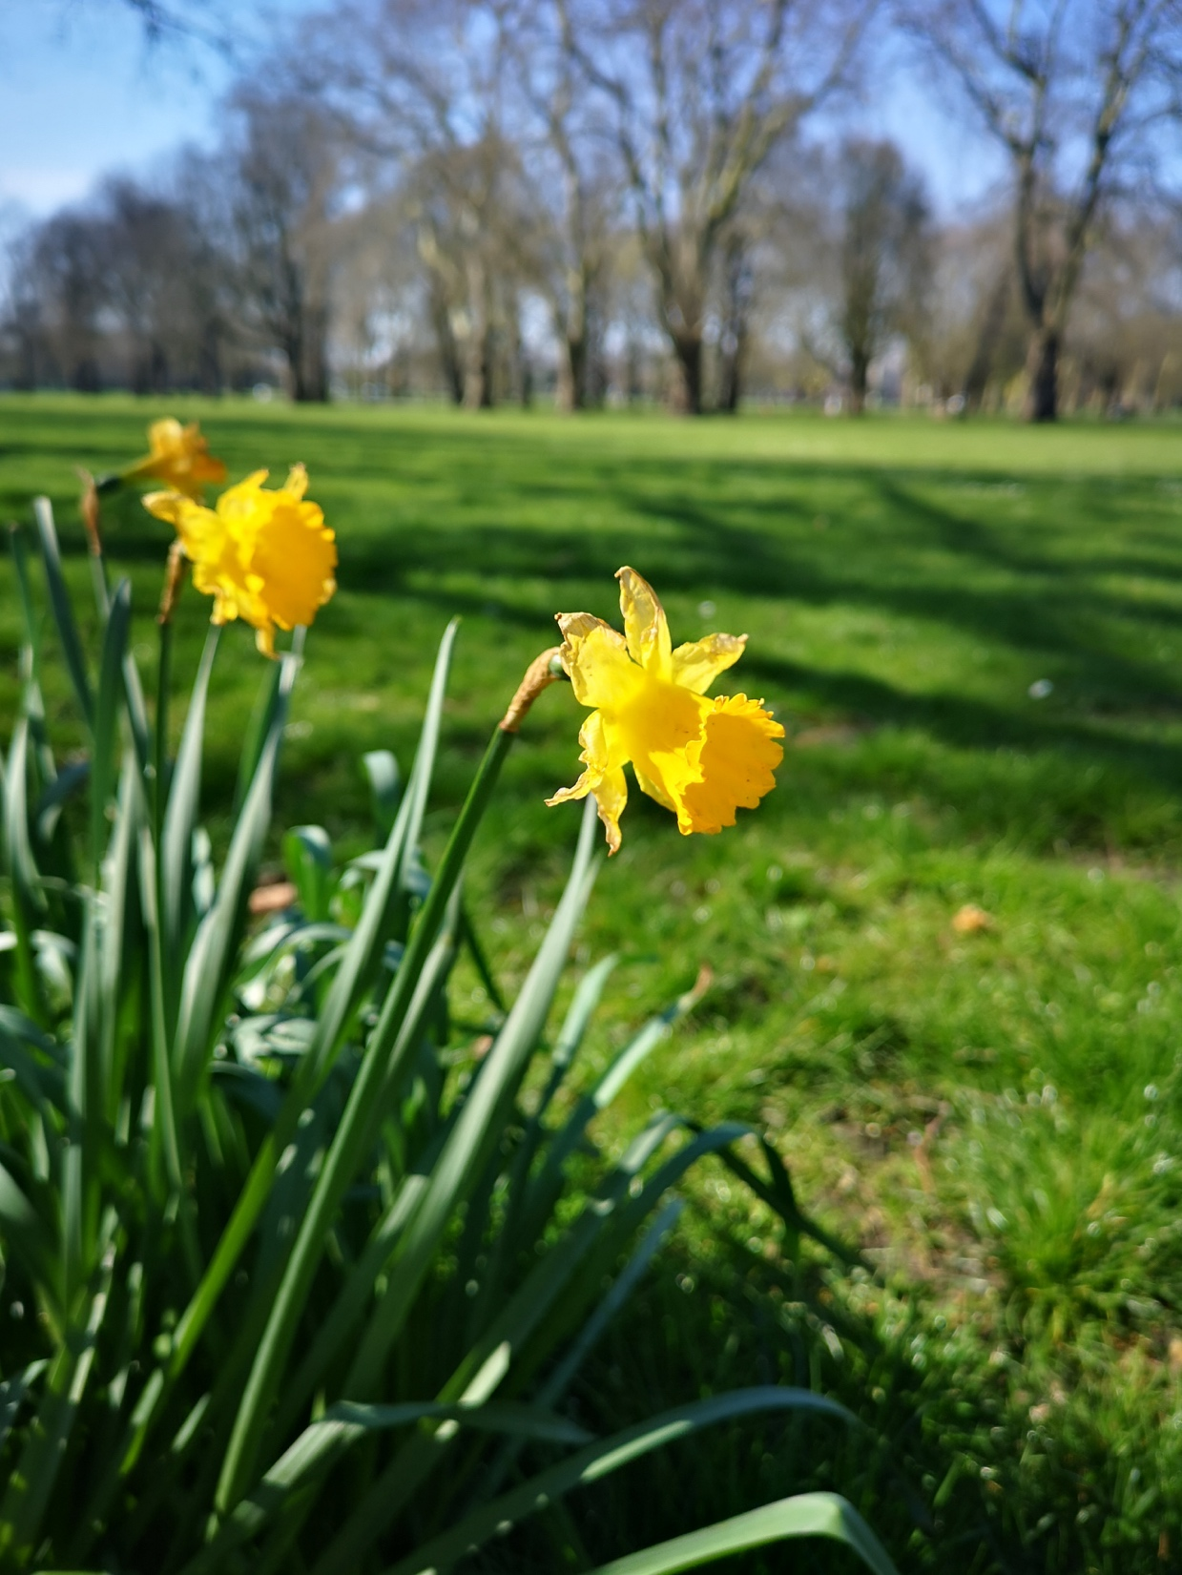
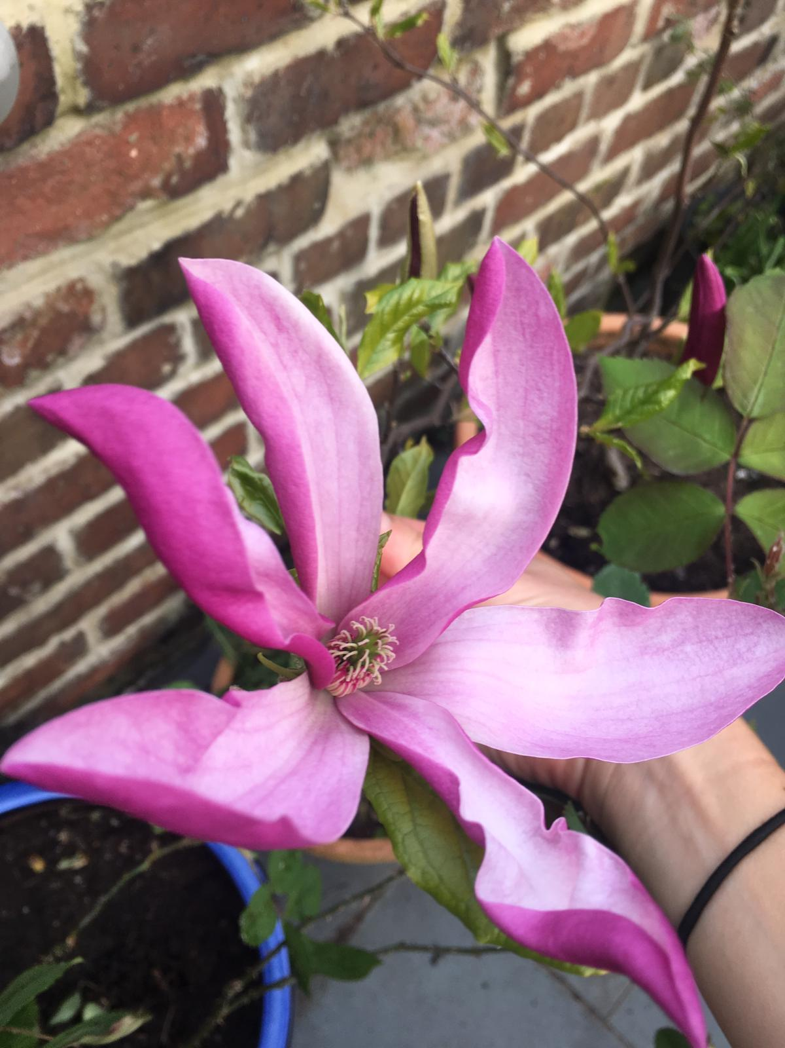
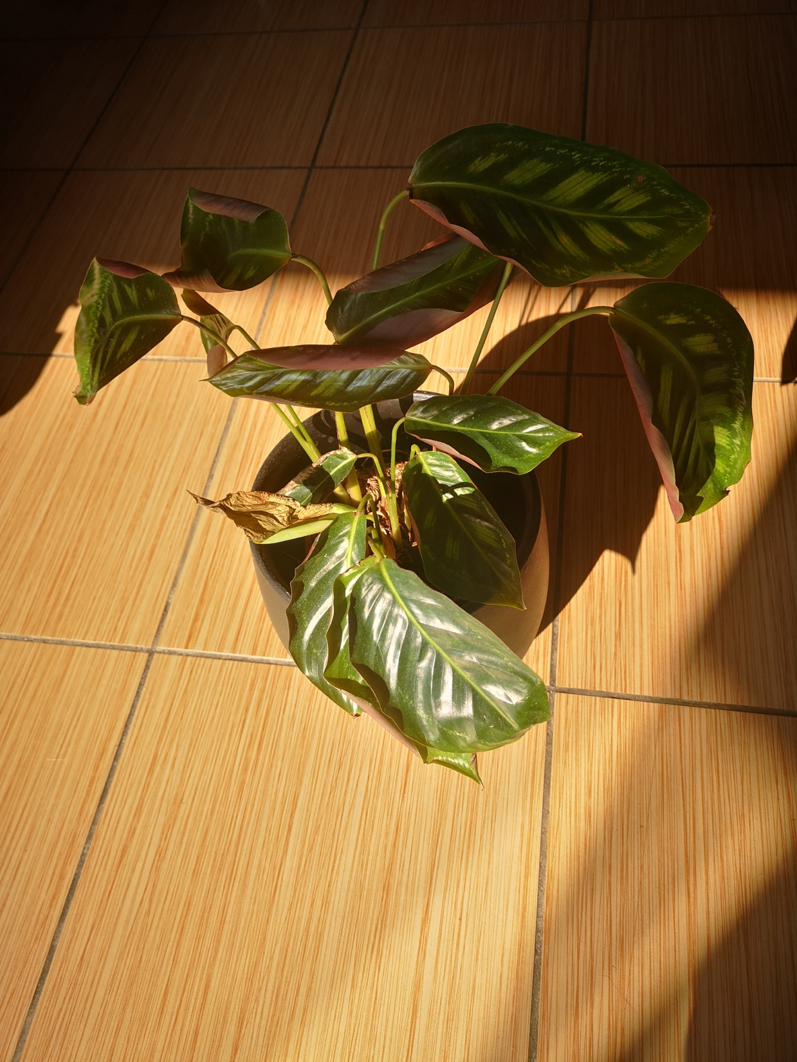
Explore, think, talk….
Logo for section to sit inside roundel
What do the children already know about plants? (20 minutes)
Instructions for Activity 1:
Show your child the pictures on this slide. Do they know what they are? Ask them how they know.
Vocab to listen out for (but not share, yet):
Leaf, flower, blossom, petal, fruit, berry, root, seed, trunk, branch, stem, bark, stalk, bud
Note:
The children may have their own unique way of describing the picture. This is GREAT! We want to encourage all language to begin with - based on what the gaps are, you can tailor the language. (See page 4)
Learning outcome: Identify and describe the basic structure of plants and trees.
3

Slide 4
Explore, think, talk….
Logo for section to sit inside roundel
What do the children already know about plants? (20 minutes)
Activity 2:
Ask your child to compare the plants.
- How are they the same?
- How are they different?
Point to the______ (choose a part of the plant using your word bank)
Do this a few times with the different pictures.
Word bank:
Leaf, flower, blossom, petal, fruit, berry, root, seed, trunk, branch, stem, bark, stalk, bud
Learning outcome: Identify and describe the basic structure of plants and trees.
4

Slide 5
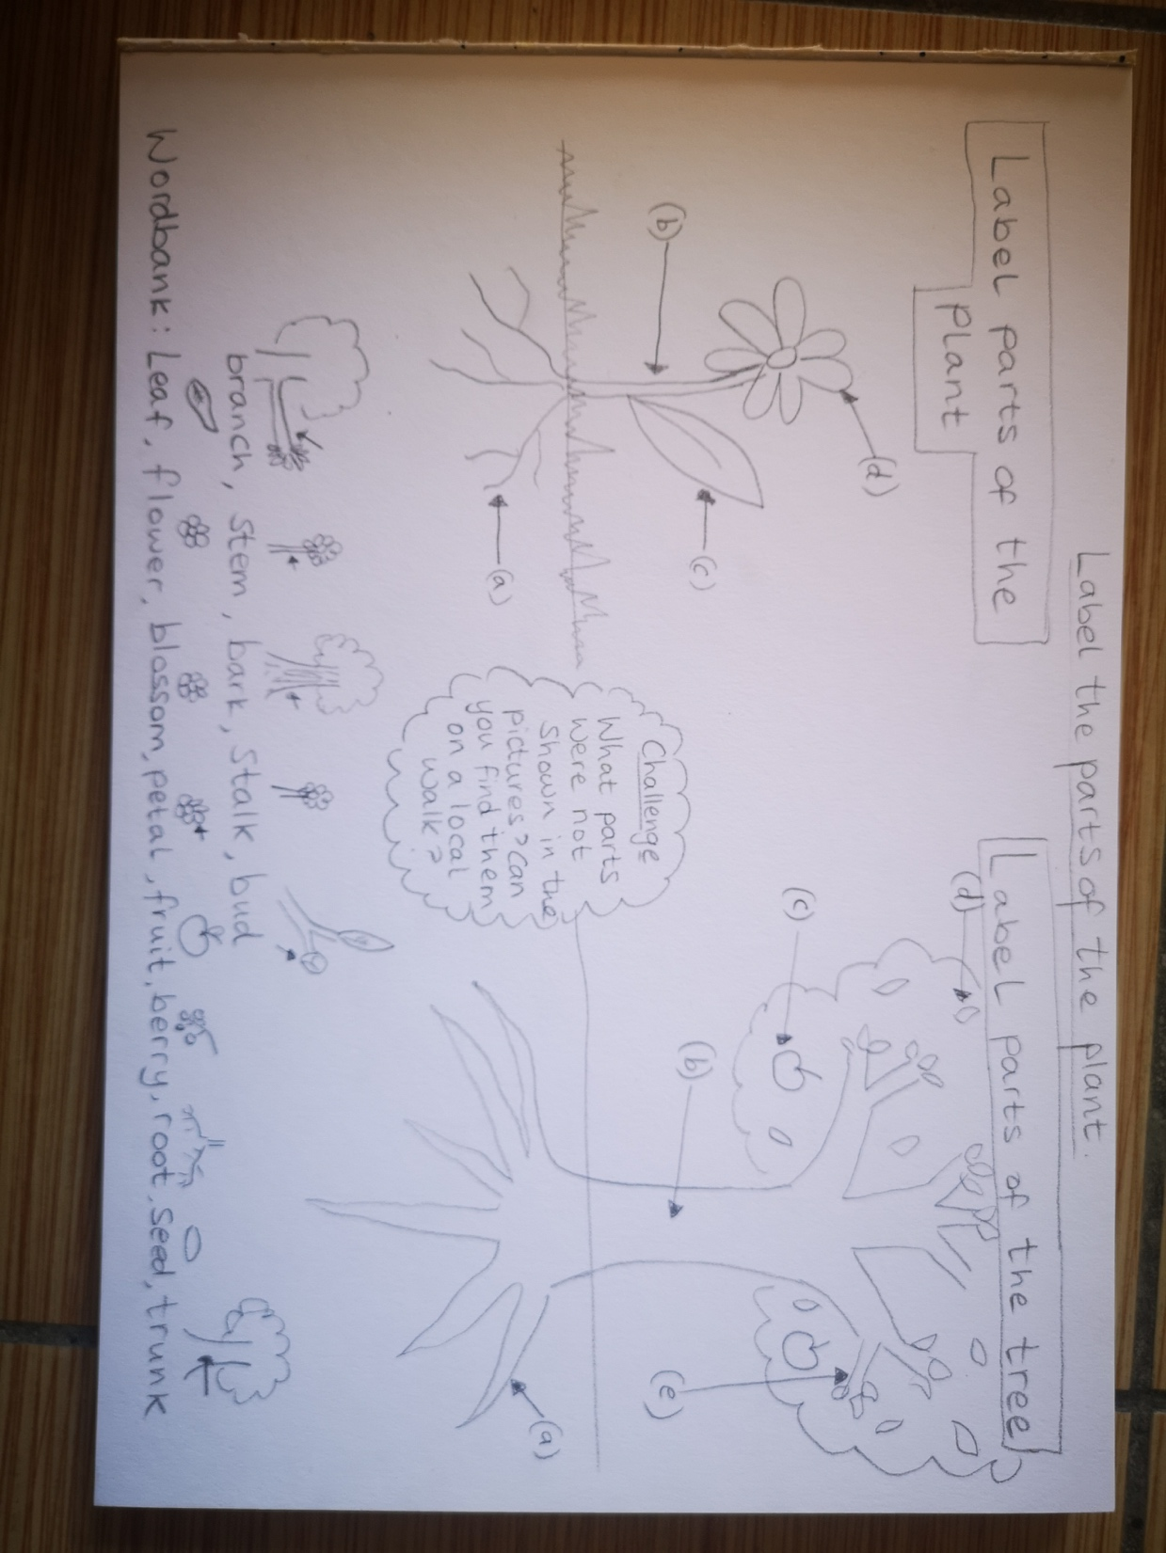
Activity 3:
Go out and look for as many different types of plants as you can in your garden or local park (30-40 minutes).
Talk about the parts of the plants and describe them.
Think about:
Where they were found (by water, in the park, in shady/light places).
The height or size of the plant. Are some bigger/taller than others?
Take photos of the plants you see or create a PowerPoint slideshow of buds, flowers, stem etc.
Word bank:
Leaf, flower, blossom, petal, fruit, berry, root, seed, trunk, branch, stem, bark, stalk, bud
Learning outcome: Identify and describe the basic structure of plants and trees.
If you cannot go outside to view plants, you can do some online research and complete the worksheet above (see slide 11 for printout).
5

Slide 6
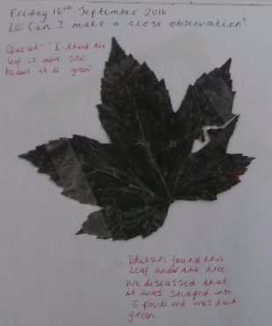
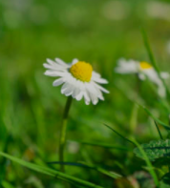
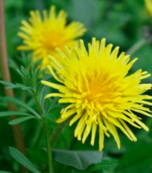
Explore, talk, identify.
Logo for section to sit inside roundel
Can you find and identify plants in your local area? (30-40 minutes)
Activity 4:
Identifying trees
Go to the Woodland Trust website:
https://www.woodlandtrust.org.uk/blog/2020/03/tree-id-kids/
Here, you can find print out sheets to help identify trees based on their leaves.
- Pick up leaves that you find on the floor (do not pick them off of the tree) and describe the leaves. Are they pointy, round, furry, smooth?
- Then use the ID sheet to try and name the tree.
Activity 4:
Identifying other plants
Download the free plant ID app:
https://www.plantsnap.com/
Once downloaded, take your child on a plant hunt in your local area.
You can take a photo on your phone and the app will identify what it is.
Once you have found the name of a plant, ask your child to find another one of the same plant nearby to show that they can identify them independently.
Ask your child to compare plants they see on a walk:
.
It’s green. It has five points. The edges go in and out.
The daisy has white petals but the dandelion has yellow ones.
6

Slide 7
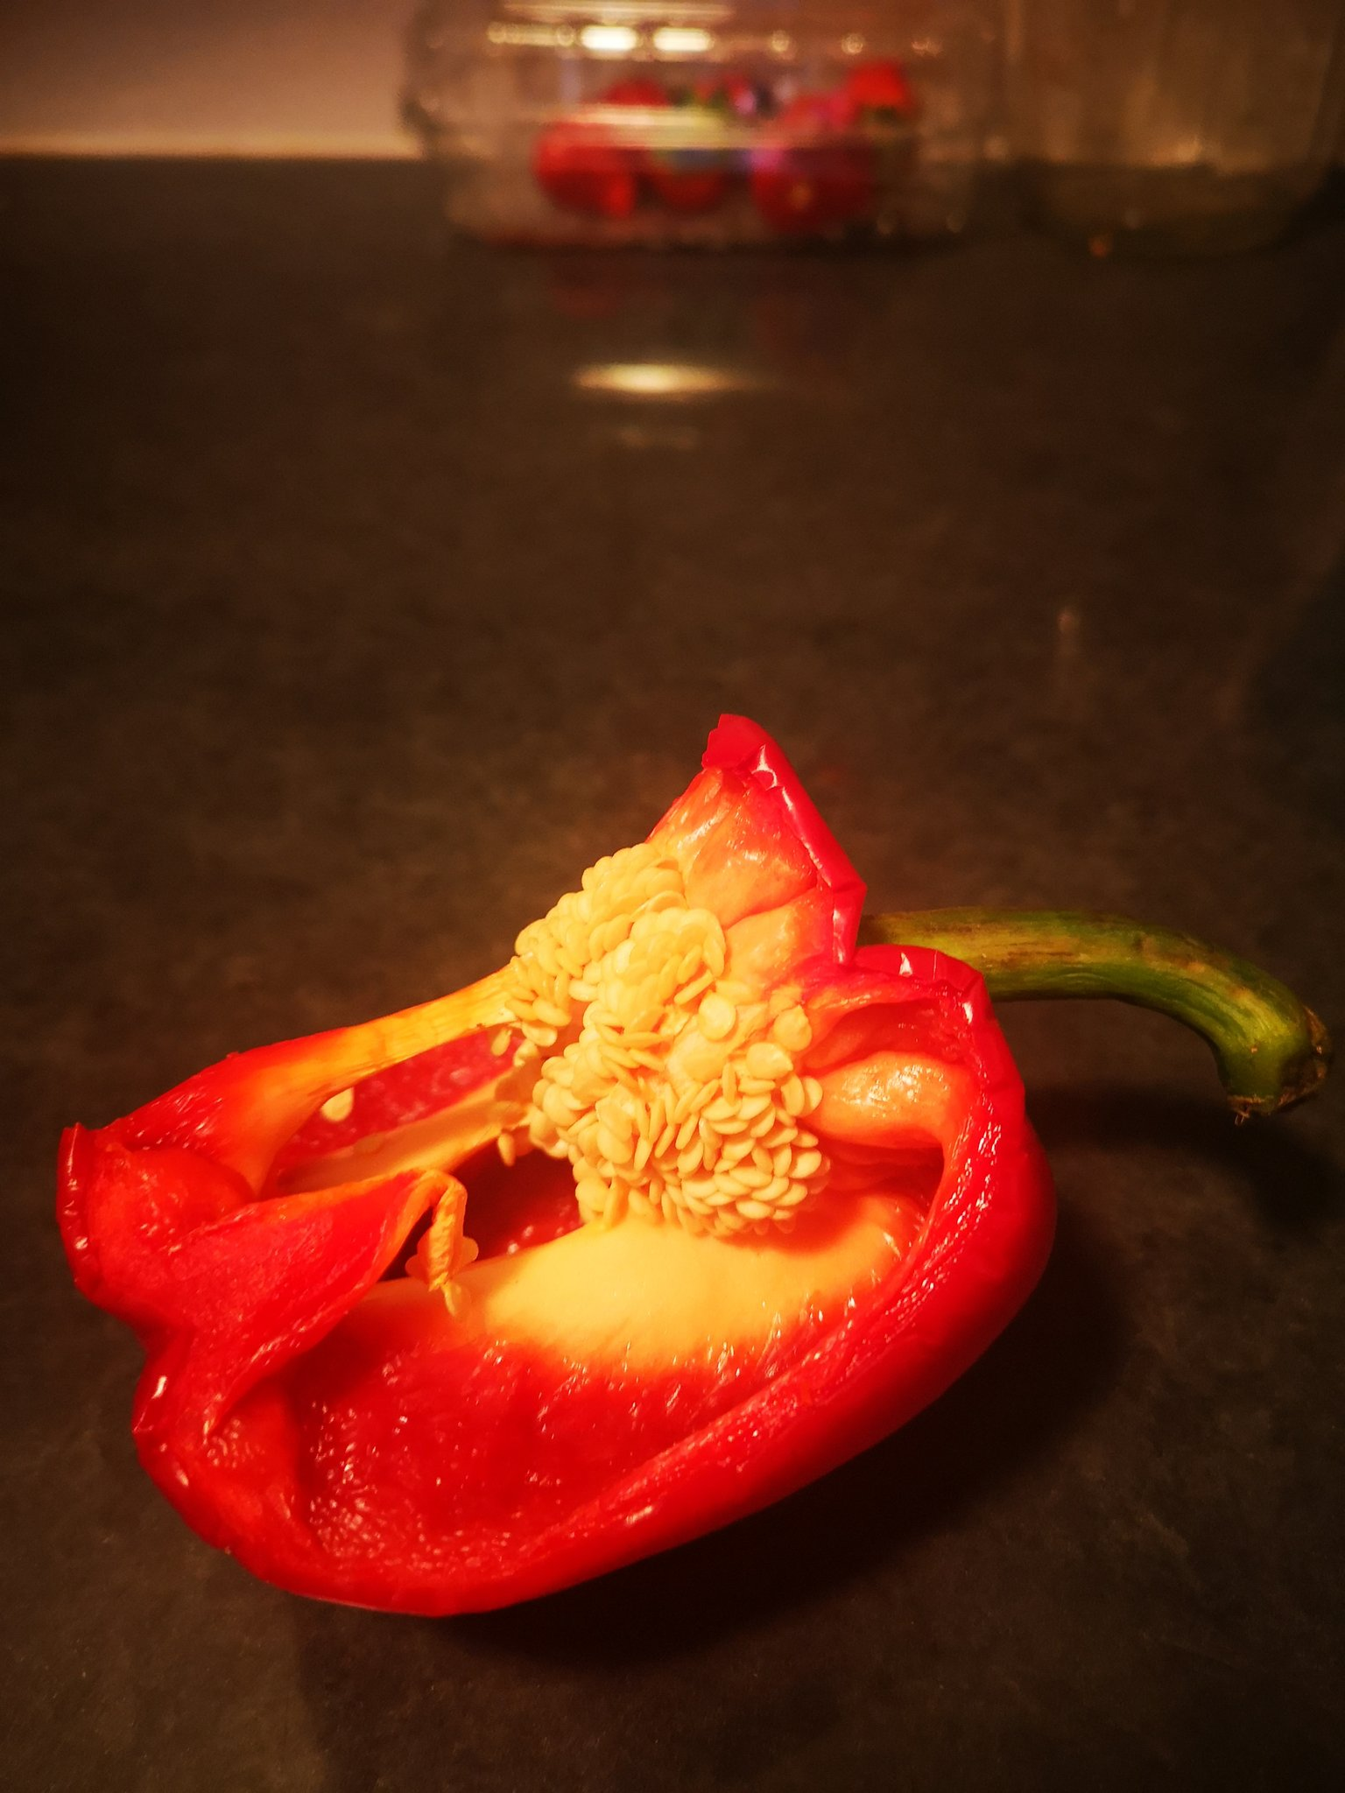
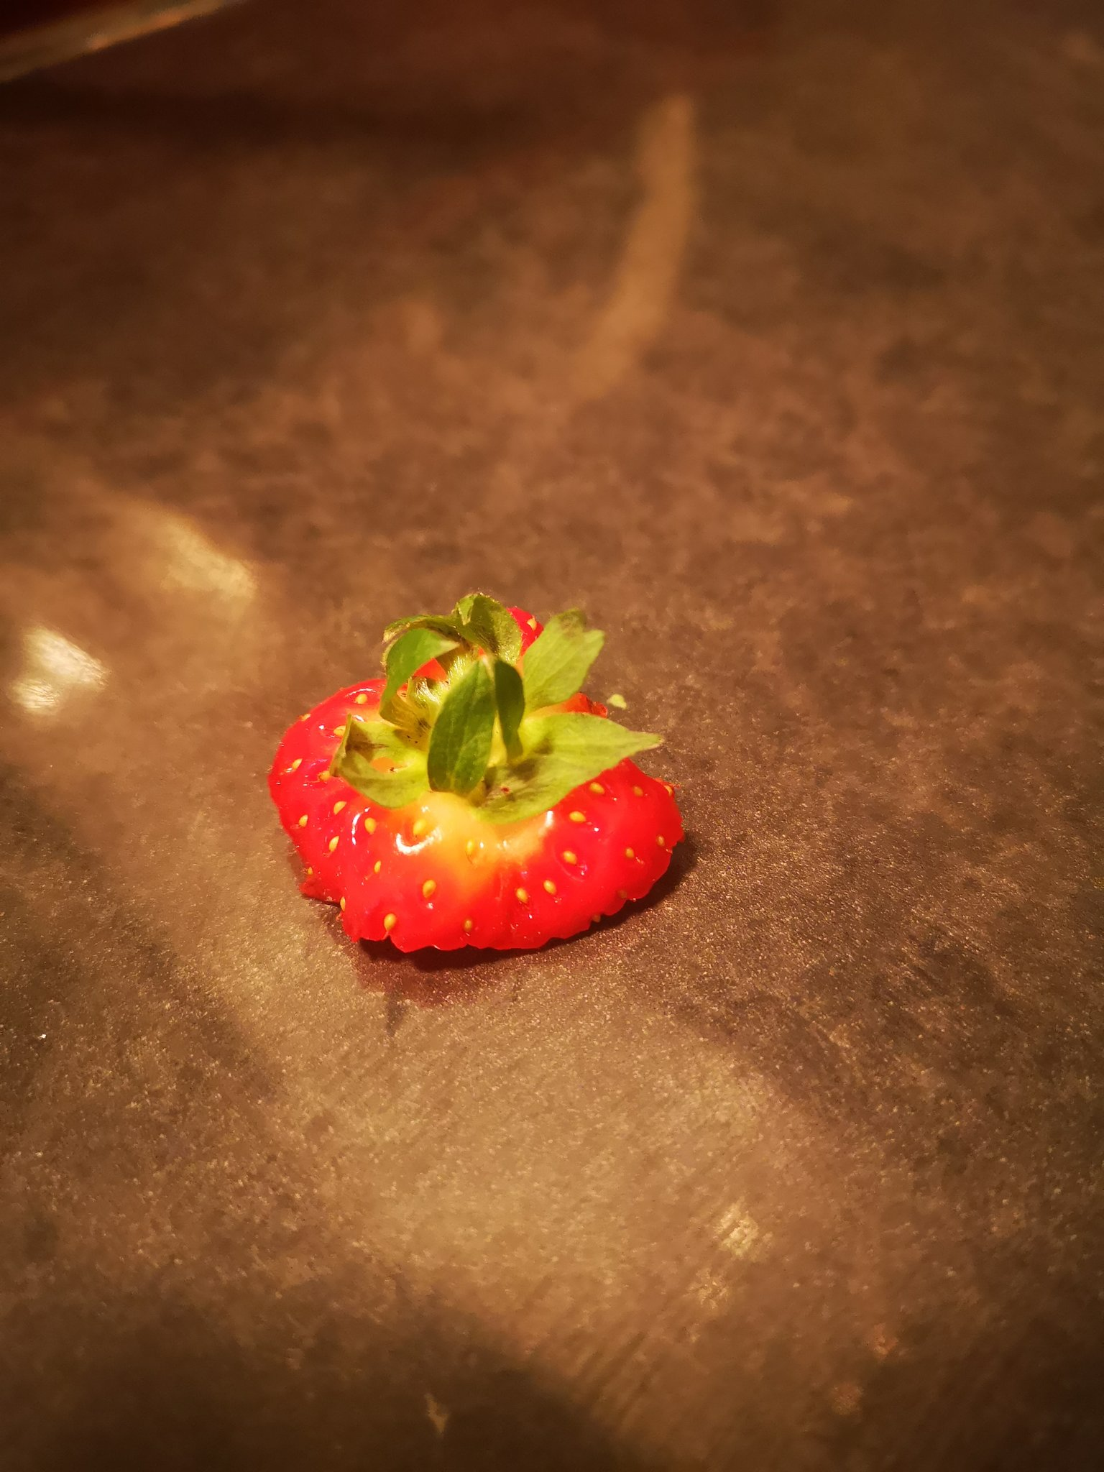
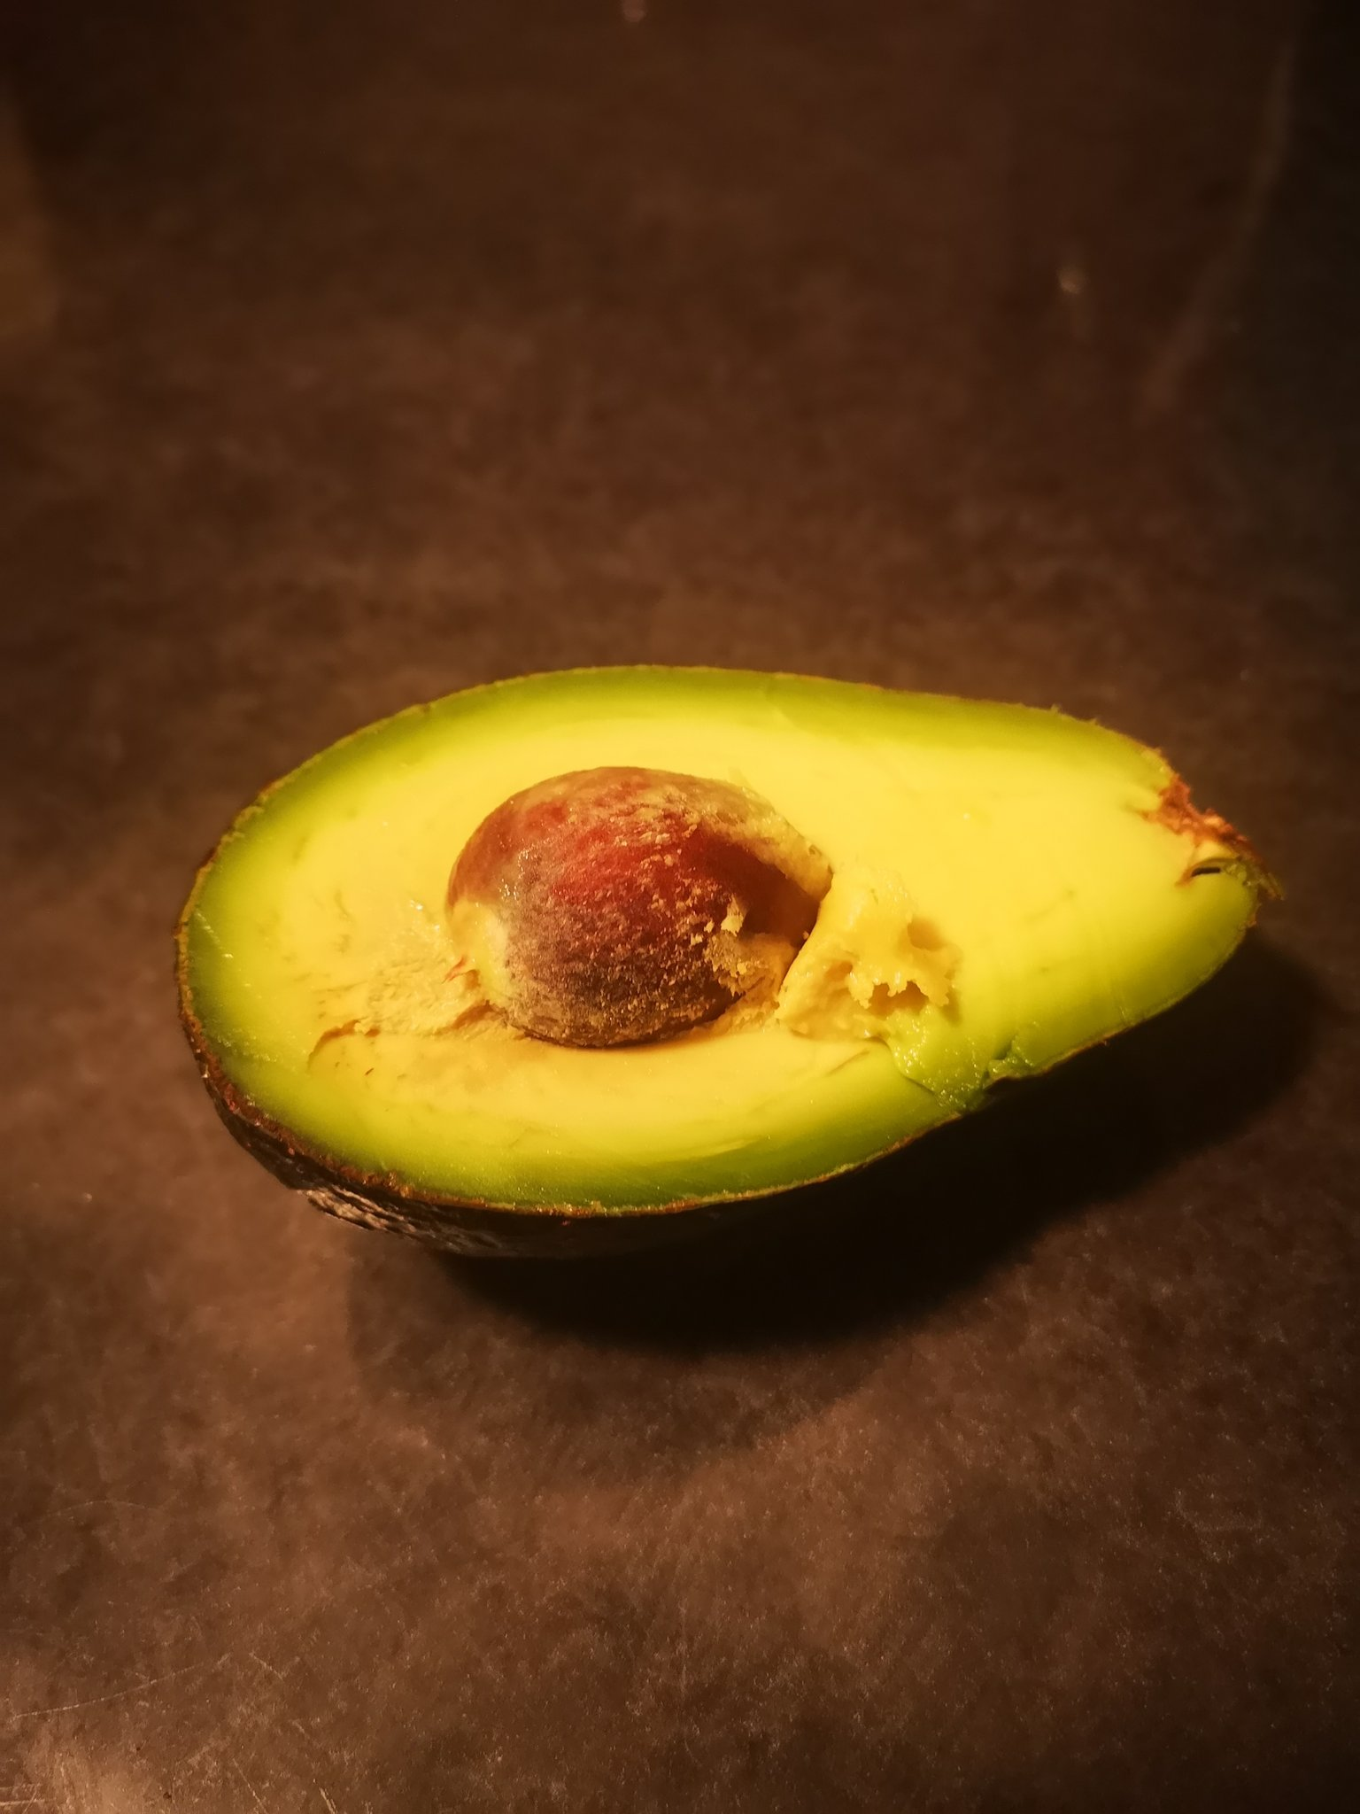
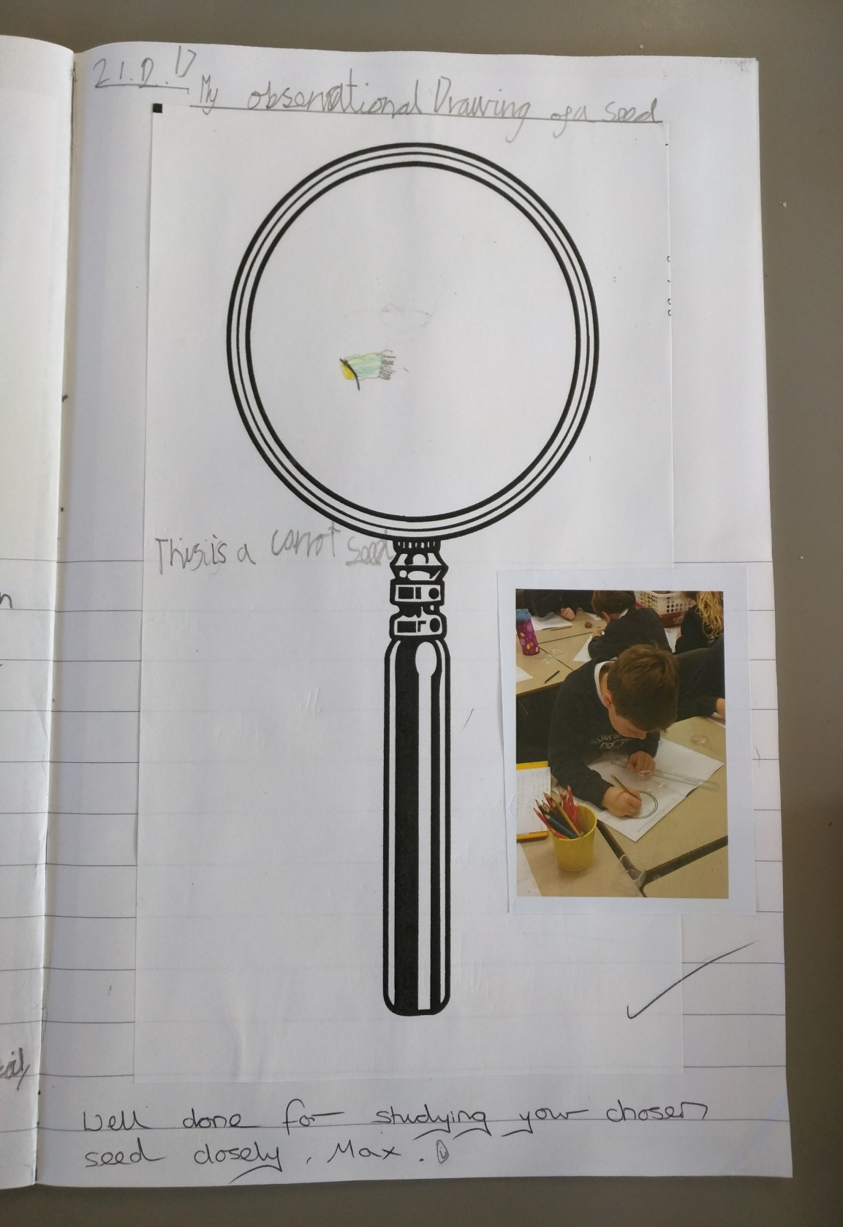
Explore, talk, observe closely.
Logo for section to sit inside roundel
Look closely at seeds and do observational drawings. (20-25 minutes)
Practical Activity 5:
Make observations of seeds:
Compare the seeds from different types of fruit and discuss:
How many seeds do they have?
What do they look they like?
Where are they in the fruit?
You could record your child verbally explaining how they are different or do observational drawings of the seeds.
e.g. - pepper seeds, strawberry seeds, avocado stone.
7

Slide 8
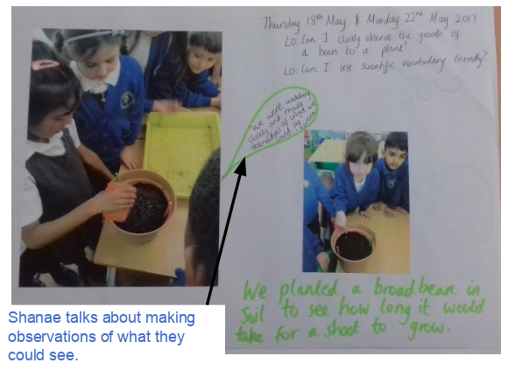
Explore, talk, observe over time.
Logo for section to sit inside roundel
Plant and observe seeds grow over time. (10 minutes as necessary)
Activity 6:
Plant some seeds that you have available to you and plant them in a pot or in your garden with your child.
As they grow, ask your child to describe what they can see.
.
Based on the learning so far, expect to hear more scientific vocabulary being used:
Leaf, flower, blossom, petal, fruit, berry, root, seed, trunk, branch, stem, bark, stalk, bud
8

Slide 9
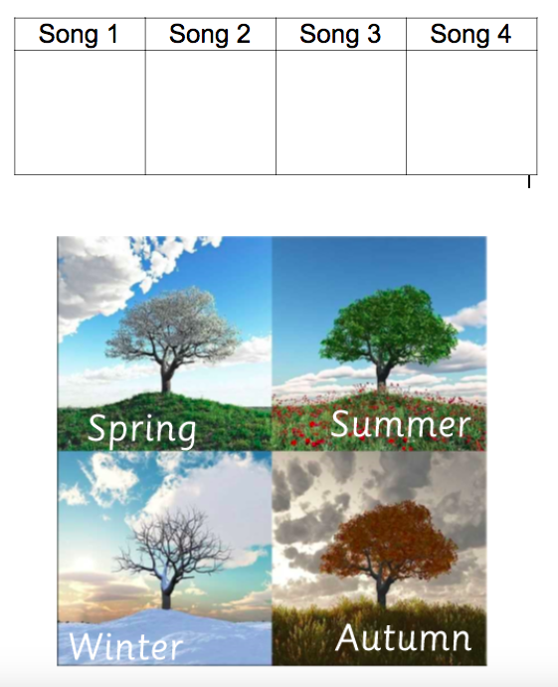
Find out more…about seasons and trees.
Science and the Arts.
Logo for section to sit inside roundel
(5-10 minutes for each song)
Practical Activity 7:
Linking to each season, think about what the tree looks like.
Spring- blossoms, buds and leaves grow back
https://www.youtube.com/watch?v=6LAPFM3dgag
Summer- leaves on the trees
https://www.youtube.com/watch?v=KY1p-FmjT1M
Autumn- some leaves change colour and fall
https://www.youtube.com/watch?v=H7hGiZ579cs
Winter- some trees have no leaves
https://www.youtube.com/watch?v=TZCfydWF48c
Listen to Vivaldi’s four seasons during the afternoon (any free time) - can the children identify the season from the music?
No right or wrong answer but must explain their reasoning.
9

Slide 10
Glossary of terms
Leaf: Flat, blade-like structure that comes off from the stem or branch of a plant.
Flower: Has petals that produce perfume and colour to attract insects.
Petal: The flat, usually coloured, part of the flower.
Blossom: The flowers of stone fruit trees that grow in Spring.
Fruit/berry: The fruit that develops after blossom.
Bud: The undeveloped shoot, leaf, or flower.
Root: The part of a plant that grows downward.
Seed: A part of the plant which can grow into a new plant.
Stem: The part that holds up the petals on a flower and where the leaves grow from.
Stalk: The main part of a plant.
Trunk: The main stem of a tree.
Branch: Any of the main branches growing off from the trunk of a tree.
Bark: The outer layers of stems and roots of woody plants.
10

Slide 11
11

Slide 12
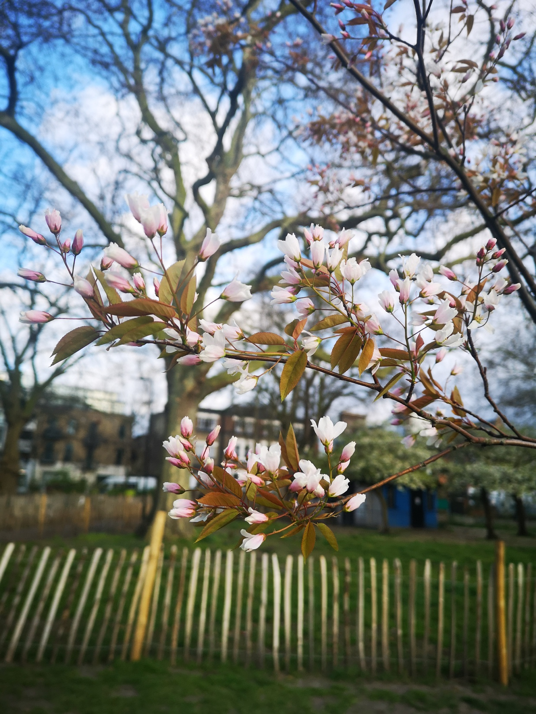
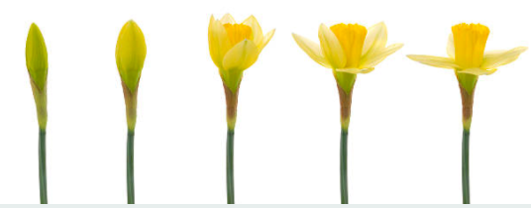
Printable Picture cards
Orchid
Willow
Oak
Blossom
Daffodil
Magnolia- Susan
Prayer- Maranta
Bud

