Slide 1

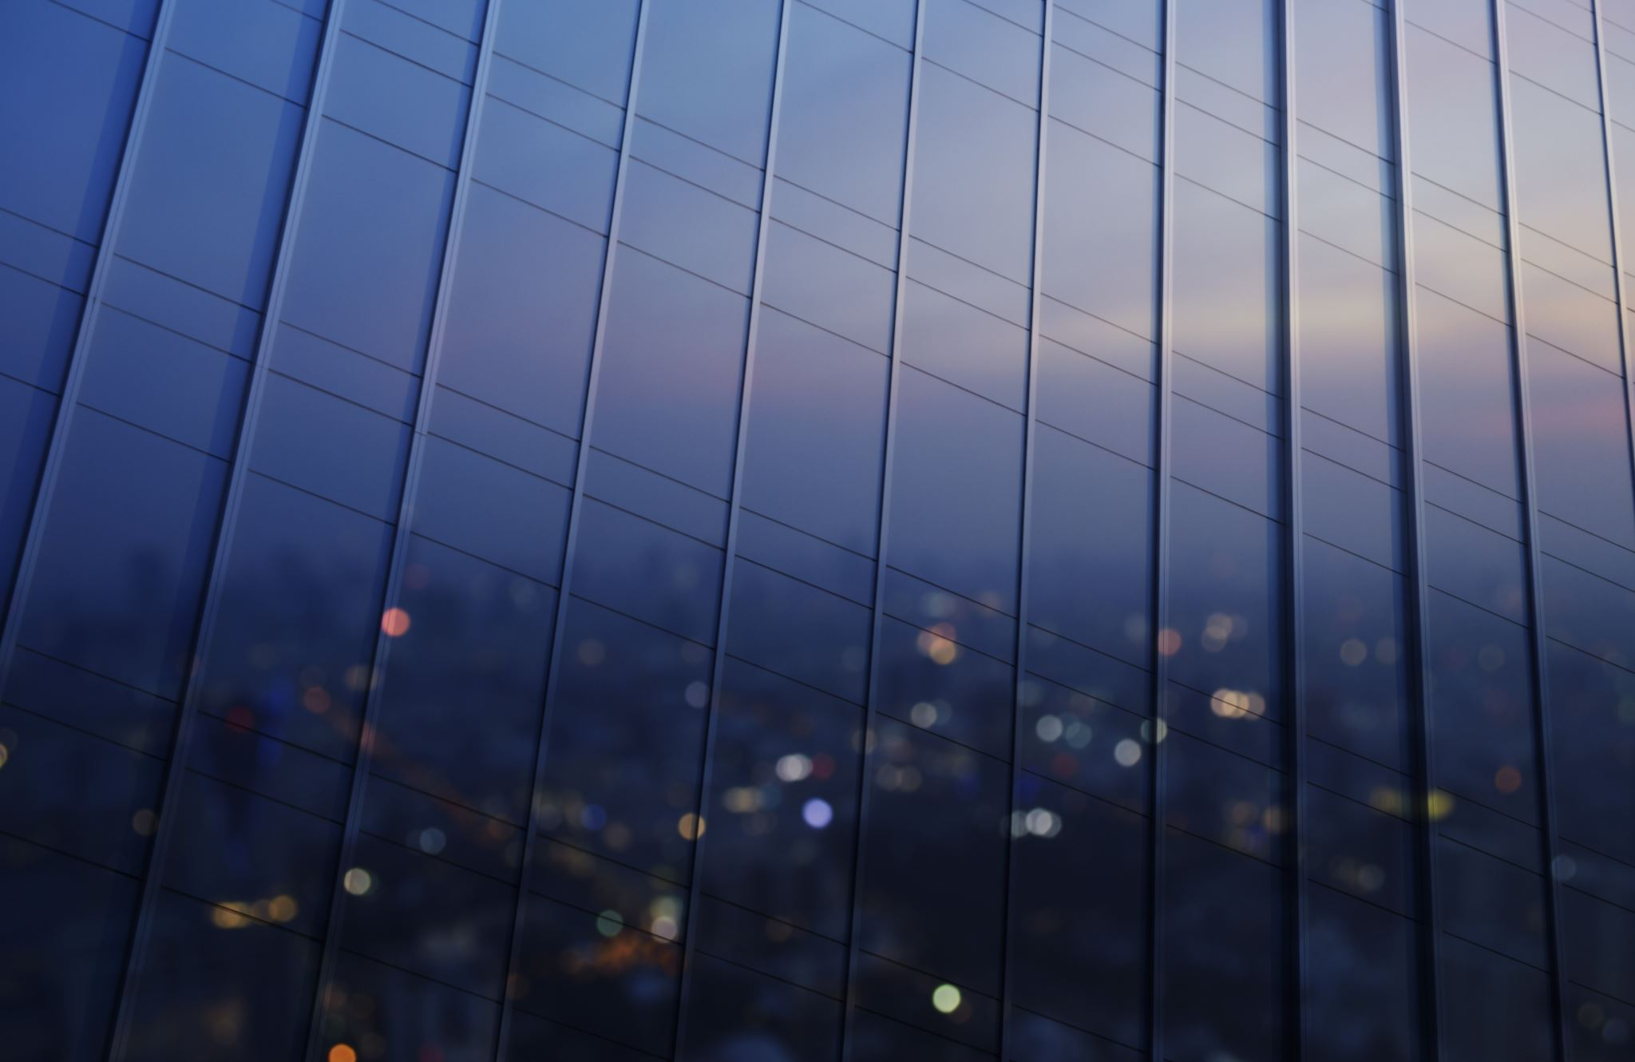


Light
For parents and carers
Thank you for supporting your child’s learning in science.
Before the session:
Please read slide 2 so you know what your child learning and what you need to get ready.
As an alternative to lined paper, slide 5 may be printed for your child to record on.
During the session:
Share the learning intentions on slide 2.
Support your child with the main activities on slides 3 & 4, as needed.
Slide 6 is a further, optional activity.
Slide 7 has a glossary of key terms.
Reviewing with your child:
Slide 8 gives an idea of what your child may produce.
Exploring reflective surfaces
Year 3 / Key Stage 2 Age 7-8

Slide 2


Light
Logo for section to sit inside roundel
Exploring reflective surfaces
Key Learning
Some surfaces reflect light.
Objects are easier to see when there is less light if they are reflective.
Activities (pages 3-5): approx. 30-40 mins
Use lined paper, ruler and pencil.
Alternatively, print page 5 as a worksheet.
Find out more… (page 6): approx. 10 mins
Thinking about mirrors and reflective surfaces
I can…
identify how objects with different surfaces (e.g. shiny vs matt) are more or less visible.
2

Slide 3
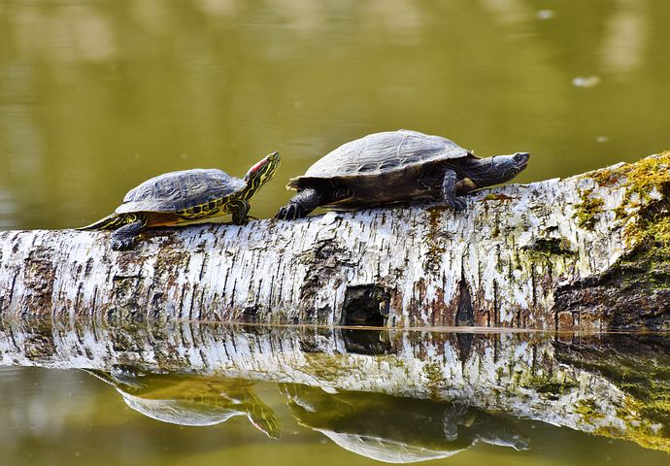
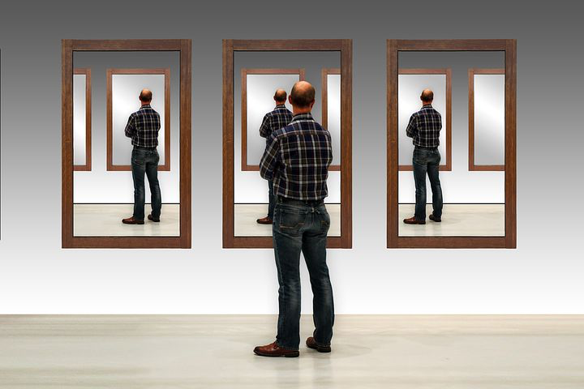
Explore, review, think, talk….
Logo for section to sit inside roundel
What do you already know about reflection?
(5 minutes)
What do we mean by the word ‘reflection’?
Think of as many different reflective surfaces as you can.
How many can you name?
3

Slide 4
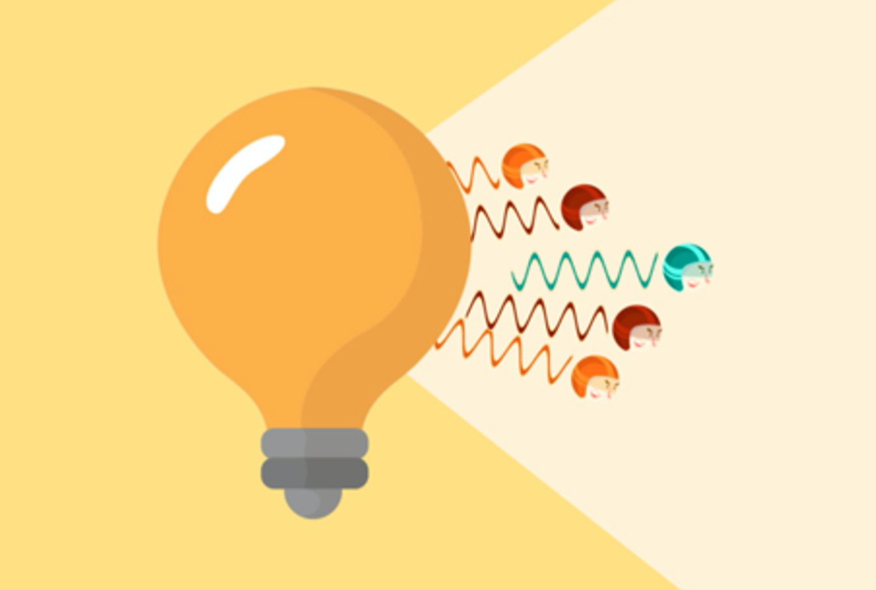
Watch, read, listen…
Logo for section to sit inside roundel
Reflection
(10 minutes)
Watch this clip about reflection.
https://www.bbc.co.uk/bitesize/topics/zbssgk7/articles/zqdxb82
What did you notice about the mirror and the black wall?
When light from an object is reflected by a surface, it changes direction.
It bounces off the surface at the same angle as it hits it.
Smooth, shiny surfaces such as mirrors and polished metals reflect light well.
Dull and dark surfaces such as dark fabrics do not reflect light well.
4

Slide 5
Instructions for Activity
Give the children a range of different materials and a torch. E.g. tin foil, paper, wood, metal, fabric.
Ask them to explain what happens when they shine the torch on the surface.
Give them tine to explore the reflectiveness of each material.
Ask them to record their findings in a table (see opposite).
Learning outcome: I can identify how objects with different surfaces (e.g. shiny vs dull) are more or less visible.
Object | Describe what it looks like | How shiny is it? (score out of 5)
What do you notice about the objects that reflected the most light?
5

Slide 6
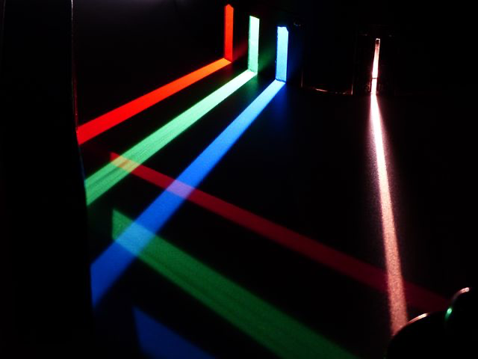
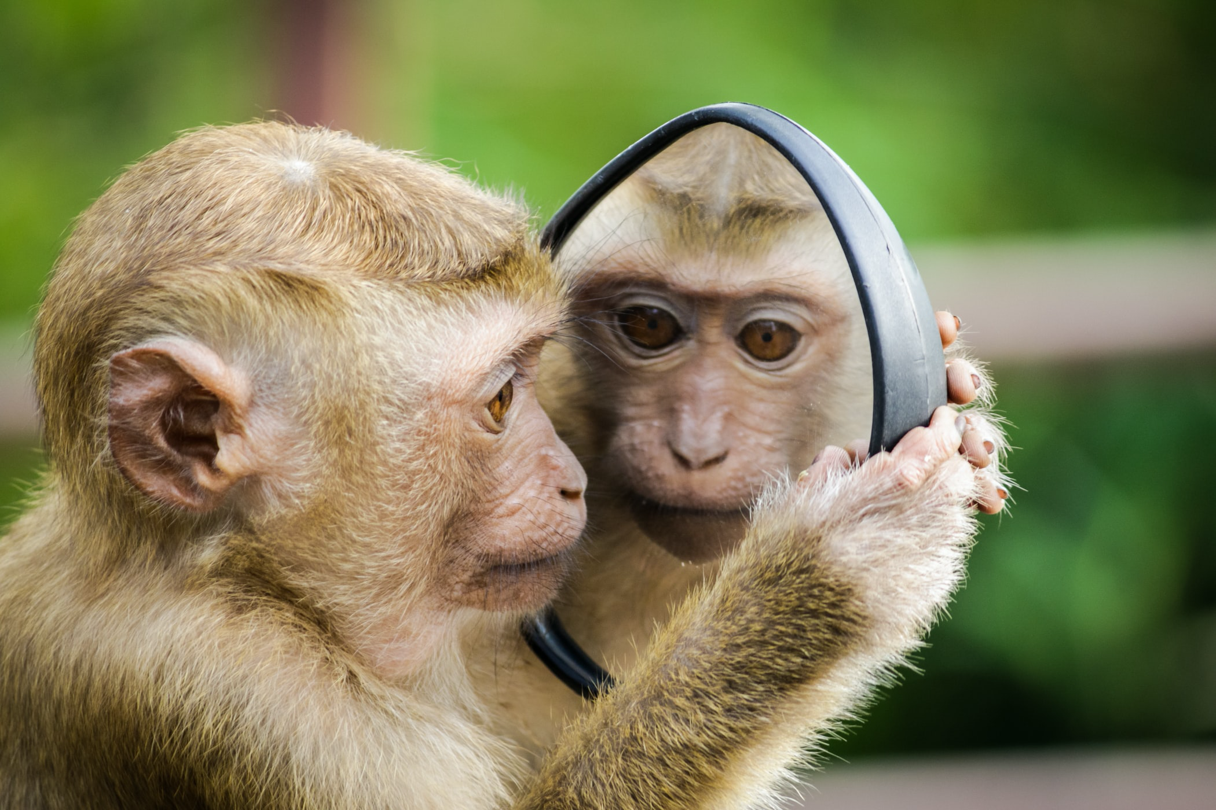
Find out more… about reflection
Logo for section to sit inside roundel
Explore these websites to find out even more about reflection
(10-15 minutes)
Rainbow Mechanic
https://www.coolmathgames.com/0-rainbow-mechanic
Place the mirrors in the right place to reflect the light from the sun through the maze and onto the prism! Mazes become more and more complicated with each level, how far can you get?
Angles of incidence and reflection
https://wowscience.co.uk/resource/light-absorption-reflection-refraction/
What if we didn’t have mirrors?
https://explorify.wellcome.ac.uk/en/activities/what-if/we-didnt-have-mirrors
6

Slide 7
Glossary of terms
bright: If an object is bright it gives out or reflects much light.
dark (scientific): Dark is the absence of light.
dark (everyday): Very little amount of light.
dull: If an object is dull it is not shiny or bright.
light: Light is the form of energy that makes it possible for eyes to see.
material: Anything used for building or making something else.
shiny: Reflecting or glowing with light.
surface: The outside limit or top layer of something.
7

Slide 8
Possible learning outcome for reviewing your work: I can explore the need for light to see things.
Encourage for interesting descriptions and use of adjectives to describe each object. Photographs/ drawings are a good idea too!
Object | Describe what it looks like | How shiny is it? (score out of 5)
Tin foil | Silver, shiny | 4/5 - quite shiny
Table | Hard, smooth, tough, dull | 1/5
C.D. | Shiny, smooth | 5/5 – only on one side. The other side is dull
Black paper | Dark, dull, smooth, flat | 0/5 – nothing is reflected
Laptop | Silver, smooth, dull | 1/5 – only a little bit is reflected
What do you notice about the objects that reflected the most light? An object is very shiny if light reflects very well from it. Some objects are shinier than others because they reflect light well.
Encourage your child to explain their ideas. This will help them understand light & reflection better.
8

