Slide 1




Light
For parents and carers
Thank you for supporting your child’s learning in science.
Before the session:
Please read slide 2 so you know what your child learning and what you need to get ready.
As an alternative to lined paper, slide 5 may be printed for your child to record on.
During the session:
Share the learning intentions on slide 2.
Support your child with the main activities on slides 3 & 4, as needed.
Slide 6 is a further, optional activity.
Slide 7 has a glossary of key terms.
Reviewing with your child:
Slide 8 gives an idea of what your child may produce.
Exploring how shadows are formed
Year 3 / Key Stage 2
Age 7-8

Slide 2


Light
Logo for section to sit inside roundel
Exploring how shadows are formed
Key Learning
The size of the shadow depends on the position of the source, object and surface.
Activities (pages 3-5): approx. 30-40 mins
Use different coloured chalk
Find out more… (page 6): approx. 15 mins
Using sundials
Exploring how shadows are formed
I can…
explain how a shadow is formed.
2

Slide 3
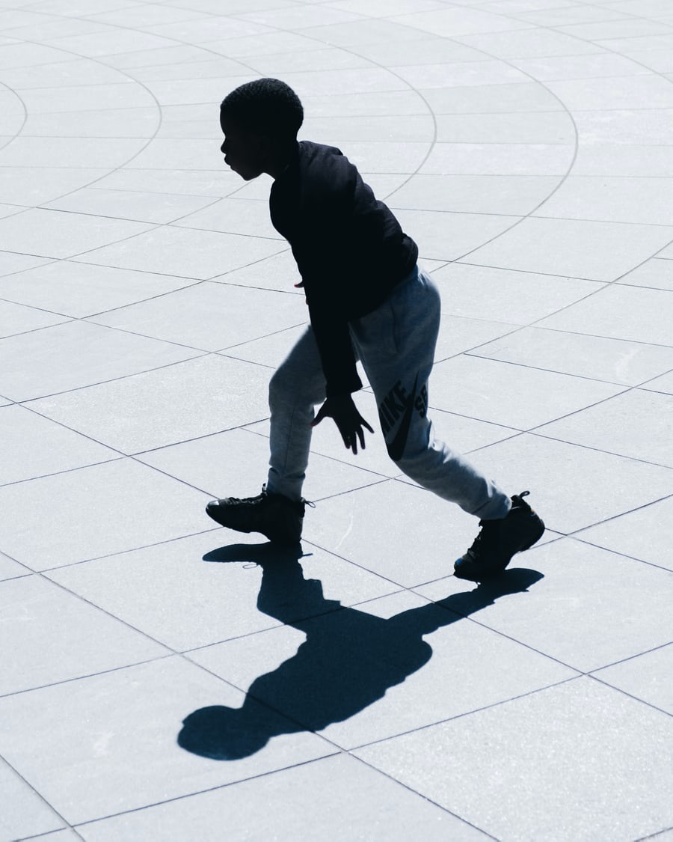
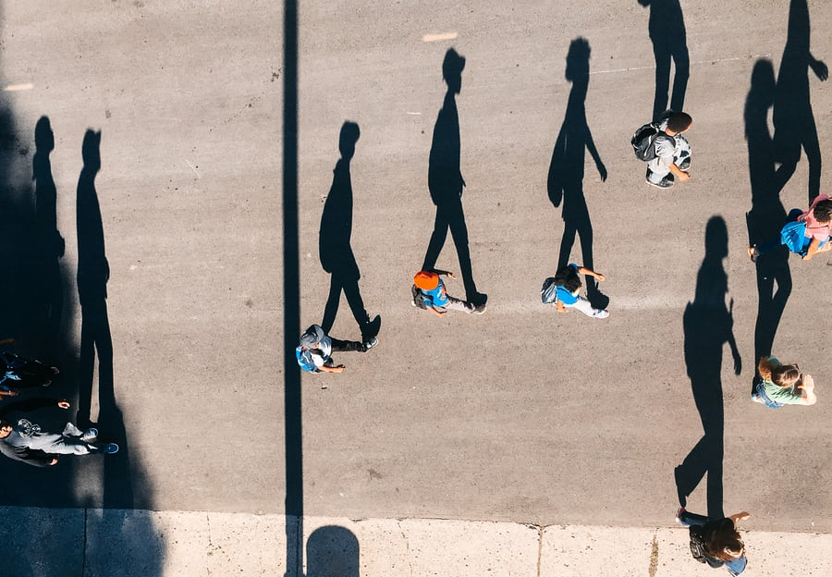
Explore, review, think, talk….
Logo for section to sit inside roundel
What do you already know about… shadows?
(5 minutes)
Watch this BBC Bitesize clip:
https://www.bbc.co.uk/bitesize/clips/z8vfb9q
When something blocks light travelling from a source, a shadow is made.
What happens to the shadow if we use a translucent or transparent object?
Read this short article from DK:
https://www.dkfindout.com/uk/science/light/shadows/
3

Slide 4
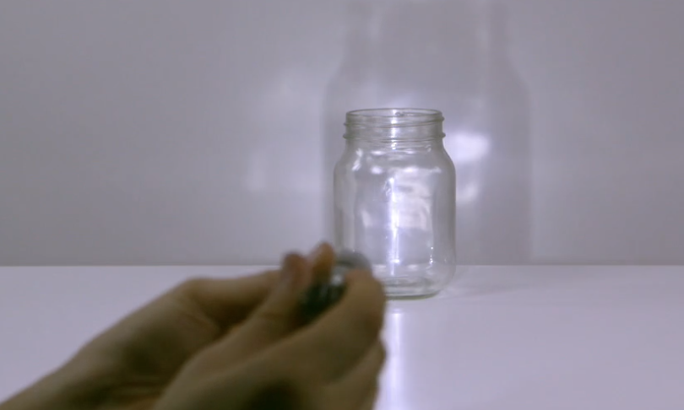
Watch, read, listen…
Logo for section to sit inside roundel
Exploring shadows
(10 minutes)
Watch this clip from Explorify showing light shining on different opaque and transparent objects:
https://explorify.wellcome.ac.uk/en/activities/whats-going-on/shadow-shapes
After you've watched the video, think about…
How are the different shadows made?
How did the light behave for each object?
Can you think of any objects that don't have a shadow?
What did you notice about the size and shape of the shadow as the torch moved?
4

Slide 5
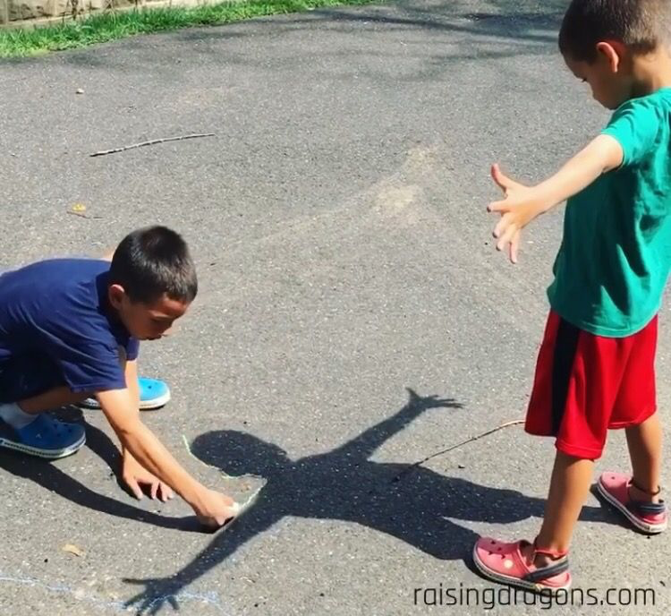
Instructions for Activity
Use chalk to trace around your shadow outside.
Repeat this at different times during the day. (e.g. 10am, 11am, 12pm, 1pm, 2pm)
What do you notice happen to your shadow?
Why do you think this happens?
Learning outcome: I can explain how a shadow is formed
Image courtesy of : https://www.raisingdragons.com/shadow-drawing-age-4/
5

Slide 6
Find out more…
Logo for section to sit inside roundel
Going further with shadows
(10-15 minutes)
Watch this BBC clip about shadow puppets:
https://www.bbc.co.uk/bitesize/clips/z87jmp3
Use a range of translucent and opaque materials to create your own shadow puppets.
Other ideas for shadow puppets:
https://www.stem.org.uk/resources/elibrary/resource/35265/making-shadow-puppets
https://www.youtube.com/watch?v=pSVd_0AKTKc
Make a sun dial
https://wowscience.co.uk/why-do-we-move-our-clocks-forward-blog-post-by-kulvinder-johal/
Lighting effects
https://www.bbc.co.uk/programmes/p0117zll
The Sun and shadows
https://www.bbc.co.uk/bitesize/clips/z6fnvcw
6

Slide 7
Glossary of terms
bright: If an object is bright it gives out or reflects much light.
dark (scientific): Dark is the absence of light.
dark (everyday): Very little amount of light.
dull: If an object is dull it is not shiny or bright.
light: Light is the form of energy that makes it possible for eyes to see.
material: Anything used for building or making something else.
shiny: Reflecting or glowing with light.
surface: The outside limit or top layer of something.
7

Slide 8
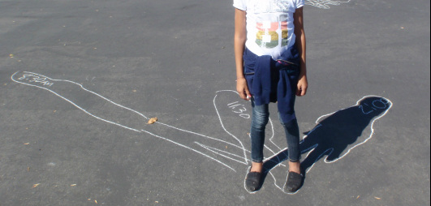
Possible learning outcome for reviewing your work: I can explain how a shadow is formed.
image courtesy of www.bregder.weebly.com/sun--moon-activities.html
8

