Slide 1
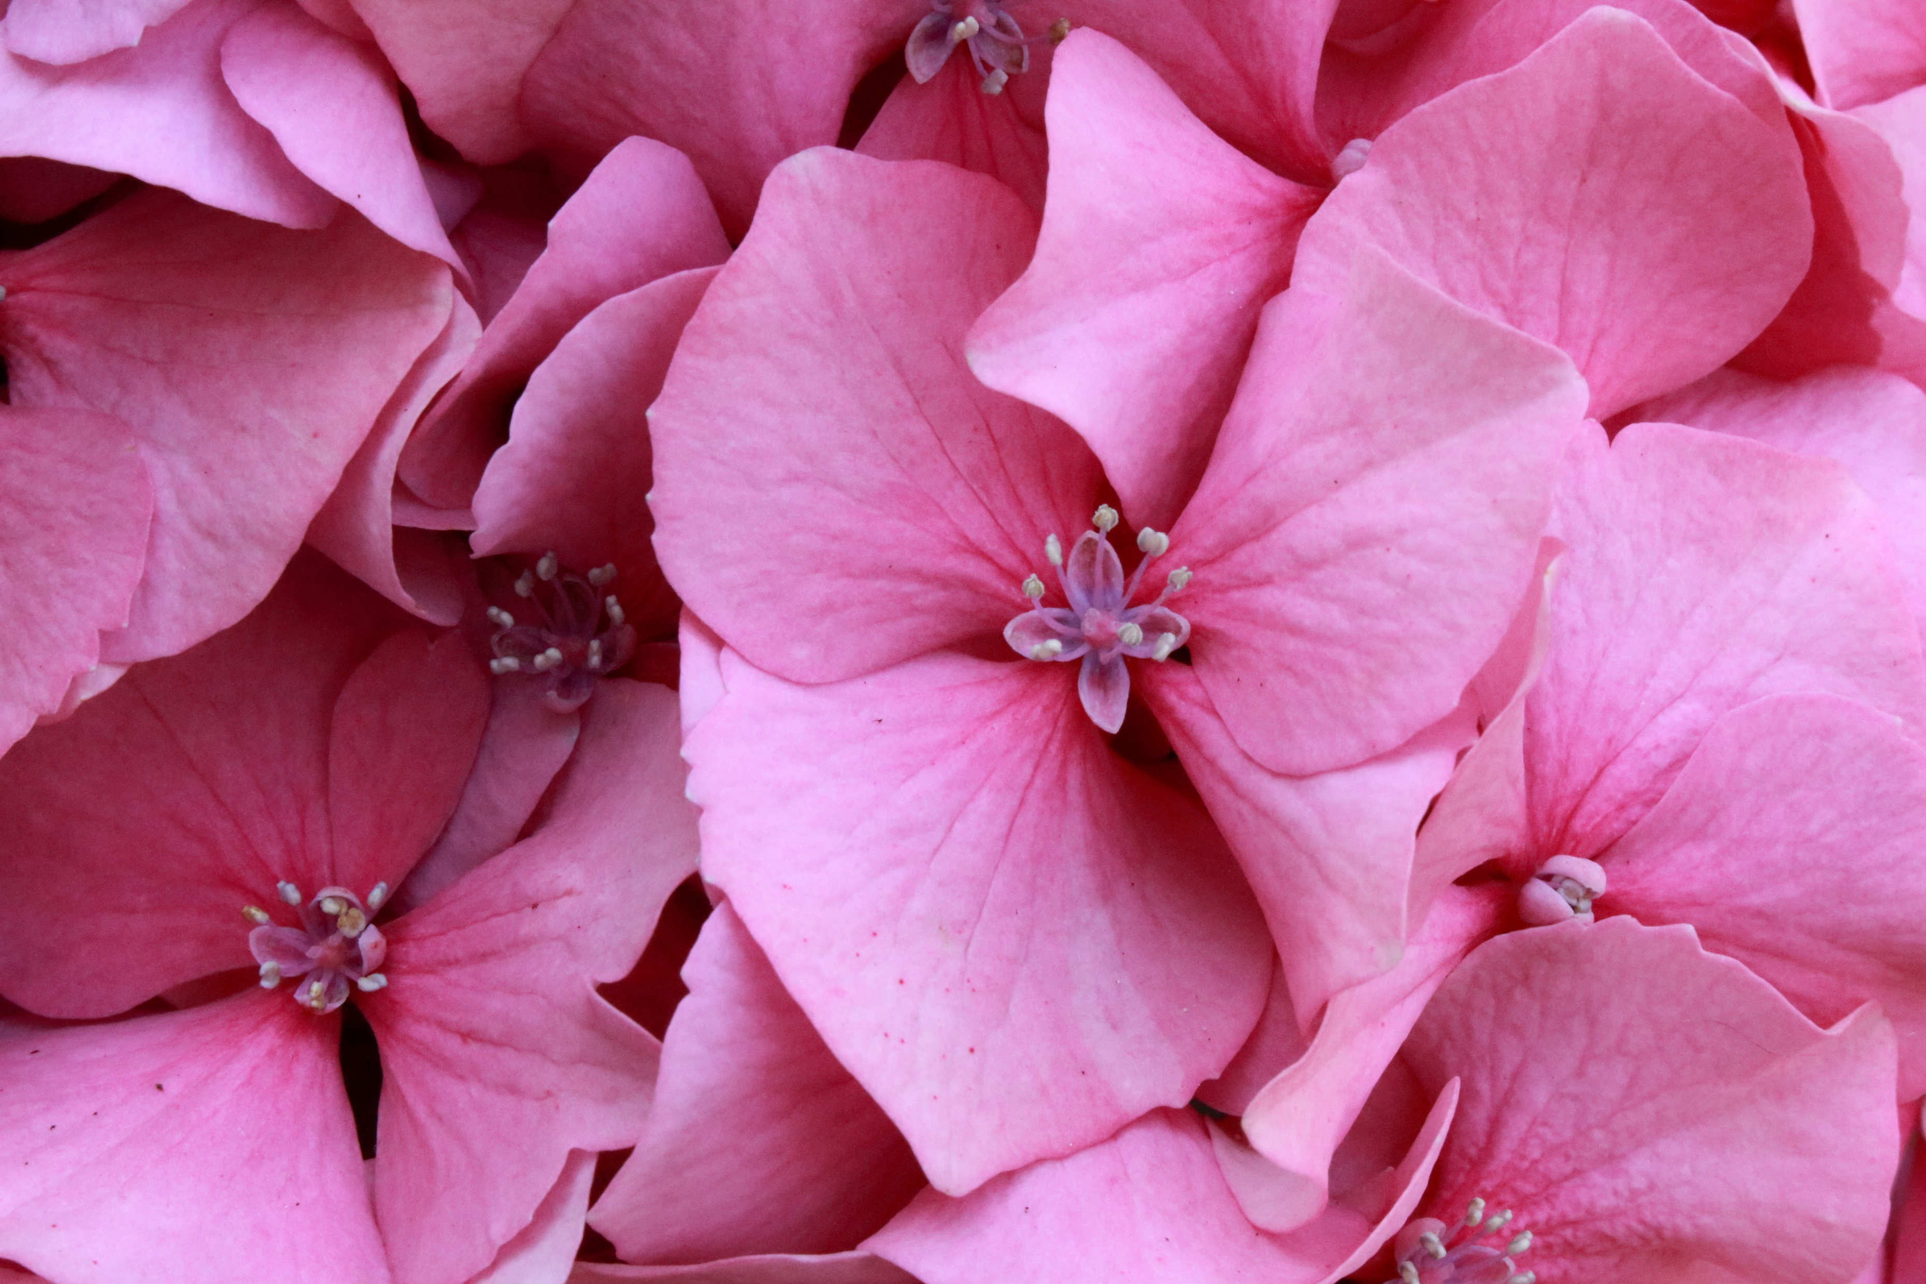



Plants
For parents
Thank you for supporting your child’s learning in science.
Before the session:
Please read slide 2 so you know what your child is learning and what you need to get ready.
As an alternative to lined paper, slide 5 may be printed for your child to record on.
During the session:
Share the learning intentions on slide 2.
Support your child with the main activities on slides 3, 4 & 5, as needed.
Slide 6 is a further, optional activity.
Slide 7 has a glossary of key terms.
Reviewing with your child:
Slide 8 gives an idea of what your child may produce.
What are the parts of a flowering plant? What do they do?
Year 3
Age 7 - 8

Slide 2
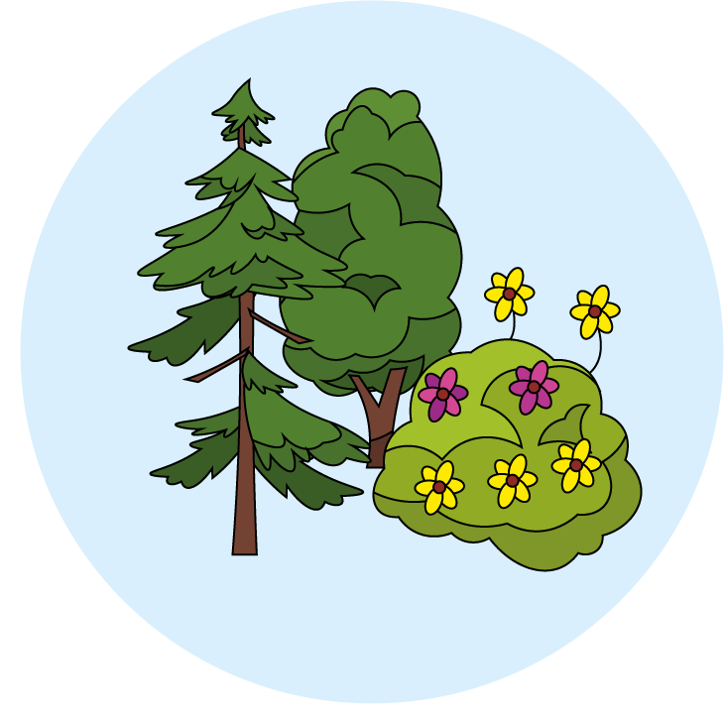

Plants
What are the main parts and functions of plants?
Key Learning
Many plants, but not all, have roots, stems/trunks, leaves and flowers/blossom.
The leaves use sunlight and water to produce the plant’s food.
Some plants produce flowers which enable the plant to reproduce.
Activities (pages 3-5): 40 mins
Use plain paper and a pencil.
You will need:
  a flowering plant (ideally a lily, tulip or daffodil)
  A paper plate or sheet of cardboard/paper
  magnifying glass (optional)
  tweezers (optional)
  scissors
  sticky tape
Find out more… (page 6): 30 mins
You may like to explore more about non-flowering plants and create a poster to show what you’ve learned.
I can…
identify the main parts of a plant and describe their purpose.

Slide 3
Explore, review, think, talk…
What do you already know about plants?
(5 -10 minutes)
How many different plants can you name (can you remember what evergreen and deciduous mean?)
How do plants and seeds grow?
What do seeds and plants need to stay healthy?
Watch these videos to help remind you:
https://www.bbc.co.uk/bitesize/topics/zy66fg8/articles/zcmtk2p
https://www.bbc.co.uk/bitesize/topics/zpxnyrd/articles/zxxsyrd
An evergreen is a plant that keeps its leaves throughout the year, these leaves may have a variety of colour.
Deciduous plants shed the parts that they no longer need to survive for the season (leaves and flowers for example).
Most plants grow from a seed or a bulb, which develop roots and a stem.
Plants need air, light, warmth, water and nutrients to be healthy.

Slide 4
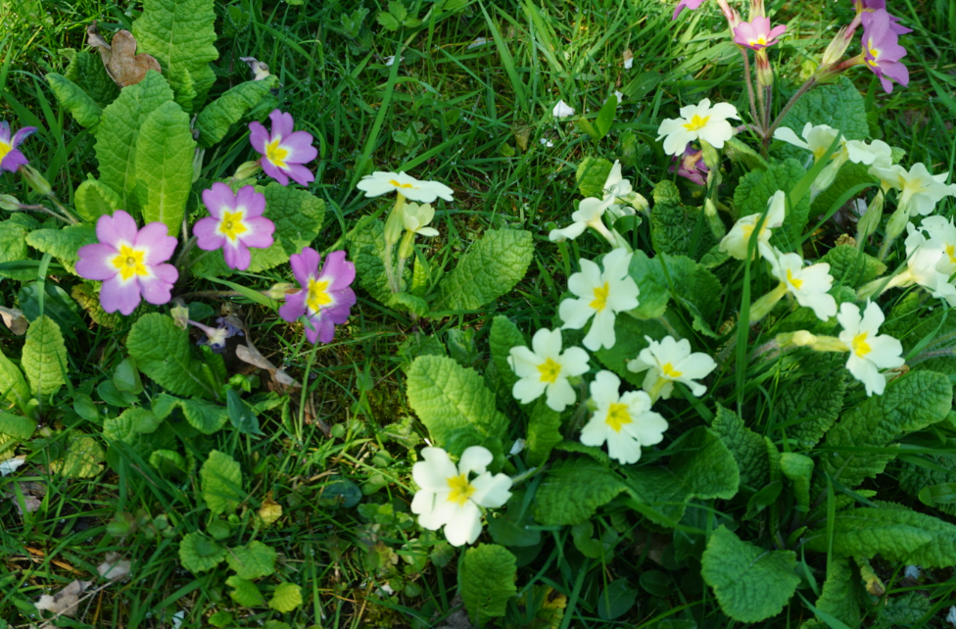
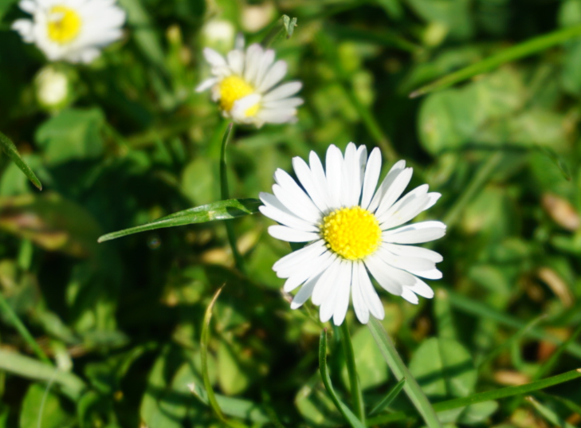
Watch, read, listen…
What are the different parts of a plant?
(page 4-5: 30 minutes)
Watch this video telling you all about the different parts of a flowering plant: https://www.bbc.co.uk/bitesize/topics/zy66fg8/articles/zcjnp39
Why do you think some plants have flowers, and others do not?
The different parts of a plant have different functions.
The roots of a plant take up water and nutrients from the soil. The roots also keep the plant steady and upright in the soil.
The stem carries water and nutrients to different parts of the plant.
The leaves use light from the sun, along with carbon dioxide from the air and water to make food for the plant. This process is called photosynthesis.
Some plants have flowers. These are involved in reproduction and produce seeds from which new plants grow.

Slide 5
Ask an adult to work with you.
This activity can be found at: https://www.science-sparks.com/dissecting-flowers-and-more-plant-experiments/
Any flowers with large parts work really well, for example:
Lily, Iris, Daffodil or Tulip
Lay your flower out over a paper plate, tray or sheet of cardboard. Can you identify the different parts?
Label areas of the different parts of a flower on your piece of cardboard or paper plate and stick these down. Then, write a definition of this part of the plant – why is it needed?
Try to find the following flower parts: root, petal, leaf, pollen, stem.
You can print out the labels opposite to help you if you need them.
The roots ________________________________
________________________________________
The petals ________________________________
_________________________________________
The stem ________________________________
________________________________________
The leaves ________________________________
_________________________________________
I can identify the main parts of a plant and describe their purpose.
_________________________________________
_________________________________________

Slide 6
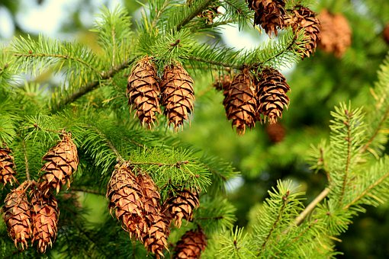
Find out more about different types of plants
Do all plants have flowers?
(30 minutes)
Did you know that not all plants have flowers?
Have a look at the following websites to find out some really interesting facts!
https://www.dkfindout.com/uk/animals-and-nature/plants/non-flowering-plants/
http://studyjams.scholastic.com/studyjams/jams/science/plants/mosses-and-ferns.htm
Create a poster about one of your favourite non-flowering plants. Think about including facts about:
  Where does it grow?
  Any interesting facts you have found out.
  Include drawings/diagrams and labels too.

Slide 7
Glossary of terms
Root: A root is a part of a plant that grows downward.
Bud: A bud is an undeveloped shoot, leaf, or flower.
Bulb: A bulb is a part of the plant which can grow into a new plant.
Stem: A stem is a part of a plant that transports water and nutrients from the roots to the buds, leaves and flowers.
Leaf: A leaf is a flat part of a plant that makes food for the plant using sunlight, water and carbon dioxide from the air, in a process called photosynthesis.
Photosynthesis: Photosynthesis is the process by which leaves convert sunlight, water and carbon dioxide into food for the plant.
Nutrient: A nutrient is a substance that is needed for healthy plant growth, development and functioning.
Flower: A flower has petals that produce perfume and colour to attract insects.
Evergreen: An evergreen plant keeps its leaves throughout the year. These leaves may have a variety of colour.
Deciduous: A deciduous plant sheds the parts that it no longer needs to survive for the season (leaves and flowers for example).
7

Slide 9
Possible learning outcome for reviewing your work:
I can identify the main parts of a plant and describe their purpose.
If you can’t find any flowering plants with large parts, you can use any flower for this activity.
Sometimes it can be tricky to get the roots too – don’t worry about this. Just be sure that your child can identify them and explain why they’re important.
Remember to include a sentence about the purpose of each part of the flower.
If
If you are not able to access a flowering plant, draw, label and annotate your diagram with the parts and functions of the plant.

