Slide 1

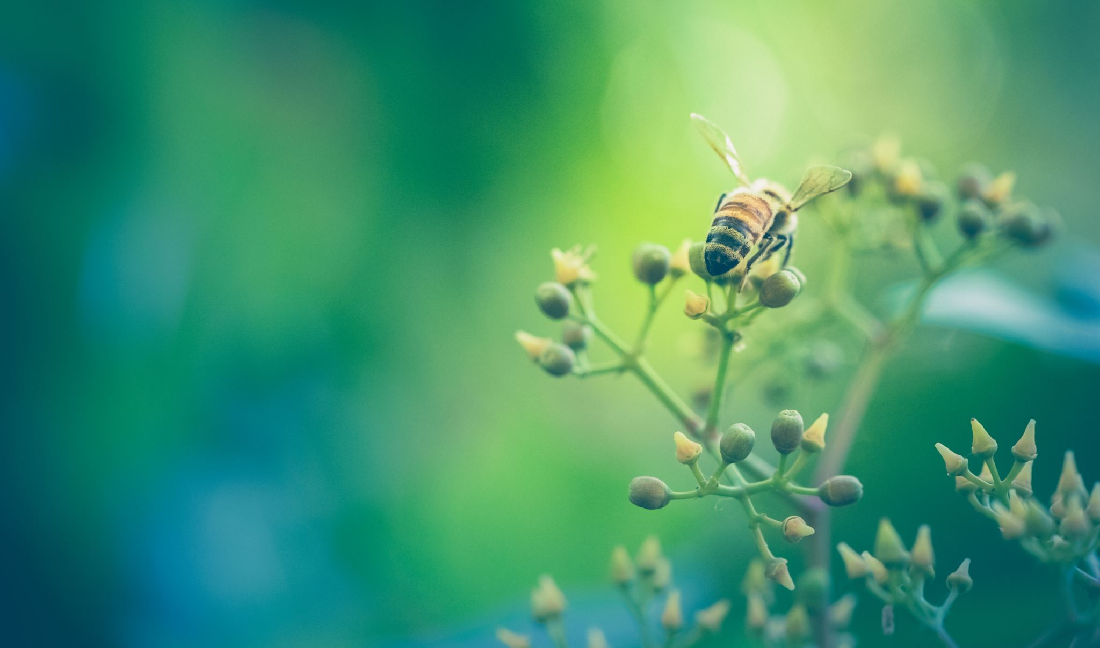

Plants
For parents
Thank you for supporting your child’s learning in science.
Before the session:
Please read slide 2 so you know what your child is learning and what you need to get ready.
As an alternative to lined paper, slide 5 may be printed for your child to record on.
During the session:
Share the learning intentions on slide 2.
Support your child with the main activities on slides 3, 4 & 5, as needed.
Slide 6 has further, optional activities.
Slide 7 has a glossary of key terms.
Reviewing with your child:
Slide 8 gives an idea of what your child may produce.
What happens to plants when they are put in different conditions?
Year 3
Age 7 - 8

Slide 2
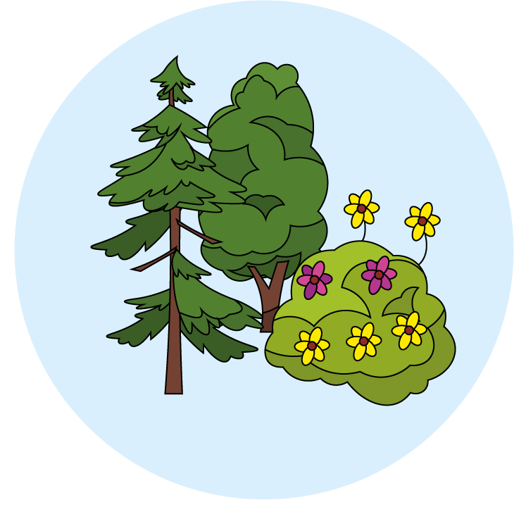

Plants
What happens to plants when they are put in different conditions?
Key Learning
Plants need certain conditions to grow well, including air, light, water, nutrients from soil, and room to grow.
Different plants require different conditions for germination and growth.
Activities (pages 3-5): 40 mins
Use lined paper and a pencil.
You will need:
  Several plants
  Water
  Measuring tape
Find out more… (page 6): 30 - 40 mins
You may like to explore how plants adapt to different conditions or find out more about carnivorous plants.
I can…
investigate what happens to plants when they are put in different conditions.

Slide 3
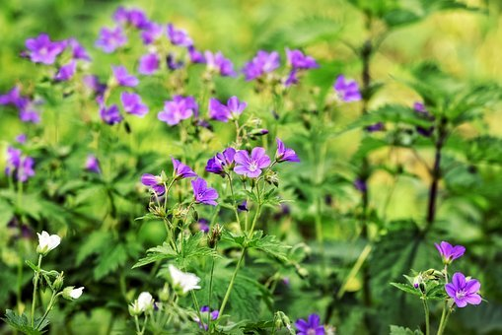
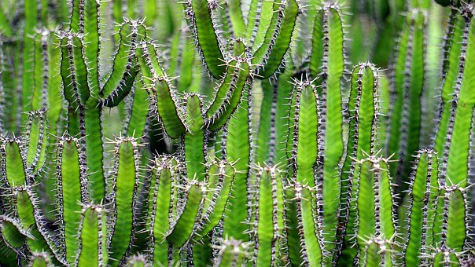
Explore, review, think, talk…
What do you already know about how plants grow?
(5 minutes)
Watch this BBC bitesize clip:
https://www.bbc.co.uk/
bitesize/topics/zy66fg8/
articles/zcmtk2p
Watch this clip exploring how cacti
survive without water:
https://www.bbc.co.uk/
bitesize/clips/z69rkqt
What do you think would happen if a plant didn’t have one of these conditions for growth?
How would the plant change?
Do you think it would still be healthy? Why? Why not?

Slide 4
Watch, read, listen…
Exploring plants in different conditions
(10 minutes)
All plants need:
  Light (to produce food)
  Air (to breathe)
  Water (to transport nutrients)
  Nutrients (through the soil)
  Space (to grow)
Watch this BBC Bitesize clip to see what plants need to grow.
https://www.bbc.co.uk/bitesize/clips/z9f87hv
Watch this BBC teach clip exploring what happens if plants don’t have one of the correct conditions.
https://www.bbc.co.uk/teach/class-clips-video/science-ks1-ks2-ivys-plant-workshop-what-do-plants-need-to-survive/zkw2gwx
Now set up an investigation to see what happens to a plant if one of the conditions is missing.
https://wowscience.co.uk/resource/grow-your-own-plants/

Slide 5
Today, you will investigate what happens to a plant if you remove one of the conditions.
For example, you might decide to grow a plant in the dark, or decide to use a different soil.
If you can, use a control plant (the same plant with all the correct conditions), so that you can compare the changes.
Use the planning sheet to help you, or you can draw the table on paper if you’d prefer.
I can investigate what happens to plants when they are put in different conditions.
Which plant are you going to use?
What do you want to find out?
What do you think will happen?
What equipment do you need?
Plant location / Day | Height of plant (cm) | Description of plant | Drawing of plant

Slide 6
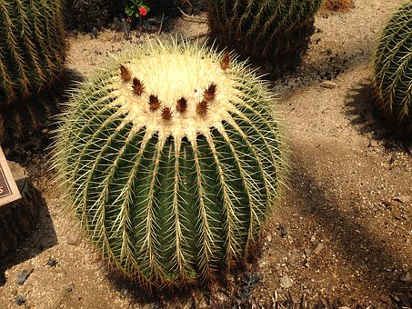
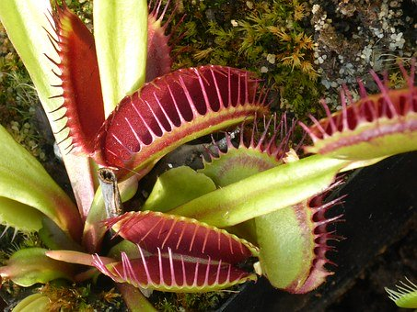
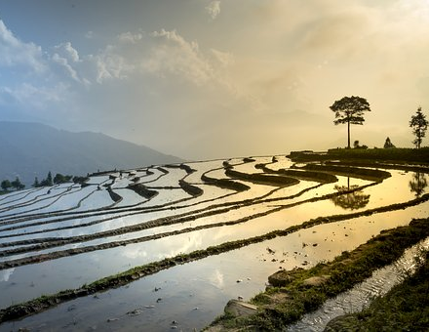
Taking it further…
Just how creative can you get?
(30-40 minutes)
How do plants grow in the desert without water?
https://www.bbc.co.uk/
bitesize/clips/z69rkqt
How does rice grow in water filled paddy fields?
https://www.youtube.com/
watch?v=kxAEiHCErSA
What are meat eating plants?
Watch this video to find out more about:
Venus Fly traps
Sundews
Pitcher plants
Bladderworts
https://www.youtube.com/watch?v=6L_p3ZkSlLo
Create a poster to sell the carnivorous plants, highlighting how they each feed.

Slide 7
Glossary of terms
Conditions: Plants need certain conditions to be able to germinate and grow. These conditions include air, water, light, nutrients from the soil and room to grow.
Control: A control is the part of an experiment that does not receive treatment and is then used as a benchmark to measure how the other tested subjects do.
Germination: Germination is the stage of plant growth when the seed splits and begins to sprout or grow and produces a shoot or seedling.
Growth: The growth of a plant starts with the germination of a seed. The root, stem and leaves grow before the flowers.
Nutrients: Nutrients are substances found in the soil which are important for healthy plant growth.
7

Slide 8
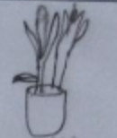
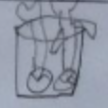
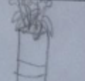

Possible learning outcome for reviewing your work: I can investigate what happens to plants when they are put in different conditions
Which plant are you going to use? | A red tulip
What do you want to find out? | What happens to the tulip when it is kept in the dark?
What equipment do you need? | Ruler
Ensure you measure from the same part of the plant each time.
What did you notice about your results?
Plant location / Day | Height of plant (cm) | Description of plant | Drawing of plant
Day 1 in the kitchen cupboard | 28 cm | Bright green. Leaves are long. Stem is thick. It smells weird.
Day 2 in the kitchen cupboard | 32 cm | Leaves are getting limp. They are mostly bright green.
Day 3 in the kitchen cupboard | 32 cm | Broken bulb. Brown leaves. Tulip has white edges. Leaves are drooping.
Day 4 in the kitchen cupboard | 29 cm | A leaf is drooping. Leaves are floppy. The petals are hanging down.
Did what you thought would happen, actually happen?
Why/Why not?
Do you think you could revive your plant? How?

