Slide 1

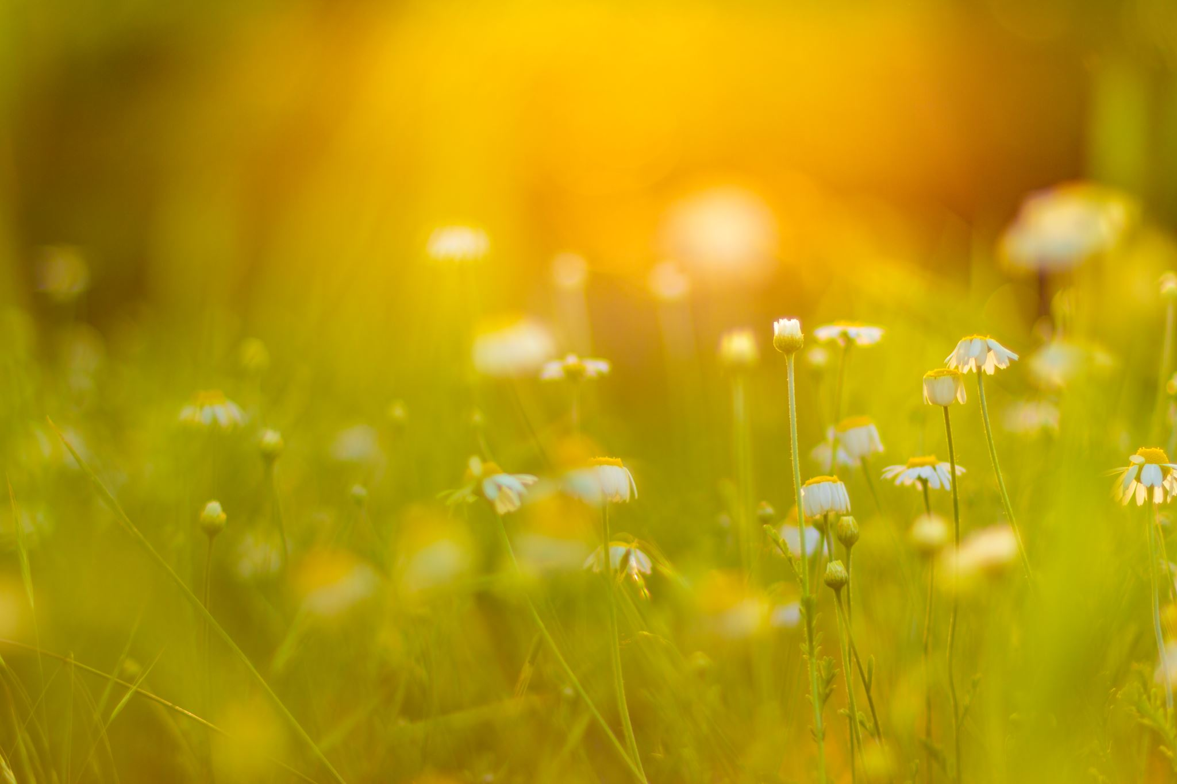

Plants
For parents
Thank you for supporting your child’s learning in science.
Before the session:
Please read slide 2 so you know what your child is learning and what you need to get ready.
As an alternative to plain paper, slide 5 may be printed for your child to record on.
During the session:
Share the learning intentions on slide 2.
Support your child with the main activities on slides 3, 4 & 5, as needed.
Slide 6 is a further, optional activity.
Slide 7 has a glossary of key terms.
Reviewing with your child:
Slide 8 gives an idea of what your child may produce.
What is pollen and pollination?
Year 3
Age 7 - 8

Slide 2
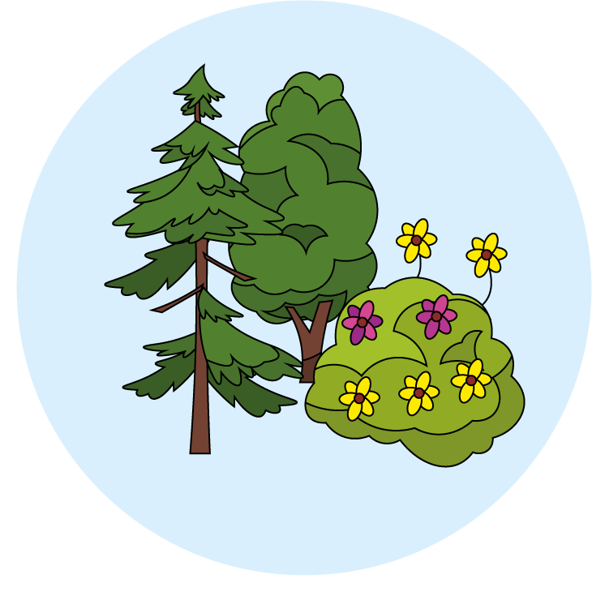

Plants
What is pollen and pollination?
Key Learning
To know that pollen is a substance that causes plants to form seeds.
Pollen, which is produced by the male part of the flower, is transferred to the female part of other flowers (pollination).
Some plants produce flowers which enable the plant to reproduce.
Activities (pages 3-5): 40 mins
Use plain paper and a pencil.
You will need:
card
colouring pens/pencils
a sugary substance (honey, sugar)
an outdoor space
Taking it further… (page 6): 20 mins
You may like to write an acrostic poem about pollination.
I can…
observe flowers carefully to identify the pollen and pollinators.

Slide 3
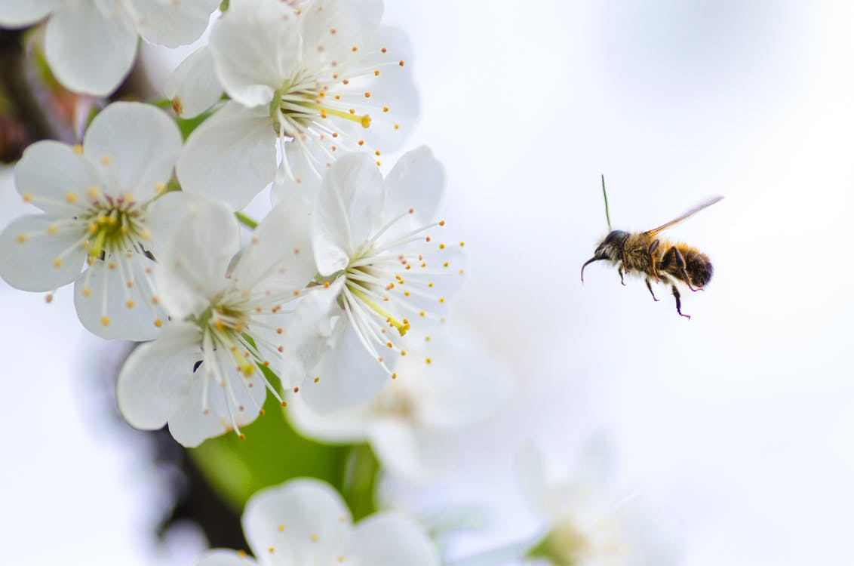
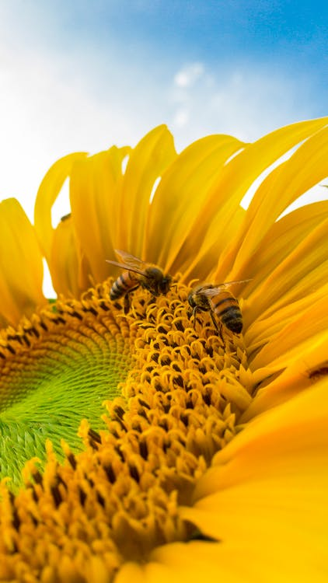
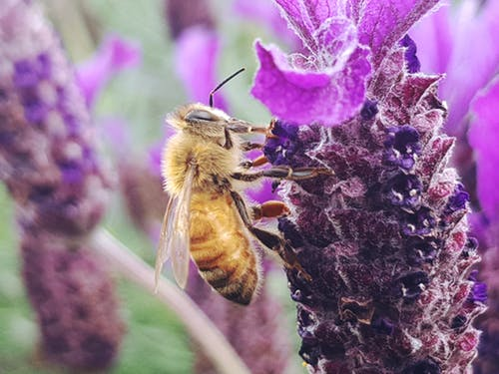
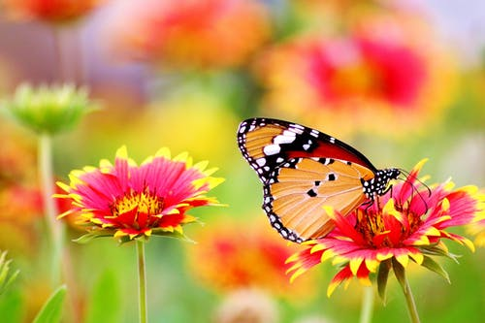
Explore, review, think, talk…
What can you observe in your outdoor space?
(10 minutes)
Watch this BBC bitesize clip:
https://www.bbc.co.uk/bitesize/topics/zy66fg8/articles/zx4ktv4
Go into your garden or outdoor space, with an adult and spend just 5 minutes observing a few of the flowers.
What will you be observing?
Look out for any insects visiting the flowers.
Which plants did they visit the most?
Can you keep a record/a tally chart of this?
Which insects did you see?
Why were they visiting some plants more than others?

Slide 4
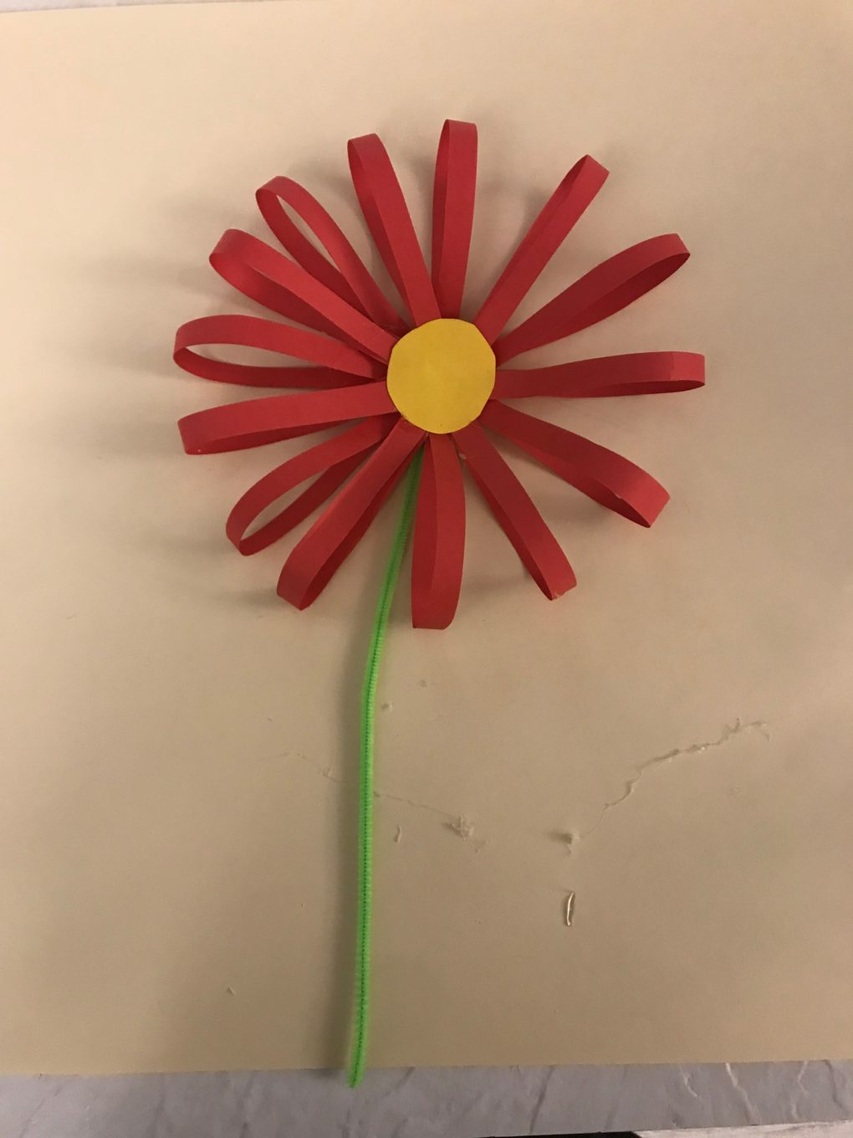
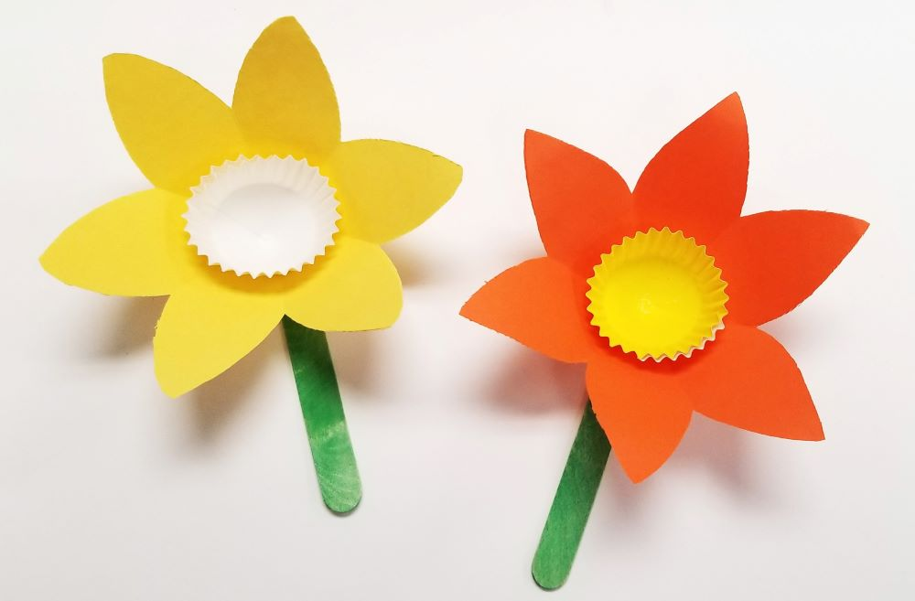
Watch, read, and then make a model
Applying your knowledge
(30 minutes)
Watch this BBC Teach clip:
https://www.bbc.co.uk/teach/class-clips-video/science-ks1-ks2-ivys-plant-workshop-what-is-pollination-and-how-does-it-work/zv4df4j
Can you make a flower that will attract insects?
What to consider:
To encourage insects to visit them, flowers have colourful petals and an attractive scent. What can you use to create an attractive scent?
Some flowers give the insects a sugary reward called nectar too. What could you use that is sugary?
Test it
Take your flower outside and leave it somewhere visible.
Watch to see if insects are drawn to it?
Did they remove some of the sugary reward?
Which insects visited it the most?

Slide 5
Today, I found out that plants are pollinated by:
I can design a garden which would encourage pollinators.

Slide 6
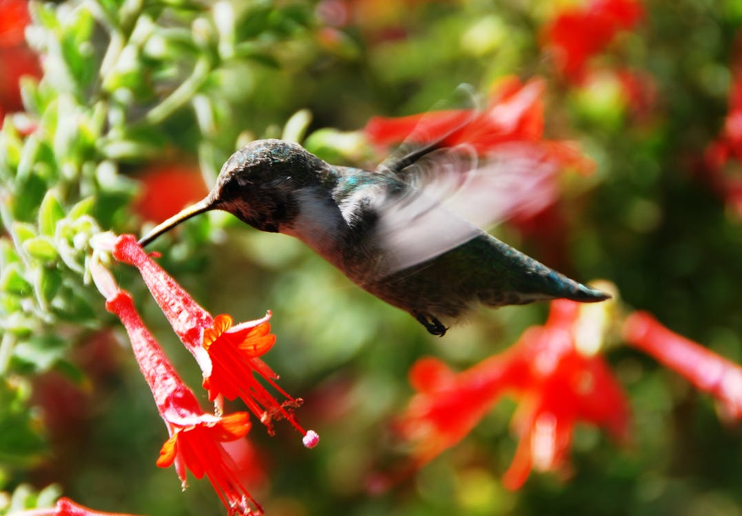
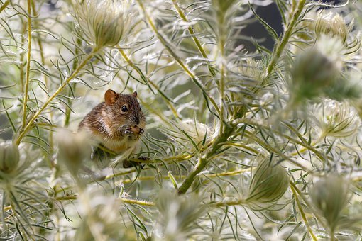
Taking it further…
Writing an acrostic poem about pollination
(20 minutes)
Many animals can act as pollinators, including bees, butterflies, bats, ants, hummingbirds and mice.
Try writing an acrostic pollination poem. Here is an example:
Pretty flowers invite me,
Oh they smell divine.
Lovely strong sugary scents,
Luscious lovely taste.
Even the butterflies are attracted to them
Now I can fly away and play my part.

Slide 7
Glossary of terms
Pollen: Pollen is a tiny substance that causes plants to form seeds. New plants then can grow from the seeds.
Pollination: Pollination is when pollen is carried from the male part of a flower to the female part of another flower, usually by insects or the wind.
Pollinator: A pollinator is an animal that moves pollen from the male part of a flower to the female part of another flower.
7

Slide 8
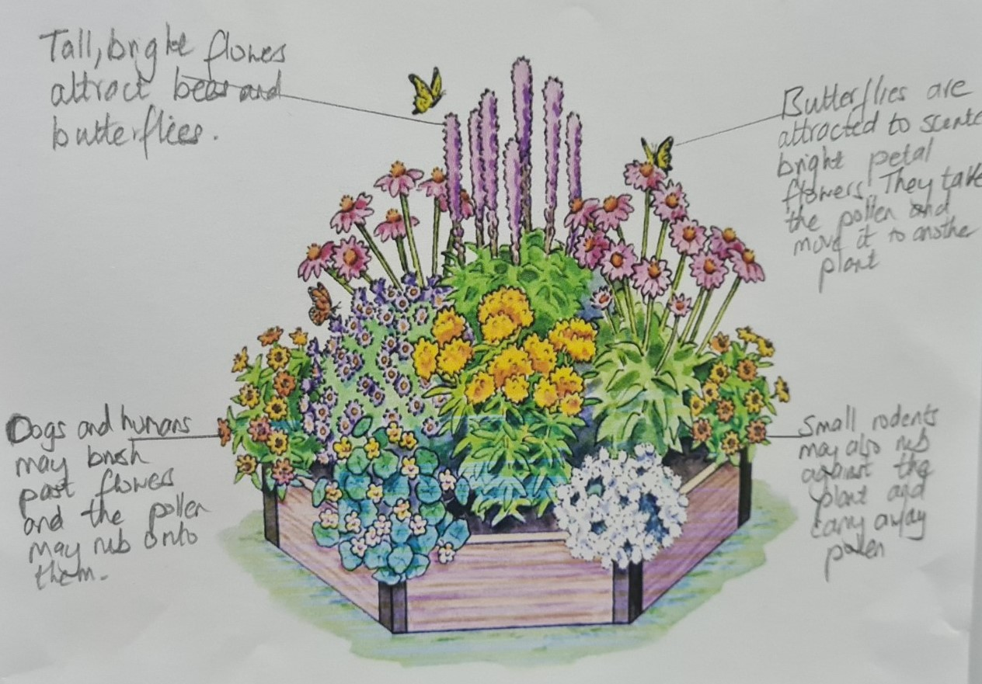
Possible learning outcome for reviewing your work: I can design a garden which would encourage pollinators.
Can you annotate your diagram to show the areas that attract the pollinators and why?
Can you add in any other pollinators?

