Slide 1

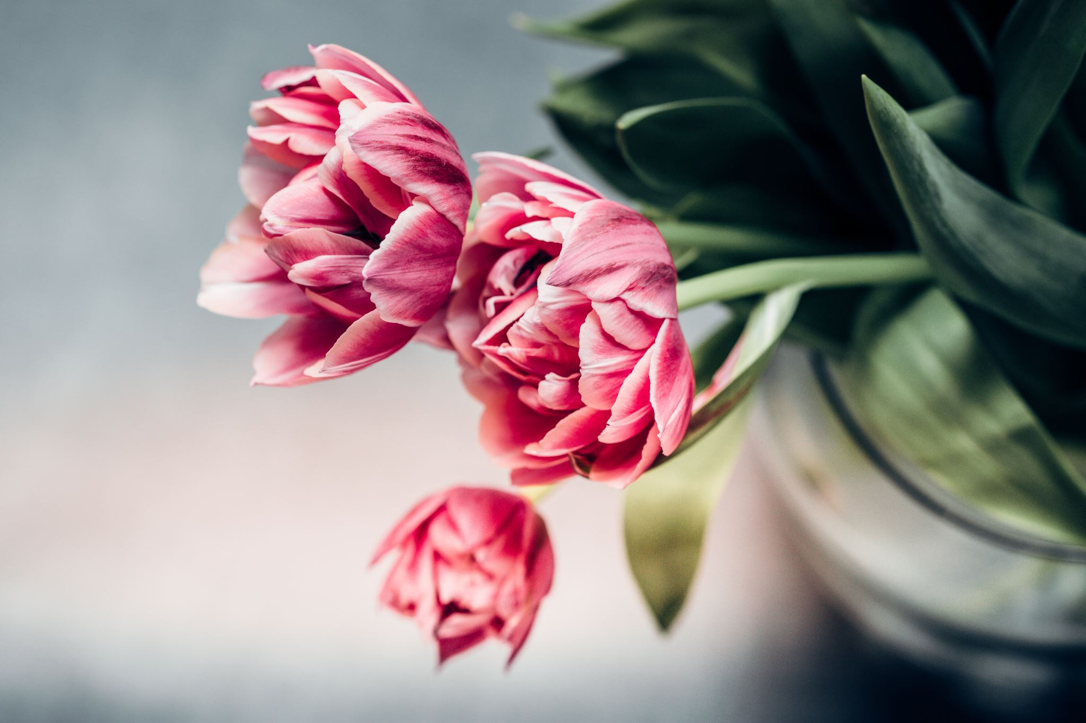

Year 3: Plants
This topic overview is based on the PLAN knowledge matrix (for England). Please use link:
https://www.planassessment.com/plants-y3
The matrix includes:
National Curriculum learning objectives
Key learning
Key vocabulary
Common misconceptions
Possible activities & evidence
Topic overview for teachers
Age 8-9

Slide 2
Year 3 – Plants
Topic | Key Learning | page
What are the main parts and functions of plants? | Many plants, but not all, have roots, stems/trunks, leaves and flowers/blossom. The leaves use sunlight and water to produce the plant’s food. Some plants produce flowers which enable the plant to reproduce. | 4
How does water travel to different parts of a plant? | Many plants, but not all, have roots, stems/trunks, leaves and flowers/blossom. The roots absorb water and nutrients from the soil and anchor the plant in place. The stem transports water and nutrients/minerals around the plant and holds the leaves and flowers up in the air to help with photosynthesis, pollination and seed dispersal. | 5
What happens to plants when they are put in different conditions? | Plants need certain conditions to grow well, including air, light, water, nutrients from soil, and room to grow. Different plants require different conditions for germination and growth. | 6
2

Slide 3
Year 3 – Plants
Topic | Key Learning | page
What is pollen and pollination? | To know that pollen is a substance that causes plants to form seeds. Pollen, which is produced by the male part of the flower, is transferred to the female part of other flowers (pollination). Some plants produce flowers which enable the plant to reproduce. | 7
Exploring seed dispersal in plants | The life cycle of flowering plants includes germination, pollination, seed formation and seed dispersal. Seeds need to be scattered or dispersed so they can germinate away from the parent plant. This seed dispersal can be done by animals, water or the wind. | 8
3

Slide 4
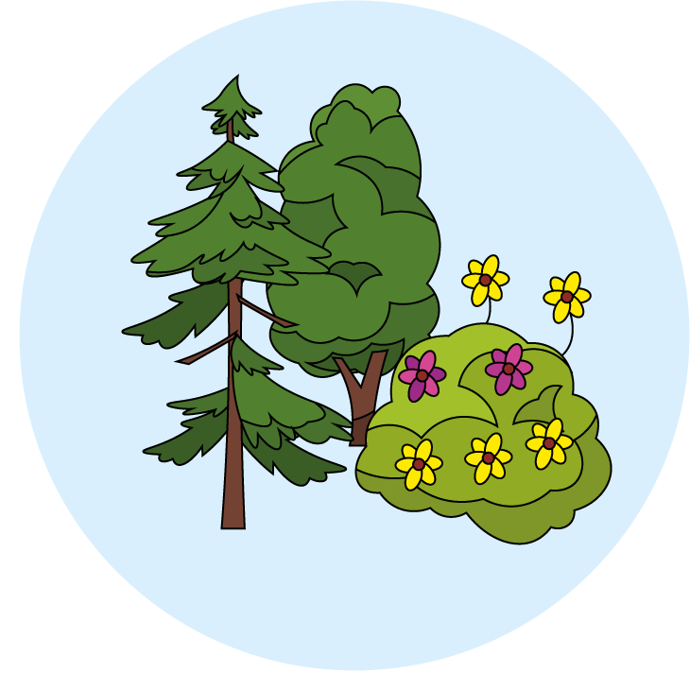
Plants
What are the main parts and functions of plants?
Key Learning
Many plants, but not all, have roots, stems/trunks, leaves and flowers/blossom.
The leaves use sunlight and water to produce the plant’s food.
Some plants produce flowers which enable the plant to reproduce.
Activities and websites
Exploring prior knowledge about plants.
https://www.bbc.co.uk/bitesize/topics/zy66fg8/articles/zcmtk2p
https://www.bbc.co.uk/bitesize/topics/zpxnyrd/articles/zxxsyrd
Dissecting a plant. Identifying the main parts of a plant and describing their purpose.
https://www.bbc.co.uk/bitesize/topics/zy66fg8/articles/zcjnp39
https://www.science-sparks.com/dissecting-flowers-and-more-plant-experiments/
Optional activity: Finding out more about non-flowering plants.
https://www.dkfindout.com/uk/animals-and-nature/plants/non-flowering-plants/
http://studyjams.scholastic.com/studyjams/jams/science/plants/mosses-and-ferns.htm
I can…
identify the main parts of a plant and describe their purpose.

Slide 5
Plants
How does water travel to different parts of a plant?
Key Learning
Many plants, but not all, have roots, stems/trunks, leaves and flowers/blossom.
The roots absorb water and nutrients from the soil and anchor the plant in place.
The stem transports water and nutrients/minerals around the plant and holds the leaves and flowers up in the air to help with photosynthesis, pollination and seed dispersal.
Activities and websites
Exploring prior knowledge about how plants transport water.
Investigating the way water travels through a plant using food colouring/dye.
https://www.bbc.co.uk/teach/class-clips-video/science-ks1-ks2-ivys-plant-workshop-how-does-water-get-from-the-roots-to-the-leaves/zdtfjhv
https://www.dkfindout.com/uk/animals-and-nature/plants/how-plants-make-food/
https://www.youtube.com/watch?v=KIug9Foou3s
Optional activity to explore with more than one colour of dye.
https://www.youtube.com/watch?v=RVBueIzlR6Y
I can…
observe the effect of putting cut white carnations or celery in coloured water.

Slide 6
Plants
What happens to plants when they are put in different conditions?
Key Learning
Plants need certain conditions to grow well, including air, light, water, nutrients from soil, and room to grow.
Different plants require different conditions for germination and growth.
Activities and websites
Considering the conditions needed for healthy plant growth.
https://www.bbc.co.uk/bitesize/topics/zy66fg8/articles/zcmtk2p
https://www.bbc.co.uk/bitesize/clips/z69rkqt
Exploring plants in different conditions.
https://www.bbc.co.uk/bitesize/clips/z9f87hv
https://www.bbc.co.uk/teach/class-clips-video/science-ks1-ks2-ivys-plant-workshop-what-do-plants-need-to-survive/zkw2gwx
https://wowscience.co.uk/resource/grow-your-own-plants/
Optional activities: Finding out about plants in deserts and water-filled paddy fields; Finding out about carnivorous plants.
(See website links on page 6 of the lesson)
I can…
investigate what happens to plants when they are put in different conditions.

Slide 7
Plants
What is pollen and pollination?
Key Learning
To know that pollen is a substance that causes plants to form seeds.
Pollen, which is produced by the male part of the flower, is transferred to the female part of other flowers (pollination).
Some plants produce flowers which enable the plant to reproduce.
Activities and websites
Observing flowers in an outdoor space to look for pollinators.
https://www.bbc.co.uk/bitesize/topics/zy66fg8/articles/zx4ktv4
Applying knowledge about pollinators to make a flower model that will attract insects.
https://www.bbc.co.uk/teach/class-clips-video/science-ks1-ks2-ivys-plant-workshop-what-is-pollination-and-how-does-it-work/zv4df4j
Designing a garden which would encourage pollinators.
Additional, optional activity to write an acrostic poem about pollination.
I can…
observe flowers carefully to identify the pollen and pollinators.

Slide 8
Plants
Logo for section to sit inside roundel
Exploring seed dispersal in plants
Key Learning
The life cycle of flowering plants includes germination, pollination, seed formation and seed dispersal.
Seeds need to be scattered or dispersed so they can germinate away from the parent plant. This seed dispersal can be done by animals, water or the wind.
Activities and websites
Exploring prior knowledge about the life cycle of a plant.
https://explorify.wellcome.ac.uk/en/activities/whats-going-on/shooting-sprouts/classroom?view-type=public
Comparing different ways plants disperse their seeds.
https://www.bbc.co.uk/programmes/p00lxv9z
https://www.bbc.co.uk/programmes/p00lxw4t
https://www.bbc.co.uk/bitesize/clips/zs9c87h
Optional activity to find out more about some unusual ways seeds are dispersed by animals.
(BBC clips from ‘Private Life of Plants’ on p.7 of the lesson plan.)
I can…
explain why and how the seeds of plants are dispersed.
8

