Slide 1
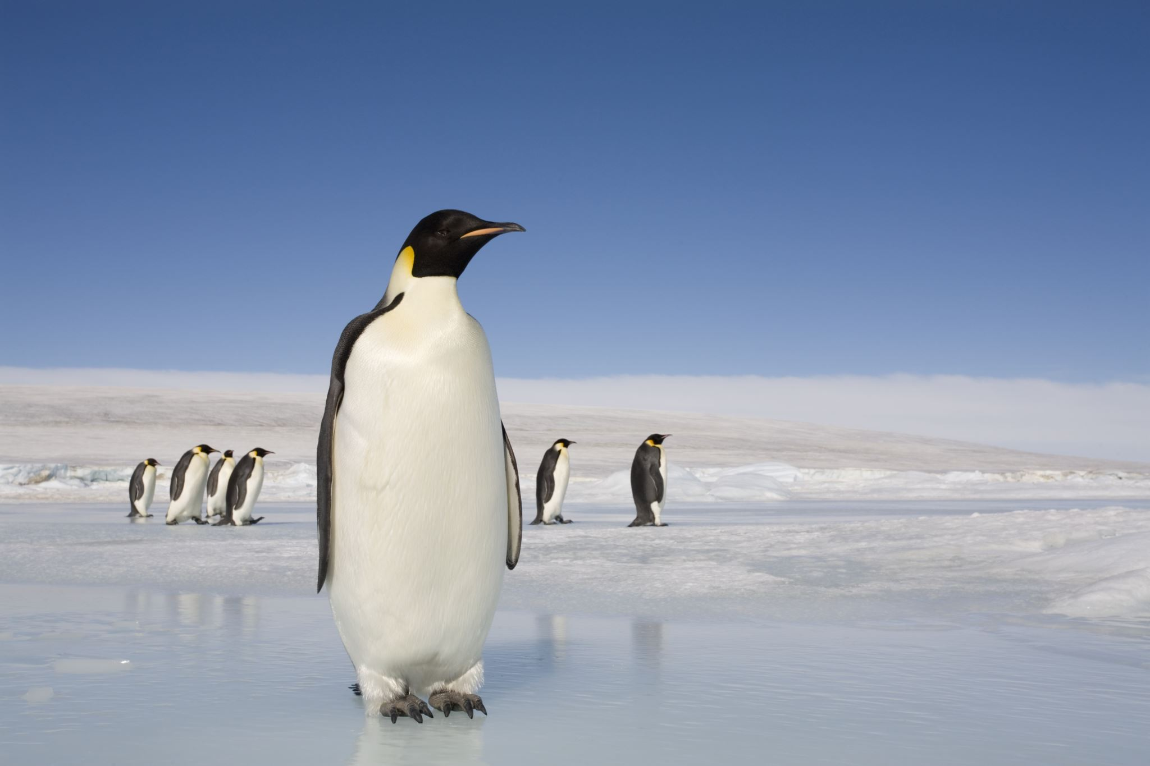



Living things and their habitats
For parents
Thank you for supporting your child’s learning in science.
Before the session:
Please read slide 2 so you know what your child is learning and what you need to get ready.
As an alternative to lined paper, slide 5 may be printed for your child to record on.
During the session:
Share the learning intentions on slide 2.
Support your child with the main activities on slides 3 to 6, as needed.
Slide 7 is a further, optional activity.
Slide 8 has a glossary of key terms.
Reviewing with your child:
Slide 9 gives an idea of what your child may produce.
Introduction to animal habitats
Year 4
Age 8-9

Slide 2
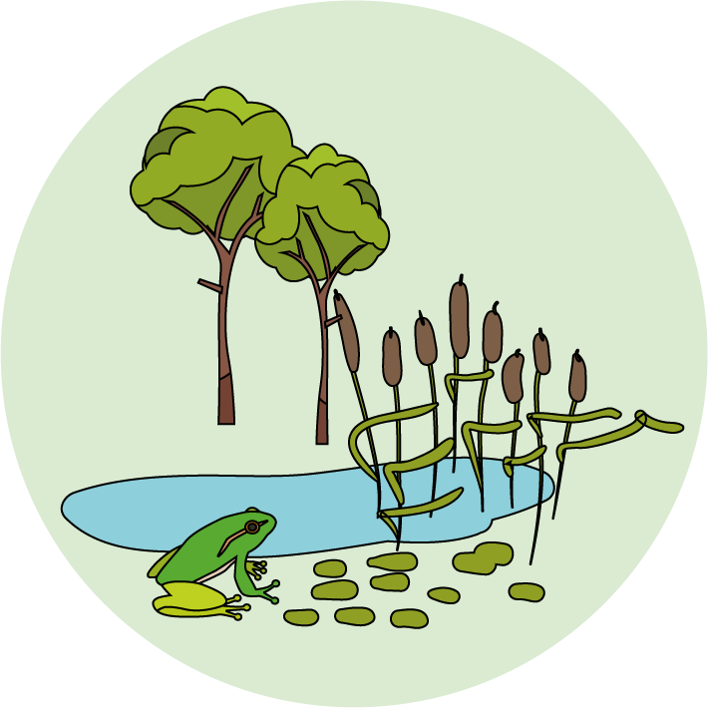

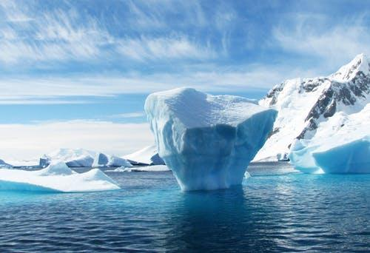
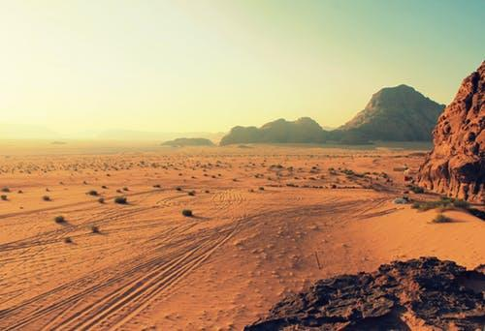
Living things and their habitats
Logo for section to sit inside roundel
An introduction to animal habitats
Key Learning
Animals live in a habitat which provides an environment to which they are suited.
A habitat provides animals with water, food and shelter.
Each habitat has different conditions such as the amount of light, the temperature and the amount of moisture.
Animals are adapted to live in their habitats.
Activities (pages 3-6): 30 - 40 mins
Use lined paper, a ruler and a pencil.
Alternatively, print page 6 as a worksheet.
Find out more… (page 7): 30 - 60 mins
You may like to explore more about animals in an Arctic habitat or a hot desert habitat.
I can…
Describe how some animals are adapted to live in an Arctic habitat or a hot desert habitat.
2

Slide 3
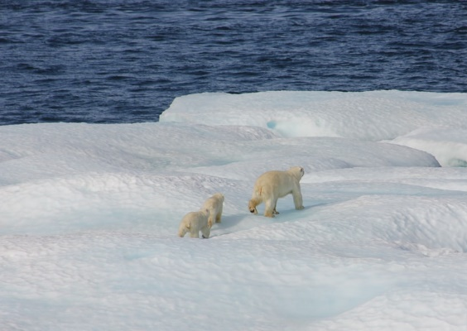
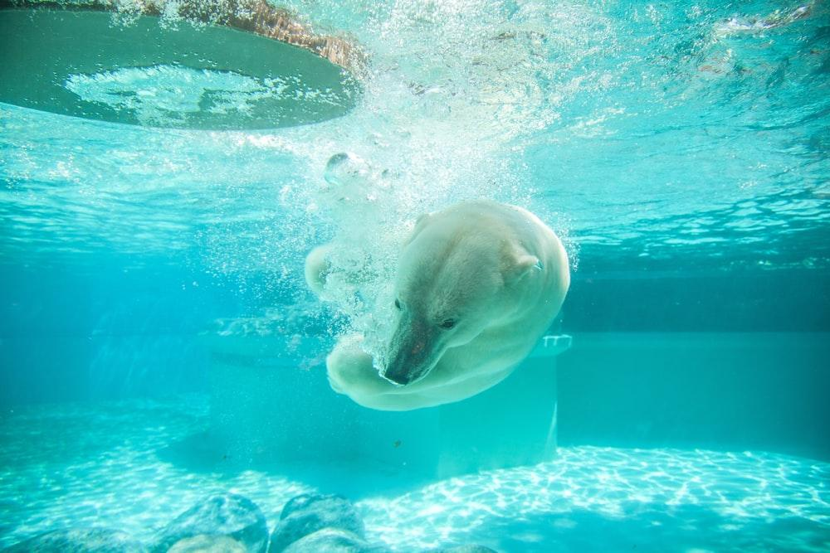
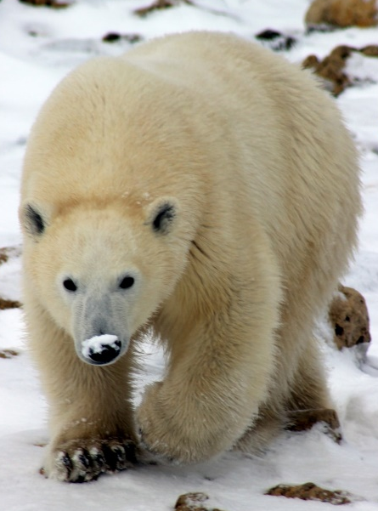
Explore, review, think, talk….
Logo for section to sit inside roundel
What do you already know about animals and their habitats?
(5 minutes)
A habitat is a place where an animal lives, providing it with water, food and shelter.
Many animals have special features or skills to help them survive in their habitat. They are adapted to live there.
Watch this BBC clip: https://www.bbc.co.uk/teach/class-clips-video/science-ks1-ks2-wonders-of-nature-polar-bears-in-their-habitat/z73ygwx
Polar bears live in an Arctic habitat.
Female polar bears dig out a den beneath the snow, where they give birth to cubs.
They have thick white fur to keep warm.
They have webbed front paws and are strong swimmers.
Where is a polar bear’s den?
In which habitat do polar bears live?
How are they adapted to live in their habitat?
3

Slide 4
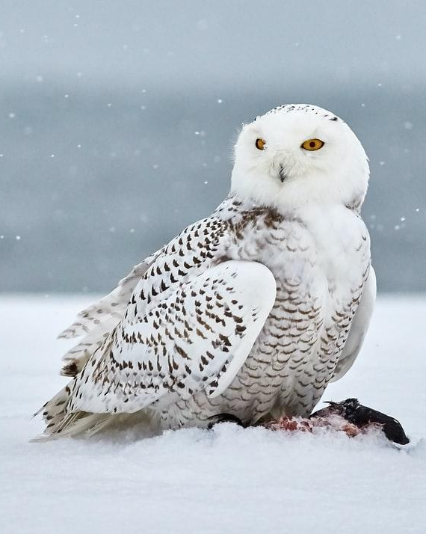
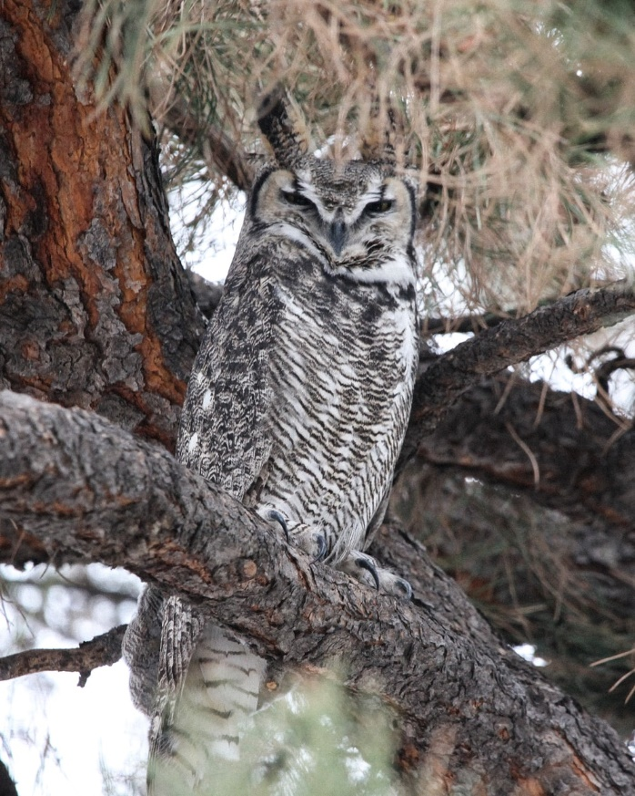
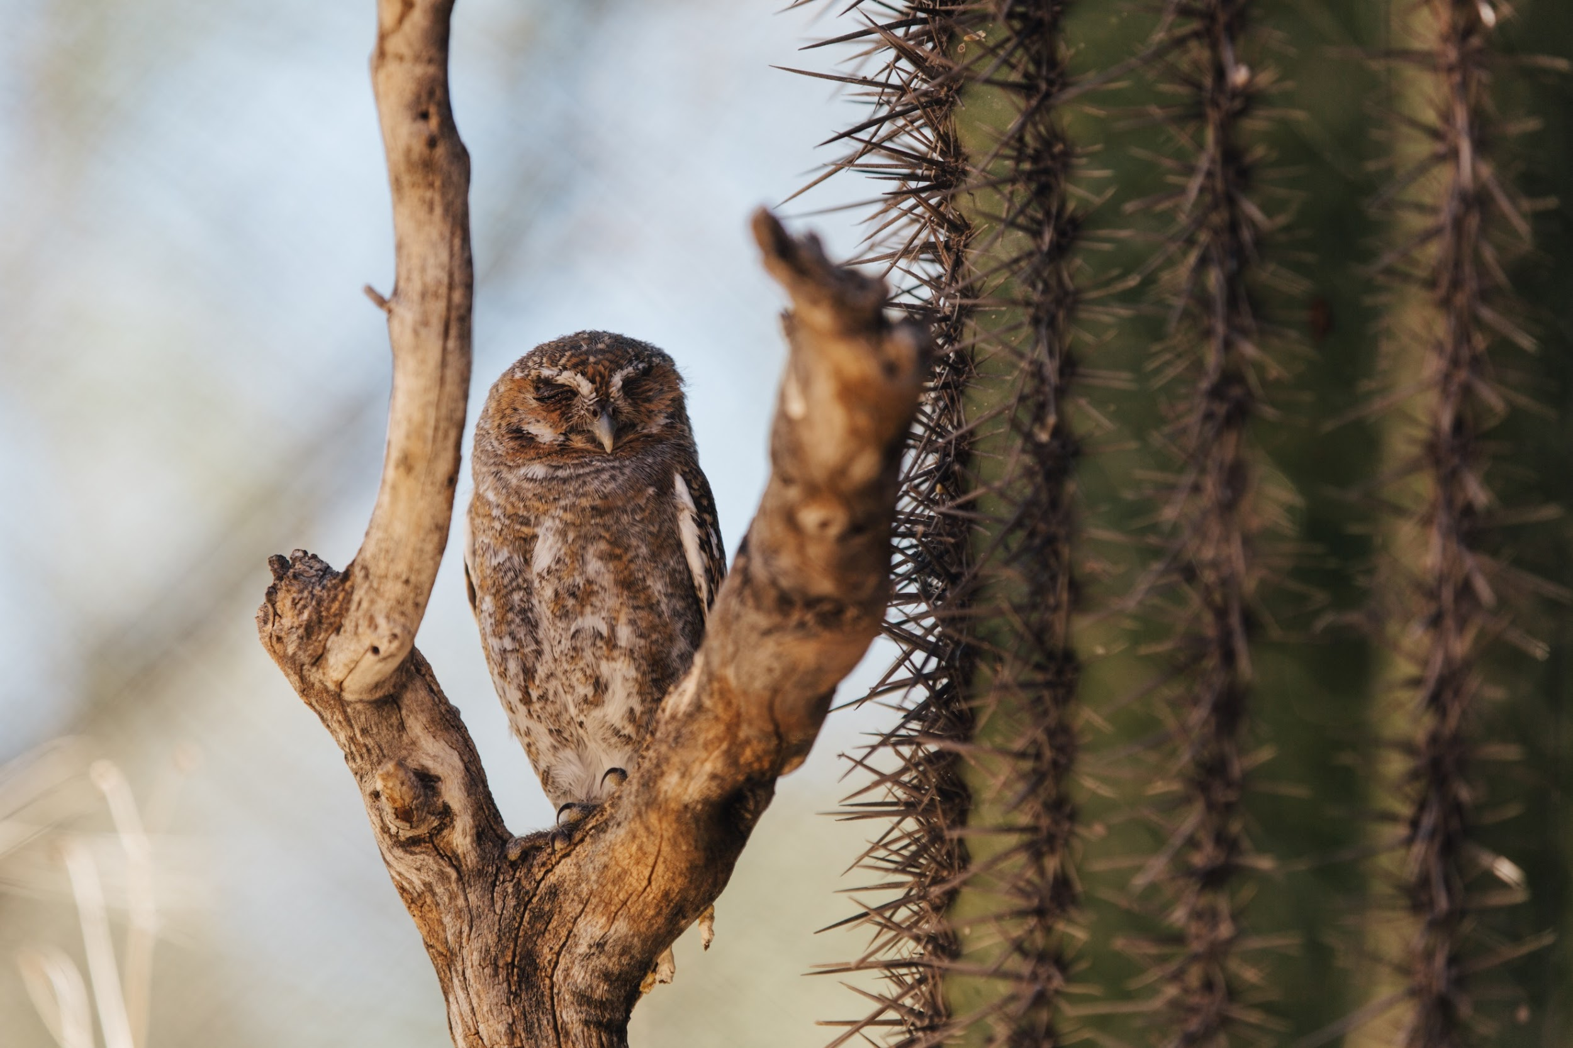
Watch, read, listen…
Logo for section to sit inside roundel
Animals are adapted to their different habitats
(10 minutes)
Watch this clip about different types of owls.
Try to jot down the habitats they live in and think about how each owl is adapted to their habitats.
https://www.bbc.co.uk/bitesize/clips/zv7w2hv
You may have noticed:
Snowy owls live in the Arctic and have mostly white feathers as camouflage, so their colour blends in with the snow.
Great grey owls live in pine forests and have very thick feathers to keep warm.
Elf owls live in the hot desert and find holes in cactus plants. They hunt insects at night when it is cooler.
Flammulated owls live in mountain forests and have feathers which match the pattern of bark on trees for camouflage.
4

Slide 5
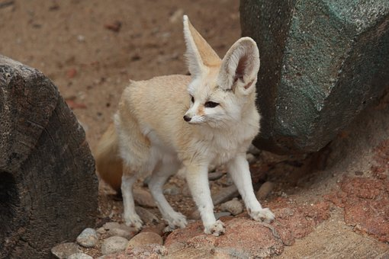
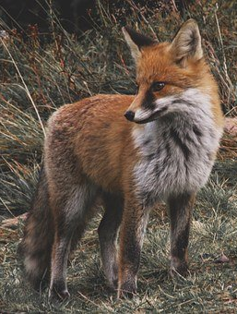
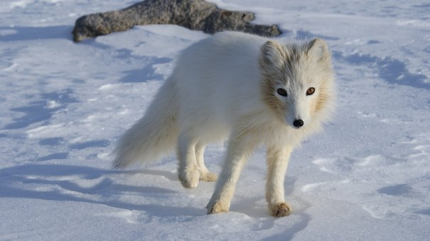
Animals are adapted to their habitats
Logo for section to sit inside roundel
Describe the adaptations of animals in an Arctic and a hot desert habitat
(page 5-6: 30 minutes)
Many animals have special features or skills so that they are suited to their habitat. These are called adaptations.
For example, the Arctic fox and the desert fox are different from the foxes we see in the UK.
Watch the first 2 ½ minutes of this BBC clip: https://www.bbc.co.uk/teach/class-clips-video/science-ks2--ks3-how-animals-have-adapted/z4y76v4
What special features, or adaptations, does the Arctic fox have?
What adaptations does the desert fox have?
5

Slide 6
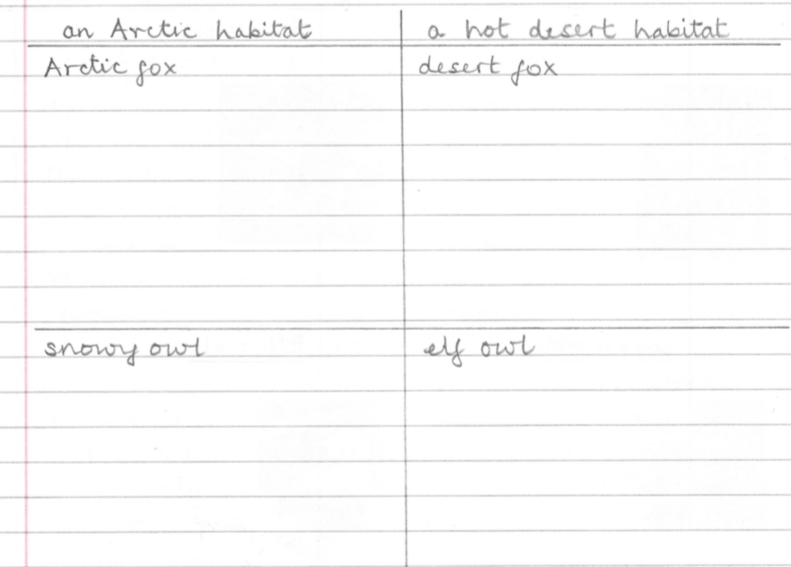
Create a fact file about the Arctic fox, the snowy owl, the desert fox and the elf owl. Use what you have learnt, the word bank and the pictures to help you.
large round body and long thick feathers
small body with grey-brown feathers
thick warm fur
white fur in winter
sandy coloured fur
mostly white feathers
small ears
large ears
nests on the ground
nests in holes in cactus plants
hunts at night
I can describe how some animals are adapted to live in an Arctic habitat or a hot desert habitat.
6

Slide 7
Find out more about Arctic or hot desert habitats
Logo for section to sit inside roundel
Extend your fact file with more animals who live in an Arctic or a hot desert habitat
(30 – 60 minutes)
Choose either an Arctic or a hot desert habitat. Find out more about the adaptations of other animals living there.
Suggested websites:
Arctic habitat
https://www.dkfindout.com/uk/animals-and-nature/habitats-and-ecosystems/arctic/
https://www.wwf.org.uk/learn/fascinating-facts/polar-bears
https://www.wwf.org.uk/learn/fascinating-facts/walrus
hot desert habitat
https://www.dkfindout.com/uk/animals-and-nature/habitats-and-ecosystems/american-desert/
https://www.bbc.co.uk/programmes/p006b3m3
7

Slide 8
Glossary of terms
Environment: The environment includes all living and non-living things. Animals and plants rely on the living and non-living parts of the environment to survive.
Habitat: Animals live in a habitat which provides an environment to which they are suited. A habitat provides animals with water, food and shelter.
Condition: Each habitat has different conditions such as the amount of light, the temperature and the amount of moisture.
Adaptation: Many animals have special features or skills so that they are suited to their habitat. These are called adaptations.
Adapted: Animals are adapted to live in their habitats. For example, an Arctic fox has thick white fur in winter for warmth and camouflage.
Camouflage: Some animals have camouflage feathers, fur or skin so they are hard to see in their environment.
8

Slide 9
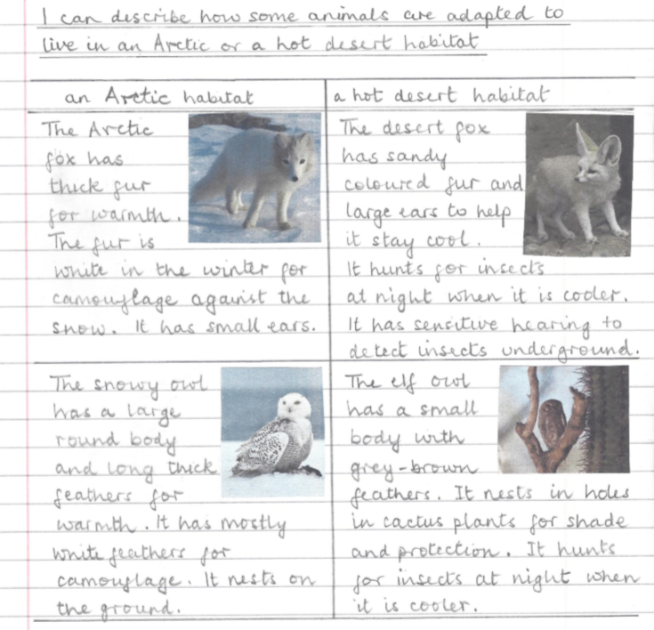
The Arctic fox has thick fur. Its coat changes from white in winter to brown-grey in summer so it is camouflaged in both seasons. It has small ears so it does not lose warmth.
Possible learning outcome for reviewing your work.
The sandy coloured fur of the desert fox reflects heat during the day and its large ears help it to keep cool. It hunts at night when it is cooler, listening for underground insects with its sensitive hearing.
Amphibians include frogs, toads and newts. They have a smooth moist skin and are cold blooded. They lay soft jelly-like eggs and can live on land and in the water.
The round body shape and thick long feathers help the snowy owl to stay warm. The feathers also extend over its feet and beak. It nests on the ground and the chicks huddle together for warmth.
The elf owl has a small body and grey-brown feathers. It can fit into holes in cactus plants to find shade and a safe nesting place. It hunts at night when it is cool and usually eats insects.
9

