Slide 1
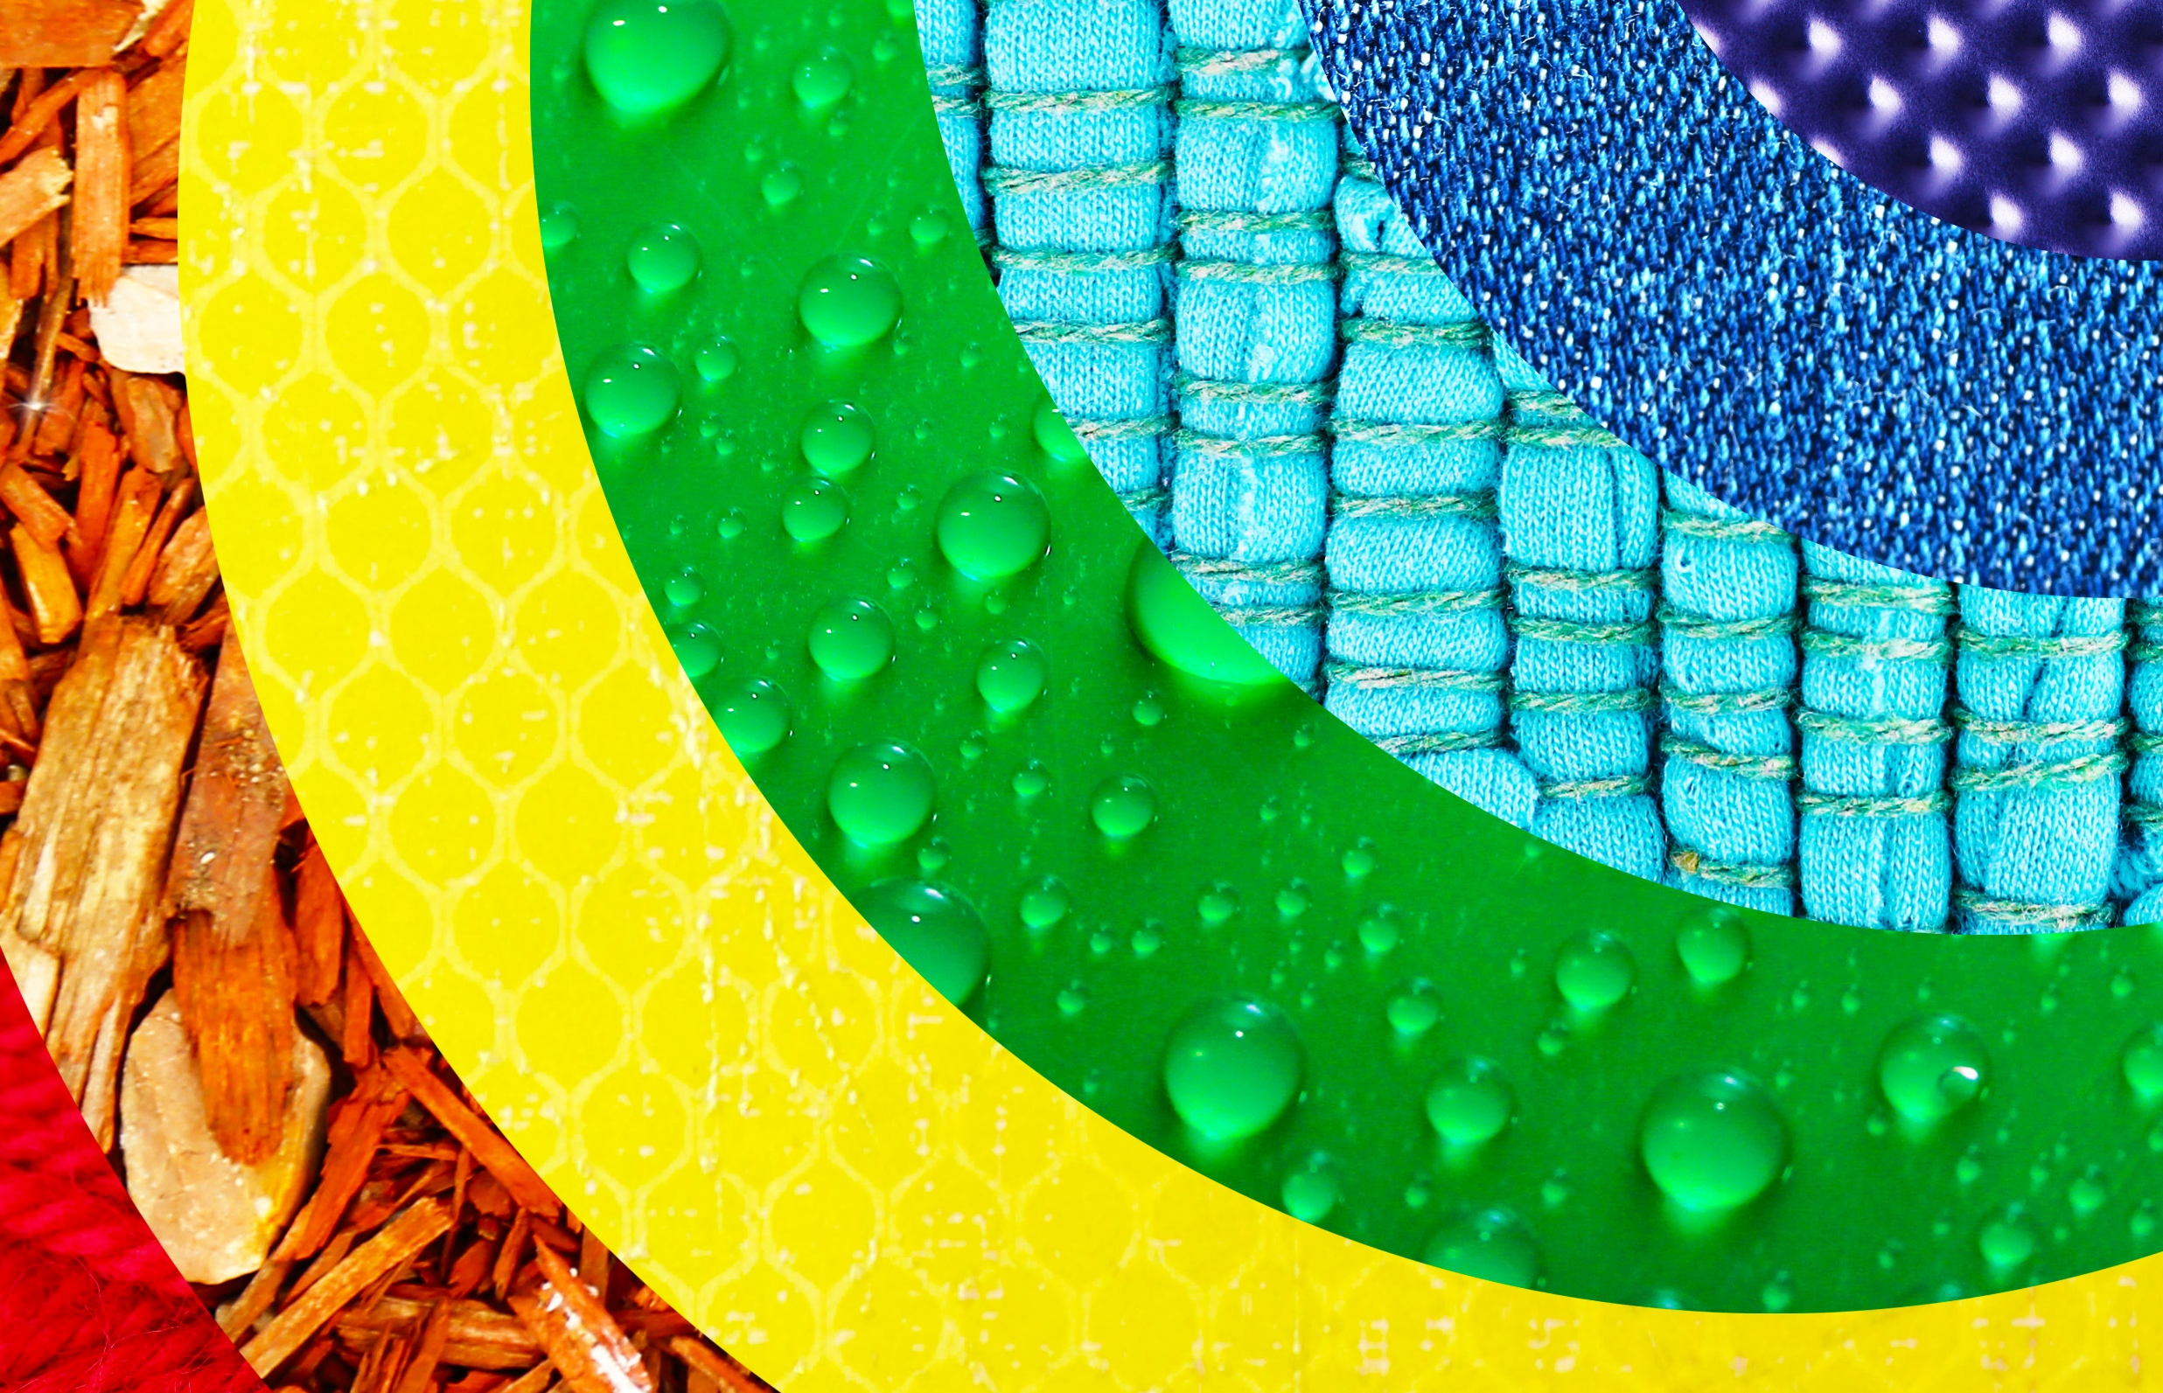


Living things and their habitats
For parents
Thank you for supporting your child’s learning in science.
Before the session:
Please read slide 2 so you know what your child is learning and what you need to get ready.
You may wish to print pages 7, 8 & 9.
During the session:
Share the learning intentions on slide 2.
Support your child with the activities on slides 3 to 7 as needed.
Slide 10 has a glossary of key terms.
Reviewing with your child:
Slides 11 – 13 gives an idea of what your child may produce.
Making branching keys and
classifying woodland invertebrates (minibeasts)
Year 4
Age 8-9

Slide 2
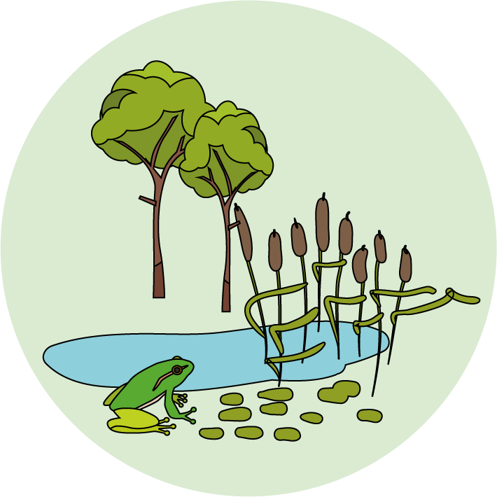
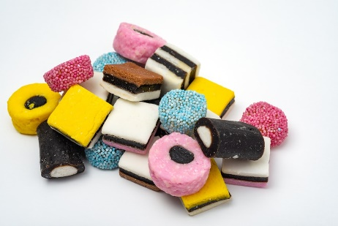

Living things and their habitats
Logo for section to sit inside roundel
Making branching keys and classifying woodland invertebrates (minibeasts)
Key Learning
Living things can be grouped or classified in different ways according to their features.
Branching keys are useful for classifying things, using descriptions of features.
Investigation (pages 2-4): 10-15 minutes.
You will need:
paper and a pencil.
one packet of liquorice allsorts.
(alternatively, use photos on page 9 or a biscuit variety pack)
Thank you to SAPS for this activity – more details on p.19 of their guide: www.saps.org.uk/attachments/article/1377/SAPS%20book%205%20-%20Grouping%20and%20Classification%20-%202016.pdf
Activity (pages 5-7): 20-30 minutes.
Use lined paper, a ruler and a pencil.
Alternatively, print page 7.
I can…
Make a branching key to classify a group of objects.
Identify woodland invertebrates (minibeasts) using a branching key.
2

Slide 3
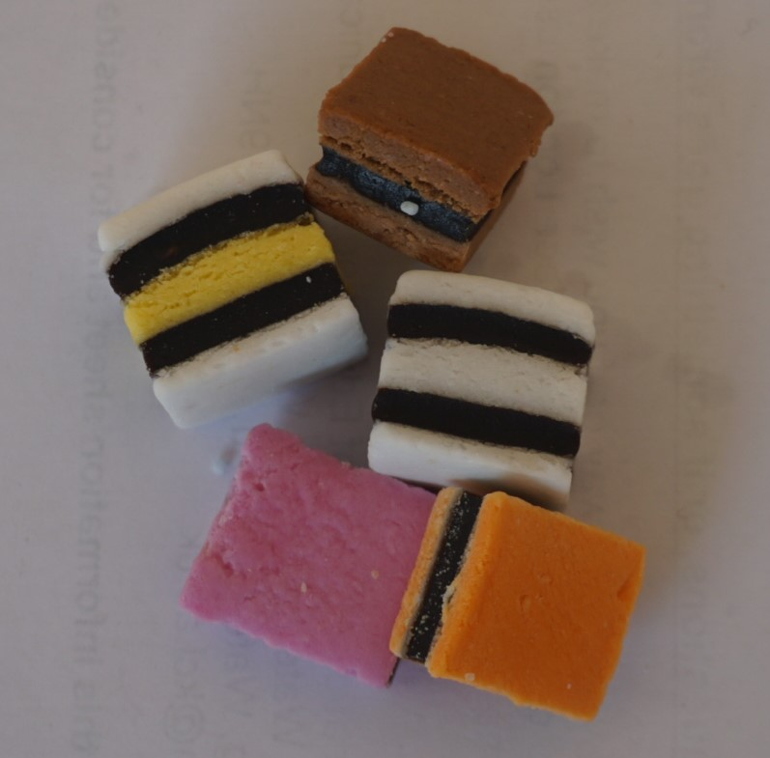
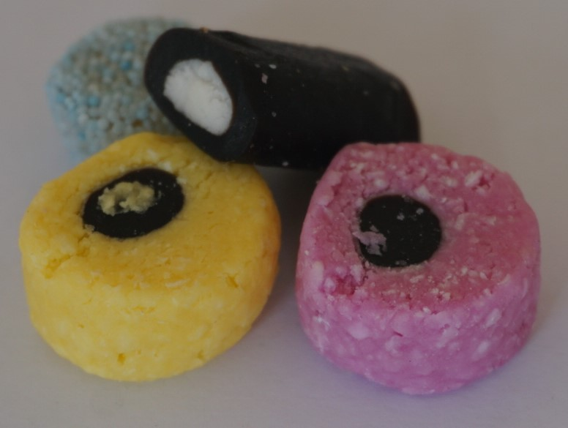

Asking questions…
Logo for section to sit inside roundel
Creating questions about liquorice allsorts with yes/no answers
(page 3-4: 10 to 15 minutes)
Investigate…
Spread out about 10 different liquorice allsorts (or cut out / draw images from page 9).
Talk or think about their features:
Round or square?
Number of different colours?
Smooth or rough surface?
Select 8-10 different sweets and try writing down some questions which will give the answer ‘yes’ for some sweets and the answer ‘no’ for the rest:
For example: Is it round? Is it pink? Is it smooth?
Test each question by sorting the sweets into two piles:
For example:
Is it a square shape?
Yes
No
3

Slide 4
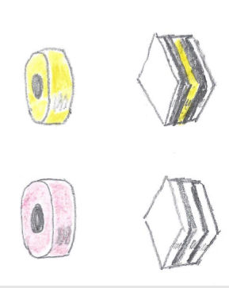
Making a branching key
Logo for section to sit inside roundel
Making a branching key with four liquorice allsorts
A branching key can be used to classify a group of items. It uses questions. The answer is ‘yes’ for some items and ‘no’ for the others.
Making a branching key for 4 items
Select two different square shaped sweets and two round shaped sweets.
Make your first question ‘Is it a square shape?’
Think of different questions to sort
(a) the square shapes.
(b) the round shapes.
Now write down the questions like this on a sheet of paper (your questions and sweets may be different):
Is it a square shape?
Put your sweets on the paper to complete the key!
yes
no
Is it only black and white?
Is it pink?
yes
no
yes
no
4

Slide 5
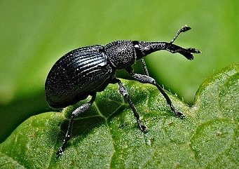
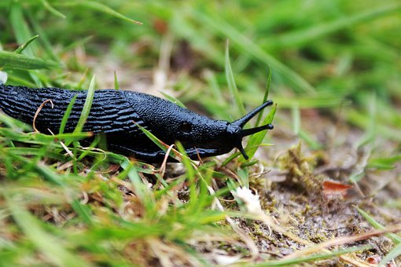
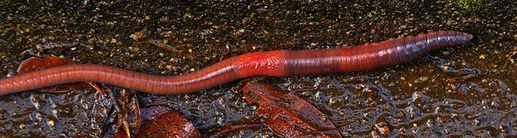
Exploring animal features
Logo for section to sit inside roundel
Which is the odd one out?
(5 minutes)
Look at these pictures.
Which one do you think is the odd one out?
Think about the animal features to help you.
You may have chosen body colour, body shape, number of legs or another feature to describe the odd one out.
The features of animals can be used to create branching key questions with yes/no answers, such as:
Is it a brown colour?
Does it have a long thin body?
Does it have any legs?
5

Slide 6
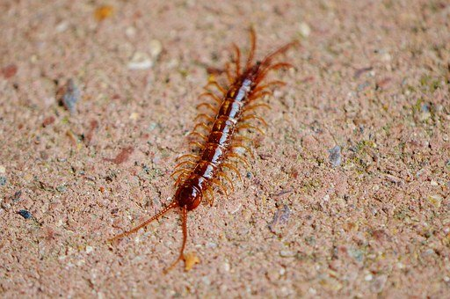
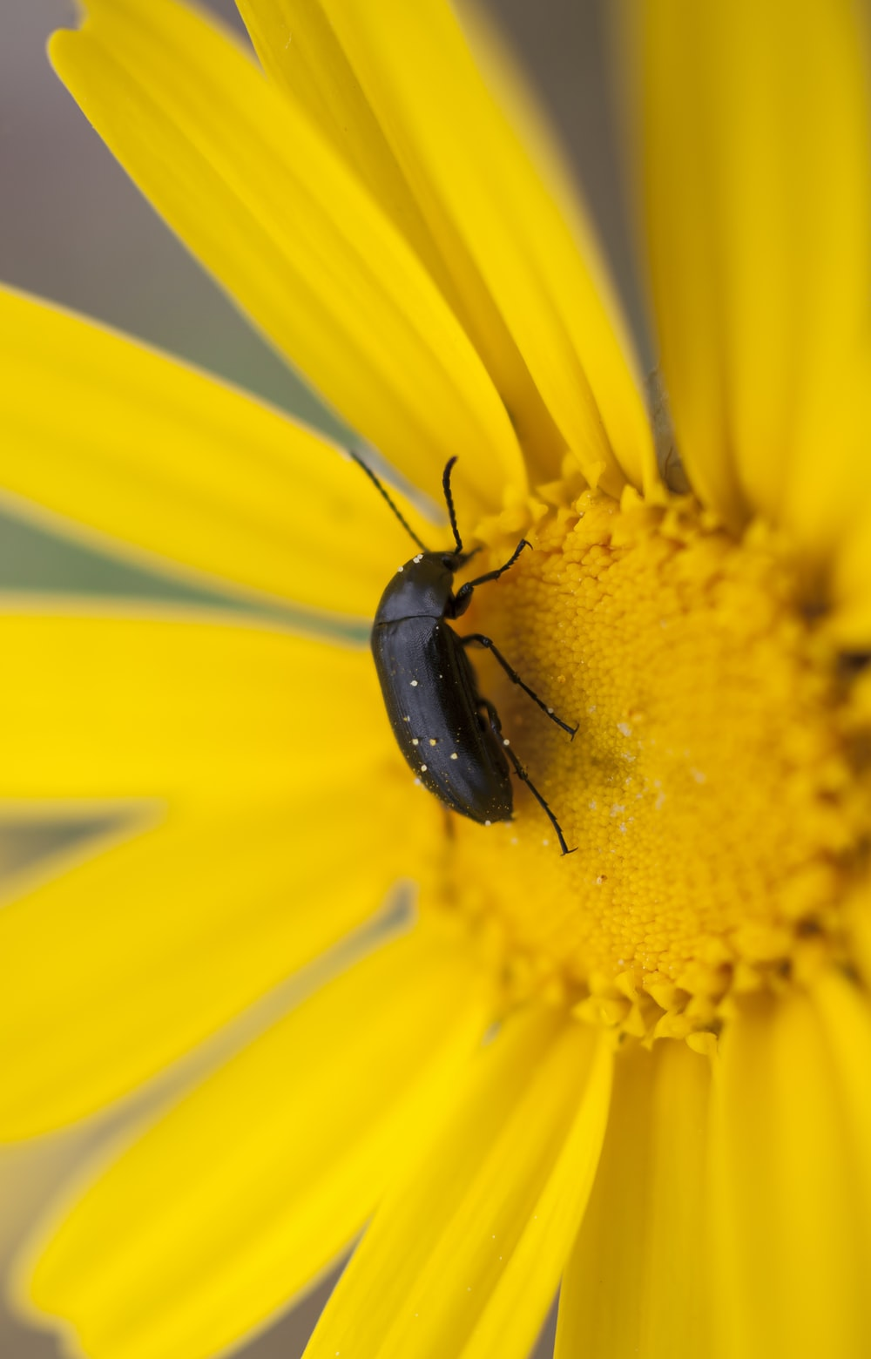
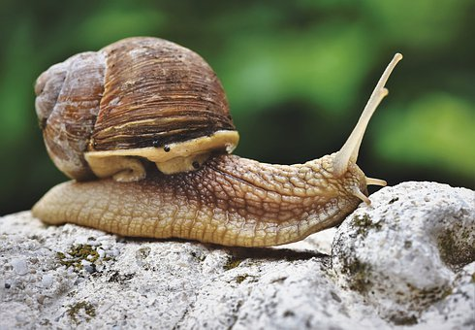
Making a branching key
Logo for section to sit inside roundel
Make a branching key for woodland invertebrates using questions about their features
(page 5-7: 20 to 30 minutes)
Think about and jot down some questions you could ask when making a key for these four animals.
Here is one example of a key for a slug, a snail, a centipede and a beetle.
Does it have any legs?
yes
no
Does it have more than six legs?
Does it have a shell?
yes
no
yes
no
6

Slide 7
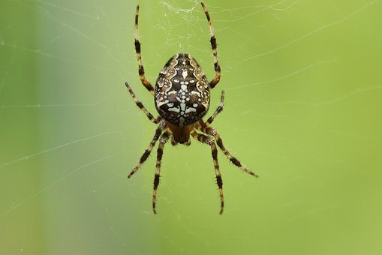
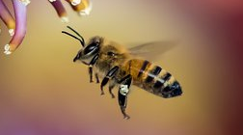
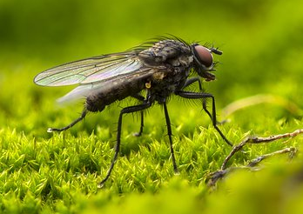
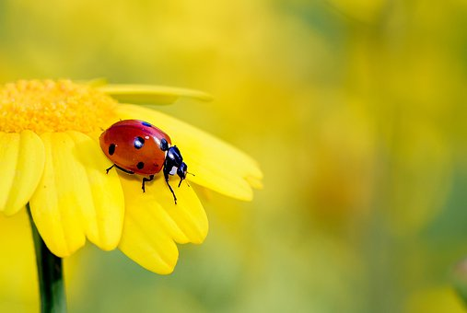
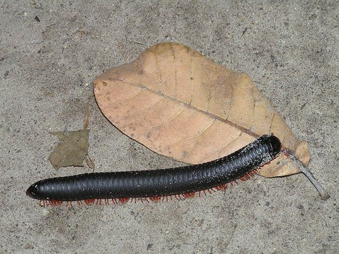
I can identify animals using a branching key.
Copy and solve the branching keys opposite for these animals:
KEY 1
Does it have wings?
yes
no
KEY 1
centipede
Does it have a striped body?
Does it have eight legs?
yes
no
yes
no
spider
fly
bee
KEY 2
Does it have any legs?
yes
no
KEY 2
Does it have an oval shaped body?
beetle
ladybird
yes
no
millipede
Does it have black spots?
yes
no
You may like to try making your own keys. You can draw your keys with a pencil and ruler or ‘cut and stick’ using labels like the ones on page 8.
worm
7

Slide 8
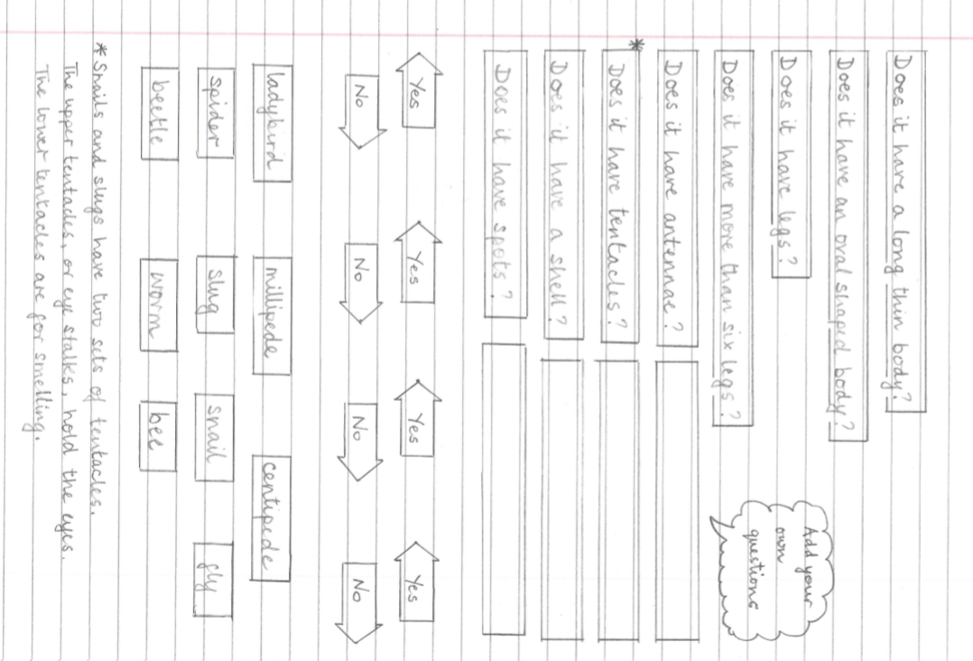
8

Slide 9
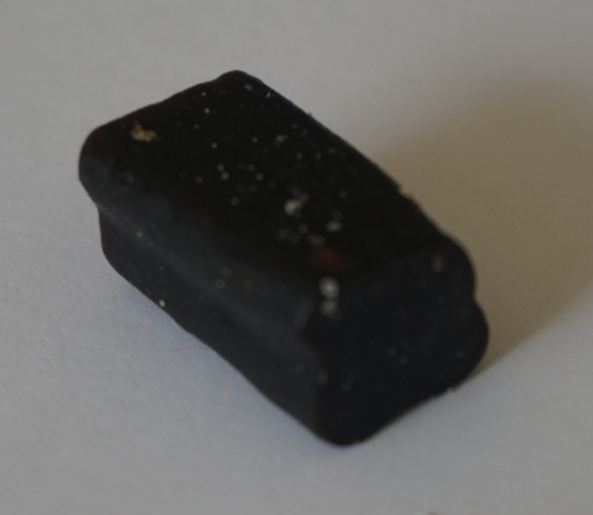
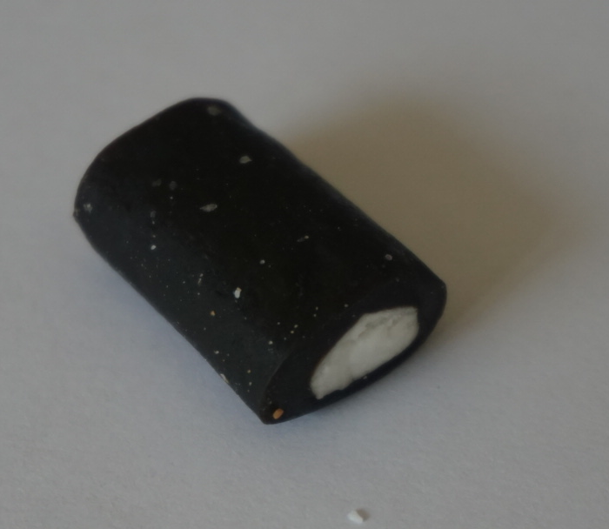
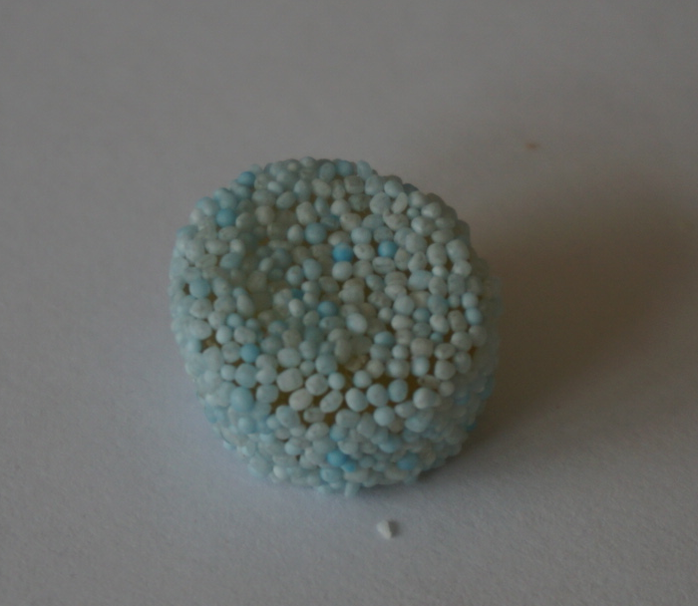
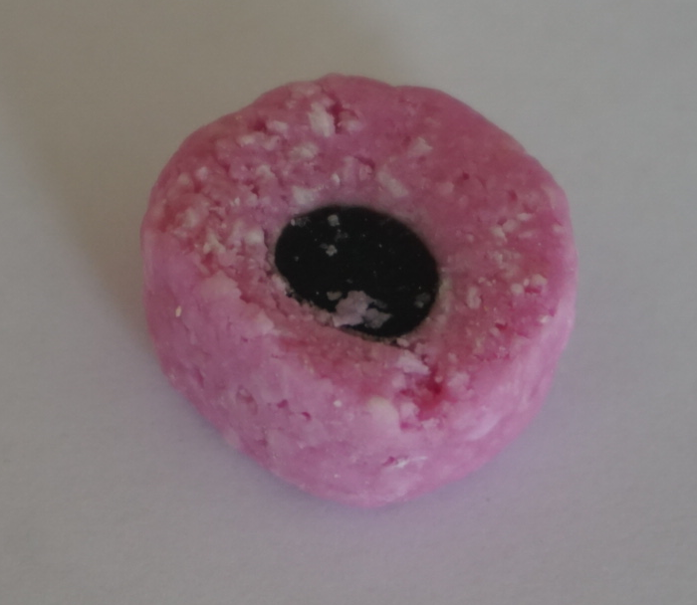
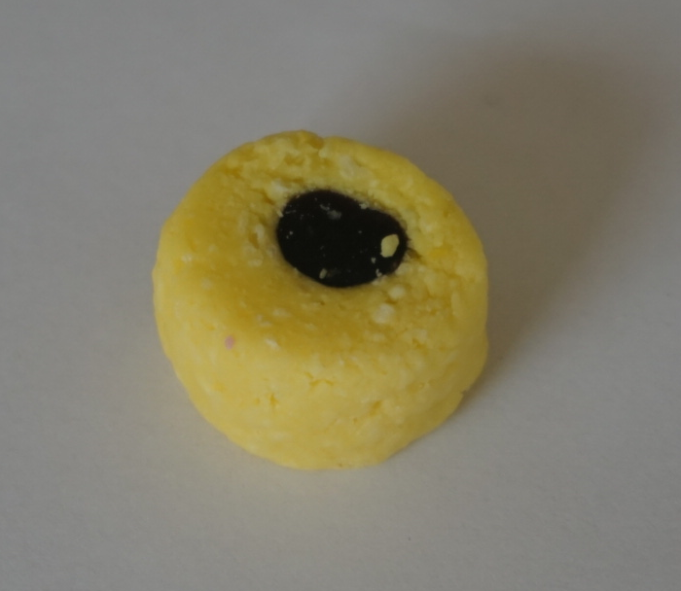
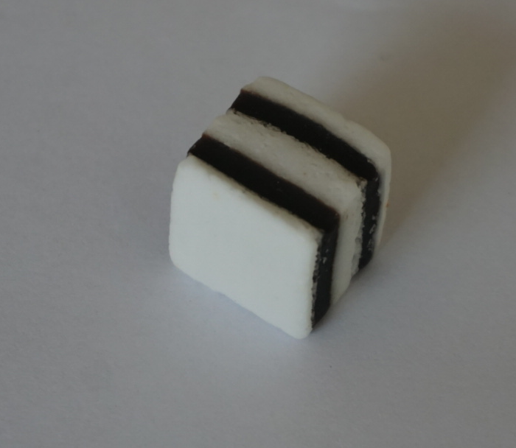
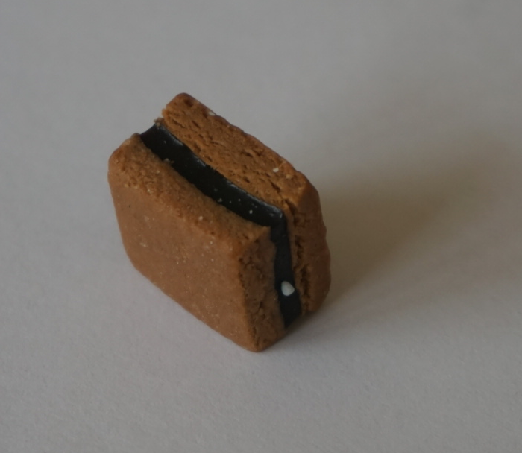
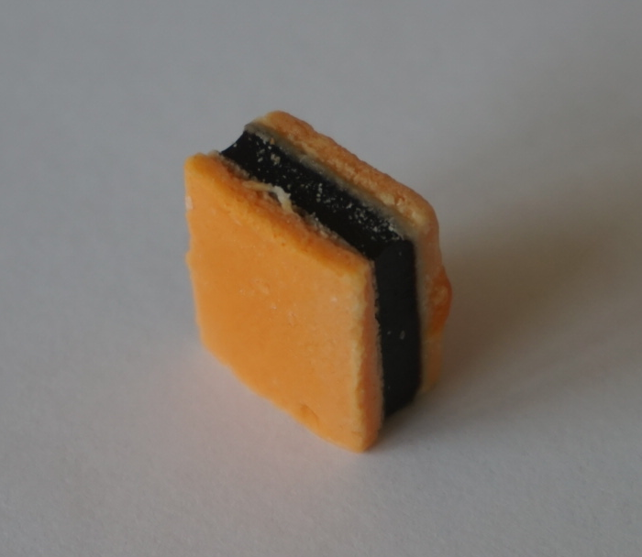
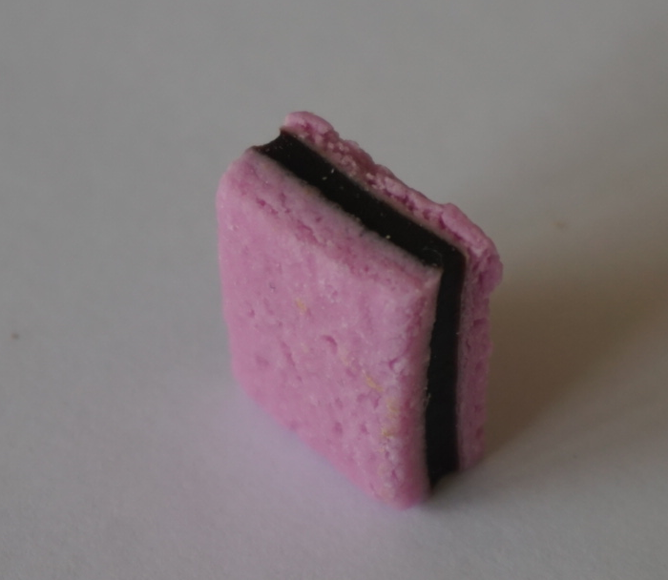
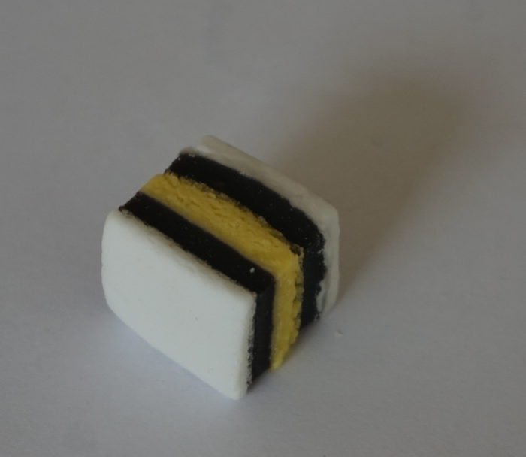
Pictures of some liquorice allsorts to print and cut out - or to draw yourself!
Alternatively, try making your key using a mixture of biscuits from a variety pack.

Slide 10
Glossary of terms
Classify: Living things can be grouped or classified in different ways according to their features.
Branching key: A branching key can be used to identify different animals. The key asks questions based on features of the animals, where the answer is ‘yes’ or ‘no’.
For example, the question ‘Does it have a shell?’ is ‘yes’ for a snail and ‘no’ for a slug.
Feature: The features of an animal are distinctive aspects of their appearance.
For example, the features of this bee include two wings, six legs, two antennae and a striped yellow and black body.
Invertebrate: An invertebrate is an animal without a backbone. Small woodland invertebrates are sometimes called minibeasts.
10

Slide 11
Expected learning outcome: I can identify animals using a branching key.
KEY 1
Does it have wings?
yes
no
KEY 1
centipede
Does it have a striped body?
Does it have eight legs?
yes
no
yes
no
spider
fly
bee
fly
spider
centipede
bee
KEY 2
Does it have any legs?
yes
no
KEY 2
Does it have an oval shaped body?
worm
beetle
ladybird
yes
no
millipede
Does it have black spots?
millipede
yes
no
worm
ladybird
beetle
11

Slide 12
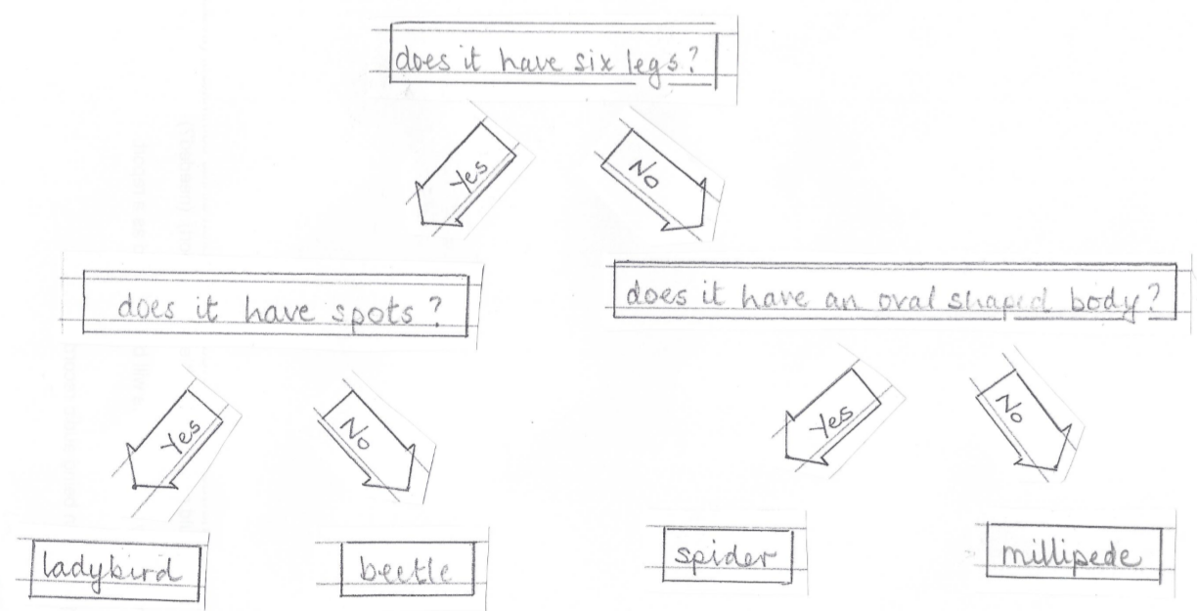
Possible learning outcome for reviewing your work.
I can make a branching key to classify four woodland invertebrates (minibeasts).
You may like to add pictures of animals to the key.
Your key may look different. There are many valid outcomes
(another example on page 13).
You can use many different questions. Make sure each question can be answered by looking carefully at the features of the animal.
12

Slide 13
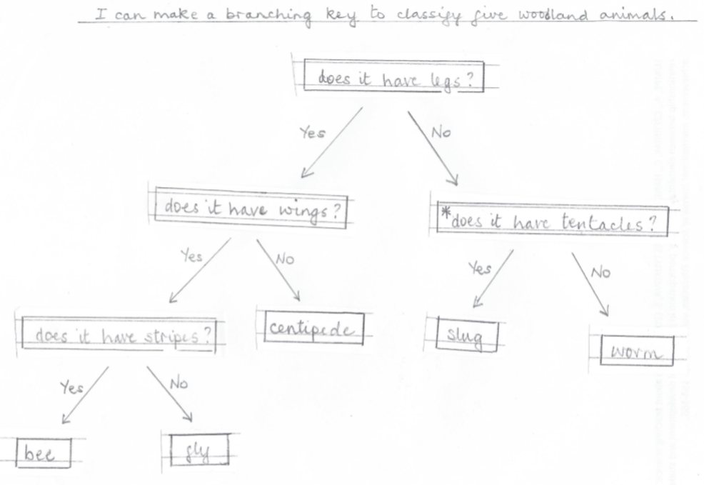
Possible learning outcome for reviewing your work.
This is an example for five animals. There are many possible ways of arranging the questions to make a valid key.
You can cut out or make labels and move them around to make alternative keys.
You may like to record your work by taking photographs.
13

