Slide 1
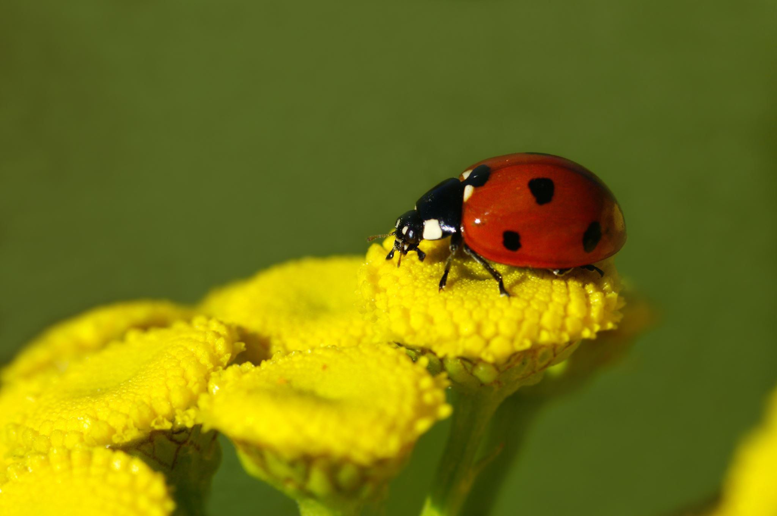



For parents
Thank you for supporting your child’s learning in science.
Before the session:
Please read slide 2 so you know what your child is learning and what you need to get ready.
As an alternative to lined paper, slide 5 may be printed for your child to record on.
During the session:
Share the learning intentions on slide 2.
Support your child with the main activities on slides 3 to 6, as needed.
Slide 7 is a further, optional activity.
Slide 8 has a glossary of key terms.
Reviewing with your child:
Slide 9 gives an idea of what your child may produce.
Living things and their habitats
Food chains in woodland habitats
Year 4
Age 8-9

Slide 2
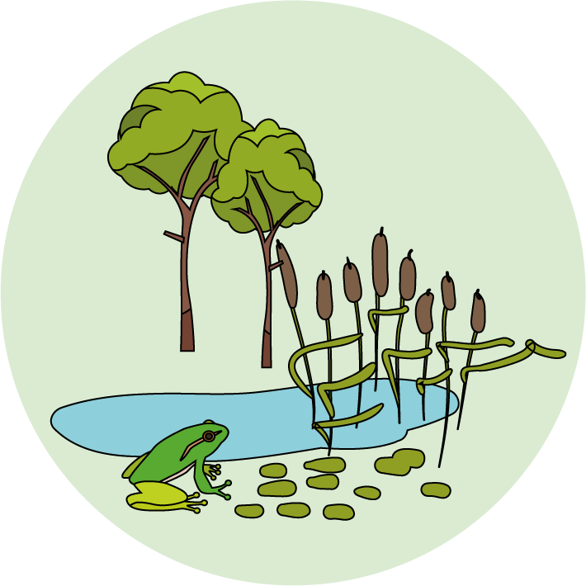

Living things and their habitats
Logo for section to sit inside roundel
Food chains in a woodland habitat
Key Learning
A food chain shows the links between different living things and where they get their energy from.
Living things can be classified as producers or consumers according to their place in the food chain.
A predator is an animal that feeds on other animals (its prey).
Animals can be described as carnivores, herbivores or omnivores.
Activities (pages 3-6): 30 - 40 mins
Use lined paper, a ruler and a pencil.
Alternatively, print page 6 as a worksheet.
Find out more… (page 7): 30 - 60 mins
You may like to explore more about predators and their prey.
I can…
Draw food chains for woodland plants and animals.
Describe the relationship between predators and their prey.
2

Slide 3
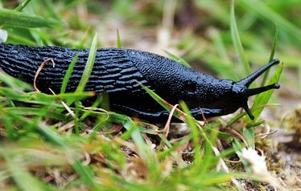
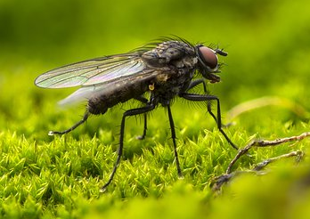
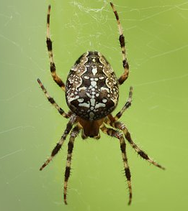
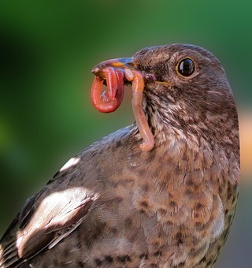
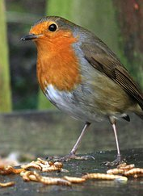
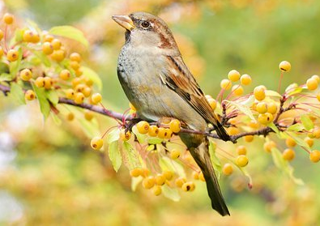
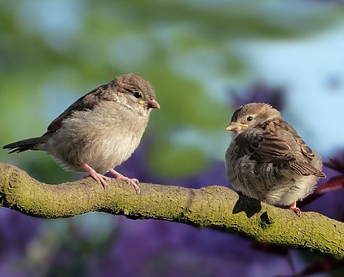
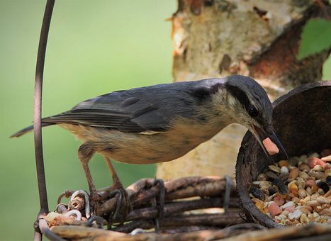
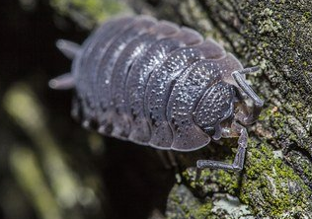
Explore, review, think, talk….
Logo for section to sit inside roundel
What do you already know about how animals feed?
(5 minutes)
All animals need to eat food to survive.
Talk about what you already know about the kind of food different animals eat.
What is the name of an animal that only eats plants?
What is the name of an animal that only eats other animals?
What is the name of an animal that eats both plants and other animals?
Animals can be described as herbivores, carnivores or omnivores.
Birds like robins, blue tits and house sparrows have a very varied diet!
slugs
flies
spiders
worms
Robins, blue tits and house sparrows are omnivores because they eat plants and other animals.
Watch this clip about birds. What kind of food do they eat? https://www.bbc.co.uk/bitesize/clips/z9nhfg8
mealworms
berries
nuts & seeds
woodlice
3

Slide 4
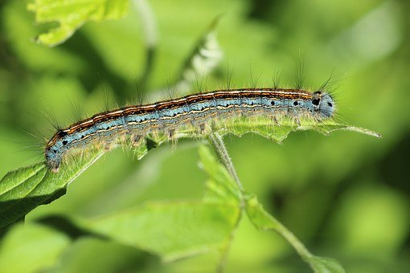
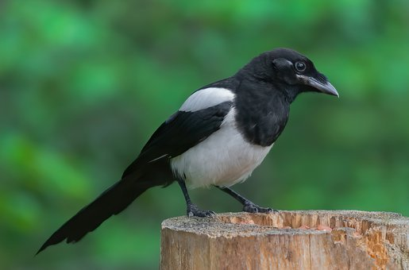
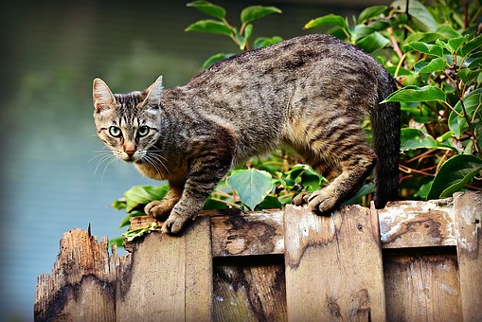
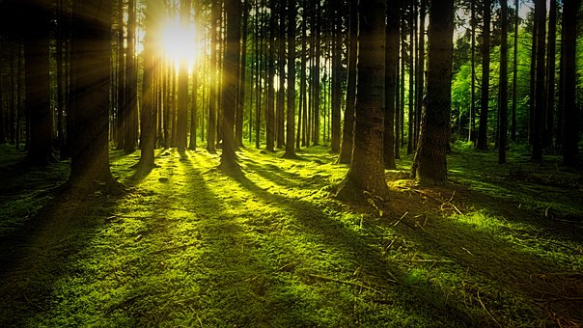
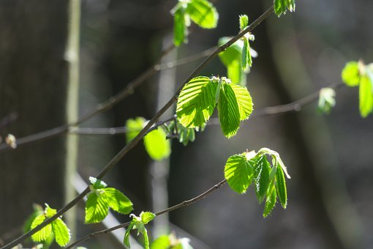
Watch, read, listen…
Logo for section to sit inside roundel
Describing a food chain
(10 minutes)
Watch this clip describing a food chain. https://www.bbc.co.uk/bitesize/clips/zjshfg8
Think about these questions as you watch
Where does a food chain start?
Which animals are herbivores?
Which animals are carnivores?
A food chain starts with energy from the Sun because plants need the Sun’s light energy to make their own food in their leaves.
Plants are eaten by animals.
These animals are then food for other animals, creating a food chain.
caterpillar
magpie
cat
The arrows in the food chain show the flow of energy.
sunlight
leaves
caterpillar
magpie
cat
4

Slide 5
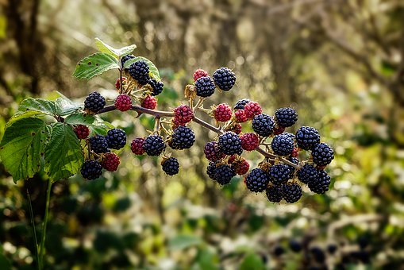
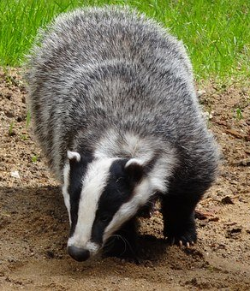
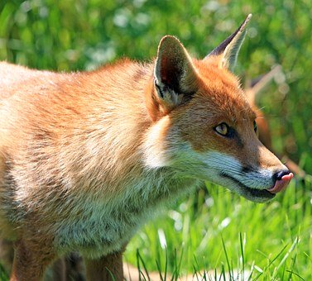
Building food chains
Logo for section to sit inside roundel
Describe producers, consumers, predators and prey in a food chain
(page 5-6: 30 minutes)
All plants make their own food. They are called producers.
Animals eat plants or other animals to survive. They are called consumers.
Play this food chain game to identify some woodland producers and consumers. https://www.bbc.co.uk/bitesize/topics/zbnnb9q/articles/zsphrwx
Animals which hunt and kill other animals to eat are called predators.
The animals they eat are called prey.
Write down a list of predators and their prey from the food chain game.
predator | prey
badger | worm
4

Slide 6
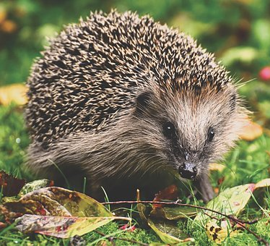
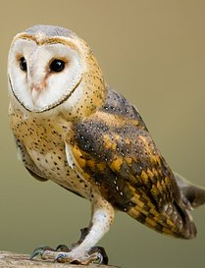
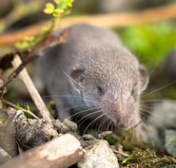
Draw four different food chains for woodland animals.
Label each living thing as producer or consumer. Write short sentences underneath to describe the predators and prey in the food chain.
Use what you have learnt and the word bank and the pictures to help you.
I can draw and label food chains for woodland animals. I can describe the relationship between predators and their prey.
Example:
leaves
producer
caterpillar
consumer
bird
consumer
fox
consumer
The caterpillar is the bird’s prey. The bird is a predator but it is also prey for the fox. The fox is the top predator in this food chain.
producer consumer predator prey
leaves
blackberries
caterpillar
worm
badger
bird
fox
shrew
hedgehog
owl
6

Slide 7
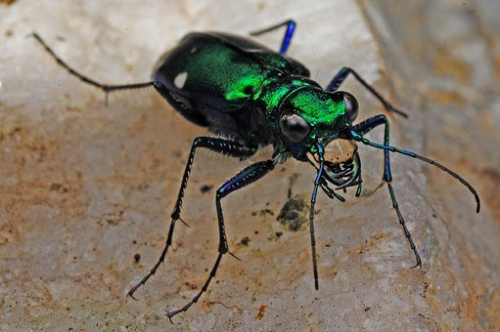
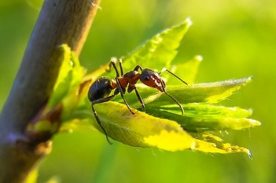
Find out more about predators and their prey
Logo for section to sit inside roundel
Explore the relationship between ants, tiger beetles and parasitic wasps
(20 – 30 minutes)
Tiger beetles are predators and one of their favourite prey are ants. However, beetles can also be prey for another insect…
Watch this BBC clip to find out more.
https://www.bbc.co.uk/programmes/p003xjbk
Most ants are omnivores. They like to eat plants, seeds, nectar, and even other animals.
Make a food chain to show how the tiger beetle larva can be a predator and prey. Write a short paragraph to describe what happens.
Taking it further….
Imagine you are Methocha, a parasitic wasp. Write a short story about how you trick a tiger beetle and what you do once you have paralysed it.
7

Slide 8
Glossary of terms
Carnivore: A carnivore is an animal which only eats other animals.
Consumer: All animals are consumers because they cannot make their own food.
Food chain: A food chain shows the links between different living things and where they get their energy from.
Herbivore: A herbivore is an animal which only eats plants.
Omnivore: An omnivore is an animals which eats plants and other animals.
Predator and Prey: A predator is an animal that feeds on other animals (its prey).
Producer: Plants are producers. A food chain starts with the Sun providing energy for a plant (the producer) to make its own food.
8

Slide 9
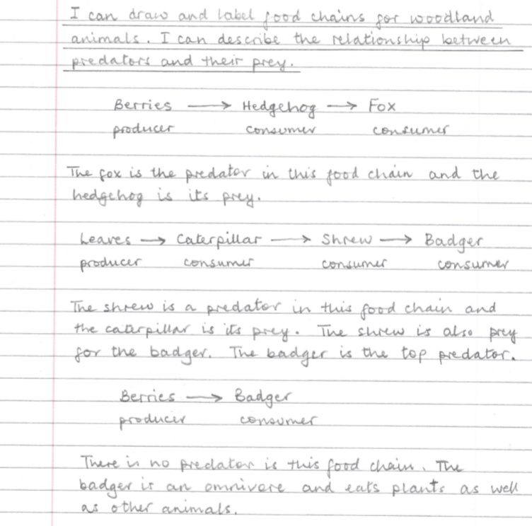
In UK woodland, badgers and foxes are ‘top carnivores’ as they are not eaten by other animals.
Possible learning outcome for reviewing your work.
The arrows in a food chain show the flow of energy. (A food chain starts with energy from the Sun because plants need the Sun’s light energy to make their own food in their leaves.)
Badgers and foxes are omnivores. They eat berries as well as small animals.
A food chain can have just a producer and one consumer. In this case there is no predator or prey.
Hedgehogs are omnivores. They eat berries, worms and insects.
9

