Slide 1



States of matter
For parents
Thank you for supporting your child’s learning in science.
Before the session:
Please read slide 2 so you know what your child is learning and what you need to get ready.
As an alternative to paper, slide 6 may be printed for your child to record on.
During the session:
Share the learning intentions on slide 2.
Support your child with the main activities on slides 3-7, as needed.
Slide 8 has further, optional activities.
Slide 9 has a glossary of key terms.
Reviewing with your child:
Slide 10 gives an idea of what your child may produce.
Introduction to solids, liquids and gases
Year 4
Age 8 - 9

Slide 2
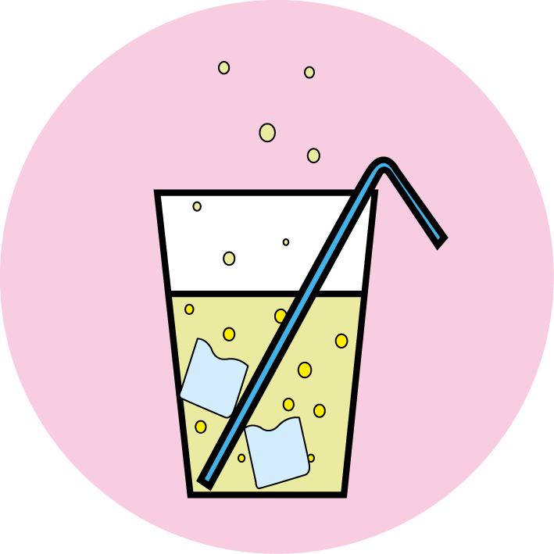
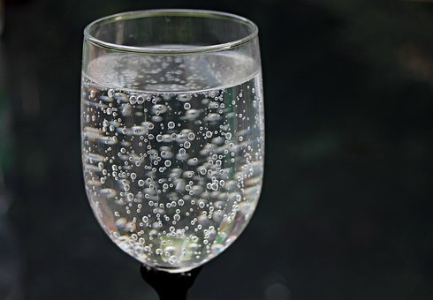
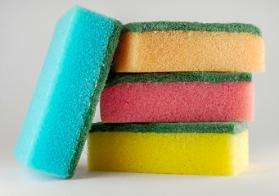
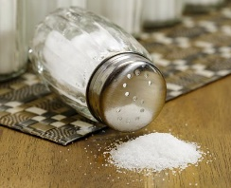
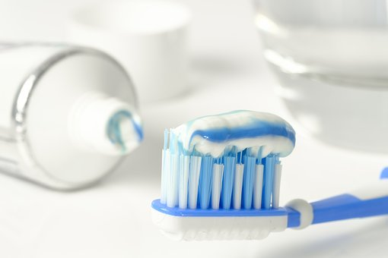
States of matter
Introduction to solids, liquids and gases
Key Learning
There are three states of matter: solid, liquid and gas.
A solid keeps its shape and has a fixed volume. Some solids are made up of small grains which can be poured into a heap.
A liquid has a fixed volume but changes in shape to fit the container. A liquid can be poured and keeps a level, horizontal surface.
A gas fills all available space; it has no fixed shape or volume.
Activities (pages 3-7): 30 - 40 mins
Useful items to support learning:
Fizzy water/drink and a glass.
Clean sponge or foam cloth and a bowl of water.
Household items such as jam, flour, sugar, milk, toothpaste and eggs (see p.5 for suggestions).
Use lined paper and a pencil. Alternatively may wish to print page 7 as a worksheet.
Find out more… (page 8): 20 - 30 mins
You may like to find out more about the solids, liquids and gases in different fruits and vegetables.
I can…
classify a range of objects and materials as solids, liquids or gases.

Slide 3
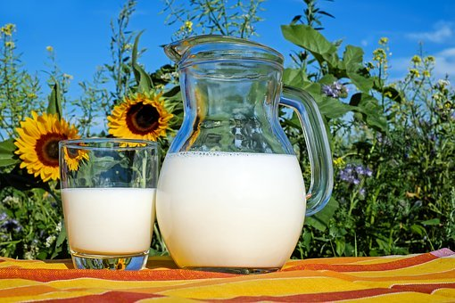

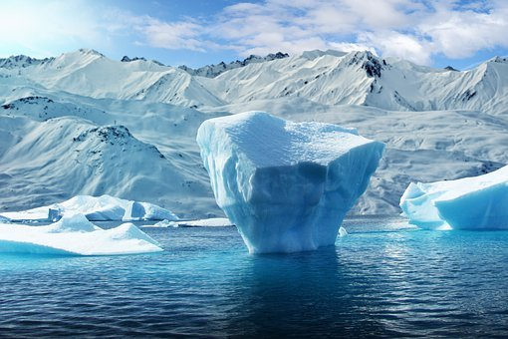

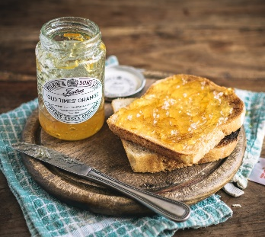
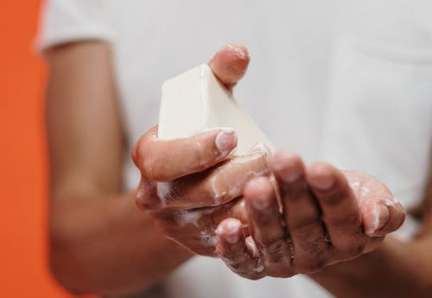
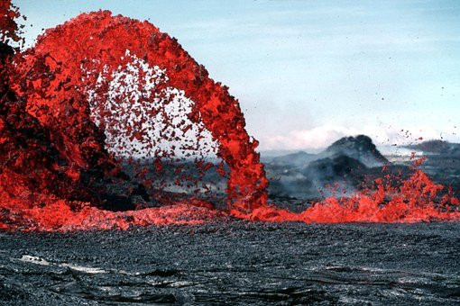
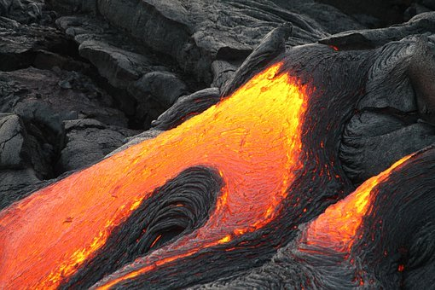
Explore, review, think, talk…
What do you already know about solids and liquids?
(5 - 10 minutes)
How would you describe the differences between a solid and a liquid? Watch this clip:
https://www.bbc.co.uk/bitesize/clips/zv4rkqt
Think about the differences between ice and water.
Is lava from a volcano a solid or a liquid?
Look at these pictures of some items you may have at home.
Think or talk about each item. Is it a solid or a liquid? How do you know?
Which items seem to be difficult to classify?
milk
glasses
fabric
salt
phone
toast
toothpaste
jam
soap

Slide 4
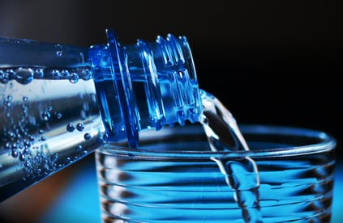
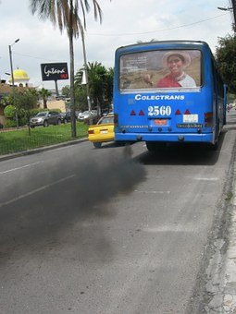
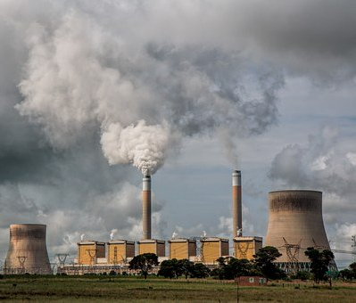
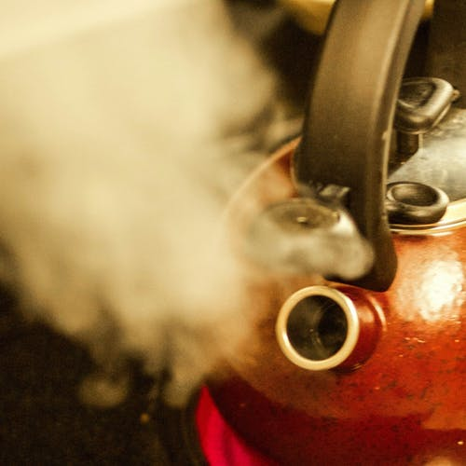
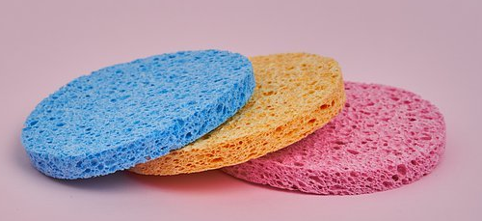
Solids, liquids and gases
Comparing the properties of solids, liquids and gases
(pages 4-7: 20 - 30 minutes)
Gases are often invisible but we can notice them when they are mixed with liquids or trapped within solids.
Where else can we notice gases? Watch this clip for clues: https://www.bbc.co.uk/bitesize/clips/zrdkjxs
Now use this BBC bitesize link to compare the properties of solids, liquids and gases. Use the descriptions to help with the next activity. https://www.bbc.co.uk/bitesize/topics/zkgg87h/articles/zsgwwxs
Pour out a glass of fizzy drink. You can see the carbon dioxide gas bubbles rising.
Squeeze a sponge or a foam cloth under water. You can see air bubbles rising.

Slide 5
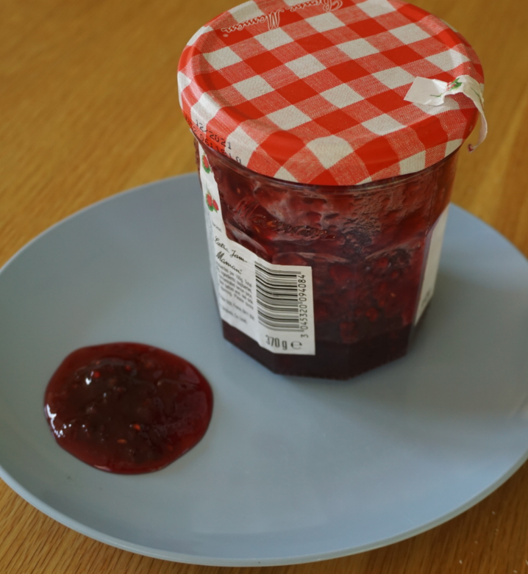
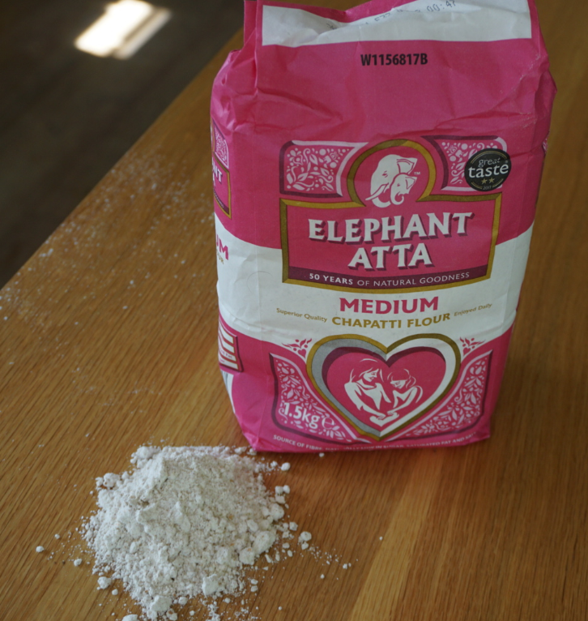
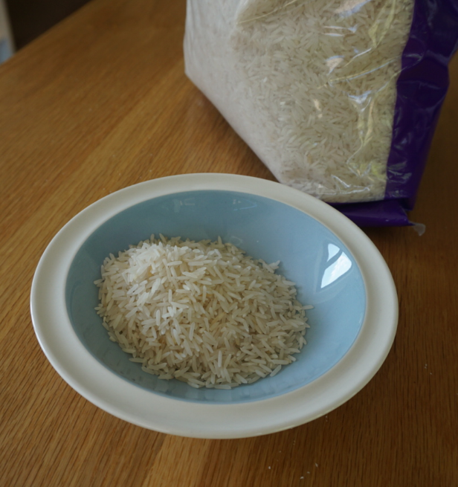
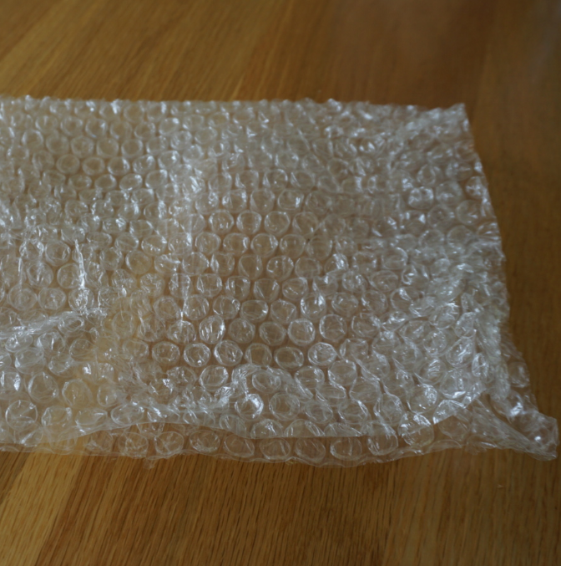
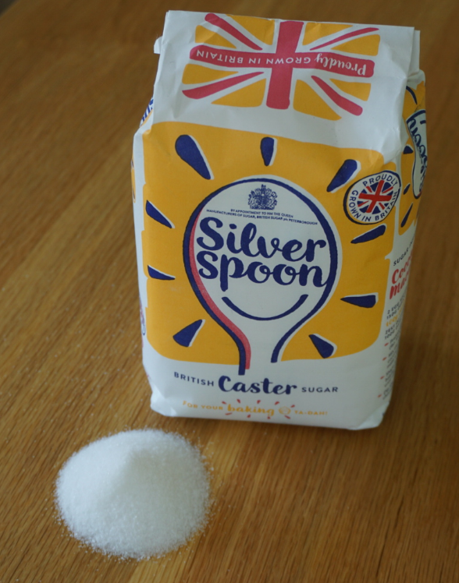
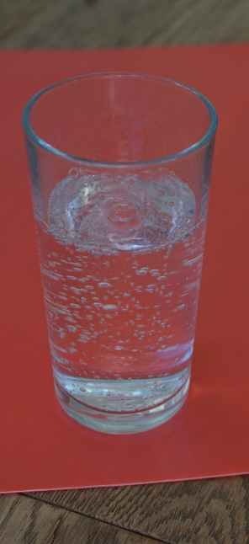
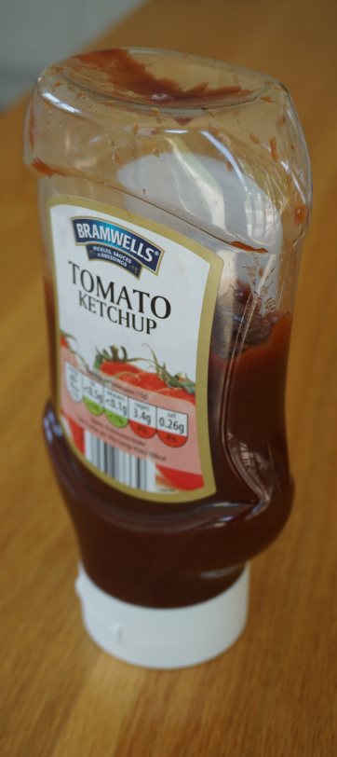
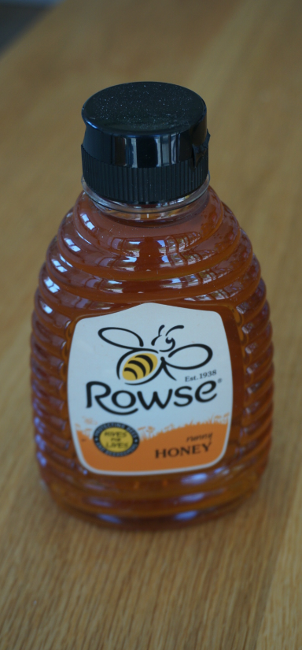
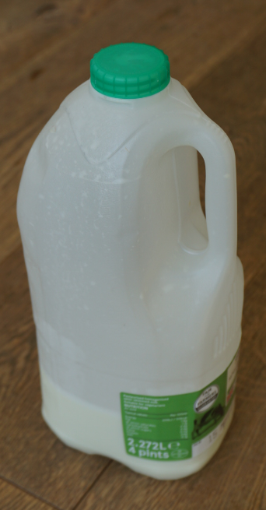
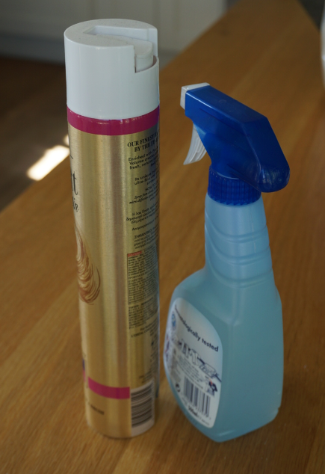
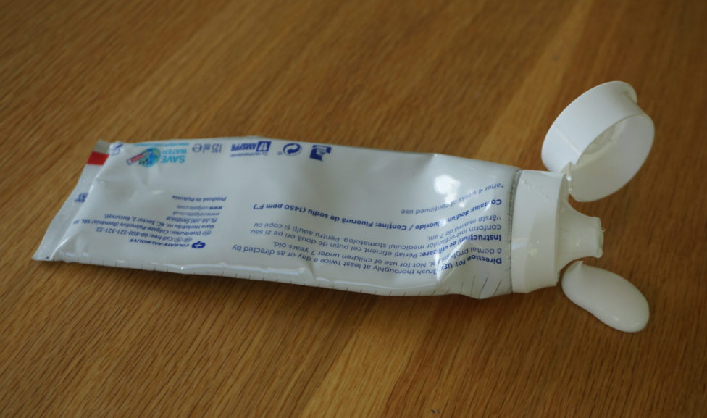
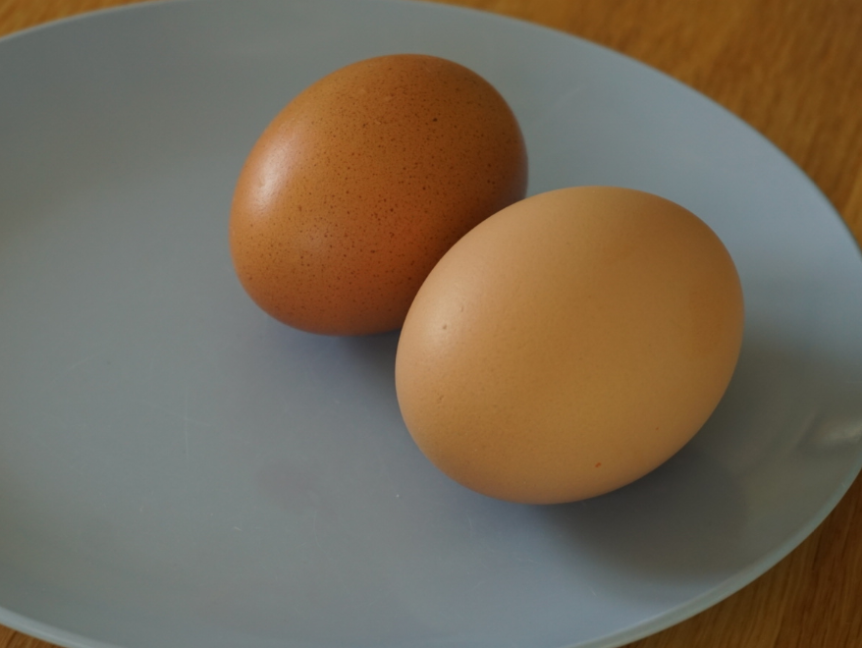
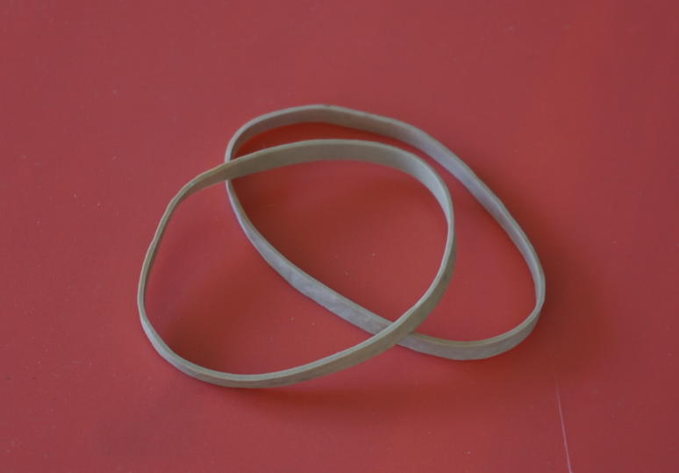
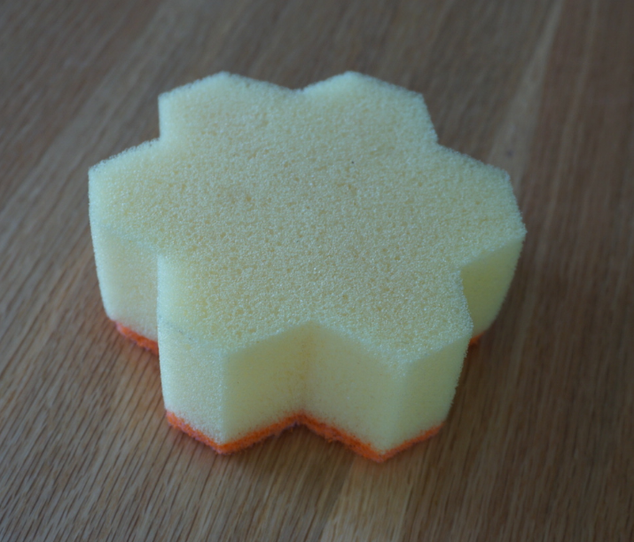
Find about 10 household items or use some the pictures opposite. Try to choose items that are trickier to classify.
Sort the items into solids, liquids and gases.
Some items may be ‘solid and liquid’, ‘liquid and gas’, ‘solid and gas’ – or ‘all three’!
Draw three overlapping circles to make a Venn diagram and record your findings.
Explain your decisions using what you have learnt and the word bank on page 6.
Milk and a sponge are shown as examples on page 6.
Items you may like to use:
fruit jam, flour, rice, bubble wrap, sugar, fizzy drink, ketchup, honey, milk, air freshener, toothpaste, uncooked egg, elastic band, sponge.

Slide 6
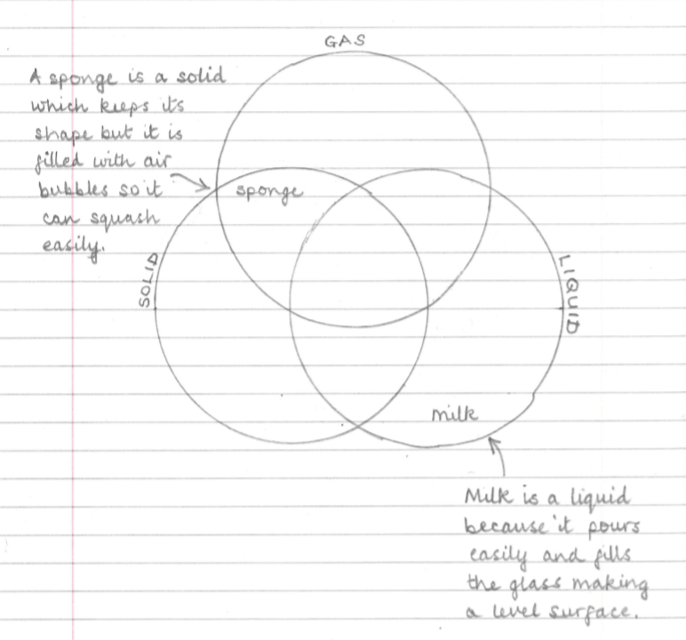
Useful phrases
keeps its shape
changes its shape
fits the container
can be twisted or stretched
can be squashed
can be cut
can / cannot be poured
is invisible
has a fixed volume
spreads out
fills the available space
forms a heap
forms a puddle
keeps a level, horizontal surface
I can classify a range of objects and materials as solids, liquids or gases.

Slide 7
Useful phrases
keeps its shape
changes its shape
fits the container
can be twisted or stretched
can be squashed
can be cut
can / cannot be poured
is invisible
has a fixed volume
spreads out
fills the available space
forms a heap
forms a puddle
keeps a level, horizontal surface
I can classify a range of objects and materials as solids, liquids or gases.

Slide 8
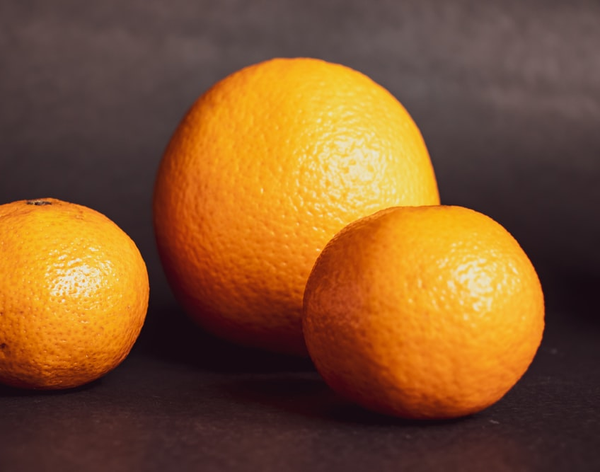
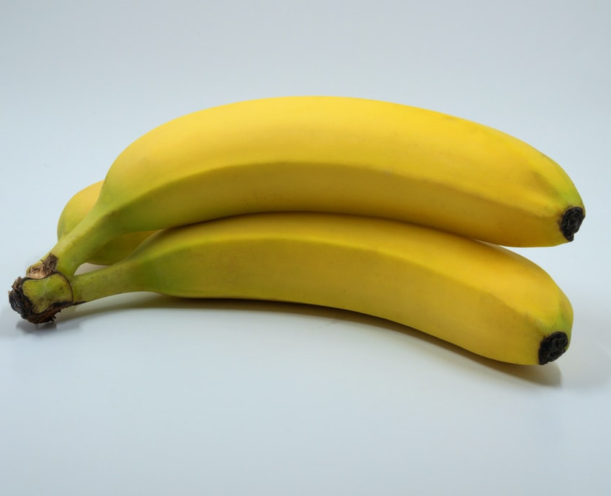
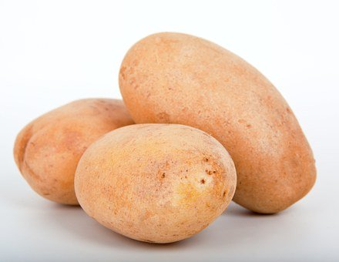

Find out more…
Exploring solids, liquids and gases in different fruits and vegetables
(20 – 30 minutes)
Does an orange float in water?
What about a banana or a potato?
Does peeling the fruit or vegetable make a difference?
Fruits and vegetables are not just solids. Some have juice (a liquid) inside them. Some have tiny pockets of air (a gas) trapped inside them.
Ask an adult if you can investigate floating and sinking fruits with them.
This activity is described and explained in Science Fun At Home ‘sink or swim’.
https://pstt.org.uk/application/files/1115/8694/0466/4._SINK_OR_SWIM.pdf
Decide how you are going to record your findings. You may like to take photographs.

Slide 9
Glossary of terms
States of matter: There are three states of matter: solid, liquid and gas.
Solid: A solid is an object or material which keeps its shape and has a fixed volume. Some solids are made up of small grains which can be poured into a heap. Some solids can change shape when they are squashed, stretched or twisted. Some solids can be cut.
Liquid: A liquid is a material which has a fixed volume but changes in shape to fit the container. A liquid can be poured and keeps a level, horizontal surface.
Gas: A gas is a material which fills all available space; it has no fixed shape or volume.
Material: Material is the matter from which a thing is or can be made.
Volume: The volume is the amount of space taken up by a solid, liquid or gas.

Slide 10
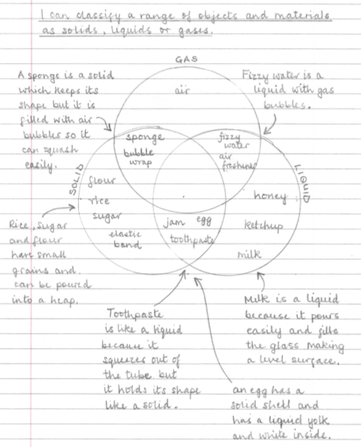
Stretchy solid objects like rubber bands only change shape when they are pulled or twisted.
Possible learning outcome for reviewing your work:
Some solids like bubble wrap and sponges have air trapped inside them.
Each grain of sugar or flour is a solid. The grains can be poured but they make a heap.
Fizzy drinks are liquids with dissolved carbon dioxide gas. You can see the bubbles of gas.
Toothpaste is a mixture of powdered solids and liquids. It behaves like a liquid and a solid. Scientists call it a colloid.
Air freshener is a liquid in the canister but sprays out to form a gas which spreads out.
Some jams pour like a liquid. Others are stiff like jelly. Jam often has solid fruit or pips in it.
Some liquids pour slowly like ketchup and honey but they form a level surface if left to settle.

