Slide 1



States of matter
For parents
Thank you for supporting your child’s learning in science.
Before the session:
Please read slide 2 so you know what your child is learning and what you need to get ready.
As an alternative to paper, slide 5 may be printed for your child to record on.
During the session:
Share the learning intentions on slide 2.
Support your child with the main activities on slides 3-5, as needed.
Slide 6 has further, optional activities.
Slide 7 has a glossary of key terms.
Reviewing with your child:
Slide 8 gives an idea of what your child may produce.
Exploring the properties of liquids
Year 4
Age 8 - 9

Slide 2
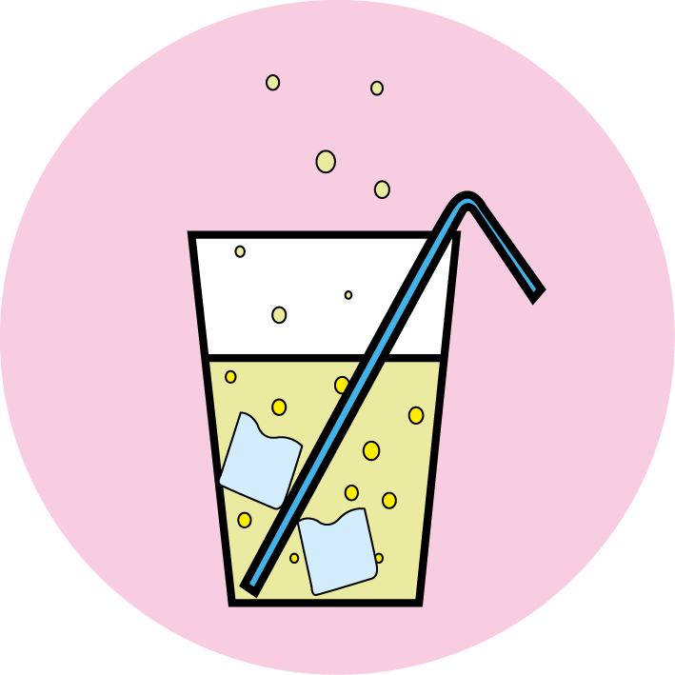

States of matter
Exploring the properties of liquids
Key Learning
A liquid has a fixed volume but changes in shape to fit the container. A liquid can be poured and keeps a level, horizontal surface.
Some liquids flow less easily and are slow to pour.
Activities (pages 3-5): 30 - 40 mins
Household items to support learning:
Plastic cups.
A variety of liquids that are safe for children to handle such as cooking oil, milk, juice, syrup and washing up liquid.
Use lined paper and a pencil. Alternatively may wish to print page 5 as a worksheet.
Find out more… (page 6): 30 - 40 mins
You may like to find out more about floating and sinking in different liquids.
I can…
describe the properties of liquids.
compare the thickness of different liquids.

Slide 3
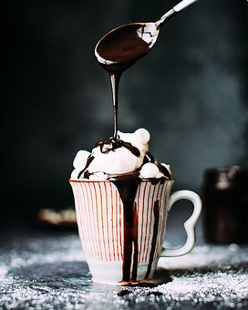

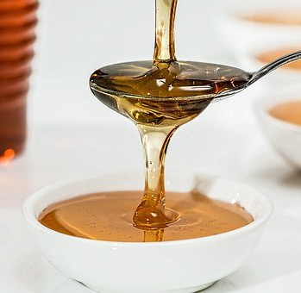
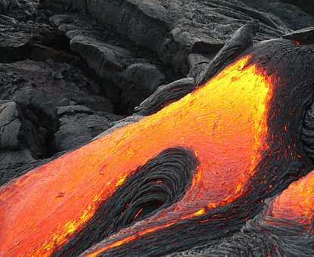
Explore, review, think, talk…
Exploring the properties of liquids
(5 minutes)
Look at these pictures of liquids.
Which one do you think is the odd one out?
Explain your reasons. There is no ‘right answer’!
You may have chosen ‘you cannot eat or drink it’ or ‘it is only a liquid when hot’ to describe the odd one out.
You may also have chosen water as the odd one out because it flows much more easily than honey or lava.
Thicker liquids like honey, syrup and chocolate sauce that pour slowly are described as viscous liquids.
water
honey
lava

Slide 4
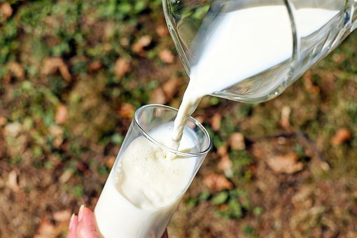
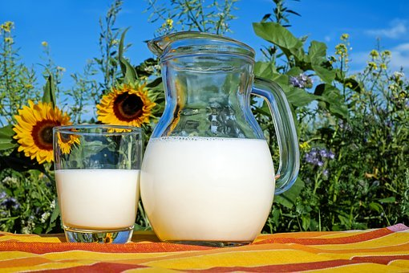
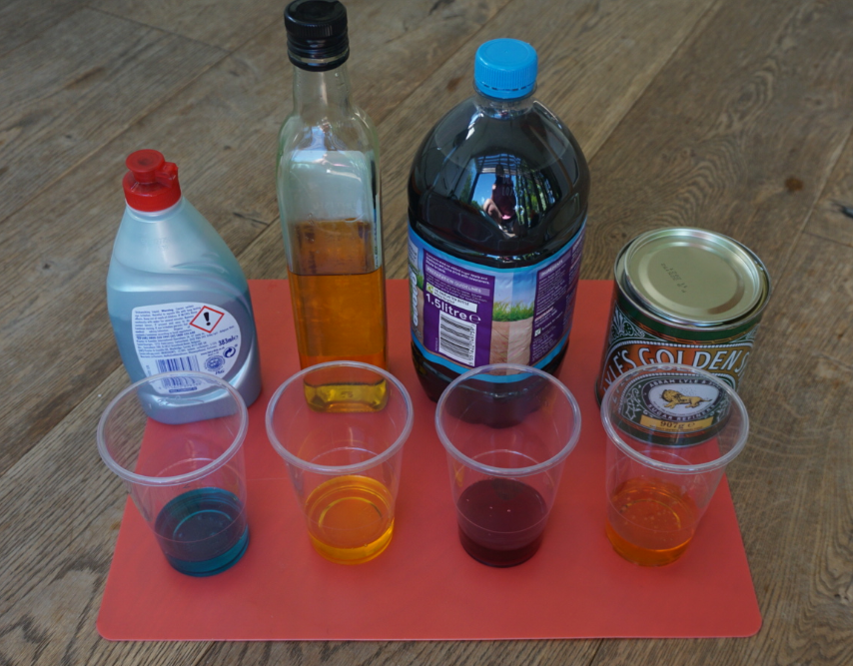
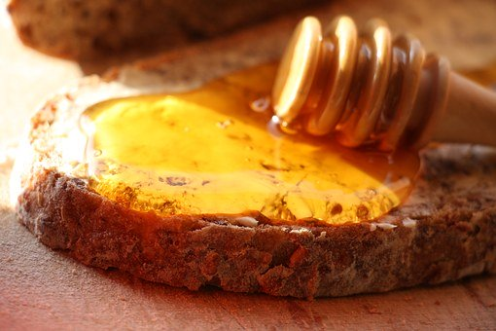
Properties of liquids
Investigating the thickness (viscosity) of different liquids
(20-30 minutes)
All liquids flow and can be poured.
Liquids like milk will quickly take the shape of the container and then keep a level, horizontal surface.
Watch this demonstration “Racing Liquids” from the Royal Society of Chemistry which shows you how to explore the thickness of different household liquids: https://www.youtube.com/watch?time_continue=1&v=m3dzLaZKmDE&feature=emb_logo
Ask an adult if you can investigate some liquids with them.
See the notes on page 5 to help you.
Thick or viscous liquids like honey flow more slowly. They have a high viscosity.
Decide how you are going to record your findings. You may wish to take photographs.

Slide 5
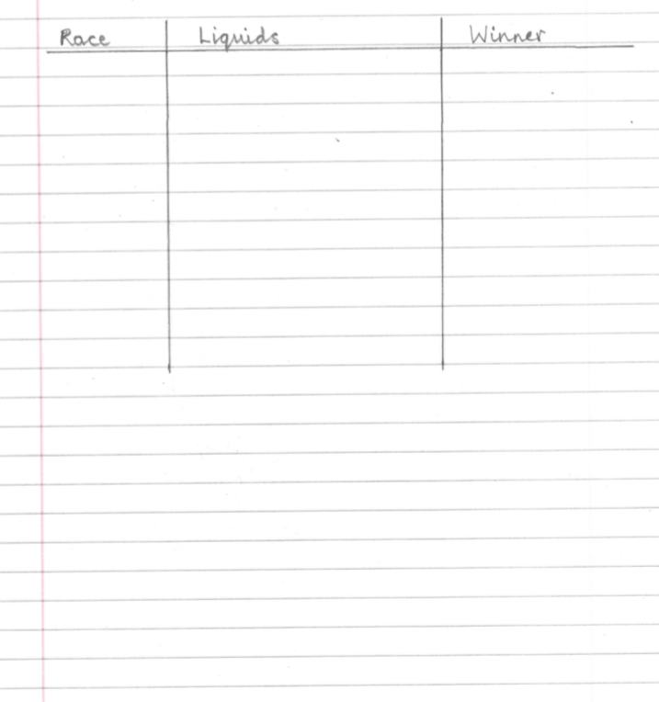
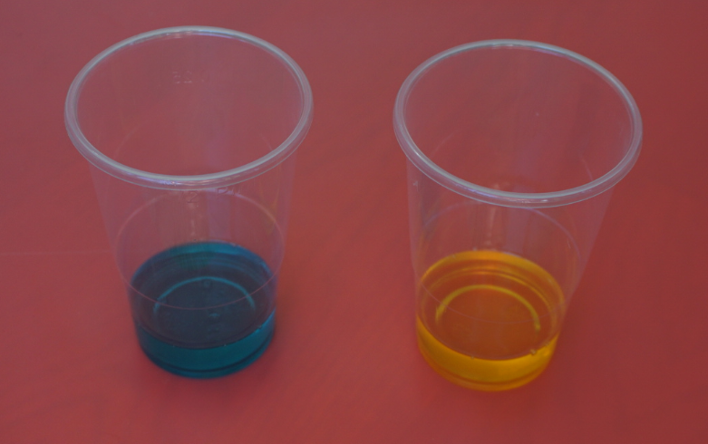
Ask an adult to work with you.
1. Find three or four liquids which are safe to handle.
For example, you may choose from water, juice, syrup, cooking oil, baby oil, washing up liquid or hand soap.
2. Collect some clean plastic cups or mugs. (You should be able to reuse the liquids after your investigation!)
3. Pour an equal volume of each liquid into separate cups. Choose two liquids to ‘race’.
4. Tip the cups slightly and look carefully at each liquid. Make a race prediction – which liquid will win?
5. Race your liquids by pouring into an empty cup and record your results.
6. Try different races. Can you order your liquids from thickest to least thick?
I can compare the thickness of different liquids.

Slide 6
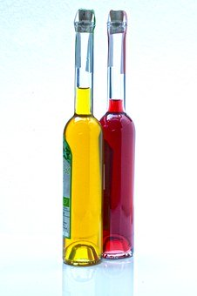
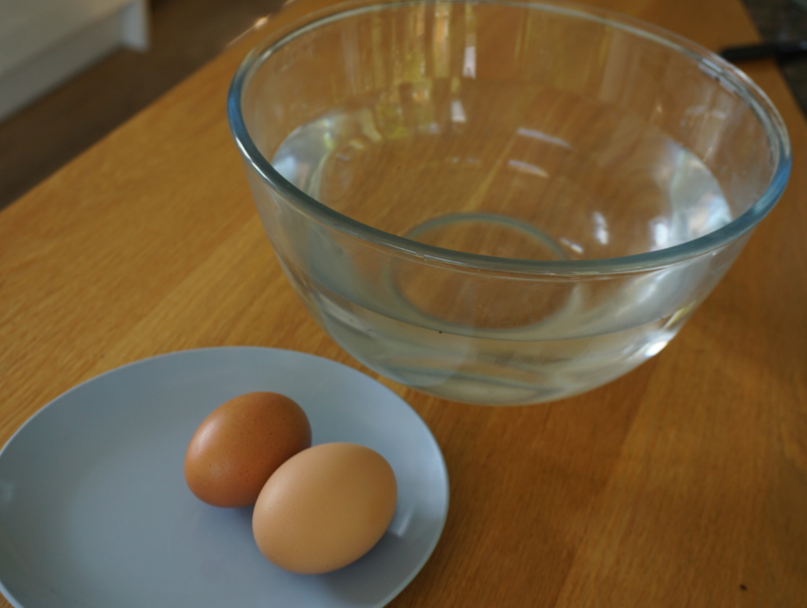
Find out more…
Find out more about floating and sinking in different liquids
(20 - 30 minutes)
Does an egg float or sink in water?
Use the link to the PSTT ‘Science Fun at Home’ activities for exploring this question.
https://pstt.org.uk/application/files/6115/8633/7142/3._EGG-CITING_SCIENCE.pdf
Take photographs or design a poster to show what you found out!
What happens when you mix different liquids?
Use the link to the Royal Society of Chemistry’s ‘Suspended ice’ investigation for exploring this question.
https://www.youtube.com/watch?time_continue=30&v=QwCgPkPrA-A&feature=emb_logo
Think about more questions you could ask about liquids.

Slide 7
Glossary of terms
States of matter: There are three states of matter: solid, liquid and gas.
Liquid: A liquid is a material which has a fixed volume but changes in shape to fit the container. A liquid can be poured and keeps a level, horizontal surface.
Material: Material is the matter from which a thing is or can be made.
Viscous: A viscous liquid flows less easily and is slow to pour.
Viscosity: The ‘thickness’ of a liquid is known as its viscosity. Viscous liquids like syrup and honey have a high viscosity. Liquids that flow easily like milk and water have a low viscosity.
Volume: The volume is the amount of space taken up by a solid, liquid or gas.

Slide 8
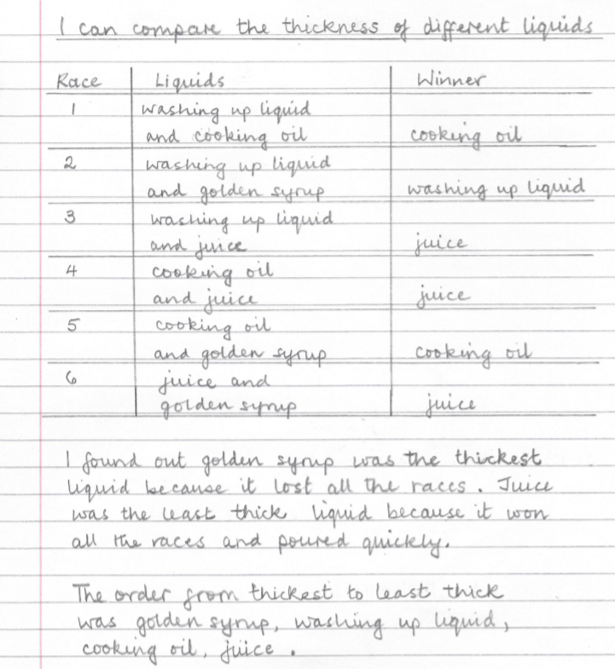
Possible learning outcome for reviewing your work:
Washing up liquids and hand soaps usually have a thickening agent added so they do not run out of the bottle too quickly. This makes the liquid quite viscous.
Liquids like water, fruit juice and squash flow easily. They have a low viscosity and can be poured quickly.
Golden syrup is a sugar syrup. It has a high viscosity and flows very slowly at room temperature. Syrup becomes less viscous when heated, so it is often warmed up when it is used for making cakes or biscuits!
Cooking oil flows quite easily but it takes slightly longer than water to be poured. Some oils are ‘thicker’ or more viscous than others.

