Slide 1

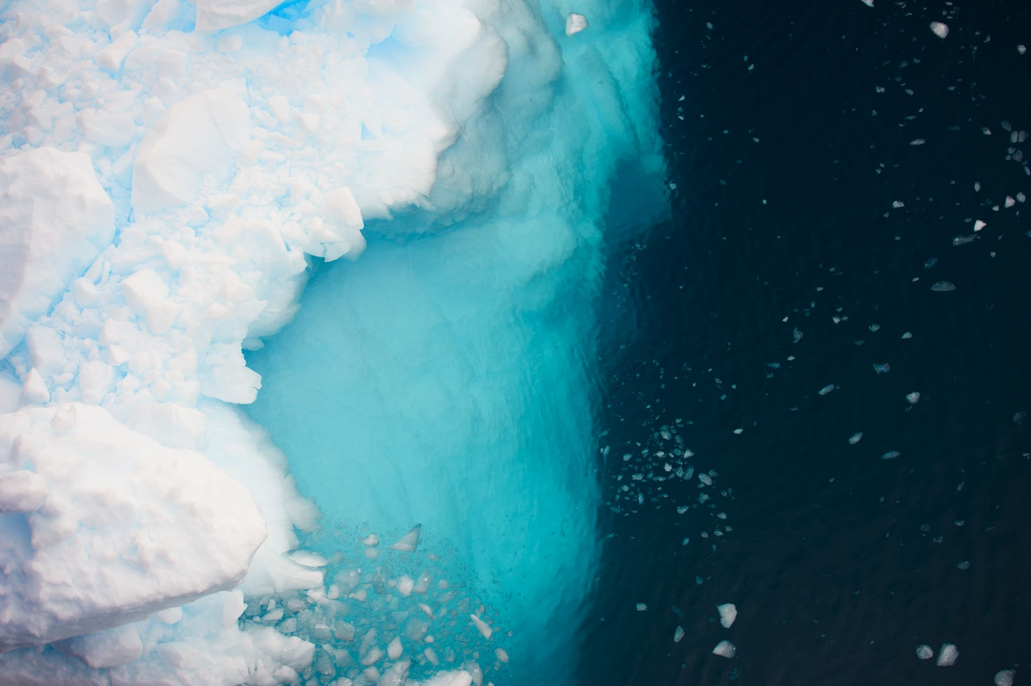

For parents
Thank you for supporting your child’s learning in science.
Before the session:
Please read slide 2 so you know what your child is learning and what you need to get ready.
As an alternative to paper, slide 5 may be printed for your child to record on.
During the session:
Share the learning intentions on slide 2.
Support your child with the main activities
on slides 3-5, as needed.
Slides 6 & 7 have further optional activities.
Slide 8 has a glossary of key terms.
Reviewing with your child:
Slide 9 gives an idea of what your child may produce.
[Parent’s note: Pre-preparing extra frozen
cubes may assist this activity.]
States of matter
Changes of state: investigating
freezing and melting
Year 4
Age 8 - 9

Slide 2
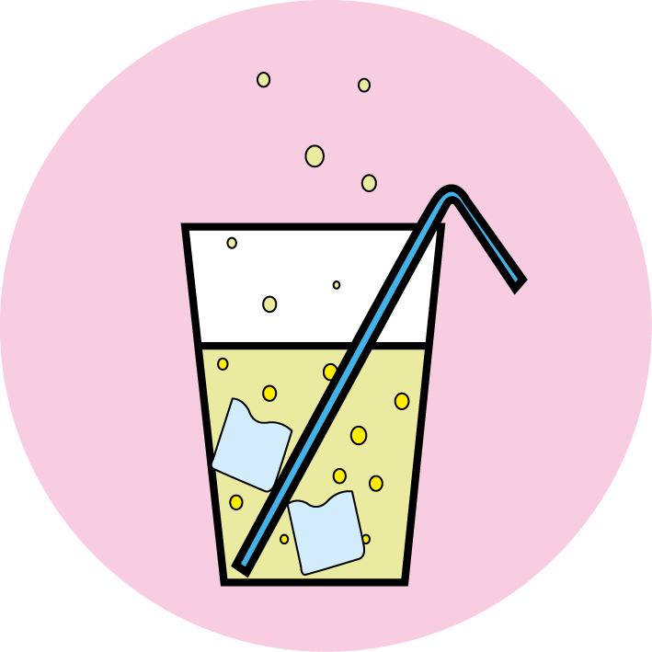

States of matter
Changes of state: investigating freezing and melting
Key Learning
Melting is a change of state from solid to liquid. Freezing is a change of state from liquid to solid.
The temperature a liquid freezes at is called its freezing point. The freezing point of water is 0ºC.
Different substances have different freezing points.
Activities (pages 3-5): 30 - 40 mins, plus freezing time
Household items to support learning:
An empty ice cube tray and a plate.
Liquids that are safe for children to handle such
as water, a fizzy drink, milk, fruit juice / squash, cooking oil or ketchup.
A small amount of salt.
Use lined paper and a pencil for recording. Alternatively you may wish to print page 5
as a worksheet.
Find out more… (pages 6-7)
You may like to explore melting ice in different places or melting different types of chocolate.
I can…
compare ice and other frozen liquids.
observe how different solids melt.

Slide 3
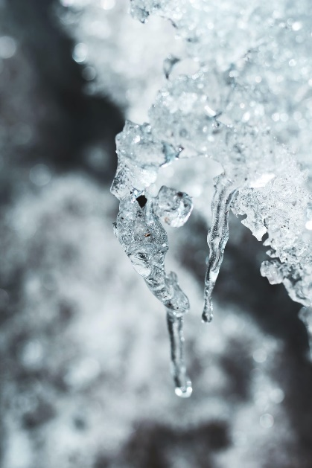
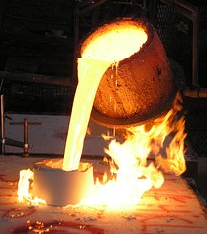

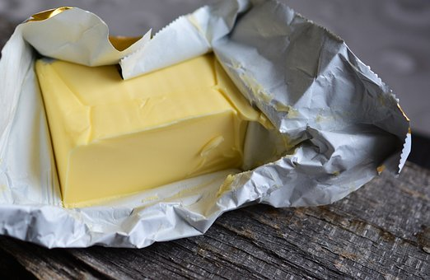
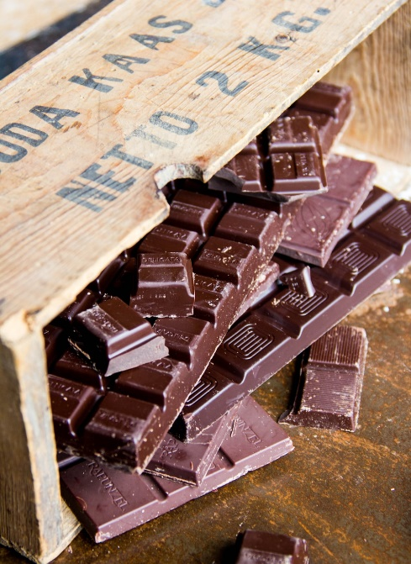
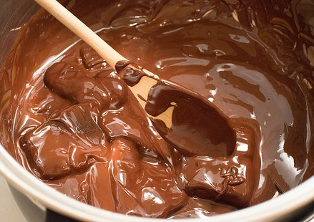
Explore, review, think, talk…
What do you already know about melting and freezing?
(5-10 minutes)
Talk or think about these questions:
Can you name some substances that melt easily?
What does ‘melting point’ mean?
Now watch this BBC clip: https://www.bbc.co.uk/bitesize/topics/zkgg87h/articles/z9ck9qt
Melting is a change of state. A solid material is heated and becomes a liquid.
Ice melts at zero degrees Celsius (0ºC). This is the melting point.
Chocolate melts at about 30ºC.
Iron melts at about 1500ºC!
Freezing is also a change of state. A liquid is cooled down and changes to a solid.
melting
solid
freezing
liquid

Slide 4
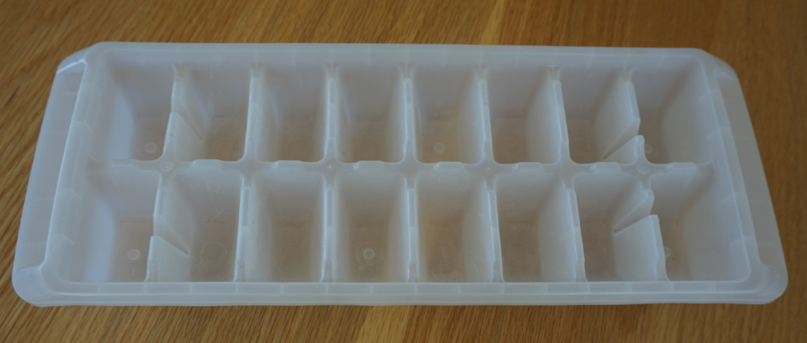
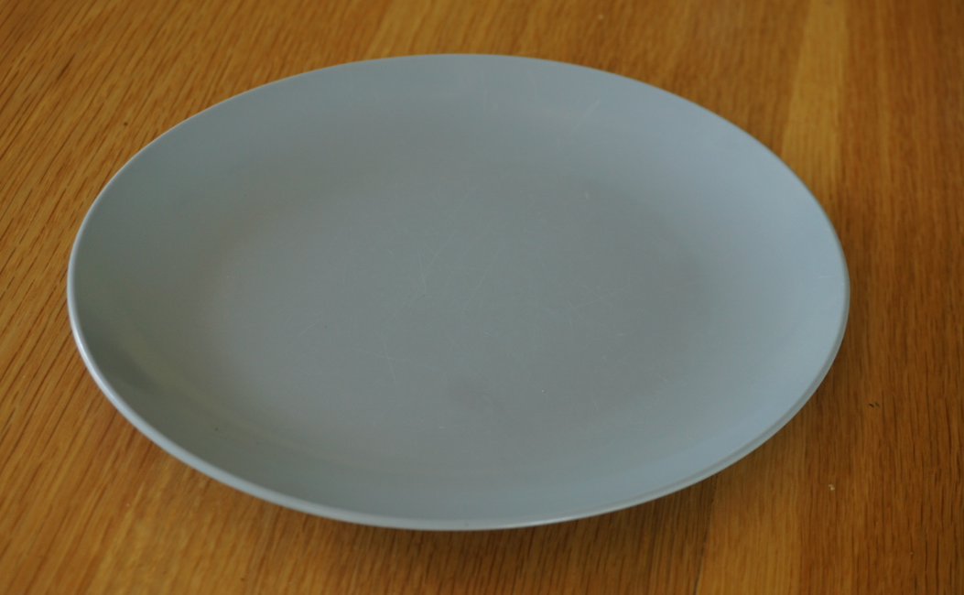

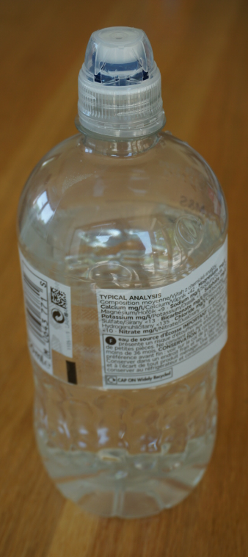
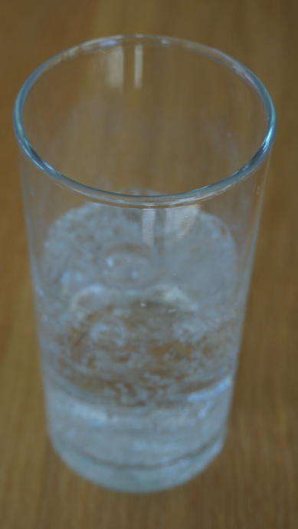
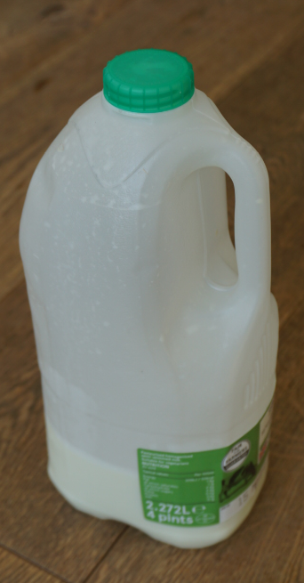
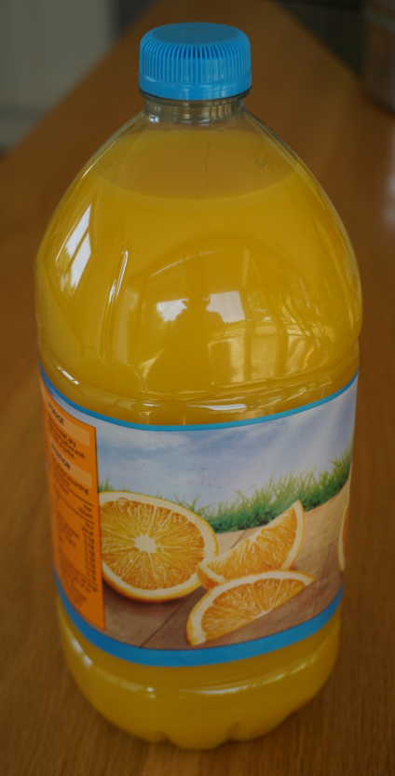
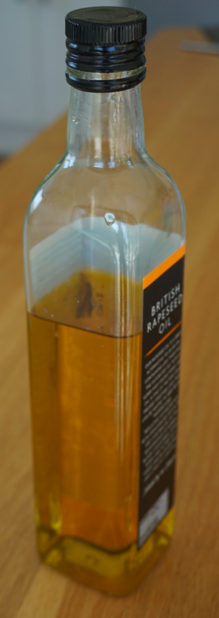
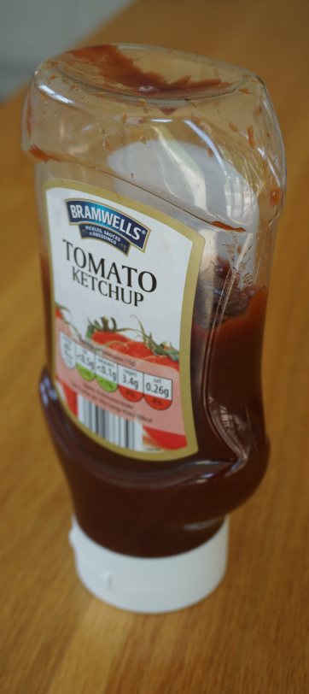
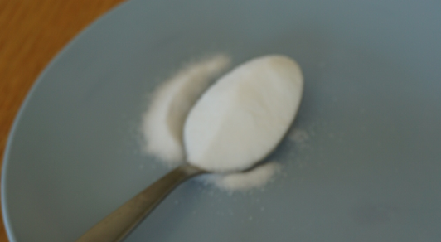
Investigating freezing and melting
Observing how different liquids freeze and melt
(20-30 minutes, plus time for freezing the liquids)
Ask an adult if you can investigate freezing and melting with them.
This activity is described in ‘Science Fun At Home’ – Activity 2: Melting ice. https://pstt.org.uk/application/files/9315/8513/5527/1._Science_with_Ice.pdf
What happens when you freeze different liquids?
Do liquids all freeze in the same way?
You will need:
An empty ice cube tray and a plate.
liquids such as water, fizzy drink, milk, fruit juice/squash, cooking oil, ketchup.
a small amount of salt.

Slide 5
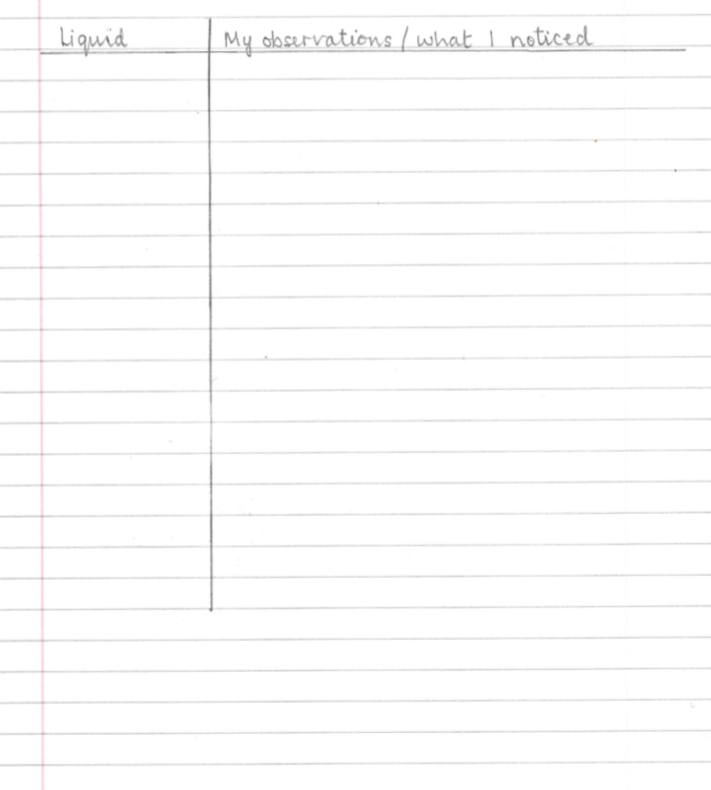
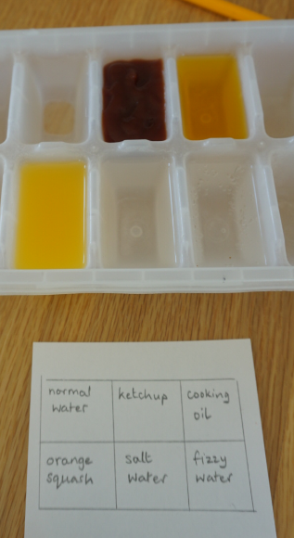
Ask an adult to work with you.
I can compare ice and other frozen liquids.
I can observe how different solids melt.
Setting up and freezing:
Choose 4 to 6 liquids to investigate, such as water, fizzy drink, milk, fruit juice / squash, cooking oil, ketchup or salt water (add a small amount of salt to some water).
Using an ice tray, pour the same volume of each liquid into separate compartments.
Label each compartment or draw a sketch.
Put in a freezer for two to three hours (or overnight).
Observing and recording (once frozen):
Look carefully at each ‘ice cube’ before you pop it out. Have all the liquids frozen in the same way?
Pop out the cubes onto a plate and take a closer look. Record your observations and/or take a photograph.
Observe how the cubes start to melt. Talk about any differences you notice.

Slide 6
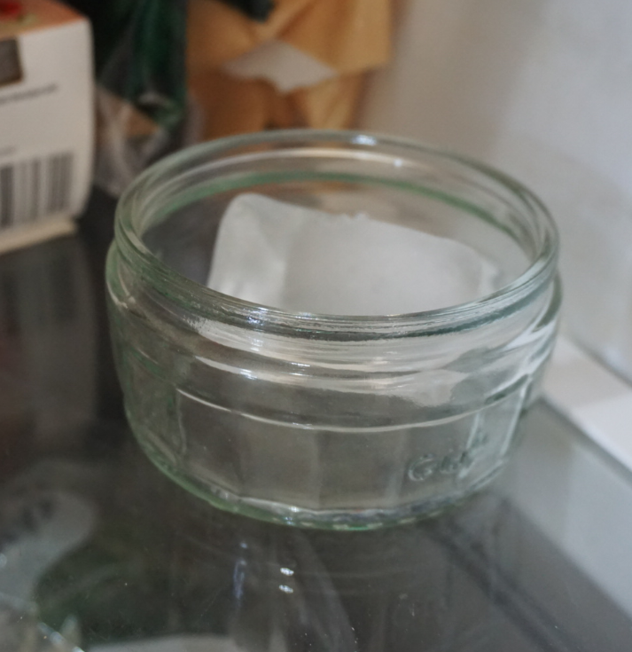
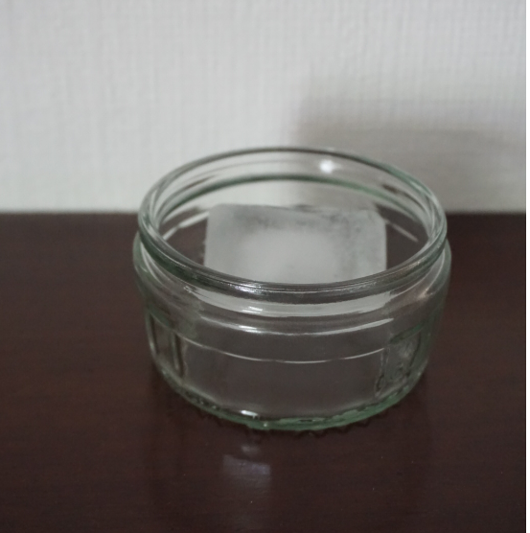
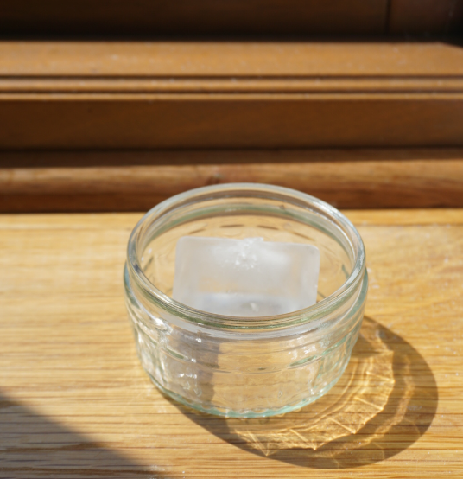
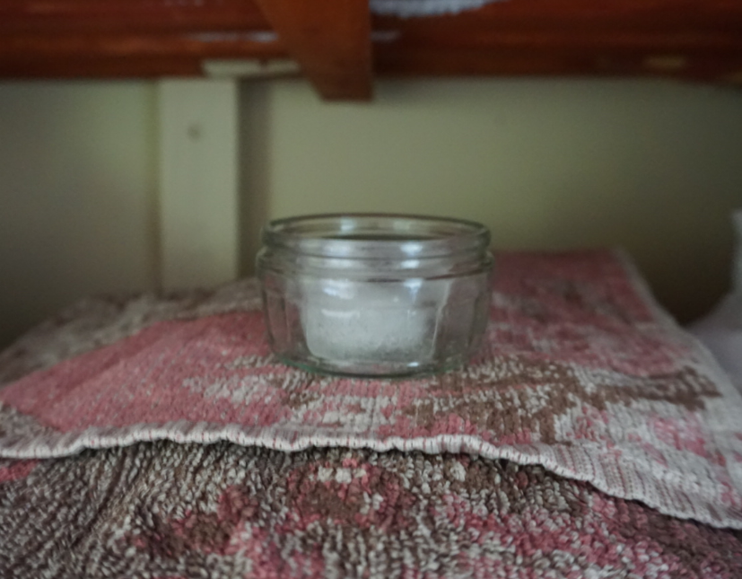
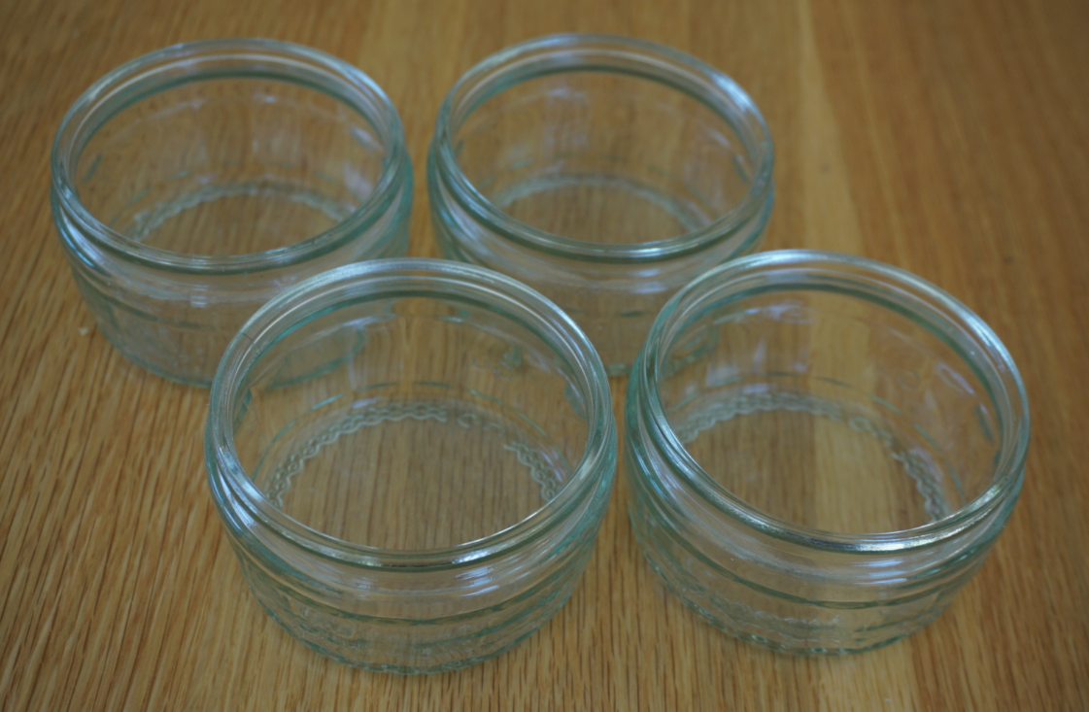
Taking it further…
Another option for investigating melting
(10-15 minutes plus freezing and melting time!)
Ask an adult to work with you. This activity is described in ‘Science Fun At Home’ – Activity 2: Melting ice. https://pstt.org.uk/application/files/9315/8513/5527/1._Science_with_Ice.pdf
Activity:
Using an ice cube tray, use the same volume of water to make four same size ice cubes.
Pop out the ice cubes and put each one in a separate container.
Choose different places to put them.
Where does the ice cube melt the most quickly? Why might that be?
What might you do differently next time?
You will need:
An empty ice cube tray.
water.
4 small bowls or containers.

Slide 7
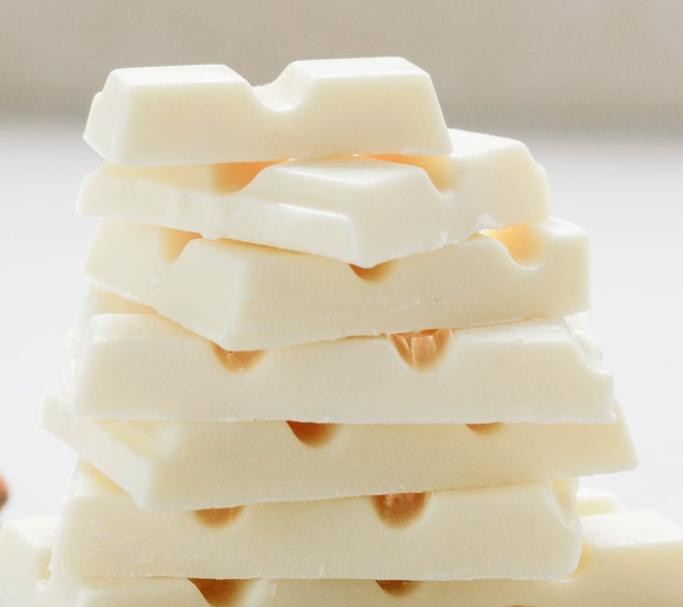
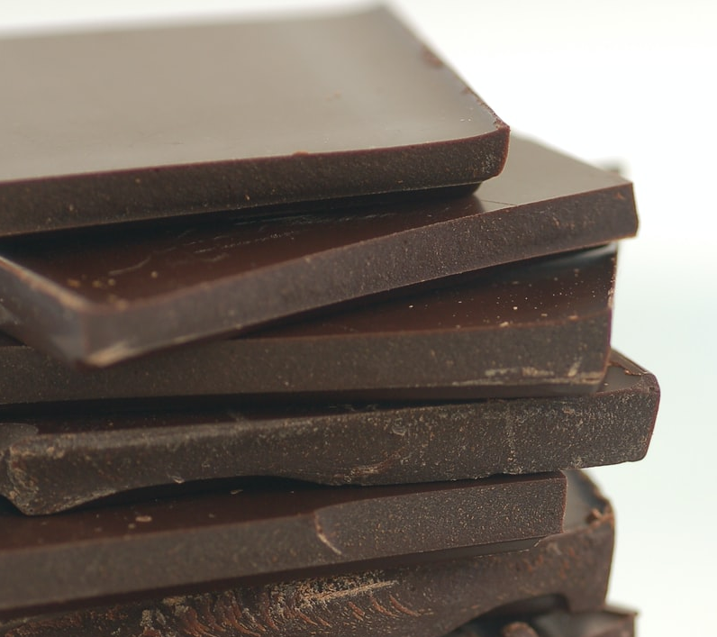

Find out more…
Find out more about melting chocolate
In this Royal Society clip, Brian Cox explores chocolate making:
https://www.youtube.com/watch?v=OnE_84GtPdU&list=PLg7f-TkW11iV563gfcXjRlafm2jlklQOc&index=12&t=0s
Do different types of chocolate melt in the
same way?
Watch this clip about how you can investigate chocolate: https://www.youtube.com/watch?v=CA2d_b8E6Ds
Ask an adult if you can try your own investigation with chocolate. Think about a question you could try to answer.
Why does the chocolate maker check the temperature of the liquid chocolate?
How do you make a ‘perfect bar’ of creamy chocolate?

Slide 8
Glossary of terms
States of matter: There are three states of matter: solid, liquid and gas.
Temperature: Temperature measures how hot or cold a material is.
ºC (degrees Celsius): The temperature of a material is measured in ºC (degrees Celsius).
Change of state: Solids can be heated and change from a solid to a liquid. This is a change of state.
Melting: Melting is a change of state from solid to liquid.
Melting point: The temperature a liquid melts at is called its melting point. The melting point of water is 0ºC.
Freezing: Freezing is a change of state from liquid to solid.
Freezing point: The temperature a liquid freezes at is called its freezing point. The freezing point of water is 0ºC.

Slide 9
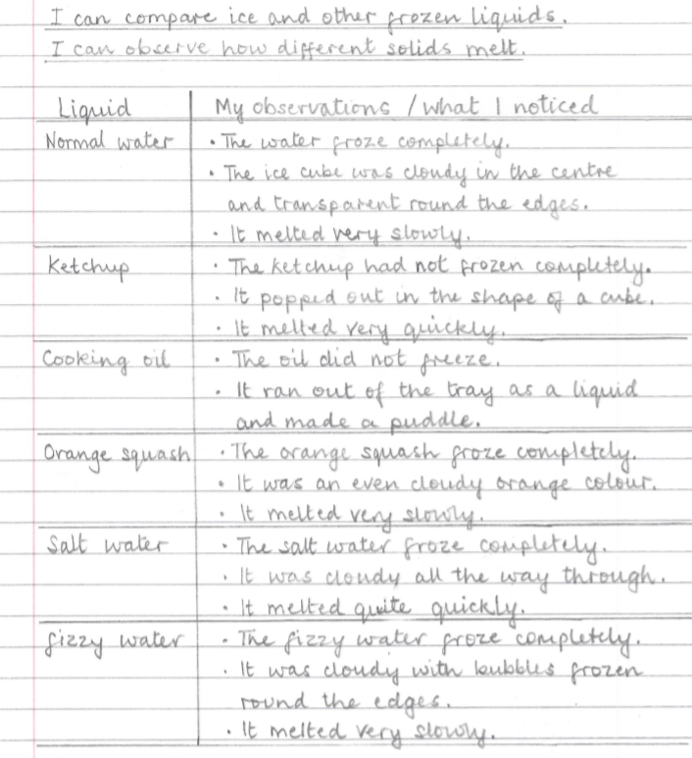
Water freezes from the outside towards the centre of the cube. Tiny air bubbles and any minerals get pushed to the centre of the cube creating a ‘cloud’ in the middle.
Watch the Royal Society of Chemistry’s ‘Intriguing ice demonstration’ for an extra explanation about different frozen liquids: https://www.youtube.com/watch?time_continue=3&v=U4LbXZib0s0&feature=emb_logo
Possible learning outcome for reviewing your work:
Water freezes at 0ºC. Adding salt to the water lowers the freezing point. This means that the salty ice cube will melt more quickly. It is why salt is spread on roads during icy weather.
Fizzy drinks have dissolved carbon dioxide gas. As the liquid freezes tiny bubbles of carbon dioxide get trapped, so the frozen cube looks cloudy.
Cooking oil freezes at about -10ºC. Many freezers are not cold enough to freeze oil.
Ketchup is a mixture of ingredients including oil, so it does not freeze easily.
Squash and juice freeze at a similar temperature to water.

