Slide 1
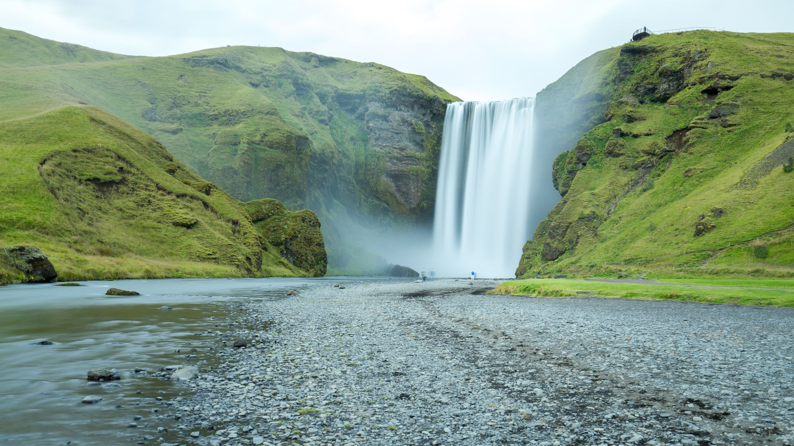


States of matter
For parents
Thank you for supporting your child’s learning in science.
Before the session:
Please read slide 2 so you know what your child is learning and what you need to get ready.
You may like to print page 7 as a worksheet.
During the session:
Share the learning intentions on slide 2.
Support your child with the main activities on slides 3-7, as needed.
Slides 8 gives a further activity with slide 9 as an optional worksheet.
Slide 10 has a glossary of key terms.
Reviewing with your child:
Slide 11 gives an idea of what your child may produce.
Understanding evaporation, condensation and the water cycle
Year 4 Age 8 - 9

Slide 2


States of matter
Understanding evaporation, condensation and the water cycle
Key Learning
The water cycle is an example of evaporation and condensation.
Water at the surface of seas, lakes and rivers evaporates into water vapour, a gas.
Water vapour rises and cools. It condenses back into liquid water droplets which form clouds.
When the water droplets in a cloud get too heavy, they fall as rain, sleet or snow. This is known as precipitation.
Activities (pages 3-7): 30 - 45 mins, plus time for your model to start working.
Household items to support learning:
A glass and some ice cubes.
Materials to make a model of the water cycle (three options – see page 6).
Use lined paper and a pencil. Alternatively may wish to print page 7 as a worksheet.
Taking it further… (page 8-9)
You may like to write a short story or make an illustrated story board to describe the journey of a water droplet in the water cycle.
I can…
make a model of the water cycle.
evaluate how well the model shows evaporation, condensation and precipitation.

Slide 3
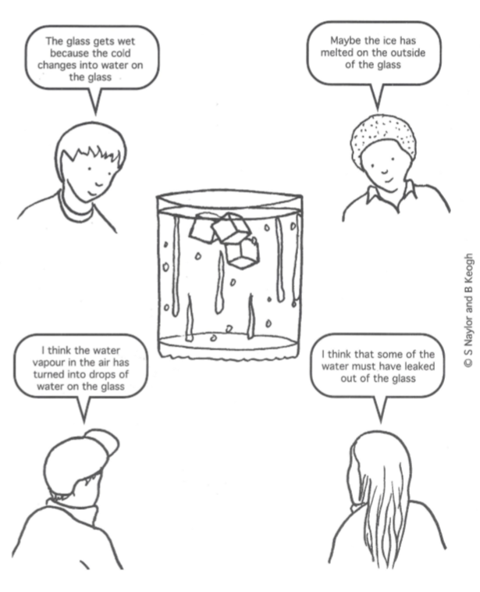
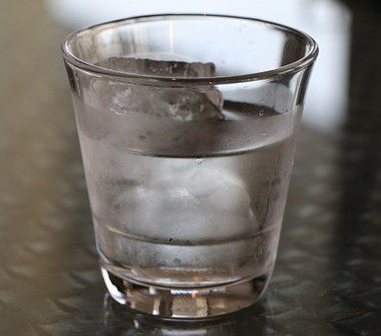
Explore, review, think, talk…
What do you already know about condensation?
(5 minutes)
Find a glass and fill it with cubes of ice.
Top up the glass with water.
Wait for five minutes.
What do you notice?
Which of these children do you agree with?
Do you have another idea?
Concept Cartoons, 2000. Reproduced courtesy of Millgate House Education Ltd.

Slide 4
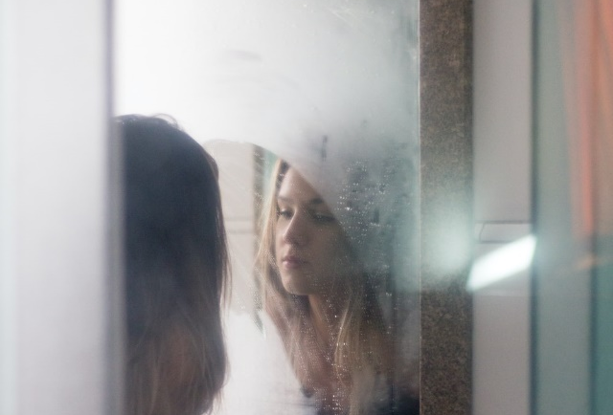
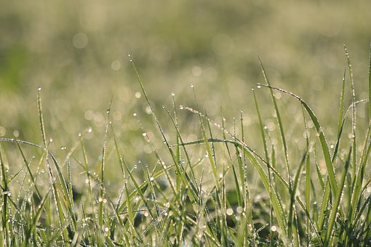
Evaporation and condensation
Understanding how water evaporates and condenses
(10 minutes)
Water vapour is an invisible gas. There is a small amount of water vapour in the air all around us.
The outside of a glass of iced water is cold, so some of the water vapour in the air can cool and condense into tiny droplets of water.
Where else can you sometimes see ‘condensation’?
How does water vapour get into the air? Watch this clip: https://www.bbc.co.uk/bitesize/topics/zkgg87h/articles/zydxmnb
evaporating
gas
liquid
condensing
Evaporating and condensing are changes of state.
Liquid water is warmed up and changes to an invisible gas, water vapour.
Water vapour can cool down and change back to water droplets.
a bathroom mirror
dew on a cool morning

Slide 5
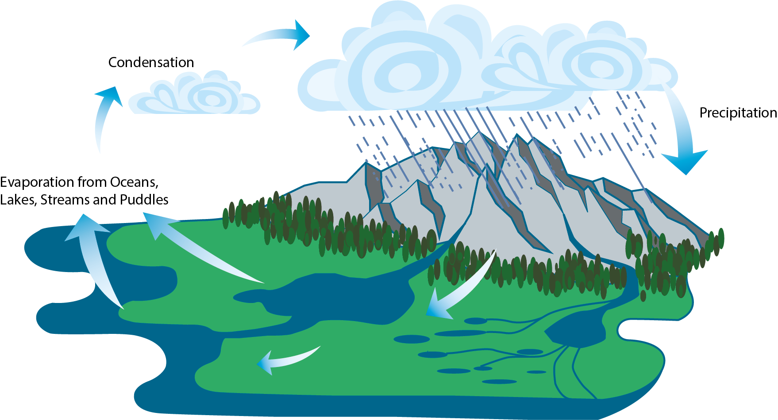
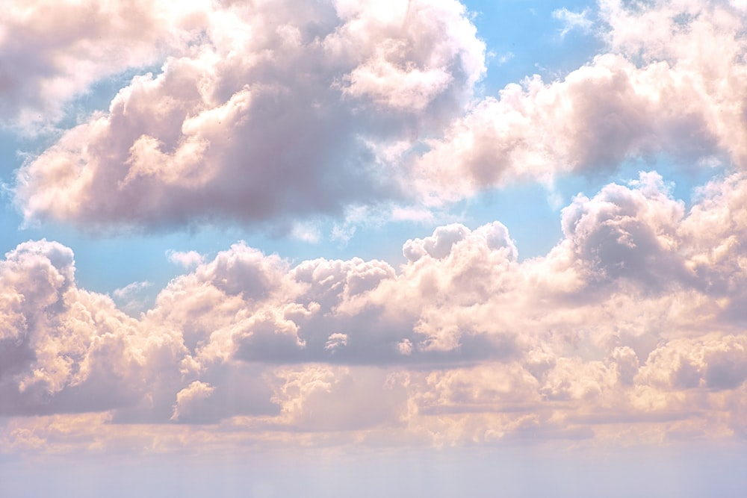
The water cycle
Investigating and modelling the water cycle
(20-30 minutes, plus time for your model to start working)
Watch these two BBC bitesize clips: https://www.bbc.co.uk/bitesize/topics/zkgg87h/articles/z3wpp39
https://www.bbc.co.uk/bitesize/clips/zh4rkqt
The water cycle is an example of evaporation and condensation.
Water vapour rises and cools. It condenses back into liquid water droplets which form clouds.
The Water Cycle
When the water droplets in a cloud get too heavy, they fall as precipitation - rain, sleet or snow.
Water at the surface of seas, lakes, rivers, puddles and damp ground evaporates into water vapour, a gas.

Slide 6
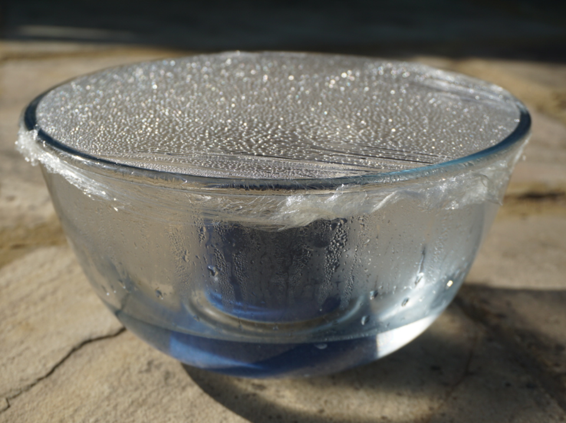
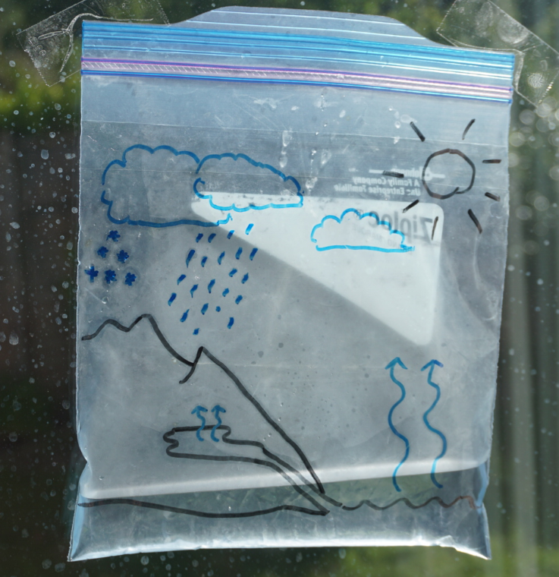
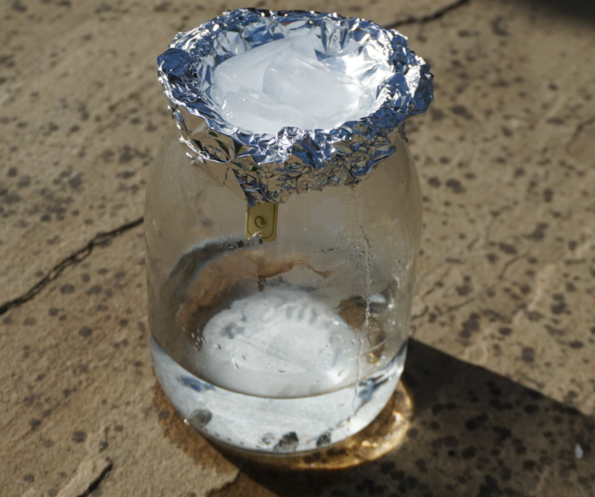
You can make different water cycle models. Ask an adult to help you. Choose one of these options:
In a bowl
You will need:
an empty transparent bowl
an empty cup or mug
cling film
warm water
Pour some warm water into a bowl (about ¼ full).
Put an empty cup in the middle.
Cover the bowl with clingfilm.
Stand it in a warm place.
Observe throughout the day.
In a plastic bag
You will need:
a sealable plastic bag
a marker pen
sticky tape
warm water
Draw a diagram of the water cycle on your bag using a marker pen.
Pour in a small amount of warm water.
Seal the top with tape/zip.
Stick it to a sunny window.
Observe throughout the day.
In a glass jar
You will need:
a small empty glass jar
kitchen foil
3 ice cubes
warm water
Pour some warm water into a glass jar (about ¼ full).
Cover the top with some kitchen foil.
Put three ice cubes on top of the foil.
Stand it in a warm place.
Observe throughout the day.
You might like to add blue food colouring to the water.

Slide 7
I can make and evaluate a water cycle model. (You may like to take a photograph or draw and label a sketch.)
Write a paragraph to evaluate how well your model represents the water cycle.
Key words: evaporation / evaporates, condensation / condenses, precipitation, water vapour, water droplet, cloud, rain, sleet, snow, sea, lake, river, puddle.
_______________________________________________________________________________________________________________________________________________________________________________________________________________________________________________________________________________________________________________________________
0

Slide 8
Taking it further…
Write a short story or make an illustrated story board
Read this description of the water cycle in DK find out.
https://www.dkfindout.com/uk/earth/water-cycle/
Imagine you are a droplet of water.
Write a short story to describe your journey round the water cycle.
You may like to create an illustrated story board using the template on page 9.

Slide 9
__________________________________________________________________
__________________________________________________________________
__________________________________________________________________
__________________________________________________________________
__________________________________________________________________
__________________________________________________________________
0

Slide 10
Glossary of terms
States of matter: There are three states of matter: solid, liquid and gas.
Change of state: Liquids can change from a liquid to a gas. This is a change of state.
Condensation: Condensation is a change of state when a gas is cooled and changes to a liquid.
Evaporation: Evaporation is a change of state from liquid to gas which can happen at any temperature and only at the surface of the liquid.
Precipitation: When the water droplets in a cloud get too heavy, they fall as rain, sleet or snow. This is known as precipitation.
Water cycle: The water cycle is the continuous process of evaporation, condensation and precipitation of the Earth’s water.

Slide 11
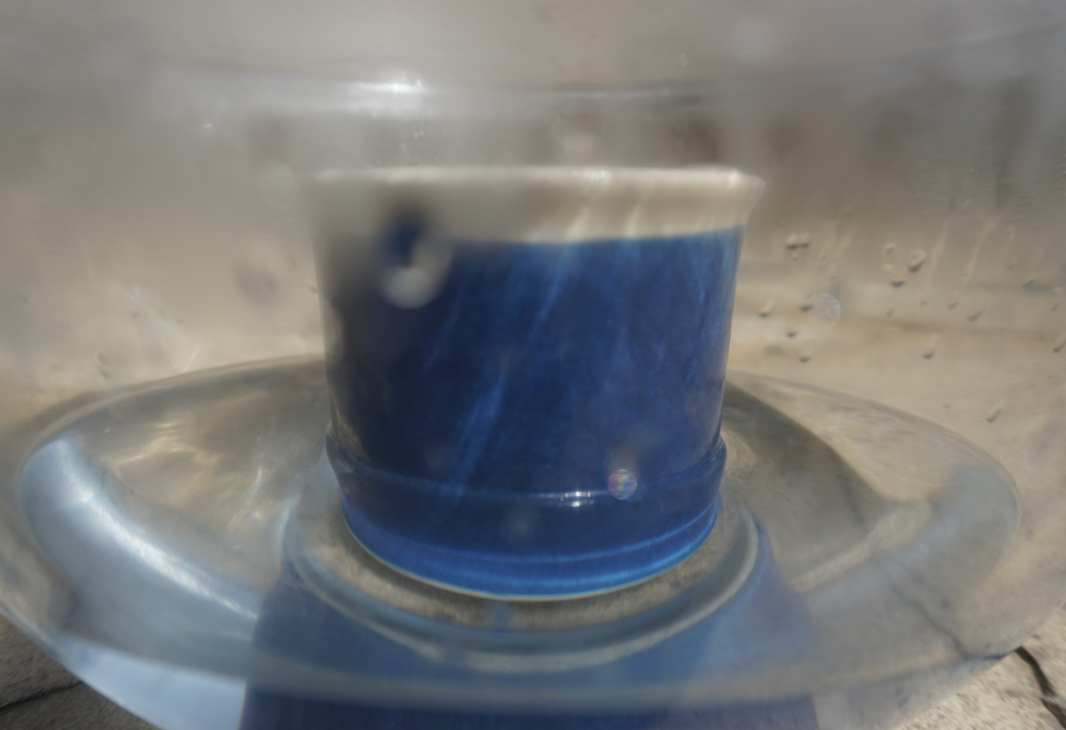
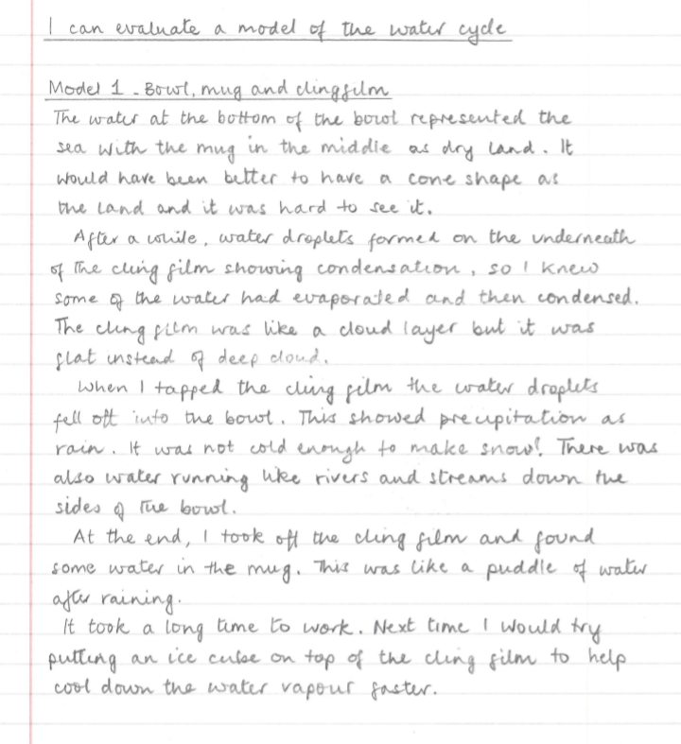
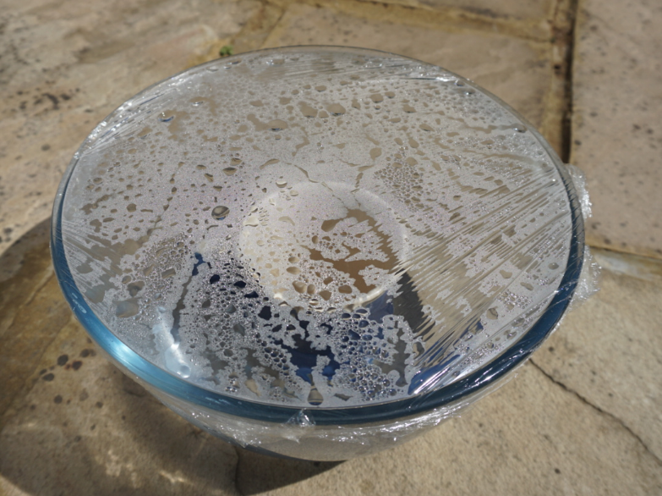
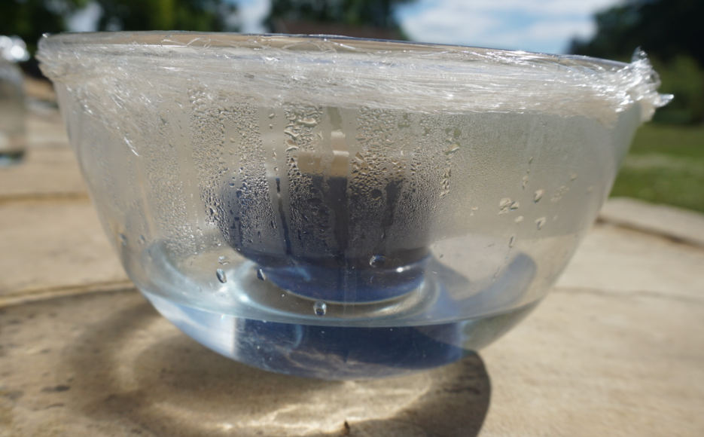
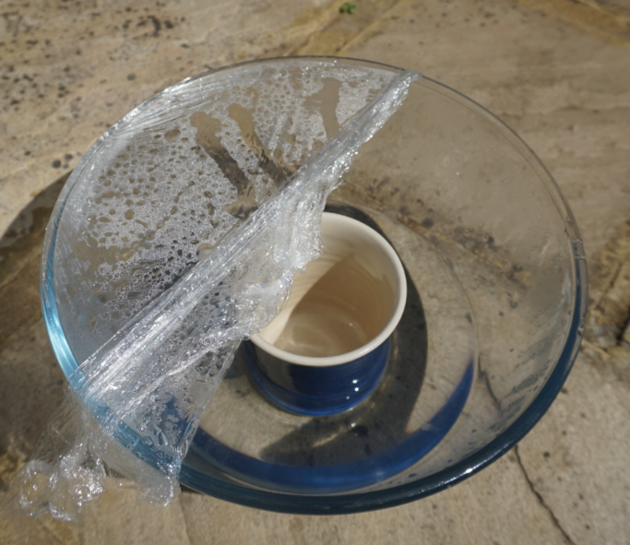
No model is a perfect representation. Your evaluation should mention where the model shows clear aspects of the water cycle. You should also highlight some of your model’s limitations.
You may like to suggest an improvement to the model. For example, adding an ice cube on top of the cling film would help cool the water vapour so it condenses more rapidly.

