Slide 1



States of matter
For parents
Thank you for supporting your child’s learning in science.
Before the session:
Please read slide 2 so you know what your child is learning and what you need to get ready.
As an alternative to paper, slide 6 may be printed for your child to record on.
During the session:
Share the learning intentions on slide 2.
Support your child with the main activities on slides 3-6, as needed.
Slide 7 has further, optional activities.
Slide 8 has a glossary of key terms.
Reviewing with your child:
Slide 9 gives an idea of what your child may produce.
Exploring the properties of gases
Year 4
Age 8 - 9

Slide 2


States of matter
Exploring the properties of gases
Key Learning
A gas fills all available space; it has no fixed shape or volume.
Many gases are invisible.
A gas has a mass, so its weight can be measured.
A gas can be squashed or compressed into a smaller space.
Activities (pages 3 - 6): 30 - 40 mins
Use lined paper, a ruler and a pencil.
Alternatively, you may like to print
page 6 as a worksheet.
Find out more… (page 7): 20 - 30 mins
You may like to investigate carbon dioxide
gas by making it from bicarbonate of soda.
I can…
understand the properties of gases.
describe some everyday uses of gases.

Slide 3

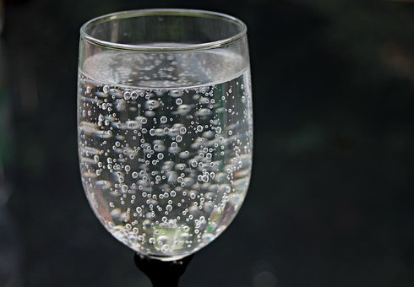
Explore, review, think, talk…
Does air weigh anything?
(5 - 10 minutes)
Does the air in a balloon weigh anything?
How do you think you could find out?
Think or talk about the questions, then watch this clip: https://www.bbc.co.uk/bitesize/clips/zhbygk7
What did the children in the clip find out about the gas in fizzy drinks?
How did they investigate?
Can this help you answer the question about air in a balloon?

Slide 4


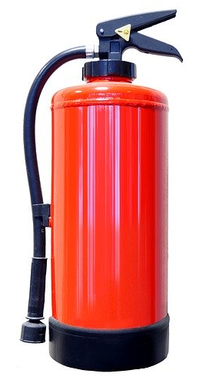
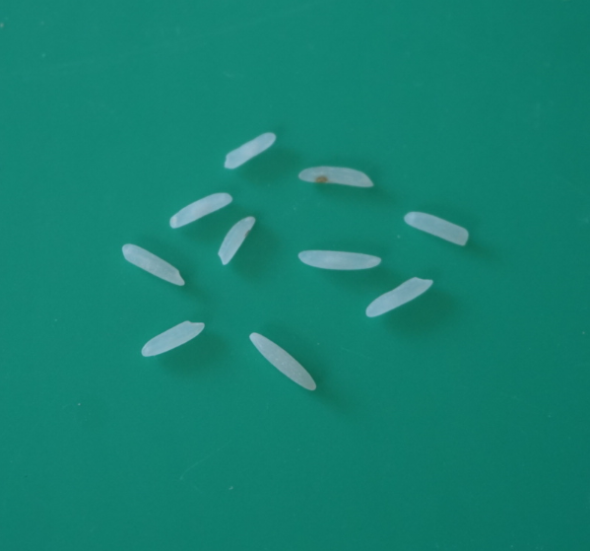
Properties of gases
Do gases weigh anything?
(5-10 minutes)
Many gases are invisible, including the air around us.
However, all gases are made up of tiny particles of matter so they have a mass and can be weighed.
Air in a full party
balloon has a mass
of about 0.2 grams.
This is about the
same mass as ten
small grains of rice!
Helium is a very light gas. It is sometimes used to fill party balloons so they rise up in air.
Carbon dioxide is a gas which is heavier than air. It is sometimes used as a fire extinguisher because it can flow down over the flames.

Slide 5
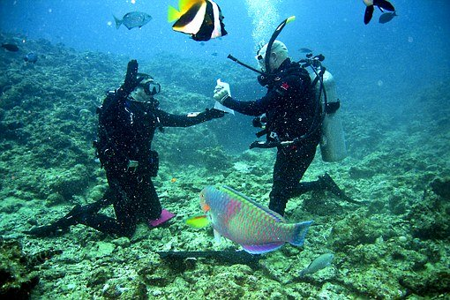
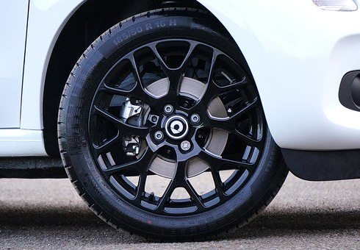

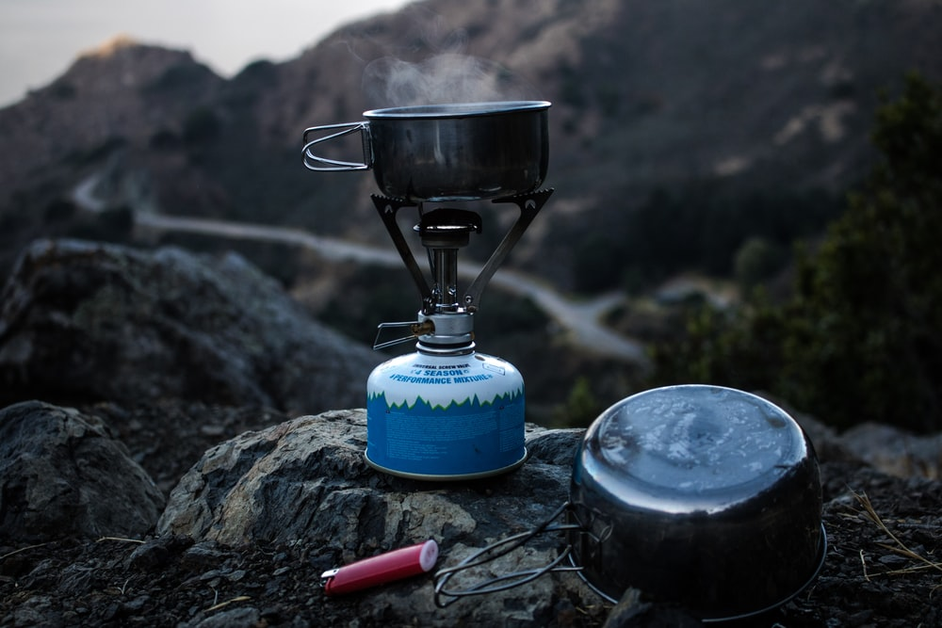

Properties of gases
Can gases be squashed or compressed into a smaller space?
(5 - 10 minutes)
Watch the first minute of this clip about deep sea diving to observe fish:
https://www.bbc.co.uk/programmes/articles/41CtKNScD66yfvn37tPzmNP/studying-tool-using-tusk-fish
Air can be squashed or compressed into a smaller space.
Scuba divers’ air tanks hold compressed air, so they can stay under water for a long time.
How else do we use compressed gas?
How does a scuba diver carry air to breathe under water?
Why can divers stay under water for over three hours?
car tyre
aerosol spray
cooking gas
bicycle tyre

Slide 6
Make a poster or mind map to describe some everyday uses of gases.
Use what you have learnt and the word bank to help you.
You may like to draw pictures or use photographs.
Word bank:
gas, compressed, air, helium, carbon dioxide, cooking gas, aerosol gas.
bicycle tyre, car tyre, balloon, fizzy drink, scuba diving tank, aerosol can, fire extinguisher, gas bottle, cooker.
I can describe some everyday uses of gases.
6

Slide 7


Find out more…
Find out more about carbon dioxide gas
(20 - 30 minutes)
Ask an adult if you can investigate more about carbon dioxide gas with them:
Use the link to the PSTT Science Fun at Home ‘What a gas!’ activity to investigate making carbon dioxide gas at home:
https://pstt.org.uk/application/files/8615/8814/8781/Science_Fun_at_Home_6_Gases.pdf
Use the link to the RSC’s Chemistry in your Cupboard ‘Building a rocket’ activity to find out how to make a gas propelled rocket by compressing carbon dioxide. (This is an outside activity only!)
https://bit.ly/3avocm1

Slide 8
Glossary of terms
States of matter: There are three states of matter: solid, liquid and gas.
Gas: A gas is a material which fills all available space; it has no fixed shape or volume.
Invisible: Many gases are invisible so you cannot see them.
Compressed: A gas can be compressed or squashed into a smaller space or volume. For example, divers use compressed air tanks under water.
Matter: A gas is made up of tiny particles of matter. This means gas has a mass and its weight can be measured.
Volume: The volume is the amount of space taken up by a solid, liquid or gas.

Slide 9
Possible learning outcome for reviewing your work: I can describe some everyday uses of gases.
Compressed air is pumped into bicycle tyres and car tyres so the wheels can roll smoothly on a road.
Helium gas is sometimes used in party balloons. Helium is lighter than air so the balloons rise up.
Carbon dioxide is added to some drinks to make fizzy drinks like lemonade and coke.
Compressed air in a scuba diving tank is used by divers so they can breathe under water.
Carbon dioxide is used as a fire extinguisher. It is heavier than air so it will flow down over the flames.
Uses of gases
Aerosol cans often have compressed gas inside to help the spray to spread out.
Cooking gas is burnt to heat water and cook food. It is compressed into gas bottles for camping.

