Slide 1



Year 4: States of Matter
This topic overview is based on the PLAN knowledge matrix (for England). Please use link:
https://www.planassessment. com/states-of-matter-y4
The matrix includes:
National Curriculum learning objectives
Key learning
Key vocabulary
Common misconceptions
Possible activities & evidence
Topic overview for teachers
Age 8-9

Slide 2
Year 4 – States of Matter
Topic | Key Learning | page
Introduction to solids, liquids and gases | There are three states of matter: solid, liquid and gas. A solid keeps its shape and has a fixed volume. Some solids are made up of small grains which can be poured into a heap. A liquid has a fixed volume but changes in shape to fit the container. A liquid can be poured and keeps a level, horizontal surface. A gas fills all available space; it has no fixed shape or volume. | 4
Exploring the properties of liquids | A liquid has a fixed volume but changes in shape to fit the container. A liquid can be poured and keeps a level, horizontal surface. Some liquids flow less easily and are slow to pour. | 5
Changes of state: investigating freezing and melting | Melting is a change of state from solid to liquid. Freezing is a change of state from liquid to solid. The temperature a liquid freezes at is called its freezing point. The freezing point of water is 0ºC. Different substances have different freezing points. | 6
2

Slide 3
Year 4 – States of Matter
Topic | Key Learning | page
Changes of state: comparing boiling and evaporation | Boiling and evaporation are both a change of state from liquid to gas. Boiling happens at a specific temperature and bubbles of the gas can be seen inside the liquid. Water boils when it is heated to 100ºC. Evaporation happens at any temperature and only at the surface of the liquid. It happens more quickly if the temperature is higher, the liquid has a larger surface area or it is windy. | 7
Understanding evaporation, condensation and the water cycle | The water cycle is an example of evaporation and condensation. Water at the surface of seas, lakes and rivers evaporates into water vapour, a gas. Water vapour rises and cools. It condenses back into liquid water droplets which form clouds. When the water droplets in a cloud get too heavy, they fall as rain, sleet or snow. This is known as precipitation. | 8
Exploring the properties of gases | A gas fills all available space; it has no fixed shape or volume. Many gases are invisible. A gas has a mass, so its weight can be measured. A gas can be squashed or compressed into a smaller space. | 9
3

Slide 4
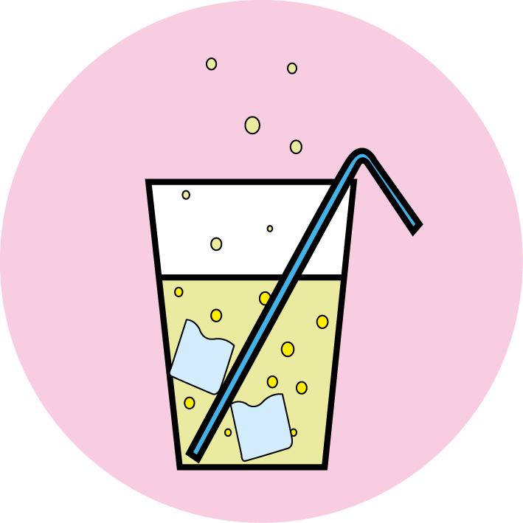
States of matter
Introduction to solids, liquids and gases
Key Learning
There are three states of matter: solid, liquid and gas.
A solid keeps its shape and has a fixed volume. Some solids are made up of small grains which can be poured into a heap.
A gas fills all available space; it has no fixed shape or volume.
A liquid has a fixed volume but changes in shape to fit the container. A liquid can be poured and keeps a level, horizontal surface.
Activities and websites
Exploring prior knowledge about solids and liquids.
https://www.bbc.co.uk/bitesize/clips/zv4rkqt
Comparing the properties of solids, liquids and gases.
https://www.bbc.co.uk/bitesize/clips/zrdkjxs
https://www.bbc.co.uk/bitesize/topics/zkgg87h/articles/zsgwwxs
Classifying a range of objects as solids, liquids or gases using a Venn diagram.
Additional activity to explore solids, liquids and gases in fruits and vegetables. https://pstt.org.uk/application/files/1115/8694/0466/4._SINK_OR_SWIM.pdf
I can…
classify a range of objects and materials as solids, liquids or gases.

Slide 5
States of matter
Exploring the properties of liquids
Key Learning
A liquid has a fixed volume but changes in shape to fit the container. A liquid can be poured and keeps a level, horizontal surface.
Some liquids flow less easily and are slow to pour.
Activities and websites
Exploring the properties of liquids.
Investigating the thickness of different liquids.
https://www.youtube.com/watch?time_continue=1&v=m3dzLaZKmDE&feature=emb_logo
Additional optional activities to find out more about floating and sinking in different liquids.
https://pstt.org.uk/application/files/6115/8633/7142/3._EGG-CITING_SCIENCE.pdf
https://www.youtube.com/watch?time_continue=30&v=QwCgPkPrA-A&feature=emb_logo
I can…
describe the properties of liquids.
compare the thickness of different liquids.

Slide 6
States of matter
Changes of state: investigating freezing and melting
Key Learning
Melting is a change of state from solid to liquid. Freezing is a change of state from liquid to solid.
The temperature a liquid freezes at is called its freezing point. The freezing point of water is 0ºC.
Different substances have different freezing points.
Activities and websites
Exploring prior knowledge about melting and freezing.
https://www.bbc.co.uk/bitesize/topics/zkgg87h/articles/z9ck9qt
Observing how different liquids freeze and melt.
https://pstt.org.uk/application/files/9315/8513/5527/1._Science_with_Ice.pdf
Optional further activity investigating melting.
Optional activity to find out more about melting different types of chocolate.
https://www.youtube.com/watch?v=OnE_84GtPdU&list=PLg7f-TkW11iV563gfcXjRlafm2jlklQOc&index=12&t=0s
https://www.youtube.com/watch?v=CA2d_b8E6Ds
I can…
compare ice and other frozen liquids.
observe how different solids melt.

Slide 7
States of matter
Changes of state: comparing boiling and evaporation
Key Learning
Boiling and evaporation are both a change of state from liquid to gas.
Boiling happens at a specific temperature and bubbles of the gas can be seen inside the liquid. Water boils when it is heated to 100ºC.
Evaporation happens at any temperature and only at the surface of the liquid. It happens more quickly if the temperature is higher, the liquid has a larger surface area or it is windy.
Activities and websites:
Exploring prior knowledge about boiling and evaporation.
Understanding the difference between boiling and evaporation.
https://www.bbc.co.uk/bitesize/clips/z9d9wmn
Investigating how quickly water evaporates with a comparative test.
Optional activity to design another investigation to explore how quickly water evaporates.
I can…
compare boiling and evaporation.
investigate how quickly water evaporates from different sized containers.

Slide 8
States of matter
Understanding evaporation, condensation and the water cycle
Key Learning
The water cycle is an example of evaporation and condensation.
Water at the surface of seas, lakes and rivers evaporates into water vapour, a gas.
Water vapour rises and cools. It condenses back into liquid water droplets which form clouds.
When the water droplets in a cloud get too heavy, they fall as rain, sleet or snow. This is known as precipitation.
Activities and websites:
Exploring prior knowledge on condensation.
Understanding how water evaporates and condenses.
https://www.bbc.co.uk/bitesize/topics/zkgg87h/articles/zydxmnb
Investigating and modelling the water cycle.
https://www.bbc.co.uk/bitesize/topics/zkgg87h/articles/z3wpp39
https://www.bbc.co.uk/bitesize/clips/zh4rkqt
Optional activity to describe the journey of a water droplet in the water cycle.
https://www.dkfindout.com/uk/earth/water-cycle/
I can…
make a model of the water cycle.
evaluate how well the model shows evaporation, condensation and precipitation.

Slide 9
States of matter
Exploring the properties of gases
Key Learning
A gas fills all available space; it has no fixed shape or volume.
Many gases are invisible.
A gas has a mass, so its weight can be measured.
A gas can be squashed or compressed into a smaller space.
Activities and websites
Does air weigh anything?
Comparing air, helium and carbon dioxide.
https://www.bbc.co.uk/bitesize/clips/zhbygk7
Understanding that gases can be compressed.
https://www.bbc.co.uk/programmes/articles/41CtKNScD66yfvn37tPzmNP/studying-tool-using-tusk-fish
Describing some everyday uses of gases.
Optional activities making carbon dioxide gas.
https://pstt.org.uk/application/files/8615/8814/8781/Science_Fun_at_Home_6_Gases.pdf
https://bit.ly/3avocm1
I can…
understand the properties of gases.
describe some everyday uses of gases.

