Slide 1
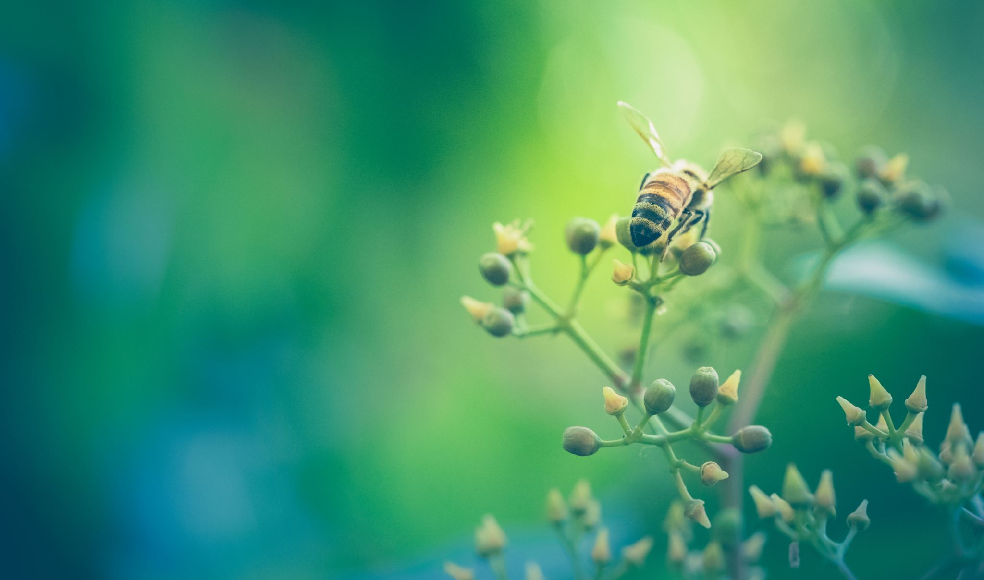



Living things and their habitats
For parents
Thank you for supporting your child’s learning in science.
Before the session:
Please read slide 2 so you know what your child is learning and what you need to get ready.
There are two suggested practical activities.
During the session:
Share the learning intentions on slide 2.
Support your child with the main activities on slides 3 to 7, as needed.
Slide 8 has an extra optional activity.
Slide 9 has a glossary of key terms.
Reviewing with your child:
Slides 10 and 11 give an idea of what your child may produce.
Pollination in flowering plants
Year 5
Age 9-10

Slide 2
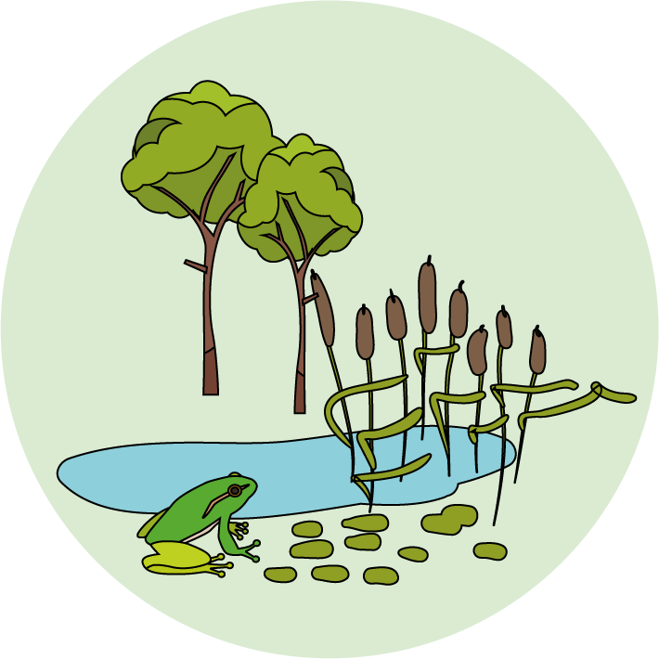

Living things and their habitats
Logo for section to sit inside roundel
Pollination in flowering plants
Key Learning
Sexual plant reproduction occurs through pollination, usually involving wind or insects.
There are male and female parts of a flower. The pollen is transferred from the male stamen to the female stigma during pollination.
Activities (pages 3-7): 40 - 50 mins
Use paper and a pencil.
You may wish to print page 6.
There are two alternative practical activities.
For a flower survey, you will need access to an outside area with some flowers.
For a flower dissection you will need a flower with clearly visible male and female parts such as a tulip, lily or daffodil.
If you unable to do a practical activity, there is an alternative suggestion on page 8.
I can…
Explain how flowering plants are pollinated in different ways.
Identify the different parts of a flower which are involved in pollination.
2

Slide 3
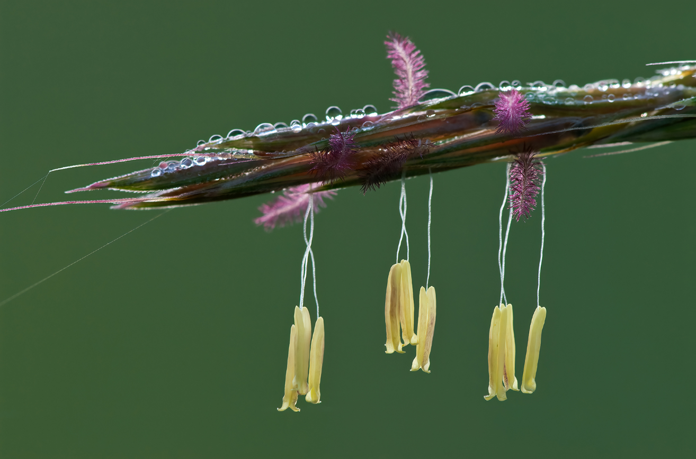
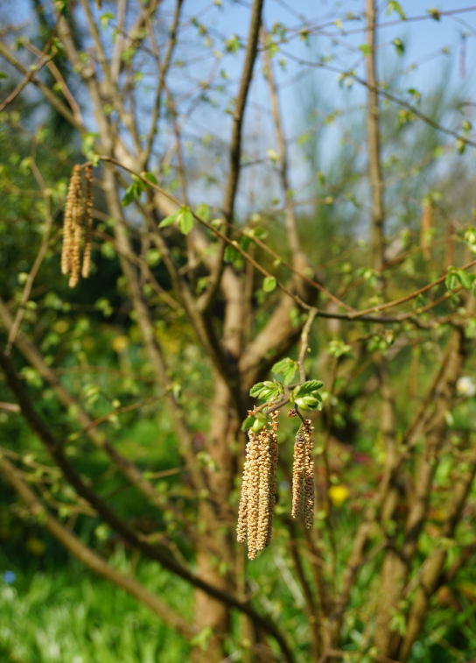
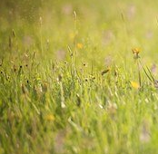
Explore, review, think, talk….
Logo for section to sit inside roundel
What do you already know about pollination?
(5 minutes)
Talk or think about what you already know about pollen.
Watch these two clips. https://www.bbc.co.uk/programmes/p00lx94l
Many flowering trees and grasses are pollinated by the wind.
stigma
Which type of tree has catkins?
What happens to the pollen?
stamen
Tiny pollen grains on male stamen are blown away by the wind.
Some of the pollen will land on the female part of another flower, called the stigma.
This is called wind pollination.
https://www.bbc.co.uk/programmes/p006997b
Why do some people get hay fever?
3

Slide 4
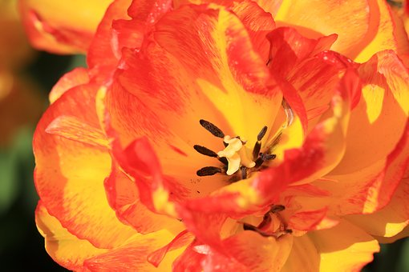
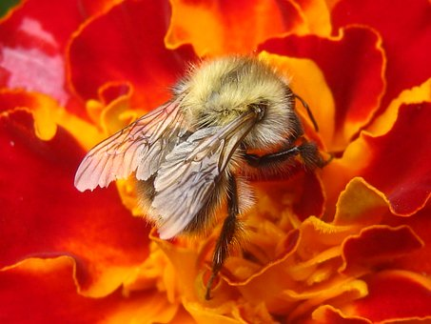
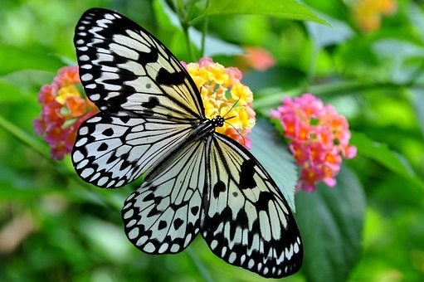
Comparing wind and insect pollination
Logo for section to sit inside roundel
Compare the differences between flowers pollinated by the wind and by insects
(5-10 minutes)
Many flowers are pollinated by insects.
Watch this clip. Talk or think about why a variety of insects act as pollinators. https://www.bbc.co.uk/bitesize/clips/zmrb4wx
You may have noticed…
Many insect-pollinated flowers:
have brightly coloured petals that attract insects.
produce nectar that insects feed on.
have a central stigma (sticky tip of the female part of the flower) surrounded by several stamens (the male part of the flower).
Many wind-pollinated flowers of grasses or trees:
have dull colours and do not produce nectar.
have feathery stigmas and hanging stamens.
Now watch this clip. Jot down any differences you notice between insect pollination and the wind pollination you saw earlier. https://www.bbc.co.uk/bitesize/clips/zfx76sg
4

Slide 5
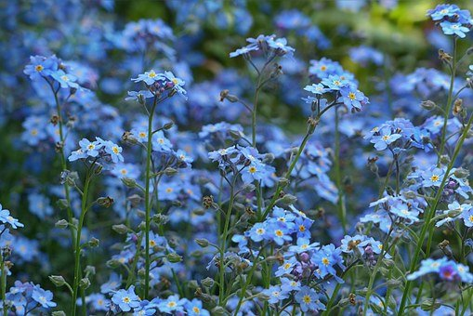
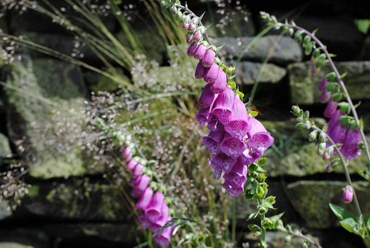
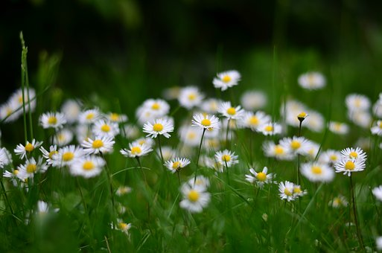
Investigate insect-pollinated flowers
Logo for section to sit inside roundel
Conduct a survey of flowers in a local environment
(page 5-6: 20-30 minutes)
Option 1: Conduct a survey of flowers
You can find many flowering plants in gardens during the spring and summer months.
If you are able to go outside, conduct a survey of plants with flowers.
Look carefully at each flower you find. What colour and shape are the petals? Can you see both a stigma and stamen?
You may like to compare two flowers.
Ask an adult to help you plan and conduct the survey.
Follow government guidelines on social distancing and staying safe.
Look carefully but avoid touching the flowers and insects you find.
You may like to take photographs.
The key on page 6 shows some of the flowers you may find. The ‘Seek’ app and many websites can also help you identify flowers:
https://www.wwf.org.uk/discover-nature-seek-app
https://www.woodlandtrust.org.uk/trees-woods-and-wildlife/plants/wild-flowers/
https://www.countrylife.co.uk/gardens/a-simple-guide-to-the-wildflowers-of-britain-71271
6

Slide 6
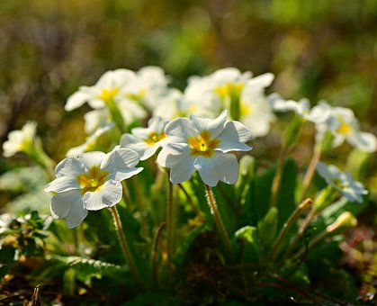
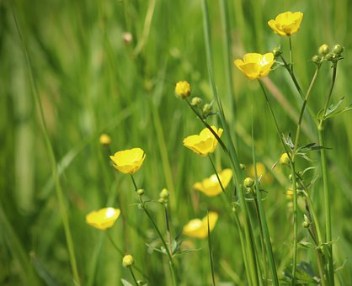
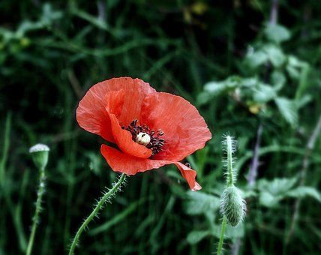
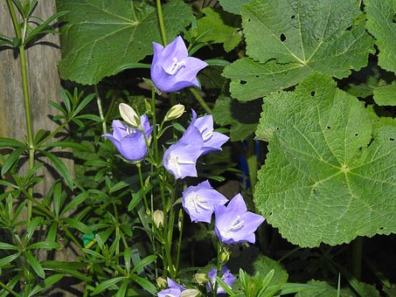
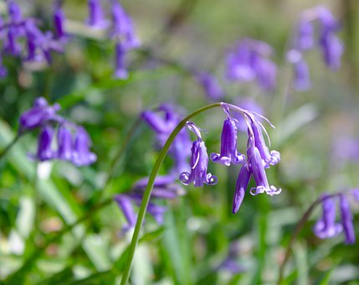
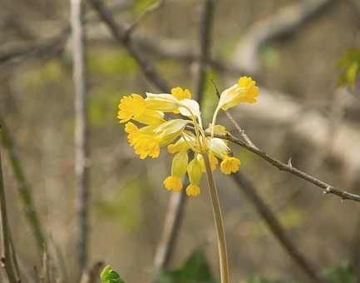
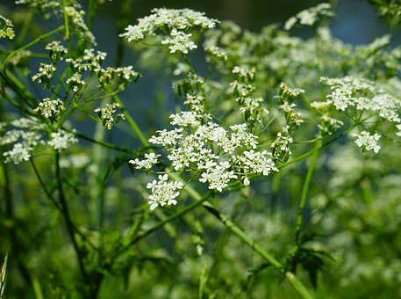
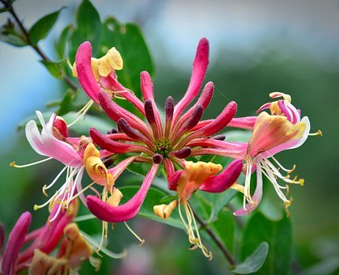
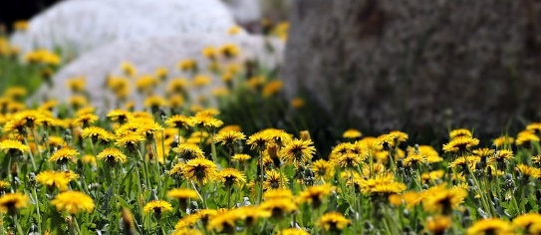
I can conduct a survey of plants with flowers and compare different flowers.
primrose
buttercup
foxglove
poppy
daisy
harebell
bluebell
cowslip
cow parsley
forget me not
dandelion
honeysuckle
6

Slide 7
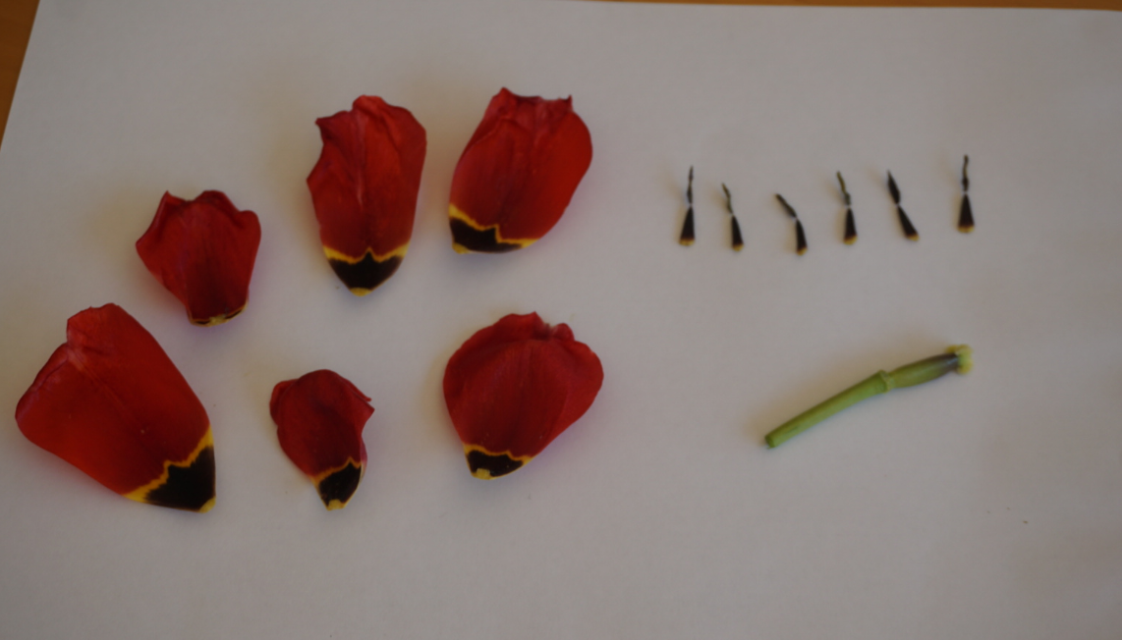
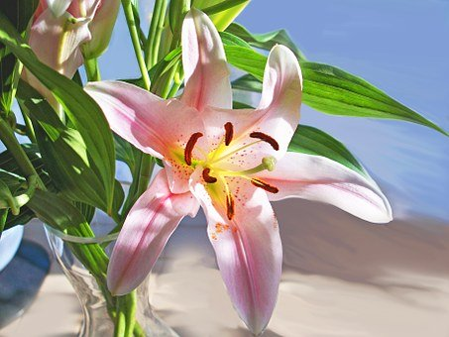
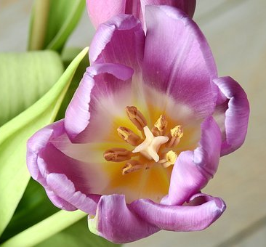
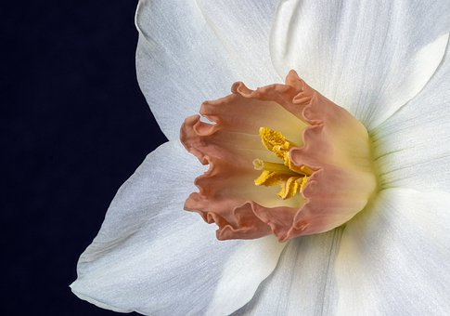
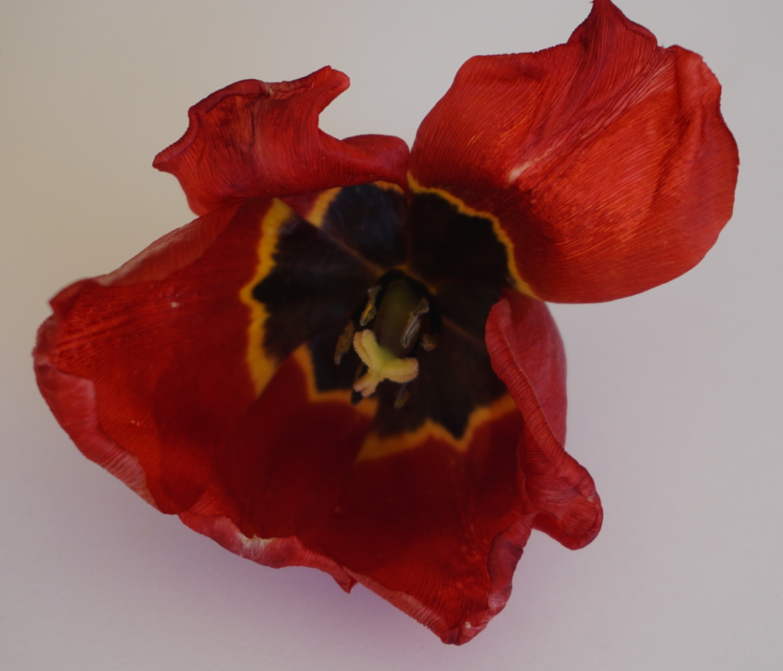
Investigate insect-pollinated flowers
Logo for section to sit inside roundel
Dissect a single flower
(15 minutes)
Option 2: Dissect a single flower
If you are unable to visit a garden or area with flowers, you may be able to buy a flower.
There are many flowers like lilies, tulips and daffodils which can be looked at carefully to observe the male and female parts of the flower.
Start by looking at the whole flower closely to try and identify the petals, the stigma (sticky tip of female part) and the stamen (male part).
Take the flower apart gently, starting from the outside and working inwards.
Lay out the different parts and label them.
You may like to take a photograph.
6

Slide 8
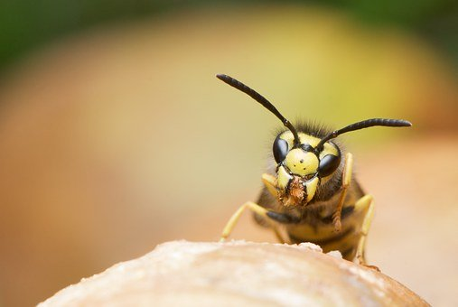
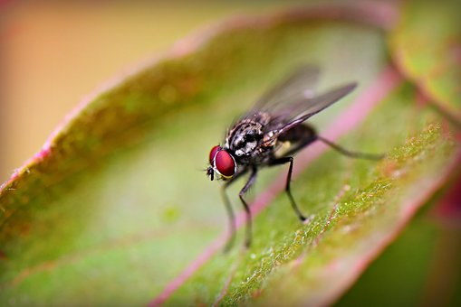
Find out more…
Logo for section to sit inside roundel
Find out how some flowers attract their pollinators in unusual ways
Some plants have developed unusual ways of attracting insects.
Watch these two clips from ‘Life of Plants’
1. Wild orchids and male wasps
https://www.bbc.co.uk/programmes/p00lx7qx
2. Dead horse arums and blow flies
https://www.bbc.co.uk/programmes/p00lx782
Choose one of the clips to watch again.
Take notes about the way pollination occurs.
Write a short report or design a poster to describe how the wild orchid or the dead horse arum ‘deceives’ the insects to make sure their flowers are pollinated.
8

Slide 9
Glossary of terms
Sexual plant reproduction is when a plant reproduces by forming seeds or spores.
Pollination is when pollen is carried from the male part of a flower to the female part of another flower, usually by insects or the wind.
The stamen is the male part of the flower. It carries the pollen.
The stigma is the sticky tip of the female part of the flower. Pollen grains land on and stick to the stigma during pollination.
9

Slide 10
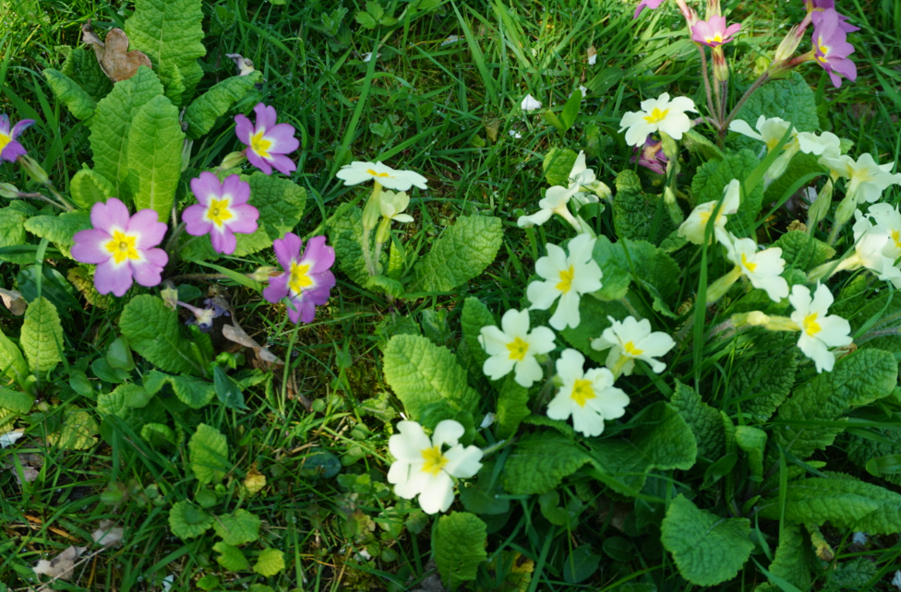
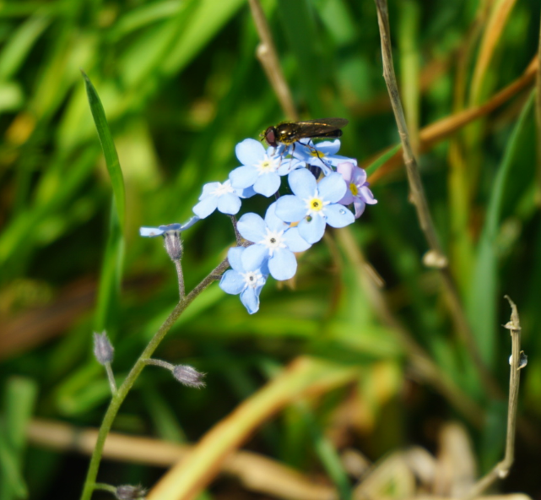
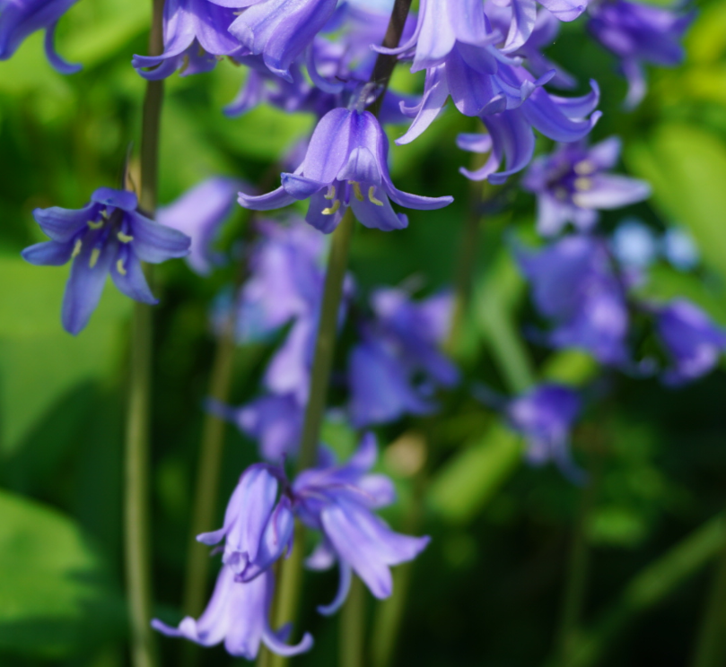
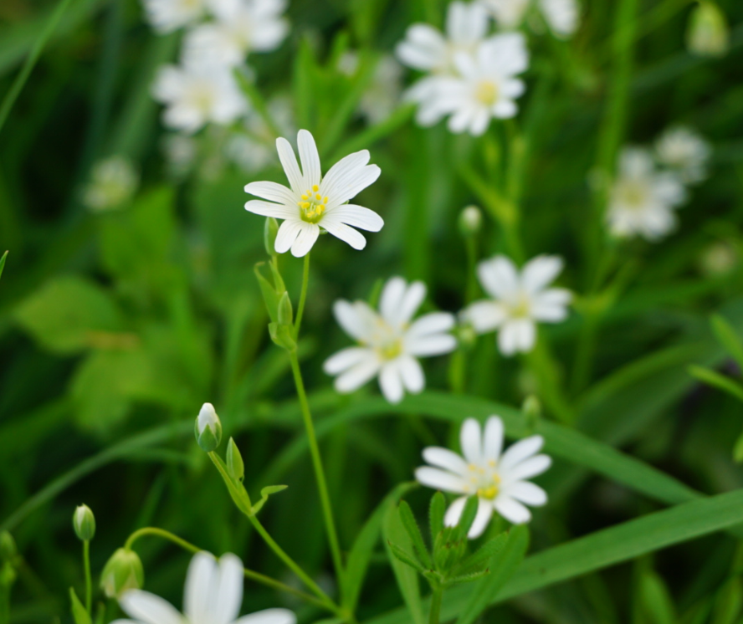
Possible learning outcome: I can conduct a survey of flowers and compare different flowers.
“I found seven different plants with flowers: primrose, forget-me-not, bluebell, daisy, cowslip, cow parsley and a plant with small white flowers called greater stitchwort (I found the name using Seek app).”
Comparing the primrose and the forget-me-not.
Comparing the greater stitchwort and the bluebell.
“The greater stitchwort had open white petals. I could see yellow stamen and a tiny stigma in the centre of the flower.”
“The bluebell had cone-shaped blue petals. I could see about seven long stamens and one stigma in the centre of the flower.”
“Some of the primroses had pink and dark yellow petals, others had light and dark yellow petals.”
“The forget-me-not had tiny blue petals with yellow at the centre.”
“The primrose and forget-me-not had the same shape of flower with a tiny hole in the centre of the petals. It was hard to see the stigma and stamens inside the hole.”
“The greater stitchwort and the bluebell had different shaped flowers but they both had visible stigmas and stamens.”
10

Slide 11
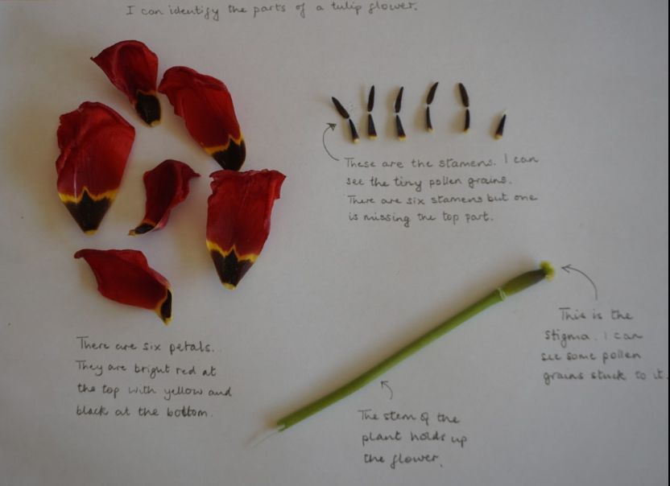
Possible learning outcome: I can identify the different parts of a flower which are involved in pollination.
11

