Slide 1
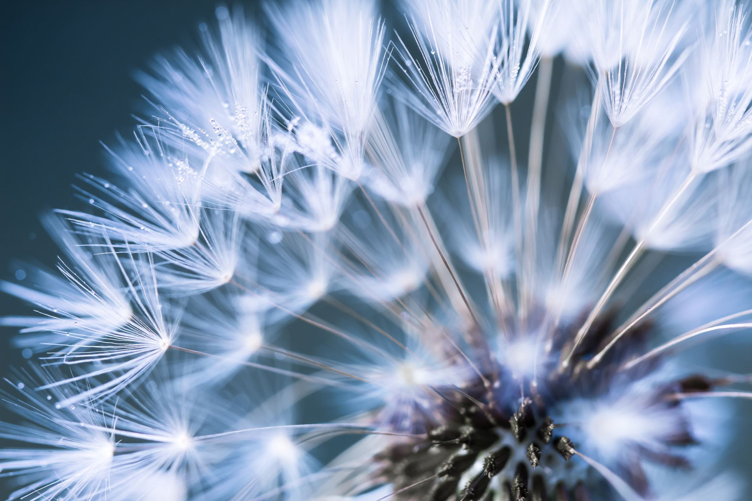



Living things and their habitats
For parents
Thank you for supporting your child’s learning in science.
Before the session:
Please read slide 2 so you know what your child is learning and what you need to get ready.
You may wish to print slide 7 and 8 as templates for the practical activity.
During the session:
Share the learning intentions on slide 2.
Support your child with the main activities on slides 3 to 6, as needed.
Slide 9 has an extra optional activity.
Slide 10 has a glossary of key terms.
Reviewing with your child:
Slide 11 gives an idea of what your child may produce.
Seed dispersal in plants
Year 5
Age 9-10

Slide 2
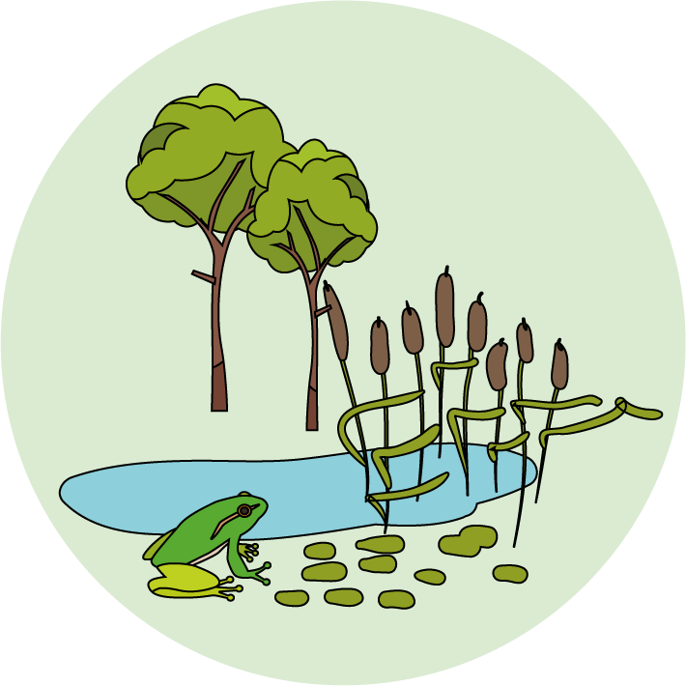

Living things and their habitats
Logo for section to sit inside roundel
Seed dispersal in plants
Key Learning
Seeds are formed as part of sexual plant reproduction.
Seeds need to be scattered so they can germinate away from the parent plant. This is called seed dispersal.
Activities (pages 3-7): 50 mins
You will need paper, scissors, a ruler and a pencil.
You may wish to print page 7 or page 8.
Find out more:
There is a further optional activity on page 9 to explore some more unusual ways seeds are dispersed.
I can…
Explain how the seeds of plants are dispersed in different ways.
Investigate a model for seed dispersal.
2

Slide 3
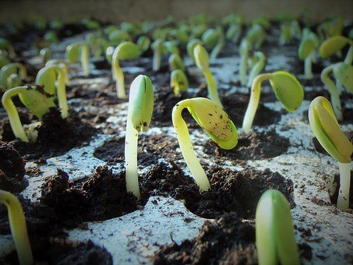
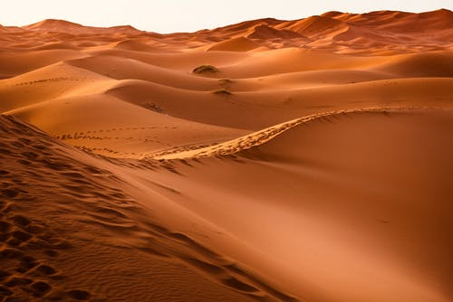
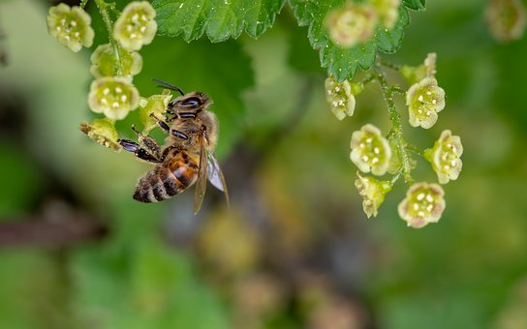
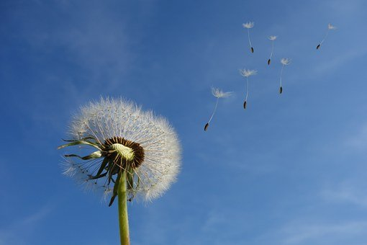
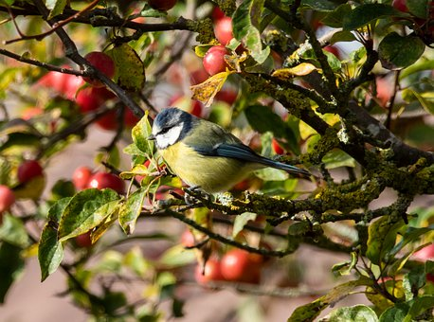
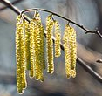
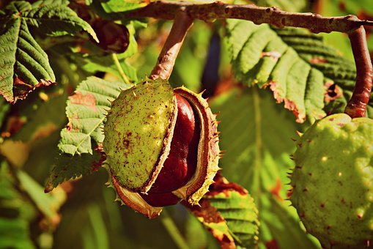
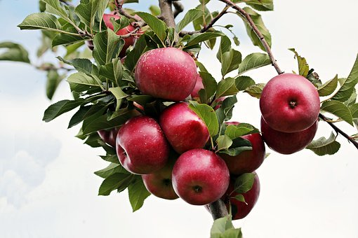
Explore, review, think, talk….
Logo for section to sit inside roundel
What do you already know about seed dispersal?
(5-10 minutes)
Watch this clip from ‘Life of Plants’.
https://www.bbc.co.uk/programmes/p00lxwk5
Seed dispersal is one stage in the life cycle of a plant.
Germination
How do you think the birdcage plant disperses its seeds?
Seed dispersal
Pollination
Seeds need to travel away from the parent plant so they can find a new place to germinate. This is called seed dispersal.
Think or talk about different types of seed dispersal you already know about .
Fertilisation and fruit formation
Dandelions use the wind to disperse their seeds:
https://www.bbc.co.uk/bitesize/clips/zs9c87h
3
3

Slide 4
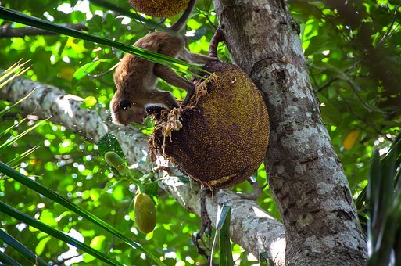
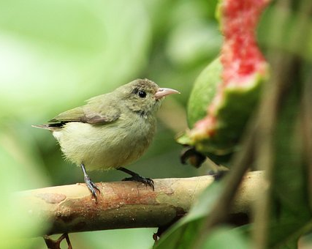
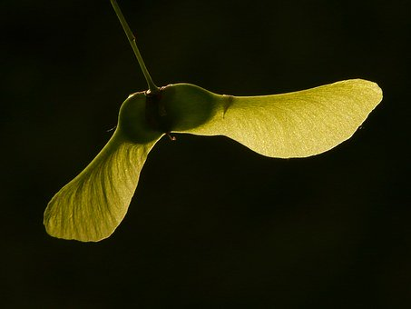
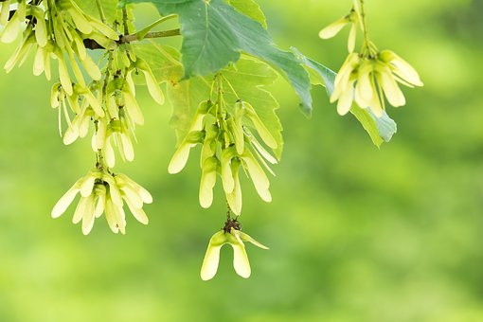
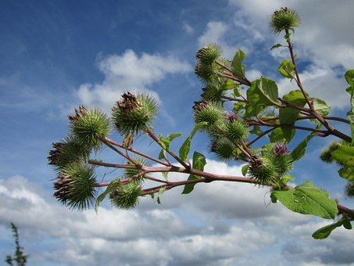
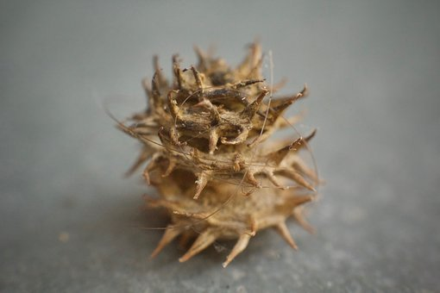
Different types of seed dispersal
Logo for section to sit inside roundel
Compare some different ways plants disperse their seeds
(10 minutes)
Seeds can be dispersed by animals.
Seeds dispersed by the wind often have ‘parachutes’ or ‘helicopters’ to help them.
Look at the seeds in this clip.
https://www.bbc.co.uk/programmes/p00lxw4t
Birds and other animals often eat the fruit of a plant. The seed is not digested and can travel large distances before it is ‘deposited’! https://www.bbc.co.uk/programmes/p00lxv9z
Other seeds have sticky burrs or spikes and catch on the fur or feet of animals to travel.
Think or talk about the differences between the seeds which are dispersed by animals and by the wind.
4

Slide 5
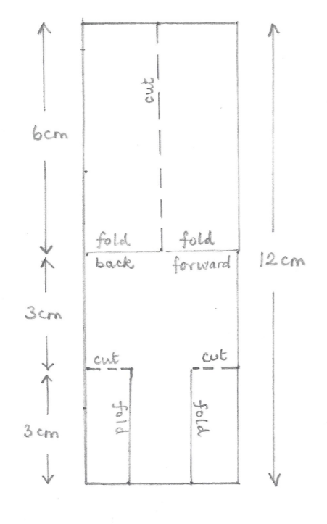
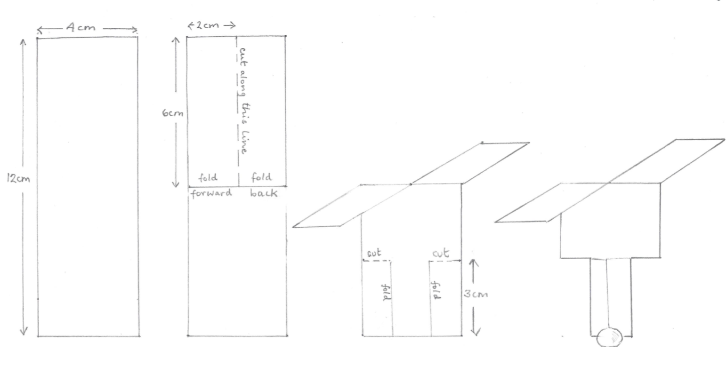
Investigating a helicopter design
Logo for section to sit inside roundel
What is the best helicopter design for dispersing seeds?
(page 5-7: 30 minutes)
You can investigate a model seed helicopter to explore how different factors might affect its flight.
Planning your investigation:
Which factors (variables) might affect the flight of your seed helicopter?
Length of the wing?
Width of the wing?
Size or weight of the ‘seed’?
Choose one factor (variable) to change.
Make three or four different helicopters.
Think about how you are going to collect and record your results to find out which is the best for dispersing your seeds. You may wish to use a mobile phone stop watch.
Good luck!
You will need:
Some paper, scissors, pencil and a ruler.
Sticky tack / Blu tack or paperclips.
You may like to print templates from page 7 or 8.
Make a helicopter by following the instructions on page 6. Use a piece of sticky tack or a paperclip to represent your seed. Try flying it!
5

Slide 6
Instructions for making a seed helicopter. You can change the measurements to suit your design!
1. Draw a rectangle 12cm long and 4cm wide.
2. Make the ‘wings’ at the top by cutting and folding as shown.
3. Make the ‘seed carrier’ at the bottom by cutting and folding as shown.
4. Attach a piece of sticky tack or a paperclip to represent the seed.
6

Slide 7
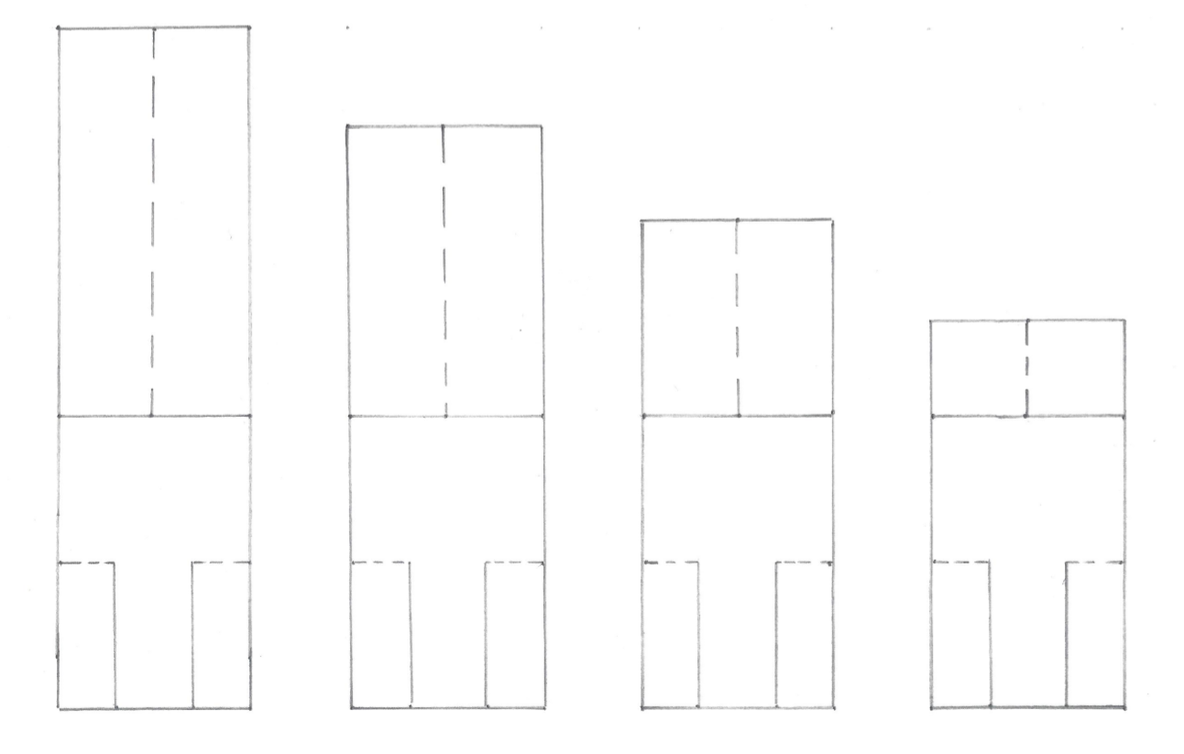
7

Slide 8
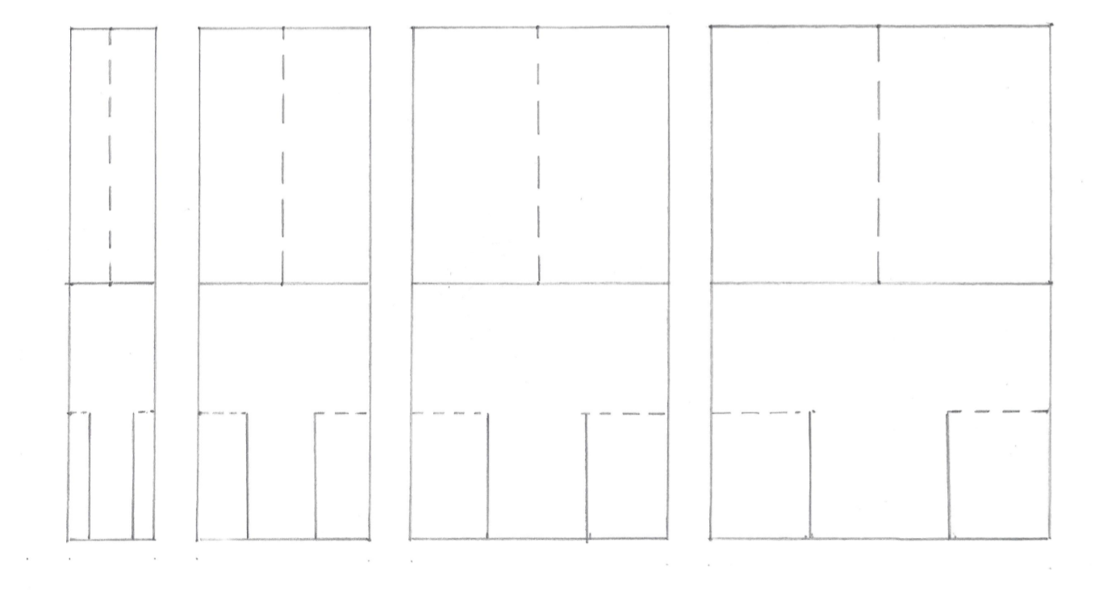
8

Slide 9
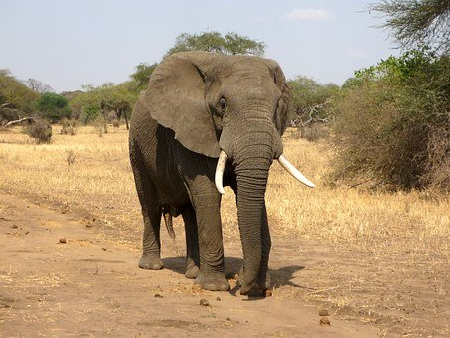
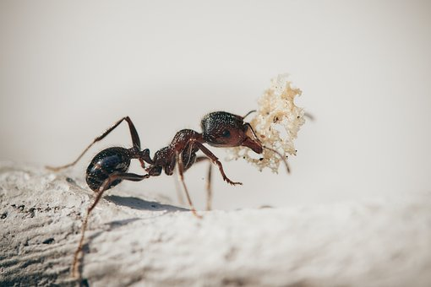
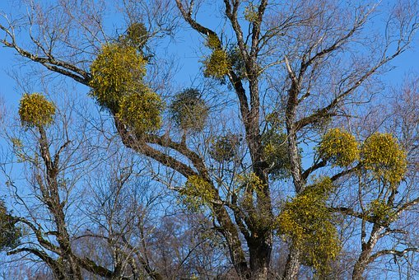
Find out more…
Logo for section to sit inside roundel
Find out about some unusual ways that seeds are dispersed by animals
Some seeds are dispersed by animals in more unusual ways. Watch these three clips from ‘Private Life of Plants’.
Think about the journey of one of these seeds:
A seed from an acacia tree which is eaten by an elephant.
A seed which falls to the ground and is found by ants.
A seed in a mistletoe fruit which is eaten by the mistletoe bird.
Write a story about the journey of the seed and how it successfully starts to grow into a new plant.
You may like to imagine you are the seed!
https://www.bbc.co.uk/programmes/p006999s
https://www.bbc.co.uk/programmes/p00lxvrk
https://www.bbc.co.uk/programmes/p00crfc4
9

Slide 10
Glossary of terms
Sexual plant reproduction is when a plant reproduces by forming seeds or spores.
Pollination is when pollen is carried from the male part to the female part of a plant, usually by insects or the wind.
Seed dispersal is when seeds are carried away from the parent plant, often by the wind or by animals. This enables the seeds to germinate away from the parent plant.
10

Slide 11
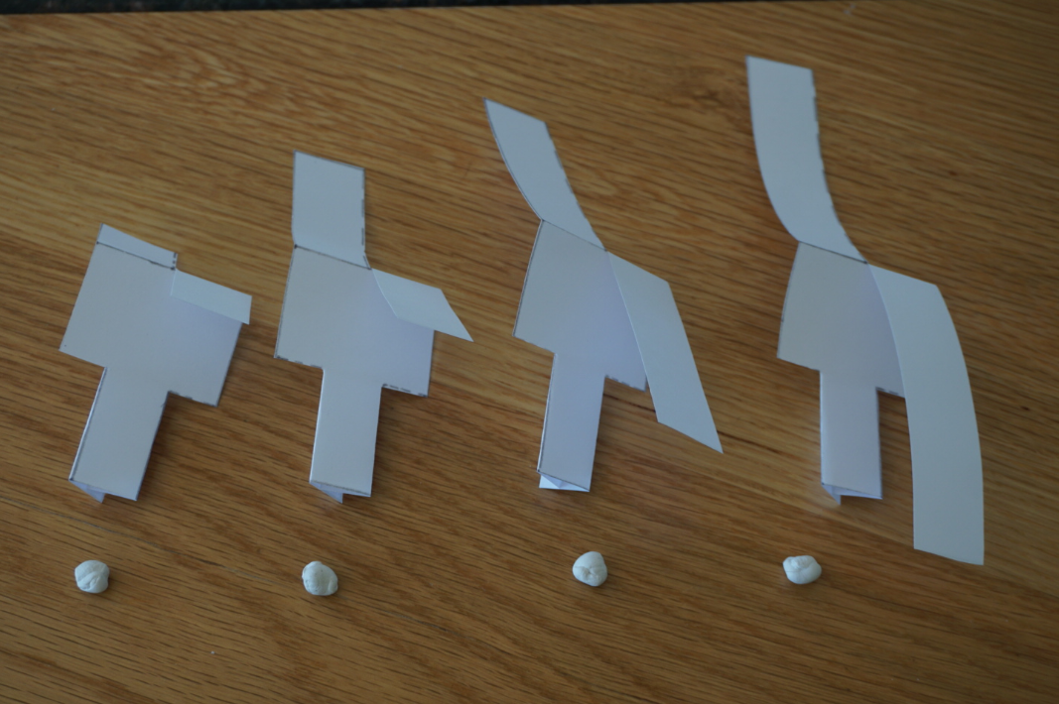
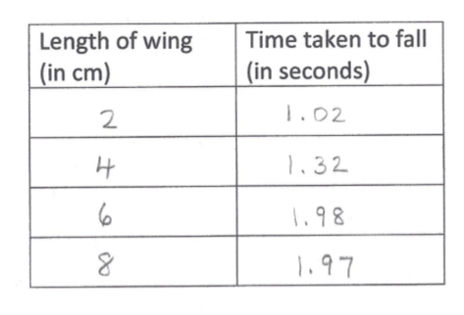
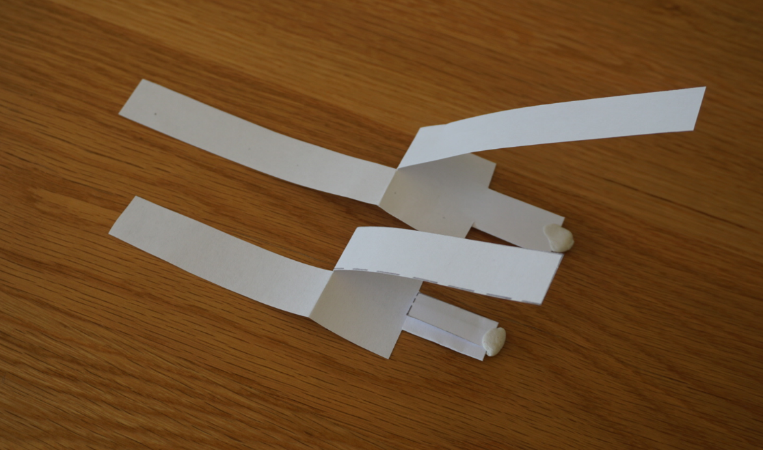
You may have chosen to investigate the width of the wing or the size of the seed.
Possible learning outcome. I can investigate a model helicopter design for dispersing seeds.
My question: Does the wing length of a helicopter affect the time it takes to fall to the ground?
Planning a fair test:
I will change the wing length.
I will keep these factors (variables) the same: the width of the wing, the size of the seed and the height of drop.
I will measure the time it takes for each helicopter to reach the ground.
You may have tested each helicopter more than once and calculated an average value for the time taken to fall.
Results:
You may have noticed the helicopters with smaller wings spin faster. When the wing gets too long it may not spin well, so will fall quickly.
I found out that my helicopters with longer wings fell to the ground more slowly than those with shorter wings. The 6cm and 8cm wing took about the same time to fall, so I wondered what would happen with an even longer wing.
I made a new helicopter with a 10cm wing length. It did not spin very well and fell to the ground in 1.68 seconds.
I think seed helicopters which fall slowly are more likely to disperse seeds the furthest. In my design, the best helicopters had medium length wings of 6cm and 8 cm because they fell the slowest.
11

