Slide 1
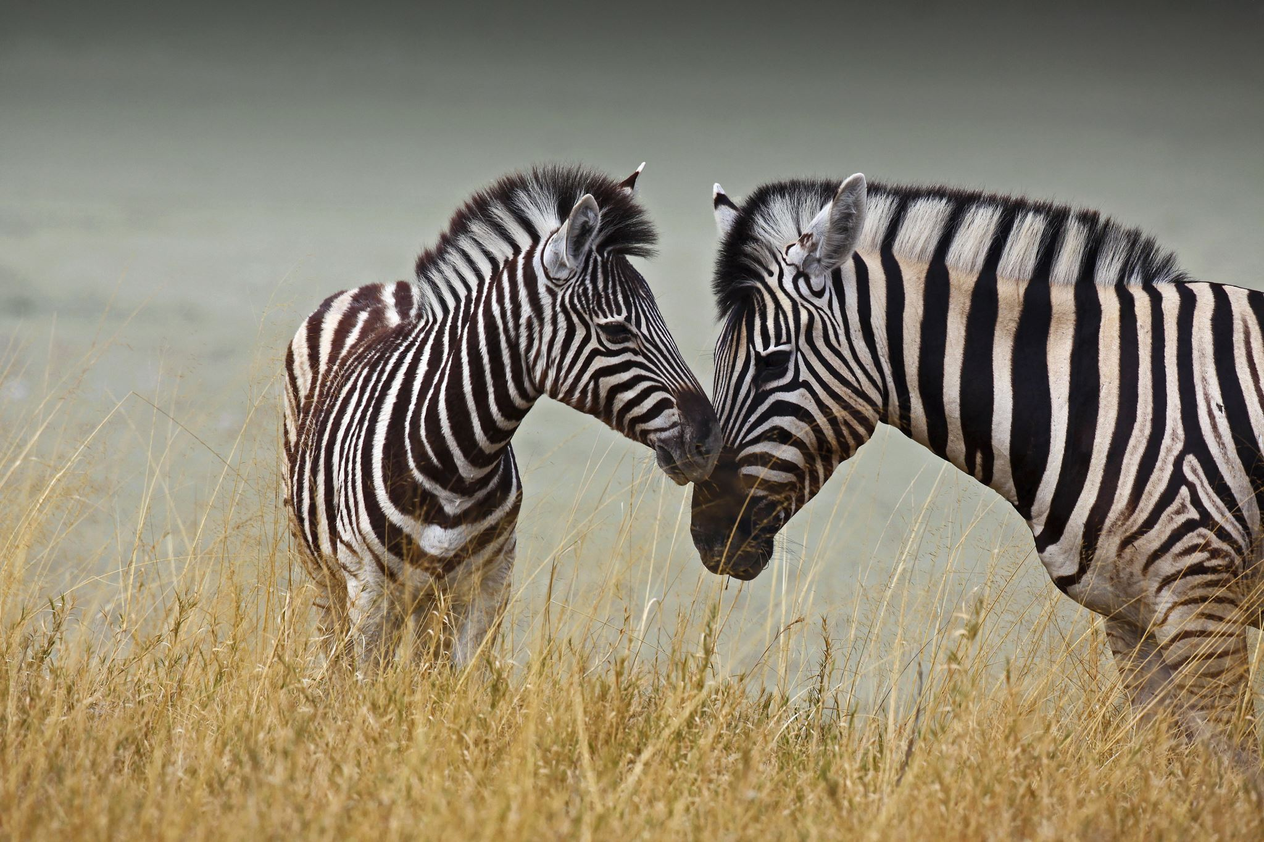



For parents
Thank you for supporting your child’s learning in science.
Before the session:
Please read slide 2 so you know what your child learning and what you need to get ready.
As an alternative to lined paper, slide 5 may be printed for your child to record on.
During the session:
Share the learning intentions on slide 2.
Support your child with the main activities on slides 3-5, as needed.
Slides 6-7 is a further, optional activity.
Slide 8 has a glossary of key terms.
Reviewing with your child:
Slide 9 gives an idea of what your child may produce.
Living things and their habitats
Comparing the life cycle of a range of animals
Year 5 Age 9-10

Slide 2
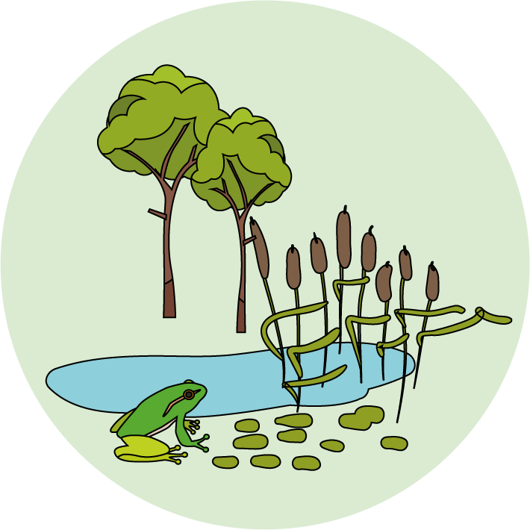

Livings things and their habitats
Logo for section to sit inside roundel
Comparing the life cycles of a range of animals
Key Learning
As part of their life cycle, plants and animals reproduce.
Most animals reproduce sexually. This involves two parents where the sperm from the male fertilises the female egg.
Some young undergo a further change before becoming adults (e.g. caterpillars to butterflies). This is called a metamorphosis.
Activities (pages 3-5): 40 - 50 mins
Use lined paper, ruler and pencil.
Alternatively, print page 5 as a worksheet.
Find out more… (page 6-7)
Compare the life cycles of more animals.
I can…
use secondary sources to find out about the life cycles of animals.
describe some differences between the life cycles of different animals.
2

Slide 3
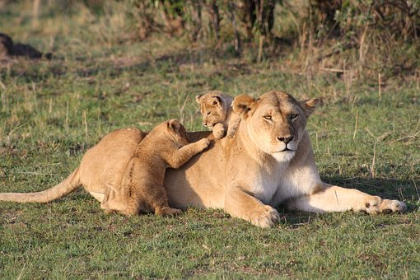
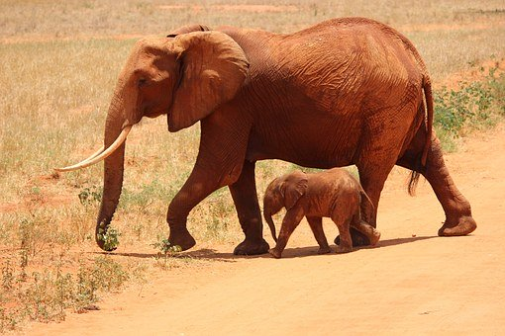
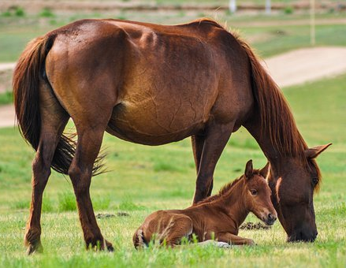
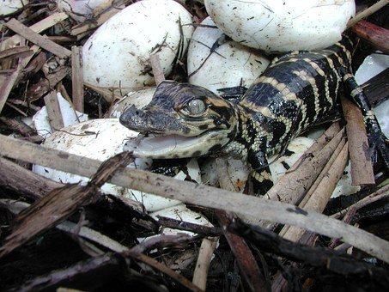
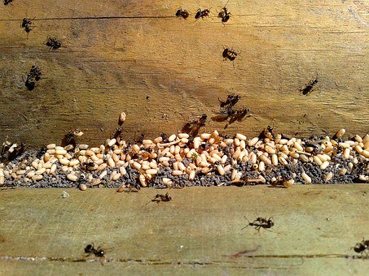
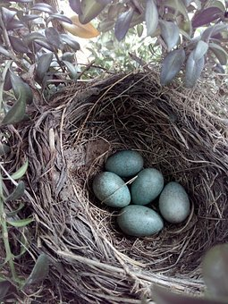
Explore, review, think, talk….
Logo for section to sit inside roundel
What do you already know about how animals reproduce?
(5 -10 minutes)
Watch these two clips:
https://www.bbc.co.uk/bitesize/clips/zp62tfr
https://www.bbc.co.uk/bitesize/clips/zdfpyrd
Which animals lay eggs?
Which animals give birth to live young?
Think or talk about how some animals start their lives and how they change as they grow.
Most animals reproduce sexually. This involves two parents where the sperm from the male fertilises the female egg. Watch this clip:
https://www.bbc.co.uk/bitesize/topics/zgssgk7/articles/z9xb39q
In many animals, the egg develops inside the female and they give birth to live young. They are called mammals. (Humans are mammals too!)
Most other animals lay eggs. These include reptiles, birds, fish, amphibians (e.g. frogs and toads) and insects.
3

Slide 4
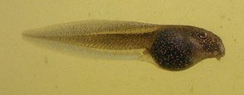
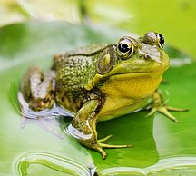
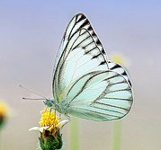
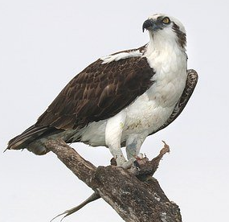
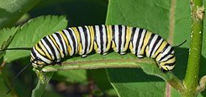
Life cycles of animals that lay eggs
Logo for section to sit inside roundel
Comparing the life cycle of an amphibian, an insect and a bird.
(page 4-6: 20-30 minutes)
Watch this 6 minute clip. It describes many life cycles, including amphibians (frogs), insects (butterflies) and birds (ospreys).
Try to jot down the names of the life cycle stages for these egg-laying animals.
Think about differences you notice for each life cycle.
https://www.bbc.co.uk/teach/class-clips-video/science-ks2--ks3-the-life-cycles-of-different-organisms/zvh8qp3
You may have noticed:
Frogs and butterflies have distinct stages in their development. The changes they undergo are described as metamorphosis.
Adult birds care for their chicks once they have hatched. The chicks grow gradually into fledglings.
Now look at the life cycle of a European common frog and a Monarch butterfly in more detail.
frog: https://www.dkfindout.com/uk/animals-and-nature/amphibians/life-cycle-frog/
butterfly: https://www.dkfindout.com/uk/animals-and-nature/insects/butterfly-life-cycle/
4

Slide 5
Using what you have learnt and your own research, create a fact file to compare the life cycle of a frog and a butterfly.
Choose your own design or use the lay out opposite.
I can compare the life cycle of a frog and a butterfly.
Name of animal | European common frog | Monarch butterfly
What do the eggs look like? |  | Pale green egg Size of a pin head
Where are the eggs laid?
What is the young animal called after it hatches? | Tadpole
What does it feed on at this stage?
How does it change (undergo metamorphosis)? |  | Forms a chrysalis (pupa)
How long does it take from the egg hatching to becoming a young adult?
Other interesting facts
5

Slide 6
Find out more…
Logo for section to sit inside roundel
How do different animal life cycles compare with each other?
Not all animals follow the same life cycle. Some have shorter or longer lifecycles, even if they belong to the same animal group.
Research a range of different animals using the links opposite.
Try and look at the life cycles of different animals from the same group.
Think about:
How long does each animal spend in each stage of the life cycle?
What is the lifespan of each animal?
What physical changes occur?
What are the names of each stage in the life cycle?
What are the most interesting facts for each stage?
Birds
Barn owl: https://www.barnowltrust.org.uk/barn-owl-facts/
Sparrow: https://www.rspb.org.uk/birds-and-wildlife/wildlife-guides/bird-a-z/house-sparrow/
Amphibians
newt: https://www.animalspot.net/newt
frog: https://www.dkfindout.com/uk/animals-and-nature/amphibians/life-cycle-frog/
Insects
bee: https://www.bumblebeeconservation.org/lifecycle/
butterfly: https://www.dkfindout.com/uk/animals-and-nature/insects/butterfly-life-cycle/
6

Slide 7
Instructions for Activity: Now that you have researched the life cycle of different animals, you can compare them.
Choose two different animals, they might even be from the same animal group!
Use a Venn diagram to compare how they are similar and different, thinking about their life cycles. Remember that the similarities go in the middle section.
For example, you could…
compare a barn owl and a sparrow,
compare a bee and a butterfly, or
compare a frog and a bee.
Learning outcome: I can describe the differences between the life cycles of different animals.
7

Slide 8
Glossary of terms
Reproduce: All living things reproduce to make new individuals.
Sexual reproduction: Sexual reproduction in animals occurs when male and female animals mate to create offspring.
Fertilises: A male sperm joins a female egg and fertilises it. This is the first stage of sexual reproduction.
Egg: A female reproductive cell is called an egg.
Sperm: A male reproductive cell is called a sperm.
Life cycle: Every animal has a life cycle which represents the stages the animal goes through during its life.
Metamorphosis: Metamorphosis is the process of transformation from an egg to an adult form in two or more distinct stages. Both insects and amphibians go through metamorphosis as part of their life cycle.
8

Slide 9
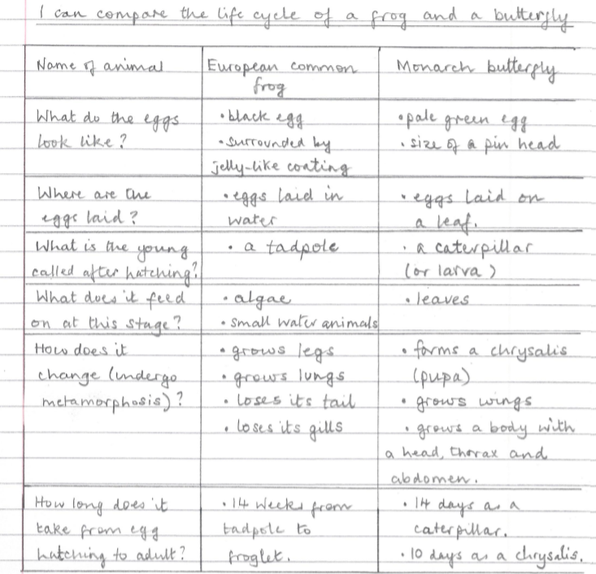
Frogs’ eggs need to stay moist, so they are laid in water.
Possible learning outcome for reviewing your work.
Monarch caterpillars shed their skin five times as they grow. They grow longer and fatter to store up energy for the next stage of their life cycle.
Tadpoles have gills so they can breathe under water.
They gradually form lungs so the froglet can breathe air and stay on the land.
Metamorphosis occurs within the chrysalis or pupa. It is similar for other insects like bees, wasps, beetles and ants.
Adults insects all have six legs and three body parts (head, thorax and abdomen.)
A tadpole grows back legs first and then front legs. Gradually their tail gets smaller. They emerge from water as froglets.
9

