Slide 1
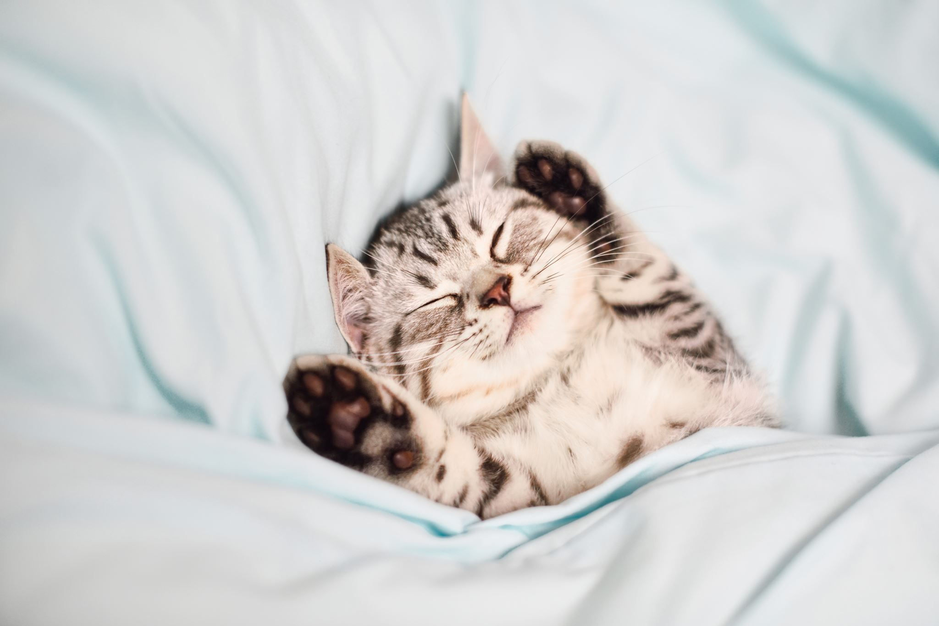



Living things and their habitats
For parents
Thank you for supporting your child’s learning in science.
Before the session:
Please read slide 2 so you know what your child learning and what you need to get ready.
As an alternative to squared paper, slide 6 may be printed for your child to record on.
During the session:
Share the learning intentions on slide 2.
Support your child with the main activities on slides 3 to 6, as needed.
Slide 7 is a further, optional activity.
Slide 8 has a glossary of key terms.
Reviewing with your child:
Slide 9 gives an idea of what your child may produce.
Comparing the gestation period of different mammals
Year 5 Age 9-10

Slide 2
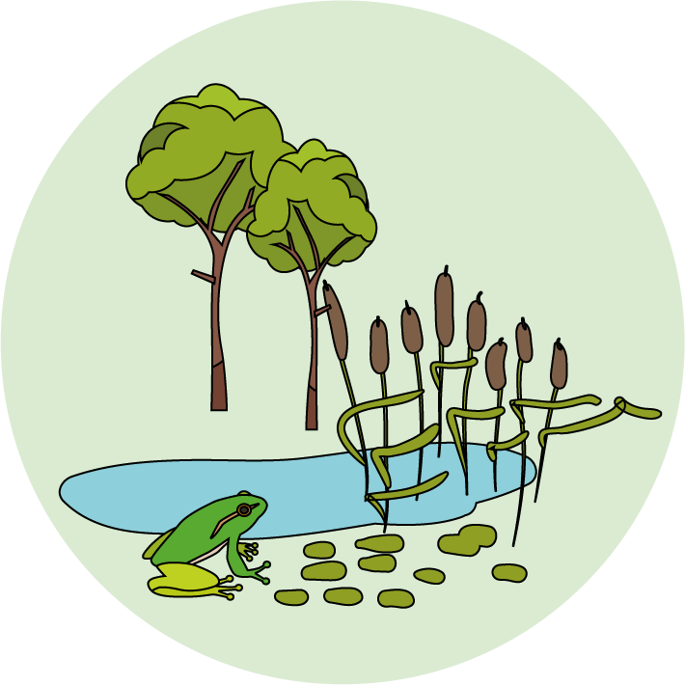

Livings things and their habitats
Logo for section to sit inside roundel
Comparing the gestation period of different mammals
Key Learning
Most animals reproduce sexually. This involves two parents where the sperm from the male fertilises the female egg. They produce offspring which grow into adults.
Humans and most other mammals give birth to live young.
The time between egg fertilisation and giving birth is called the gestation period.
Activities (pages 3-6): 30 - 45 mins
Use lined paper, squared paper, a ruler and pencil.
Alternatively, print page 6 as a worksheet.
Find out more… (page 7)
Find out about some mammals with more unusual life cycles.
I can…
compare the gestation period for different mammals and look for patterns.
2

Slide 3
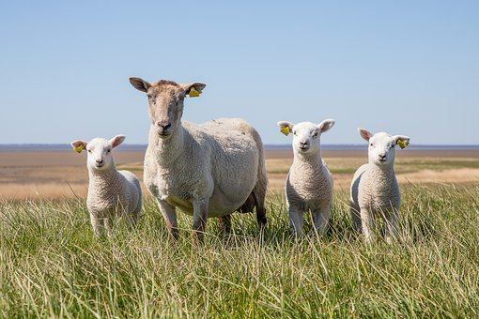
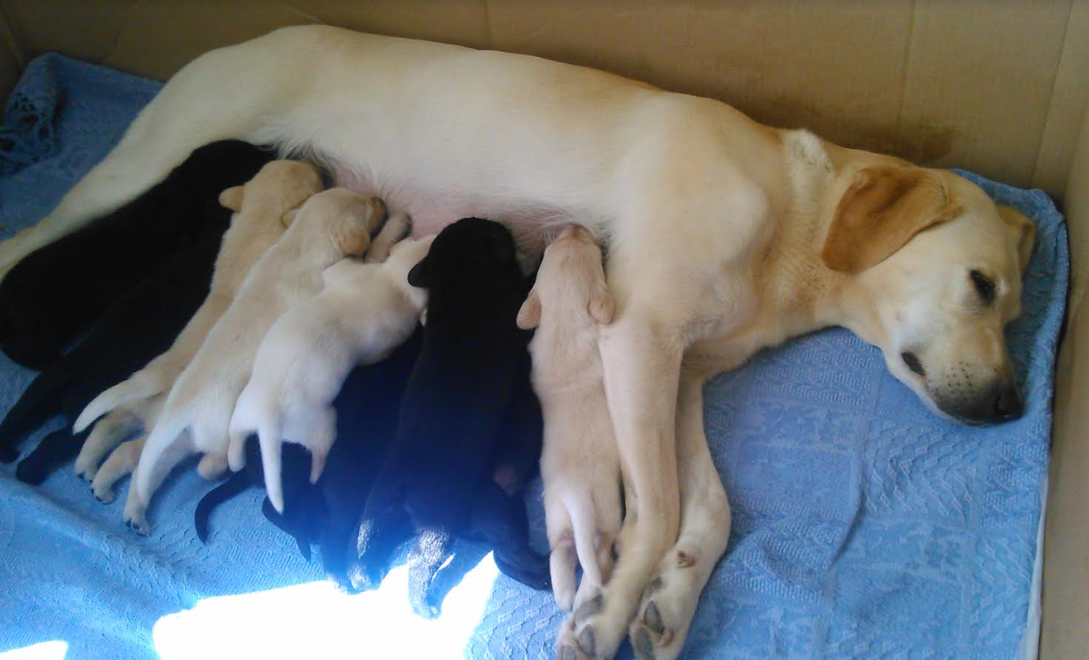
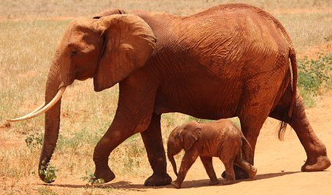
Explore, review, think, talk….
Logo for section to sit inside roundel
What do you already know about life cycle of mammals?
(5 - 10 minutes)
Humans and most other mammals give birth to live young.
Watch this BBC bitesize clip:
https://www.bbc.co.uk/bitesize/clips/zpmqxnb
How many months does it take for a human baby to develop before it is born?
How does this compare to other mammals?
The length of time a mammal is pregnant is known as the gestation period.
The gestation period starts when the sperm from the male fertilises the female egg.
It finishes when the baby animal is born.
Look at this information about the gestation of a baby elephant: https://www.dkfindout.com/uk/animals-and-nature/mammals/mammals-and-their-young/
3

Slide 4
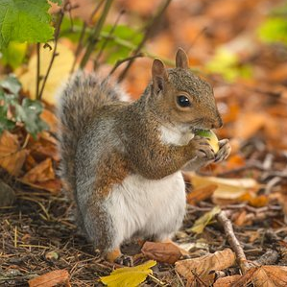
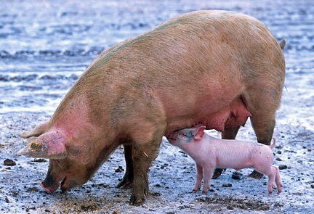
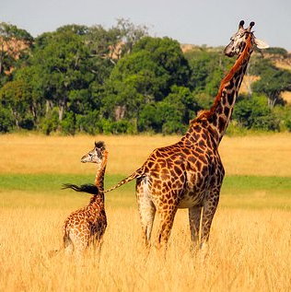
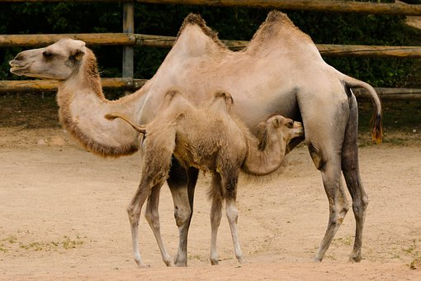
Gestation period of mammals
Logo for section to sit inside roundel
Investigating the gestation period of different mammals
(page 4-6: 20-35 minutes)
The gestation period of mammals can range from a few weeks to almost two years.
From these four examples, do you notice a possible pattern about the length of the gestation period and the size of the adult animal?
Do you think a sample of four mammals gives you enough data to be certain?
How might the size of an animal be measured?
Squirrel – 44 days
Pig – 114 days
Camel – 400 days
Giraffe – 425 days
4

Slide 5
Look at the information about the average female weight and the gestation period of twelve different mammals.
Draw a table to order the mammals from smallest to largest by weight.
Next plot a bar chart showing the gestation period for each mammal, ordered from the smallest to the largest.
Look carefully to see if there is a pattern and make a note of any unusual results.
Explain what you have found out from the data you have been given.
Think about other questions you might now ask.
Learning outcome: I can compare the gestation periods for different mammals and look for patterns.
Type of mammal | Average weight of female mammal in kg | Gestation period in weeks (rounded to nearest whole week)
Hamster | 0.12kg (120g) | 2
Dog (Labrador) | 29kg | 9
Lion | 130kg | 15
Human | 77kg | 40
Giraffe | 828kg | 62
African Elephant | 3,150kg | 92
Grey Squirrel | 0.56kg (560g) | 6
Sheep | 72kg | 21
Cow (Jersey) | 450kg | 40
Rabbit | 2.5kg | 4
Pig | 250kg | 16
Camel | 650kg | 57
5

Slide 6
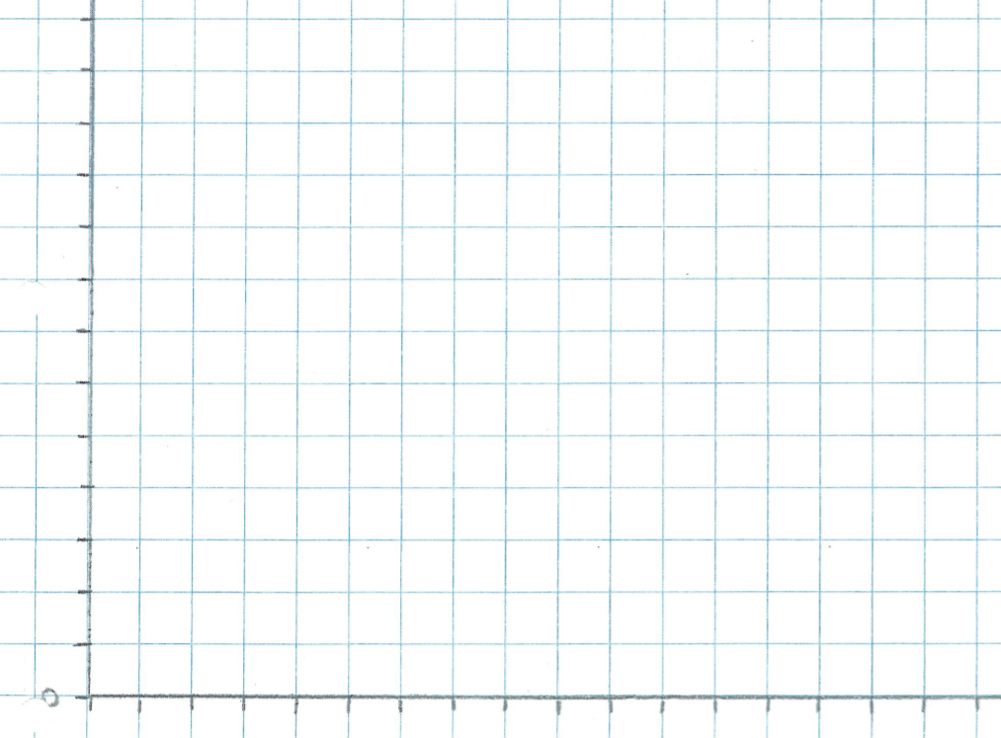
I can compare the gestation periods for different mammals and look for patterns.
Type of mammal | Average weight (kg) | Gestation period (weeks)
hamster | 0.12 | 2
grey squirrel | 0.56 | 6
100
90
80
Gestation period (weeks)
70
60
50
40
30
20
10
0
Remember to explain your findings and think about further questions.
hamster
squirrel
6

Slide 7
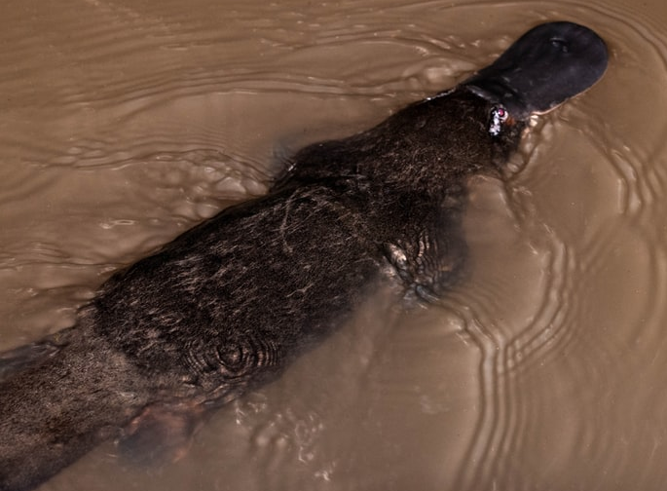
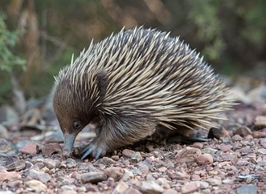
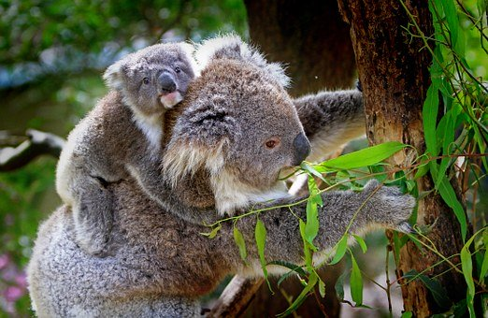
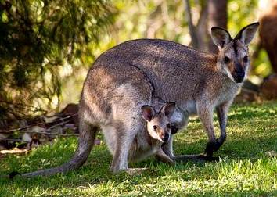
Find out more…
Logo for section to sit inside roundel
Find out about some mammals with more unusual life cycles
Some mammals have more unusual life cycles.
Find out how the young of marsupials or monotremes develop:
https://www.dkfindout.com/uk/animals-and-nature/mammals/marsupials/
https://www.bbc.co.uk/programmes/p004vtyd
https://www.dkfindout.com/uk/animals-and-nature/mammals/egg-laying-mammals/
https://www.bbc.co.uk/programmes/p004jl2c
Choose one of these mammals and create a poster to illustrate its life cycle.
7

Slide 8
Glossary of terms
Reproduce: All living things reproduce to make new individuals.
Sexual reproduction: Sexual reproduction in animals occurs when male and female animals mate to create offspring.
Fertilises: A male sperm joins a female egg and fertilises it. This is the first stage of sexual reproduction.
Gestation period: For mammals, the time between egg fertilisation and giving birth is called the gestation period.
Egg: A female reproductive cell is called an egg.
Sperm: A male reproductive cell is called a sperm.
Life cycle: Every animal has a life cycle which represents the stages the animal goes through during its life.
Mammal: A mammal is an animal that gives birth to live young and provides milk.
8

Slide 9
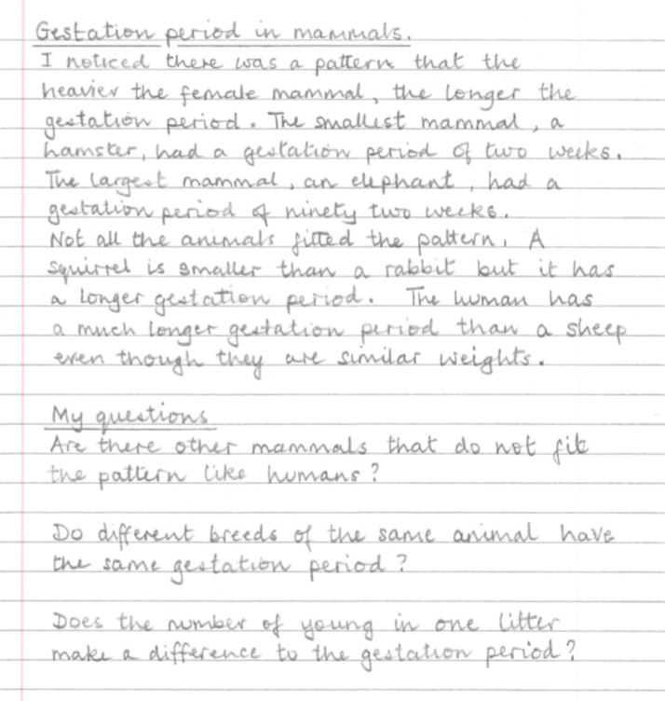
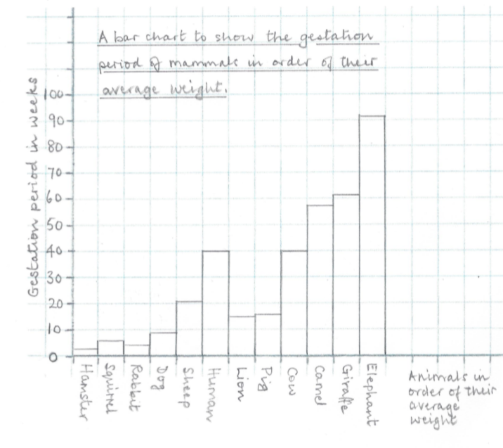
Possible learning outcome for reviewing your work.
I can compare the gestation periods for different mammals and look for patterns.
Check your bar chart has labelled axes and a title.
Your explanation should recognise the pattern and comment on some of the unusual results.
There are many different questions you can ask about gestation periods.
9

