Slide 1

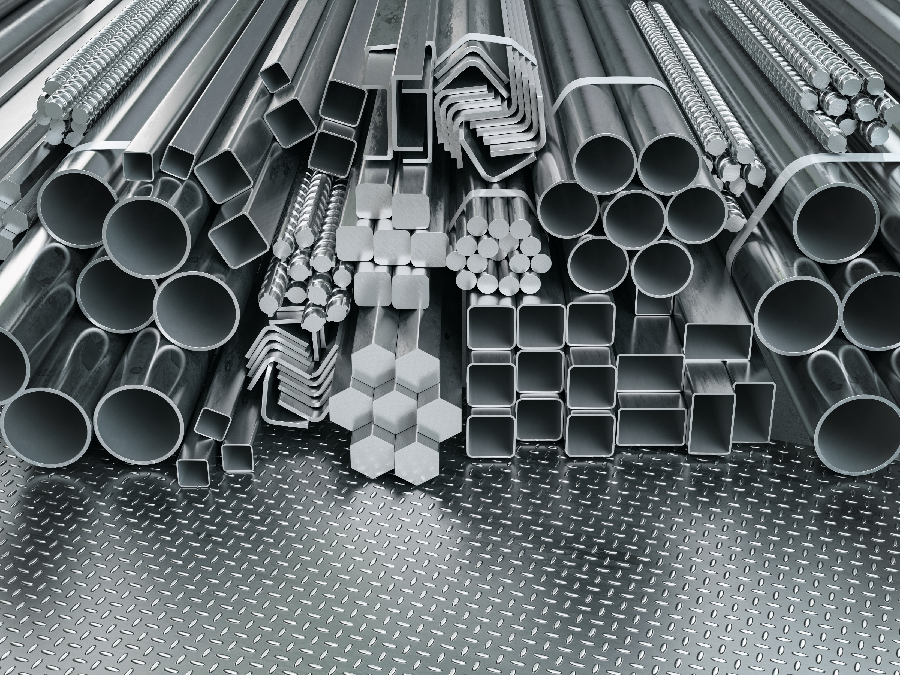

Properties and changes of materials
For parents
Thank you for supporting your child’s learning in science.
Before the session:
Please read slide 2 so you know what your child is learning and what you need to get ready.
As an alternative to lined paper, slide 6 may be printed for your child to record on.
During the session:
Share the learning intentions on slide 2.
Support your child with the main activities on slides 3-6, as needed.
Slide 7 is a further, optional activity.
Slide 8 has a glossary of key terms.
Reviewing with your child:
Slide 9 gives an idea of what your child may produce.
Exploring properties and uses
of materials
Year 5
Age 9 - 10

Slide 2
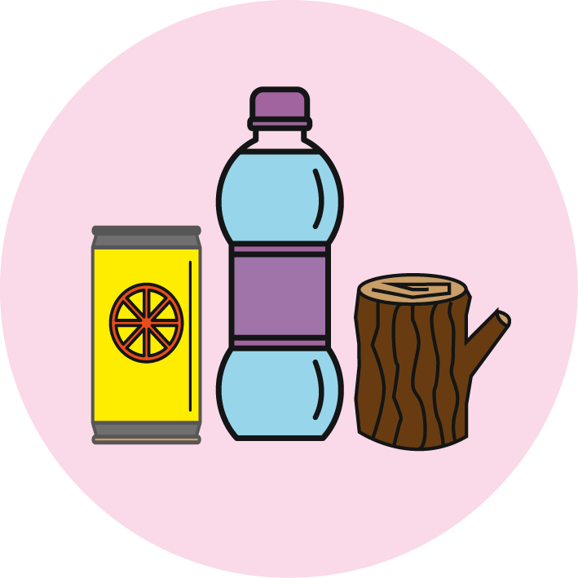

Properties and changes of materials
Exploring properties and uses of materials
Key Learning
Materials have different uses depending on their properties.
Properties include hardness, flexibility, absorbency, strength, transparency, electrical and thermal conductivity and attraction to magnets.
See the word bank of vocabulary on page 3.
Activities (pages 4-6): 30 - 40 mins
Household items to support learning:
10-12 items made from different materials. See page 5 for suggestions.
Use lined paper and a pencil for recording. Alternatively you may wish to print page 6
as a worksheet.
Taking it further… (page 7): 20 - 30 mins
You may like to investigate a household object, a toy or a piece of sports equipment made of two or more materials.
I can…
use Carroll diagrams to classify materials by their properties.

Slide 3
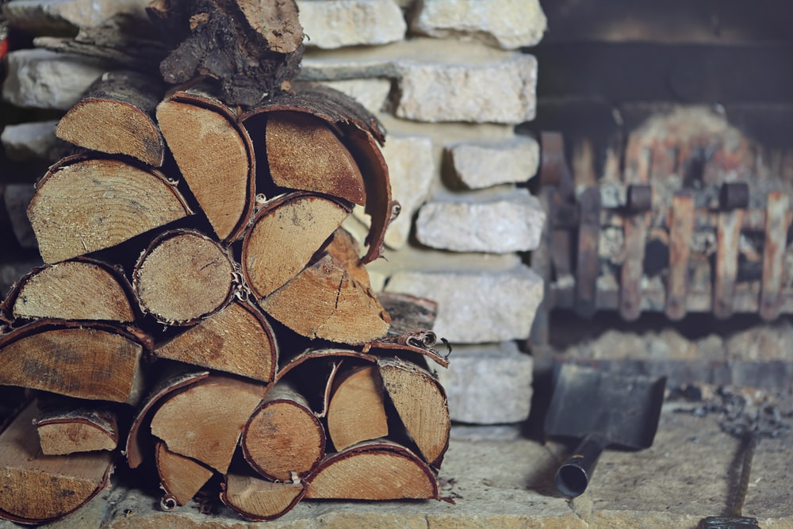
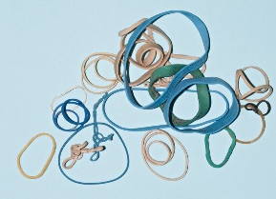
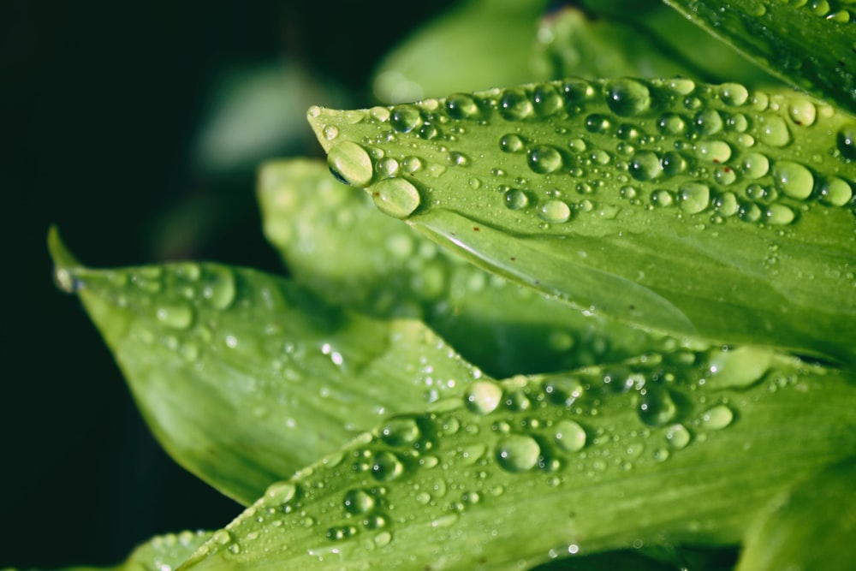


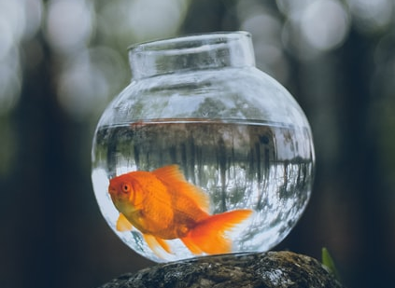
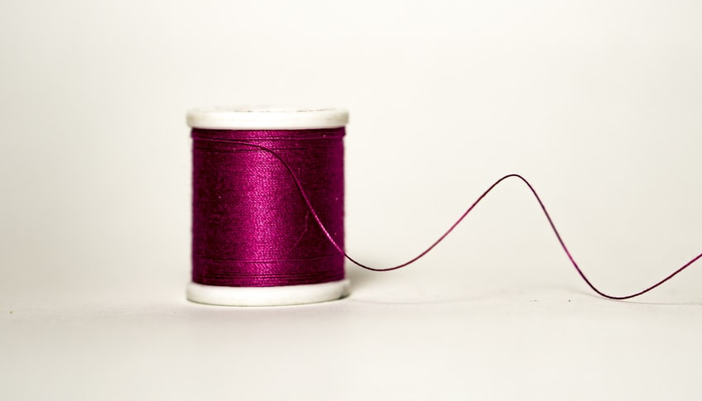

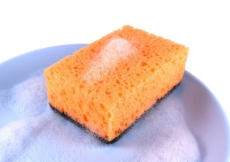
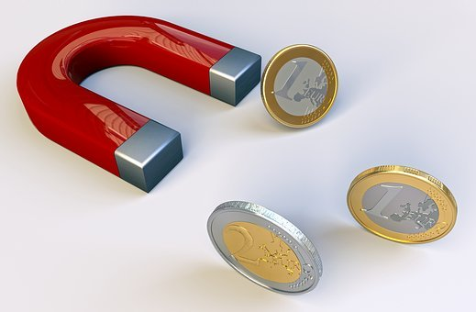
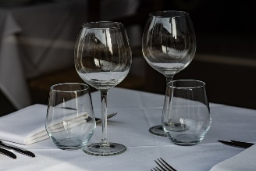
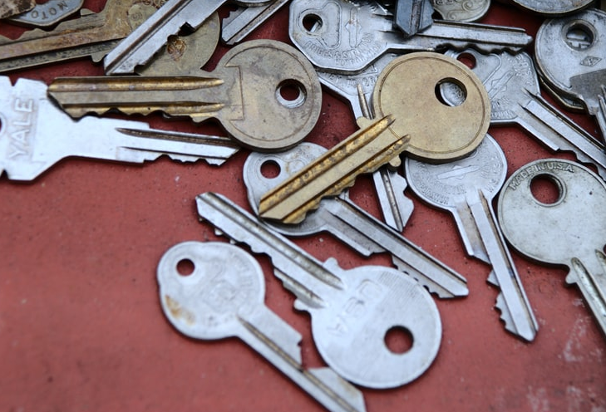
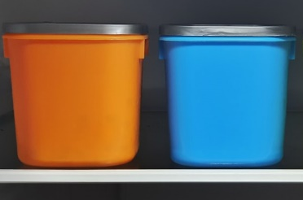
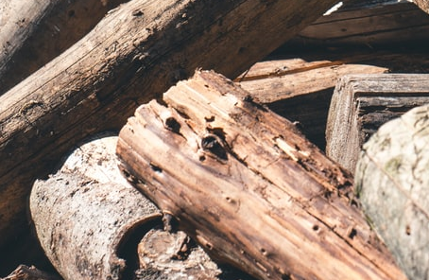
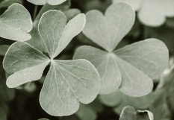
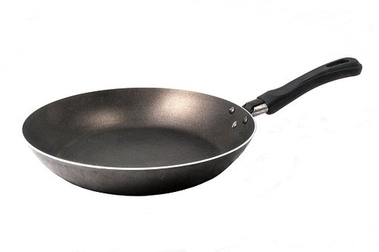
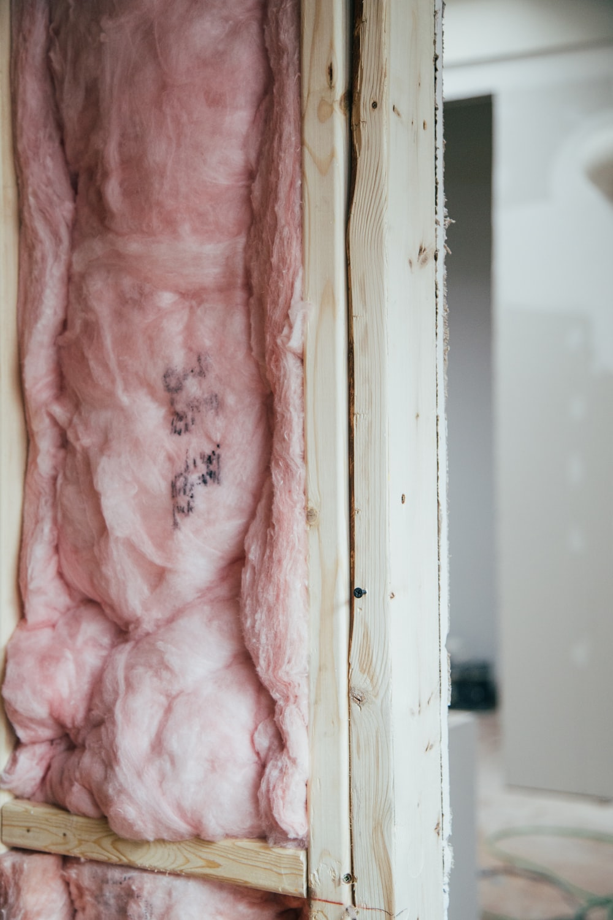
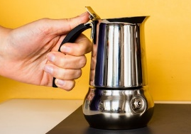
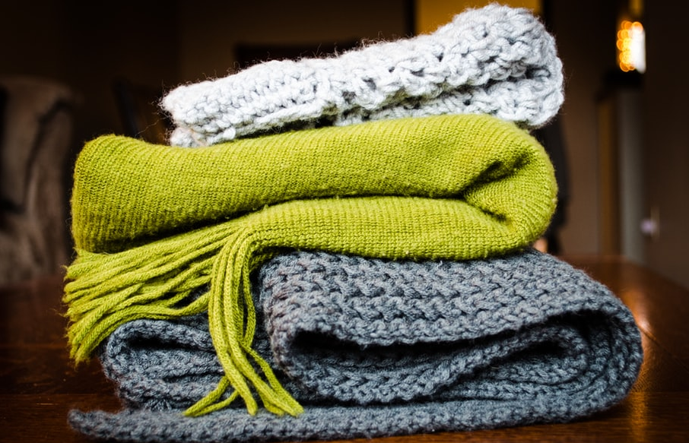


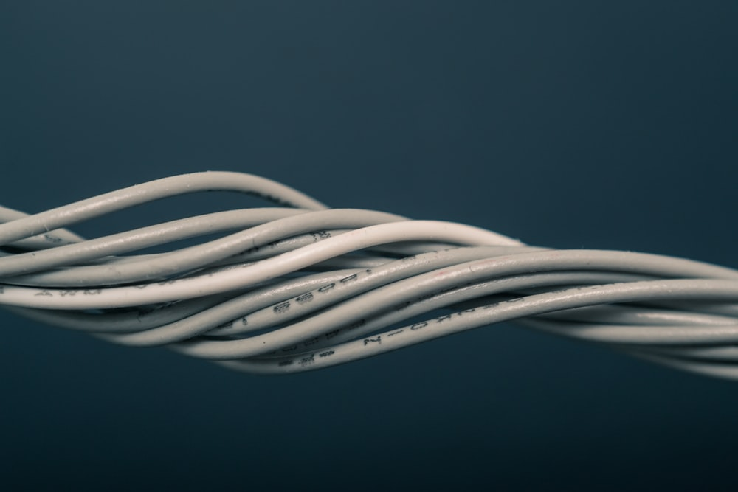
Word bank – properties of materials
materials
elastic
waterproof
opaque
translucent
transparent
flexible
rigid
absorbent
magnetic
brittle
strong
smooth
rough
dull
thermal conductor
thermal insulator
3
hard
soft
reflective
electrical conductor
electrical insulator

Slide 4
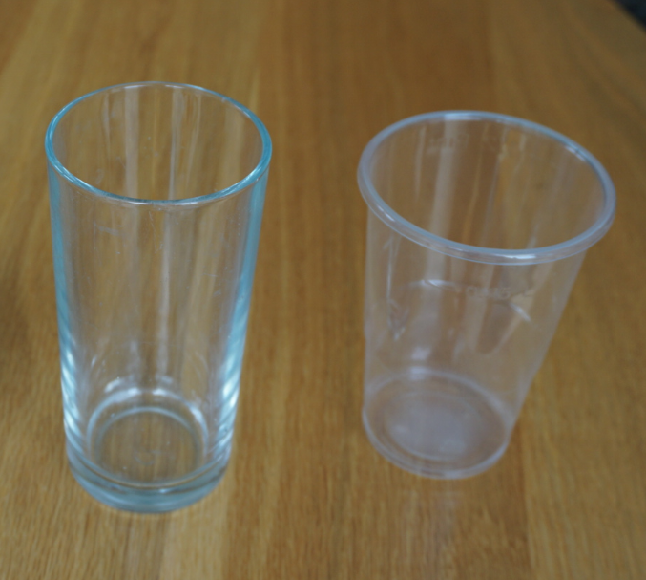
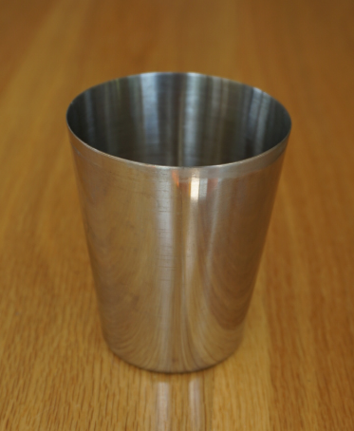
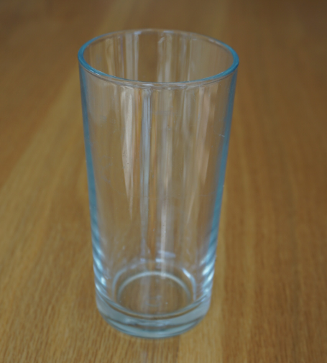
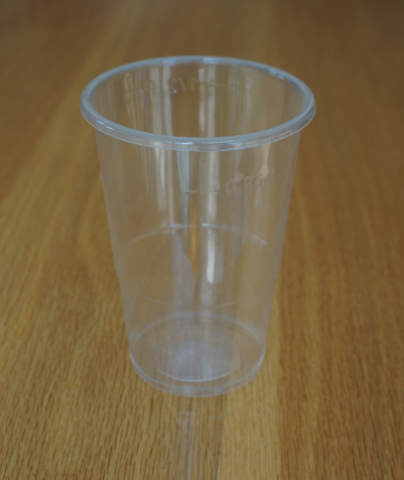
Explore, review, think, talk…
What do you already know about the properties of materials?
(5 – 10 minutes)
Look at these three cups which are made of different materials.
Which do you think is the odd one out?
There are many possible answers. Think about the properties of the materials to explain your ideas. You can use the word bank on page 3 to help you.
For example, you may have considered transparency to choose the odd one out.
The properties of materials help us to decide which materials are suitable to make a particular object.
Which important properties do all three cups need to have?
Watch this clip to help you decide: https://www.bbc.co.uk/bitesize/topics/z4339j6/articles/zx8hhv4
metal
glass
plastic

Slide 5
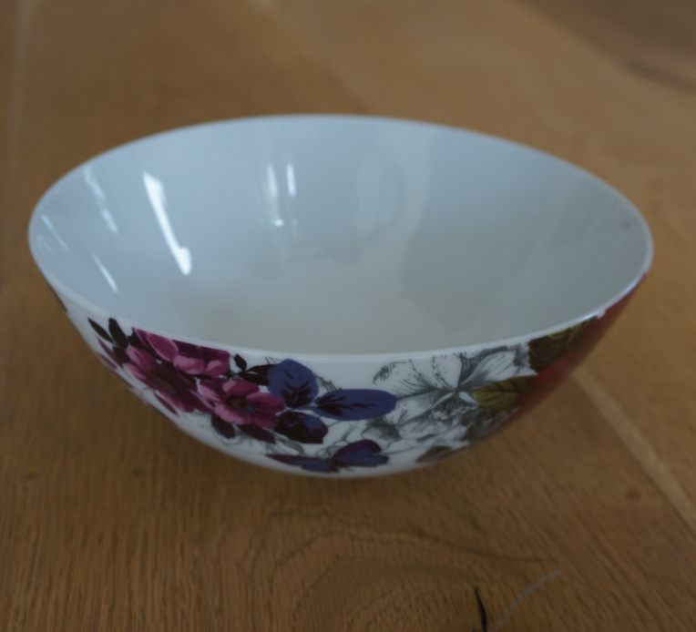
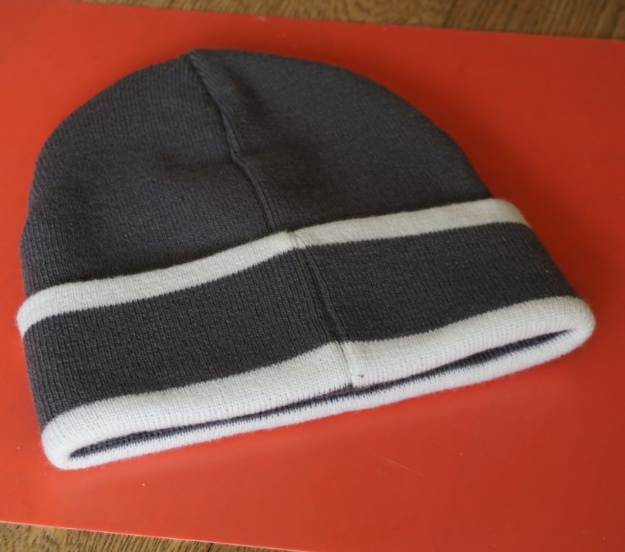
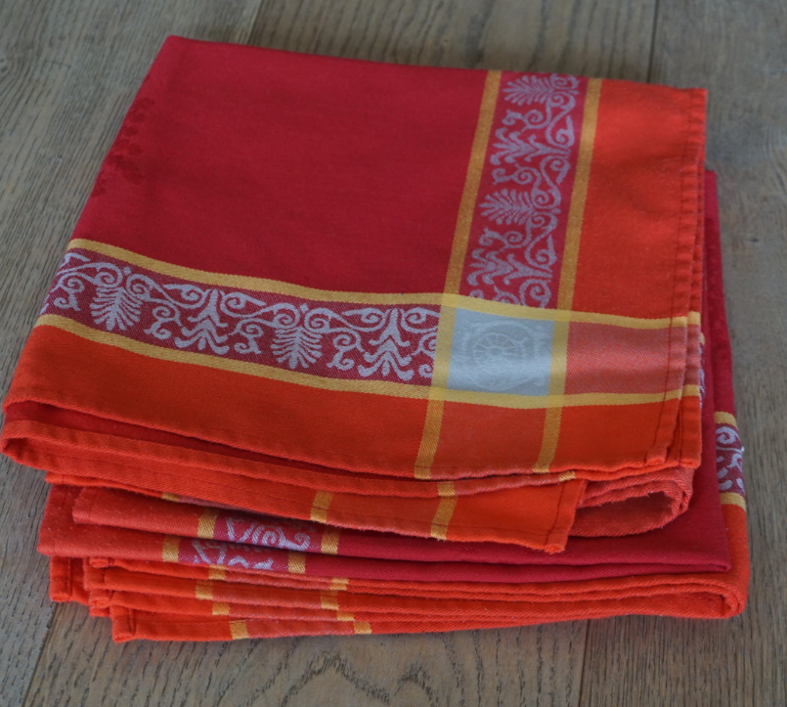
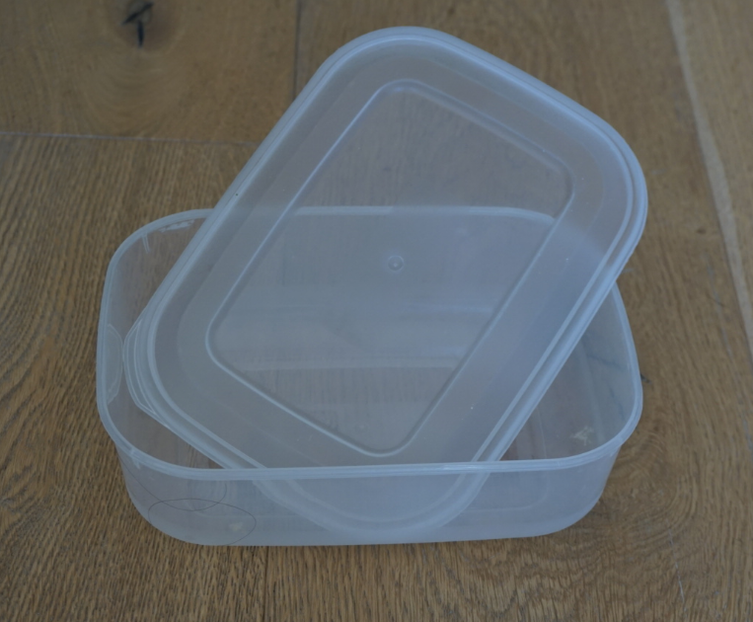
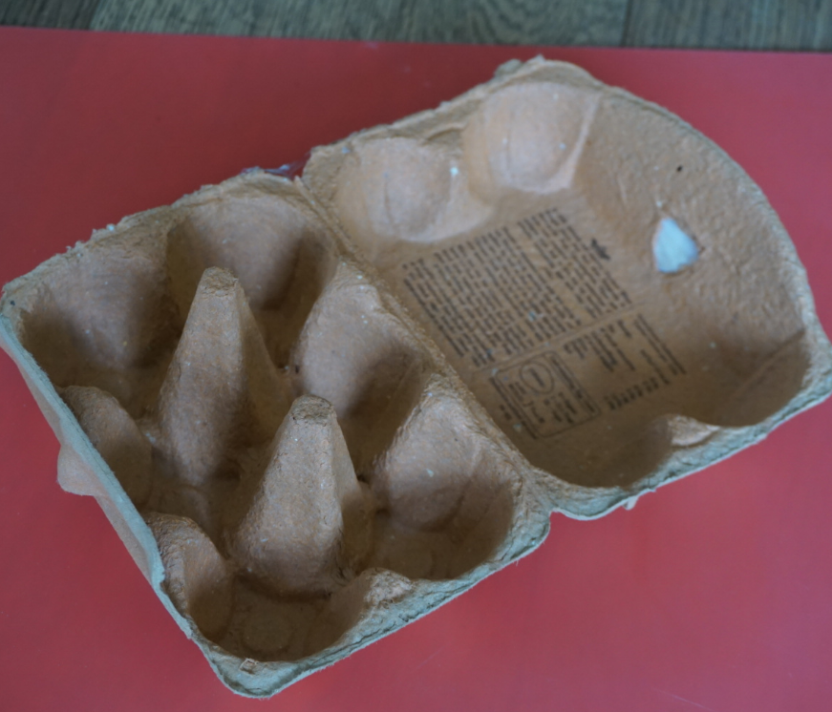
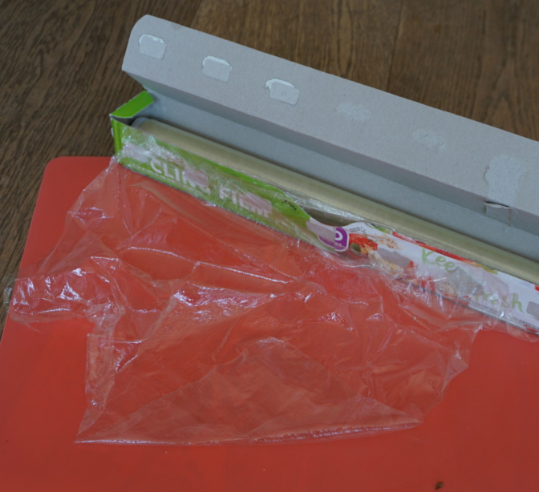
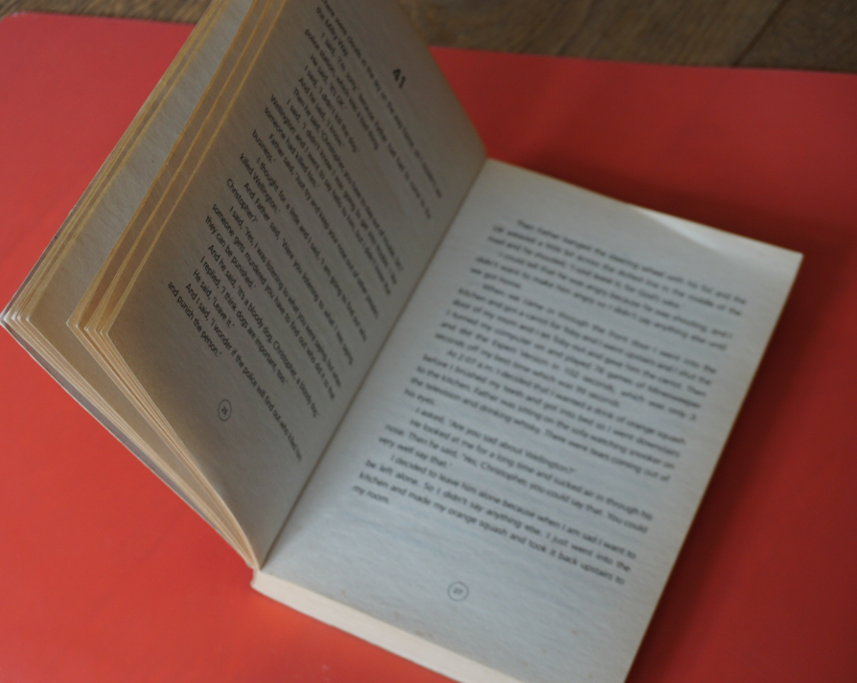
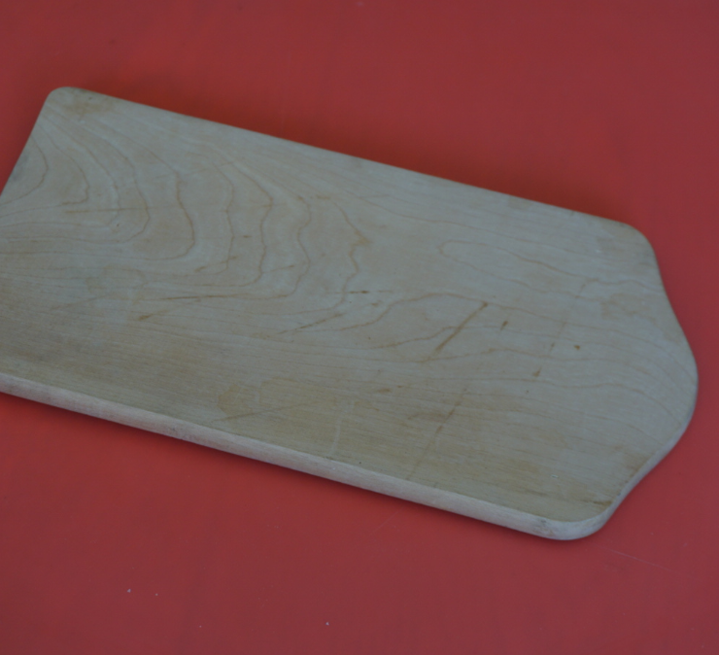
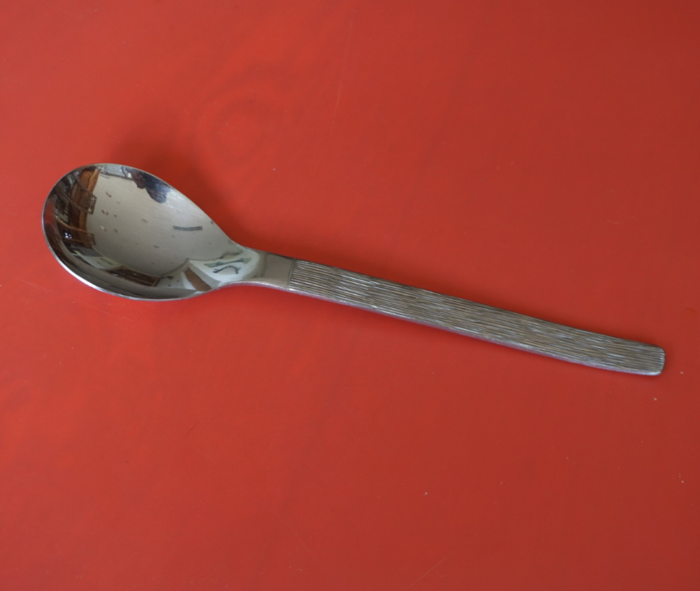
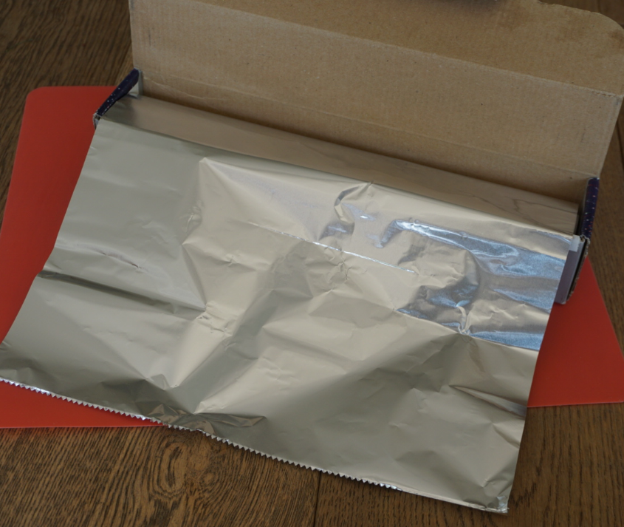
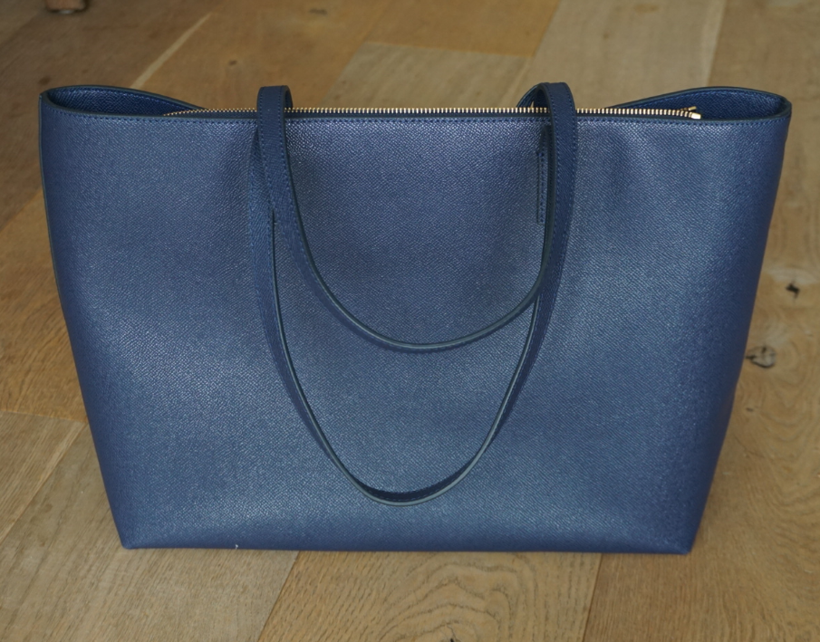
Properties and uses of materials
Exploring the materials of household objects
(pages 5-6: 20 - 30 minutes)
Find 10 - 12 items made of various materials. For example:
Sort the objects into groups. You may like to use the word bank on page 3.
For example:
Try this three or four times for different properties.
slightly flexible
flexible
china
wool
fabric
plastic
china
rigid
paper
wood
glass
metal
metal
leather
cardboard
plastic

Slide 6
Classify your household items using two different Carroll diagrams.
You may like to use the example opposite for your first one.
Use what you have learnt and the word bank to help you.
I can use Carroll diagrams to classify materials by their properties.
 | rigid | not rigid
opaque
not opaque
waterproof | absorbent
rigid | flexible
strong | brittle
rough | smooth
reflective | dull
elastic | non-elastic
hard | soft
magnetic | non-magnetic
thermal conductor | thermal insulator
electrical conductor | electrical insulator
transparent | opaque
translucent

Slide 7
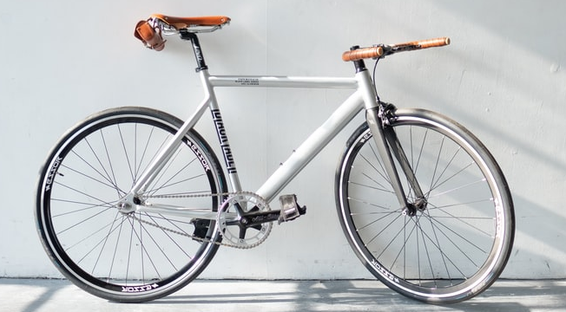

Taking it further…
Investigate a household object made of two or more materials
(20 – 30 minutes)
Many objects are made of more than one material because different parts need different properties.
Use DK Find Out to explore more materials: https://www.dkfindout.com/uk/science/materials/
Choose a household object, a toy or a piece of sports equipment which is made of two or more materials.
For example, you might like to investigate a bicycle or a skateboard.
Investigate each material to decide why it has
been selected.
Draw a labelled diagram to explain what you have found out.
The plastic handle is a thermal insulator so it does not get too hot.
The non-stick coating inside stops the food sticking to the pan.
The metal pan is a thermal conductor so the heat can travel through it.

Slide 8
Glossary of terms
Absorbent: An absorbent material is able to soak up liquid easily.
Brittle: A brittle material is usually hard but can break easily, like china or glass.
Electrical conductor: An electrical conductor allows electricity to flow through it.
Electrical insulator: An electrical insulator does not allow electricity to flow through it.
Flexible: A flexible object or material can be bent easily without breaking.
Material: Material is the matter from which a thing is or can be made.
Opaque: Light cannot pass through opaque material.
Property: A property of an object or material is a feature that makes it suitable for a particular use.
Reflective: Light bounces off reflective material making it bright or shiny.
Rigid: A rigid object or material cannot be easily bent out of shape.
Thermal conductor: A thermal conductor allows heat to pass through it easily.
Thermal insulator: A thermal insulator does not allow heat to pass through it easily.
Translucent: Some light can pass through translucent material.
Transparent: Light can pass through transparent material.

Slide 9
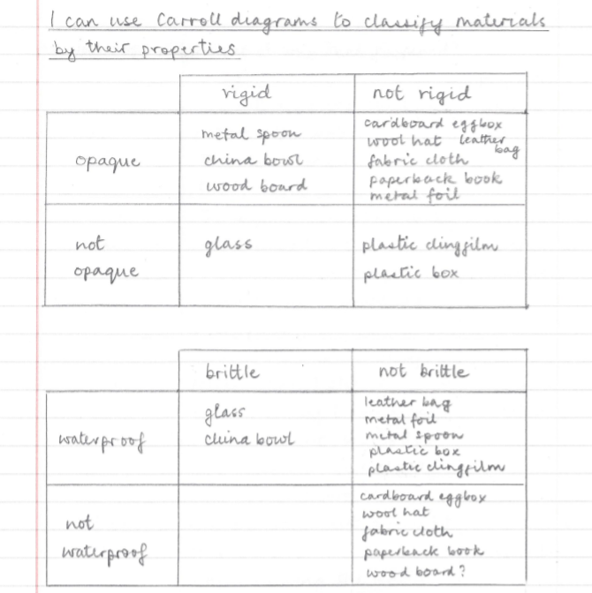
Possible learning outcome for reviewing your work:
There are many possible outcomes for this activity.
Try to use the name of the material and the object, for example ‘metal spoon’.
It may be difficult to classify some objects. For example, a cardboard egg box needs to be fairly rigid but it has a flexible hinge so the lid can open easily.
You may find there is a Carroll diagram quadrant with no objects.
For example, here there are no objects which are both ‘brittle’ and ‘not waterproof’.
These Carroll diagrams only have two options. If the property selected in the first column is ‘rigid’, the second column should be labelled ‘not rigid’.

