Slide 1

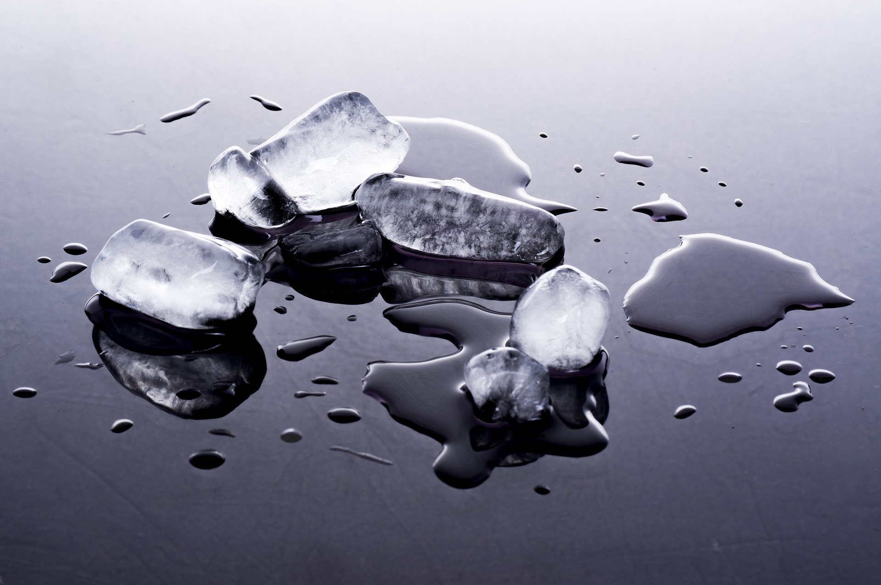

For parents
Thank you for supporting your child’s learning in science.
Before the session:
Please read slide 2 so you know what your child is learning and what you need to get ready.
You will need to freeze two ice cubes of the same size in advance.
As an alternative to squared paper, slide 5 or 6 may be printed for your child to record on.
During the session:
Share the learning intentions on slide 2.
Support your child with the main activities on slides 3 - 6, as needed.
Slide 7 is a further, optional activity.
Slide 8 has a glossary of key terms.
Reviewing with your child:
Slides 9 and 10 gives an idea of what your child may produce.
Properties and changes of materials
Investigating thermal insulators
Year 5 Age 9 - 10

Slide 2
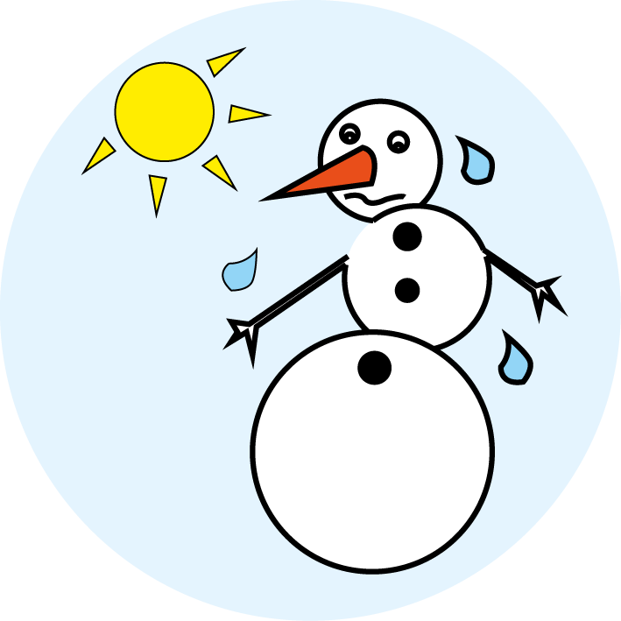

Properties and changes of materials
Investigating thermal insulators
Key Learning
Thermal insulators do not allow heat to pass through them easily.
Materials which trap air inside them are good thermal insulators.
Activities (pages 3-6): 60 - 80 mins (allowing for melting time)
Household items to support learning:
Two ice cubes of the same size.
A piece of flexible material such as bubble wrap or a cleaning cloth.
Scissors and a ruler.
Use squared paper and a pencil for recording. Alternatively you may wish to print: page 5 (for drawing a bar chart) or page 6 (for drawing a line graph).
Taking it further… (page 7):
You may like to extend your investigation by exploring different types of materials or additional layers of material.
I can…
investigate how to stop a snowman melting using a comparative test.
plot a bar chart or a line graph with my results.

Slide 3
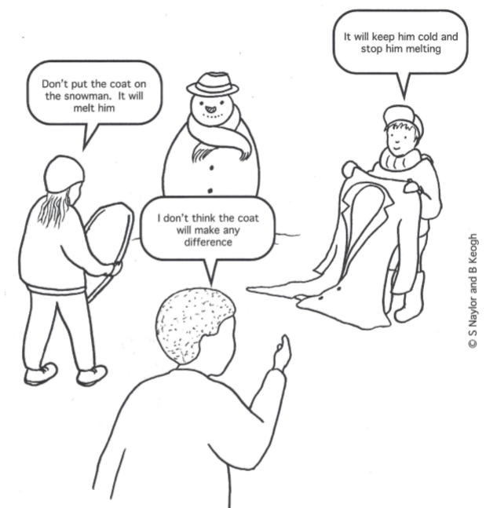
Explore, review, think, talk…
How could you stop a snowman from melting?
(5 minutes)
Imagine you have just made a snowman. How could you stop it from melting?
Which of these children do you agree with?
Do you have a different idea?
Might the type of jacket make a difference?
Talk or think about how you might investigate this question.
Concept Cartoons, 2000. Reproduced courtesy of Millgate House Education Ltd.

Slide 4
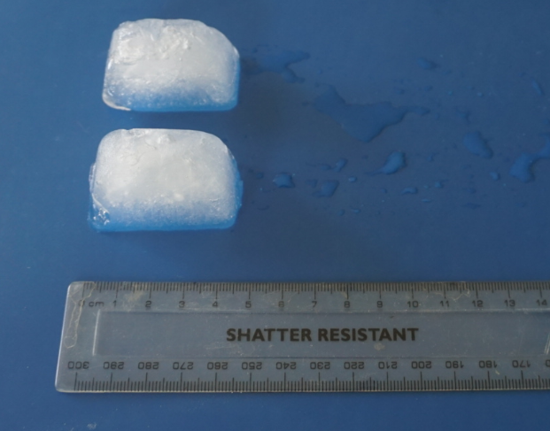
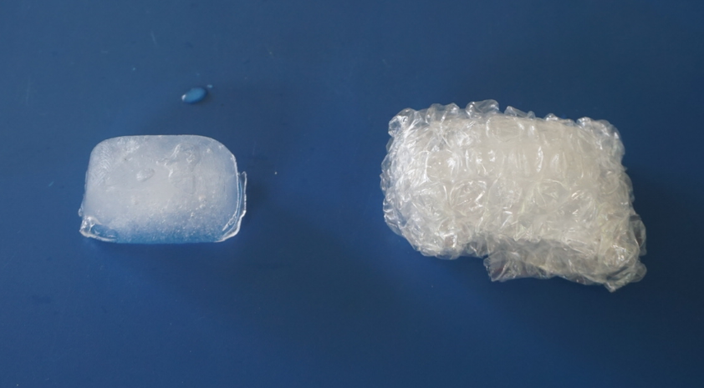
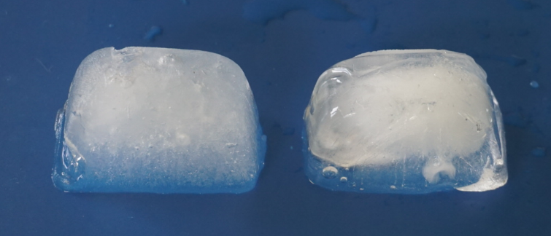
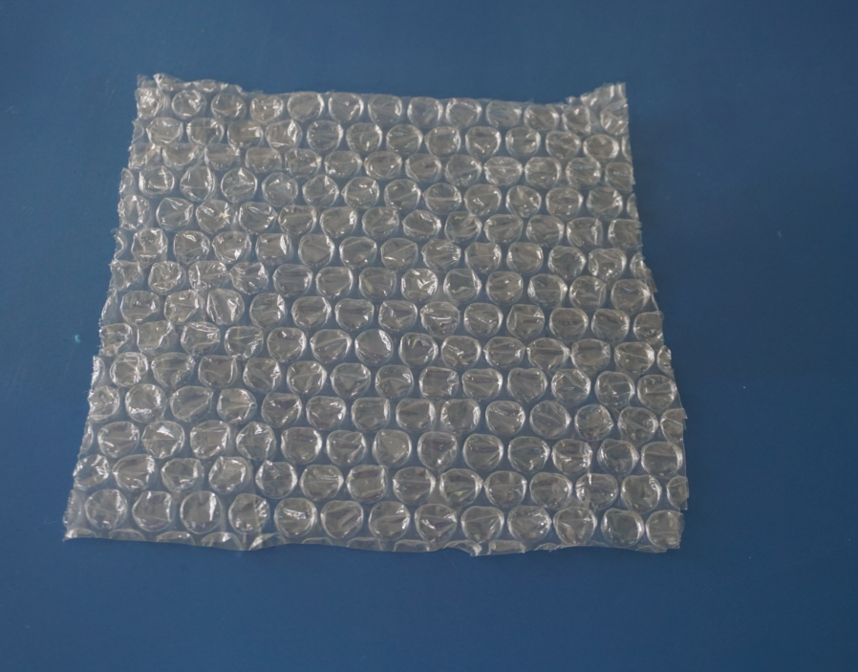
How could you stop a snowman melting?
Investigating how quickly an ice cube melts with or without a ‘jacket’ on.
(pages 4-6: 60 minutes to collect your results, 15-20 minutes to analyse your results)
It is hard to investigate a snowman without any snow!
Instead, you can use an ice cube and bubble wrap as a model snowman and jacket.
Ask an adult to work with you.
You will need:
Two ice cubes of the same size.
A piece of bubble wrap (or cloth).
Scissors, a ruler and a clock.
Take the two ice cubes out of the freezer. Measure and record their lengths in mm.
Cut a 15-20 cm square piece of bubble wrap or cloth.
Wrap one ice cube in the bubble wrap or cloth. Leave the second ice cube uncovered.
Put the ice cubes in the same place for 20 minutes.
Unwrap the ‘jacket’. Measure the length of both ice cubes. Wrap up again and leave for another 20 minutes.
Repeat the measurement after 40 and 60 minutes.

Slide 5
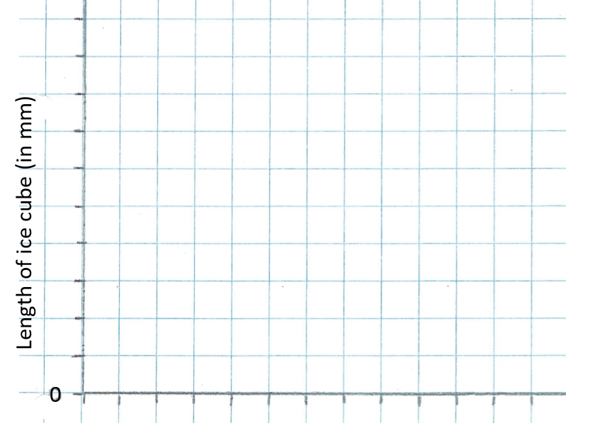
Option 1 – Use your results to plot a bar chart.
Results
Plot a bar chart showing the length of each ice cube at the start and after 20, 40 and 60 minutes.
What have you found out? Try to explain your results. Use the word bank to help you.
Which variables did you need to keep the same?
I can investigate using a comparative test. I can plot a bar chart.
Time in minutes | Length of ice cube in mm
 | without a jacket | with a jacket
0 (start)
20
40
60
40
35
30
25
20
15
10
5
no jacket
no jacket
no jacket
no jacket
with jacket
with jacket
with jacket
with jacket
thermal insulator | heat
insulation | frozen
surroundings | melt
At start
20 mins
40 mins
60 mins

Slide 6
Option 2 – Use your results to plot a line graph.
Results
Plot two lines on the graph, one for each ice cube, showing the length at 0, 20, 40 and 60 minutes. Label your lines ‘no jacket’ and ‘with a jacket’.
What have you found out? Try to explain your results. Use the word bank to help you.
Which variables did you need to keep the same?
I can investigate using a comparative test. I can plot a line graph.
Time in minutes | Length of ice cube in mm
 | without a jacket | with a jacket
0 (start)
20
40
60
40
35
30
25
20
15
10
5
0
10
20
30
40
50
60
70
80
Time (in minutes)
thermal insulator | heat
insulation | frozen
surroundings | melt

Slide 7
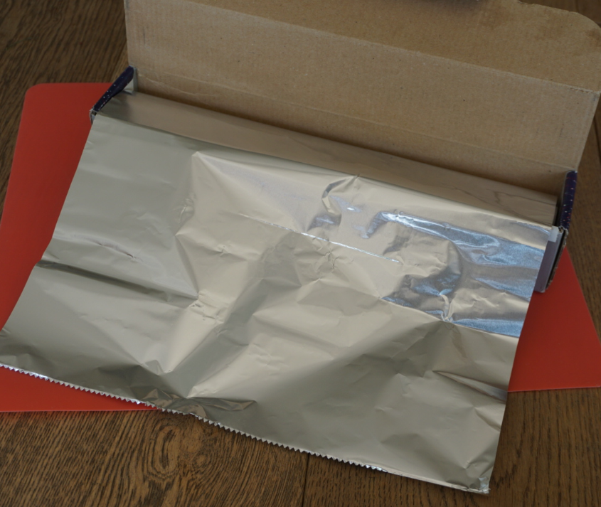
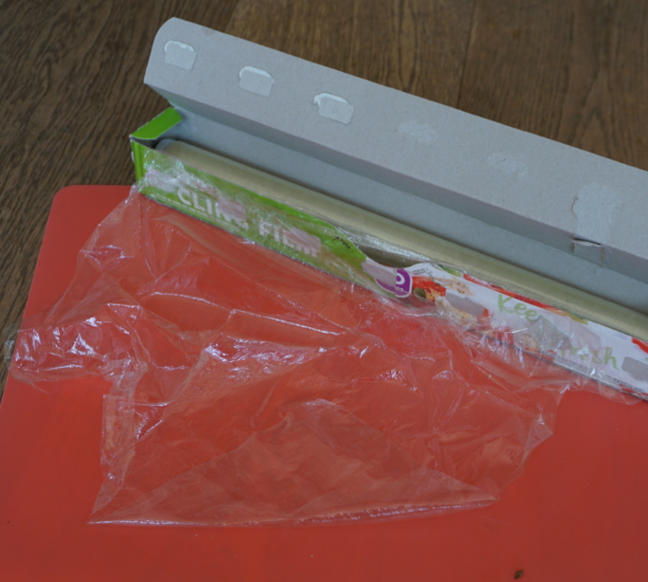
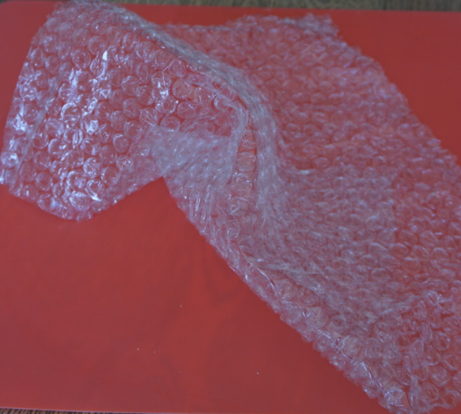
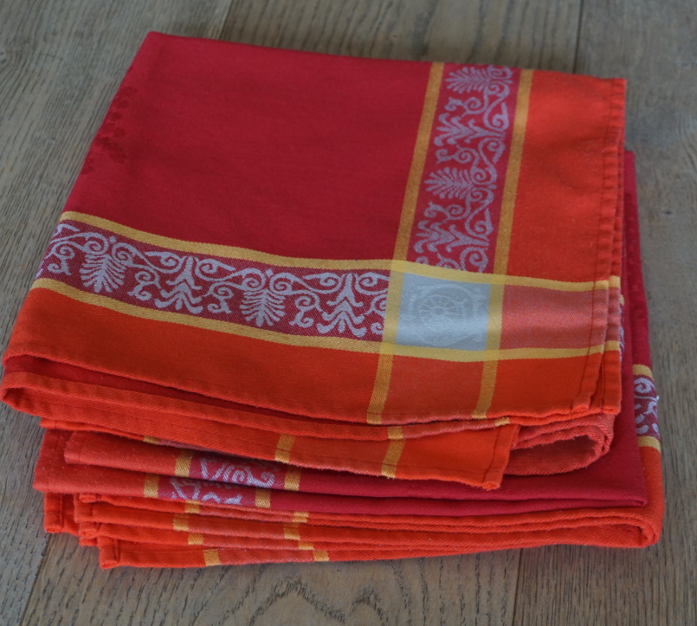
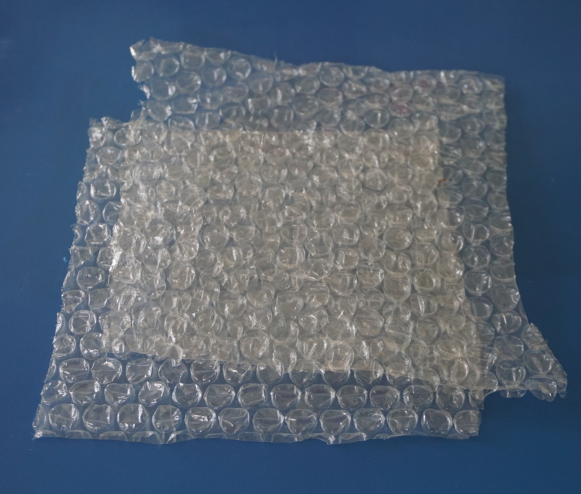
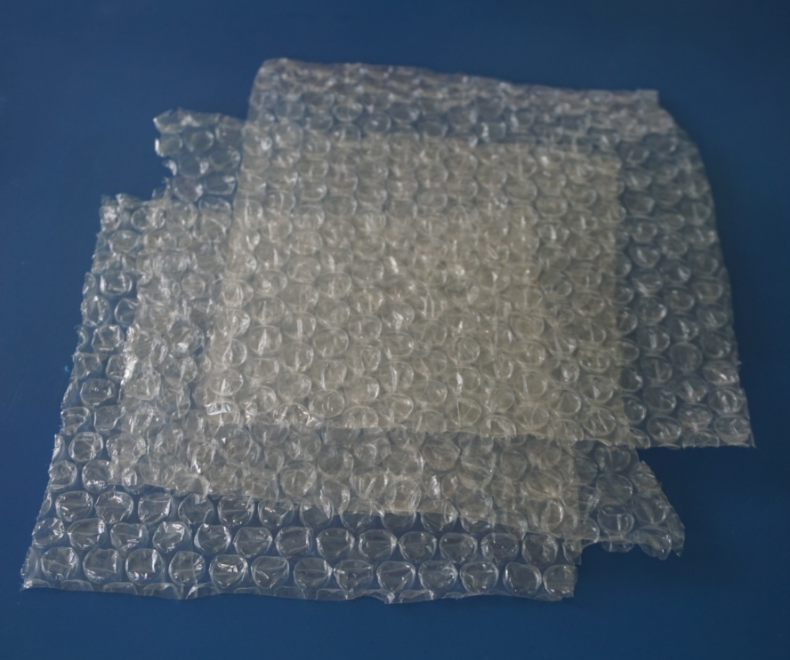
Taking it further…
You may like to try a further investigation
(60 minutes)
How else could you investigate the time it takes for a ‘snowman’ to melt?
Which variables might affect the how quickly it melts?
Remember that you can only change one variable to make your investigation a comparative or fair test.
You might like to try wrapping your ice cubes in different materials such as kitchen foil, cling film, bubble wrap and fabric.
Alternatively, you might like to try different numbers of layers of one material.
Decide how you are going to record your results and report your findings. You may like to take photographs.
Start size of ice cube?
Material of the jacket?
Layers of material?
Surrounding temperature?
Time left for?

Slide 8
Glossary of terms
Comparative test: A comparative test explores the relationship between variables.
One variable which can have two or more ‘types’ or ‘categories’ is selected to be changed, for example ‘the material of a jacket’.
One variable is selected to be measured, for example ‘the length of the ice cube’.
All other variables are kept the same, for example ‘the start size of the ice cubes’ and ‘the place where the ice cubes are left’.
Thermal insulator: A thermal insulator does not allow heat to pass through it easily. Thermal insulators help to keep hot things hot and cold things cold.
Thermal conductor: A thermal conductor allows heat to pass through it easily. Most metals are good thermal conductors.

Slide 9
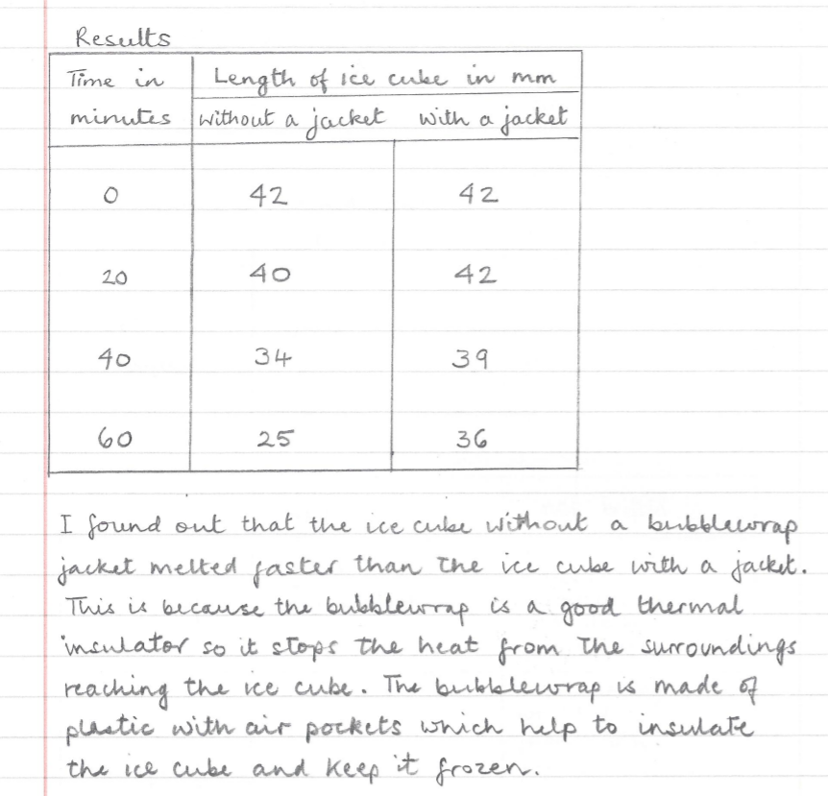
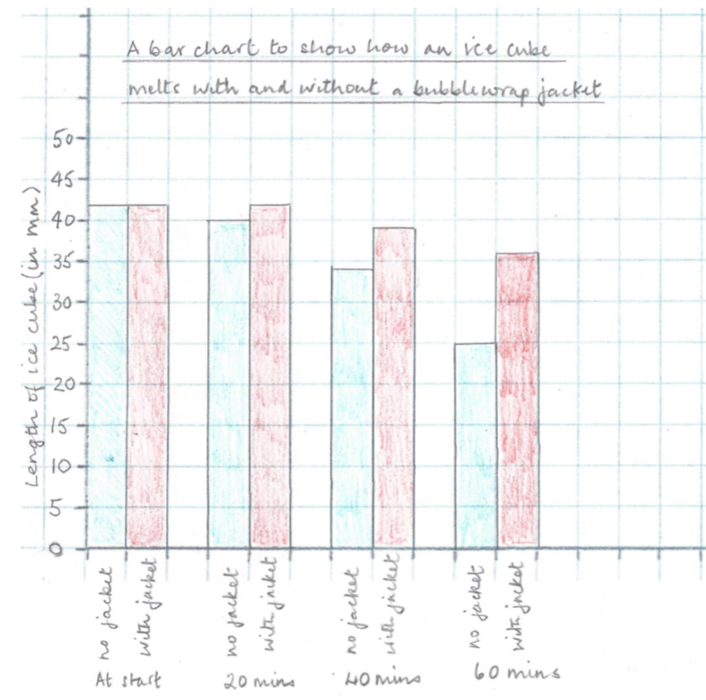
This is a comparative test as you are comparing ice cubes with and without a ‘jacket’. The variable you change is jacket/no jacket. The variables you keep the same include the size of ice cube at the start and the place where the cubes are left.
The variable you measure is the size (length) of the ice cube every 20 minutes.
The bar chart here shows that both ice cubes melted very slowly in the first 20 minutes. After 60 minutes the ice cube with no jacket had melted much more than the one with a jacket.

Slide 10
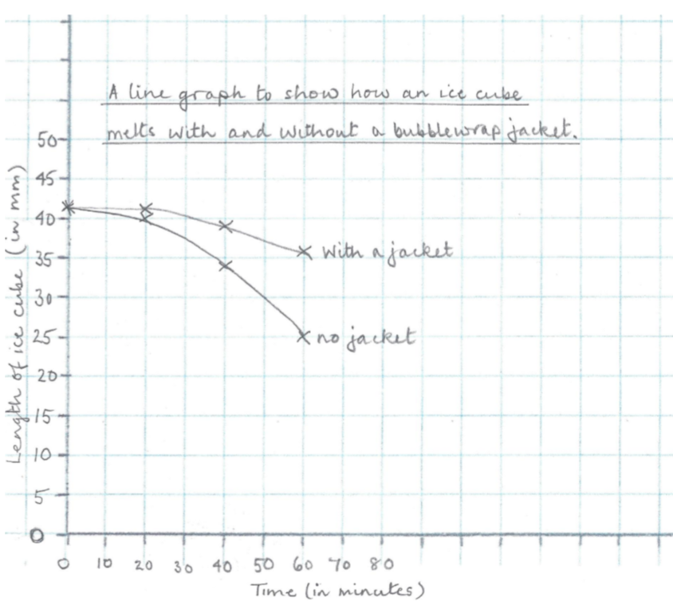
This is a comparative test as you are comparing ice cubes with and without a ‘jacket’. The variable you change is jacket/no jacket. The variables you keep the same include the size of ice cube at the start and the place where the cubes are left.
The variable you measure is the size (length) of the ice cube every 20 minutes.
The line graph here shows that both ice cubes melted very slowly in the first 20 minutes. After 60 minutes the ice cube with no jacket had melted much more than the one with a jacket.

