Slide 1

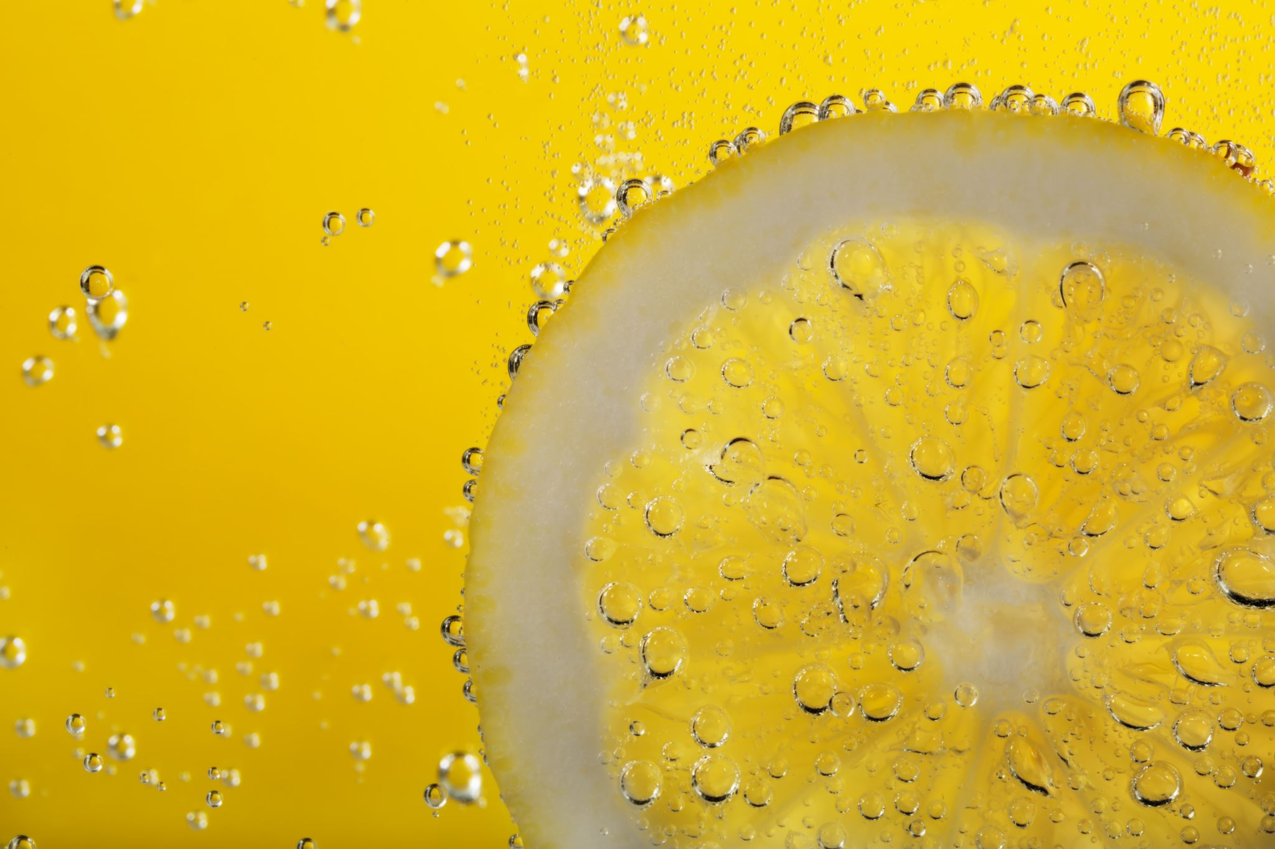

For parents
Thank you for supporting your child’s learning in science.
Before the session:
Please read slide 2 so you know what your child is learning and what you need to get ready.
As an alternative to lined paper, slide 6 may be printed for your child to record on.
During the session:
Share the learning intentions on slide 2.
Support your child with the main activities on slides 3 - 6, as needed.
Slide 7 is a further, optional activity.
Slide 8 has a glossary of key terms.
Reviewing with your child:
Slide 9 gives an idea of what your child may produce.
Properties and changes of materials
Comparing soluble and insoluble materials
Year 5 Age 9 - 10

Slide 2
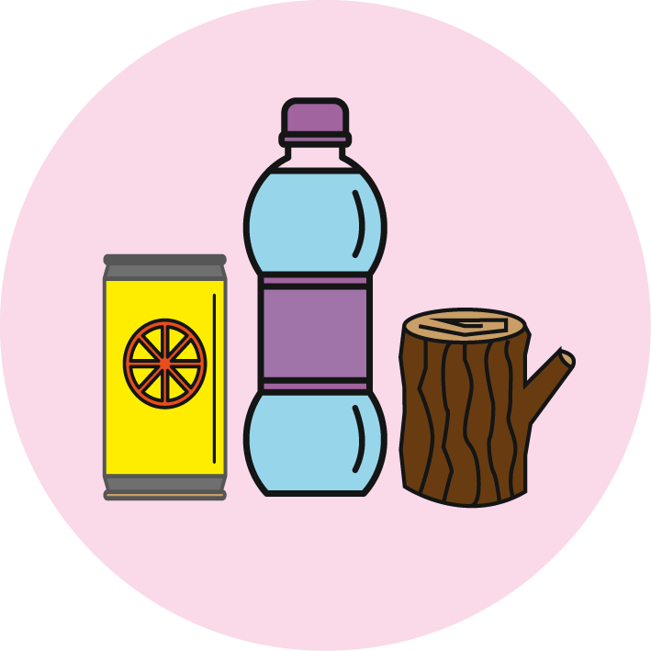

Properties and changes of materials
Comparing soluble and insoluble materials
Key Learning
Some materials will dissolve in a liquid and form a solution. They are soluble materials.
Other materials do not dissolve in a liquid. They form a sediment. These materials are insoluble.
Activities (pages 4-6): 30 - 40 mins
Household items to support learning:
Clear plastic cups (or glass cups).
Salt, white sugar, brown sugar, flour and rice (or other grain/pulse).
Teaspoon and water.
Use lined paper and a pencil for recording. Alternatively you may wish to print page 6 as a worksheet.
Taking it further… (page 7): 20 - 30 mins
You may like to find out more about the properties of salty water.
I can…
identify and compare soluble and insoluble materials.

Slide 3

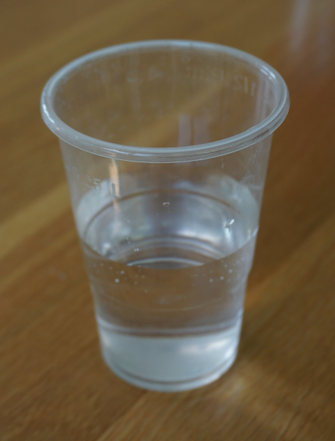
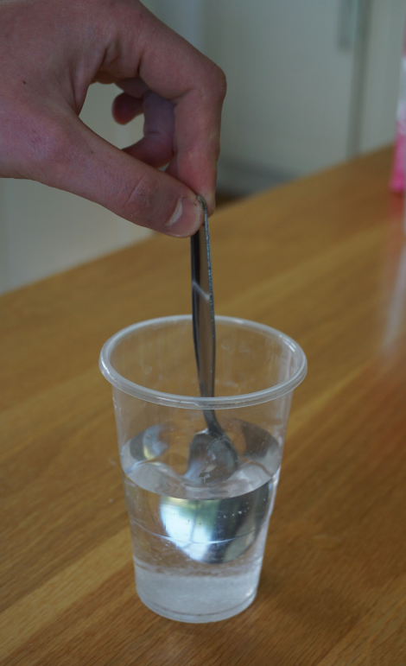
Explore, review, think, talk…
What happens when you add sugar to a warm drink?
(5 minutes)
Some people like to add sugar to their tea or coffee.
What happens to the sugar?
Ask an adult to work with you.
Half fill a clear plastic cup or glass with lukewarm water.
Add ½ teaspoon of white sugar.
Stir slowly and watch what happens.
Talk about what you see.
Sugar seems to ‘disappear’ when you stir it into water but it is still there!
The sugar has dissolved in the water to form a transparent, clear solution.
Sugar is a soluble material.
Which other soluble substances can you find in the kitchen?
Watch this clip: https://www.bbc.co.uk/bitesize/topics/zcvv4wx/articles/zpbdpbk

Slide 4
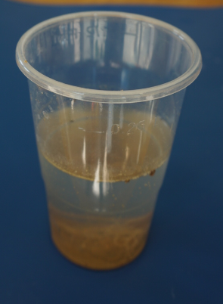
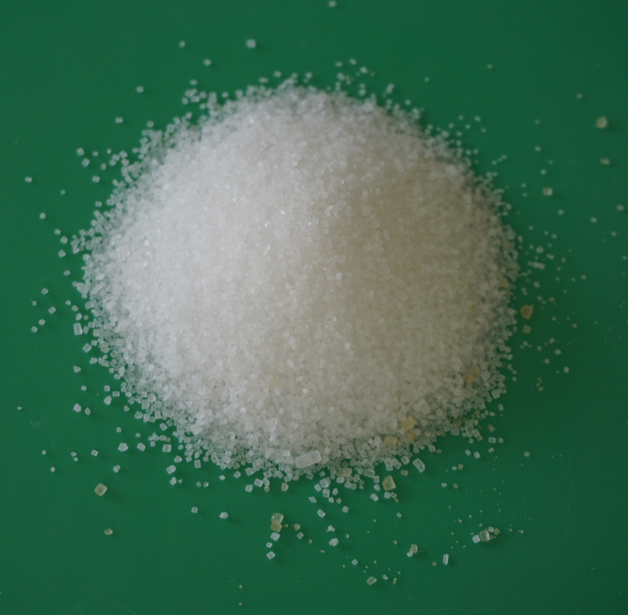
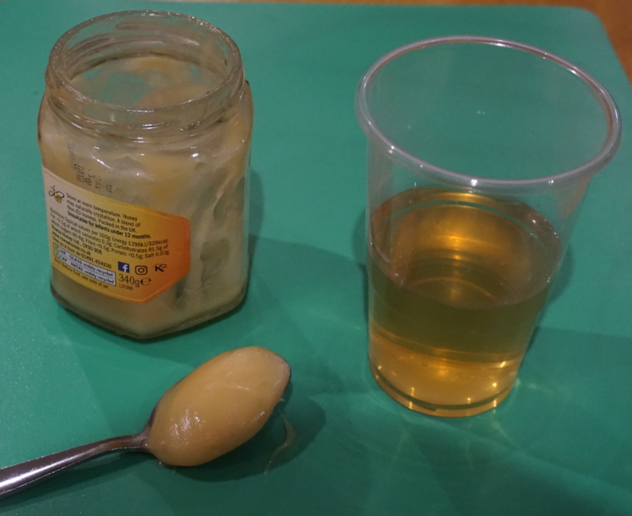
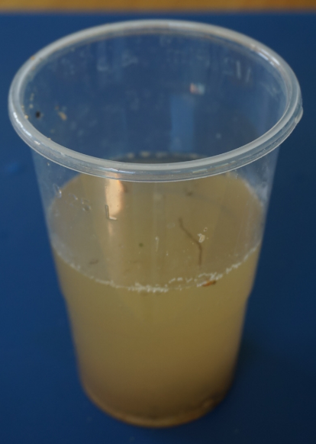
Soluble and insoluble materials
Comparing soluble and insoluble materials
(pages 4-6: 30 minutes)
Soluble substances like white sugar dissolve in water to form a transparent, clear solution.
A solution can also be clear and coloured, for example when you dissolve honey in water.
Insoluble substances like sand do not dissolve. They often sink quickly to the bottom and form a sediment.
Some insoluble substances, like the particles of fine clay soil do not sink quickly. The water looks cloudy. The sediment is suspended in the water.

Slide 5
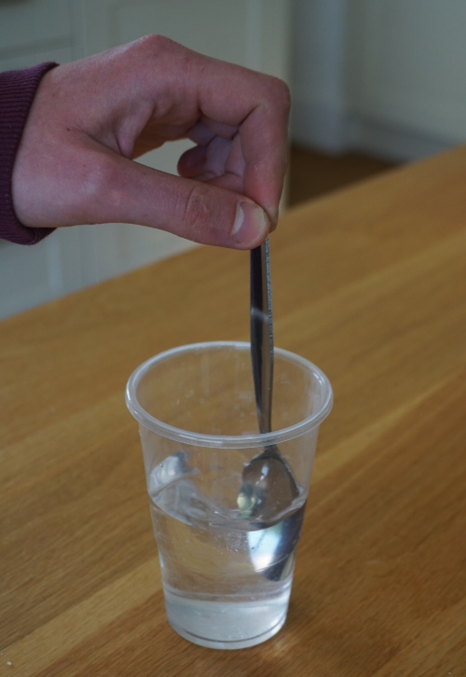
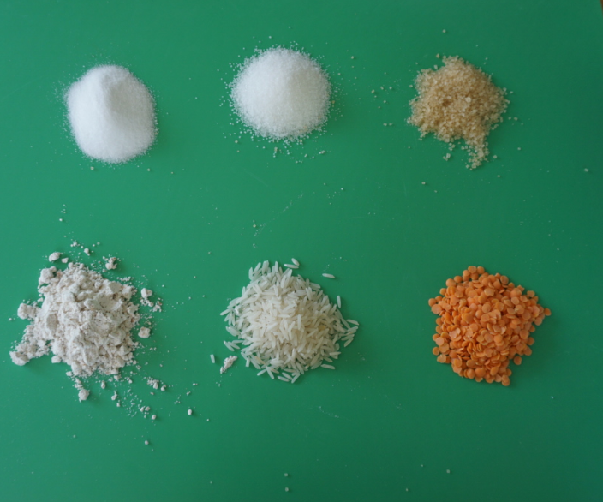
Soluble and insoluble materials
Comparing soluble and insoluble materials we use in the kitchen
Ask an adult to work with you. Remember to wash your hands afterwards. You will need:
A clear plastic cup (or glass).
A teaspoon.
Materials to test: a variety of small-grained solids such as:
1. Fill ½ cup or glass with lukewarm water.
2. Add ½ teaspoon of your first material.
3. Stir slowly for a minute and watch carefully what happens.
4. Stop stirring and watch again.
5. Record your observations in a table (see page 6).
6. Classify your substance as ‘soluble’ or ‘insoluble’.
7. Wash out your cup and repeat for other materials.
white
sugar
brown sugar
salt
flour
rice
lentils

Slide 6
Ask an adult to work with you.
Add ½ teaspoon of each material to a separate cup of lukewarm water.
Stir slowly for a minute and watch carefully.
Stop stirring and watch again.
Record your observations. Use the word bank to help you.
Is the material soluble or insoluble?
Word bank:
soluble insoluble
dissolve solution
transparent coloured
sediment cloudy
suspended clear
I can identify and compare soluble and insoluble materials.
Name of material | Observation - what happened? | Soluble or insoluble?

Slide 7
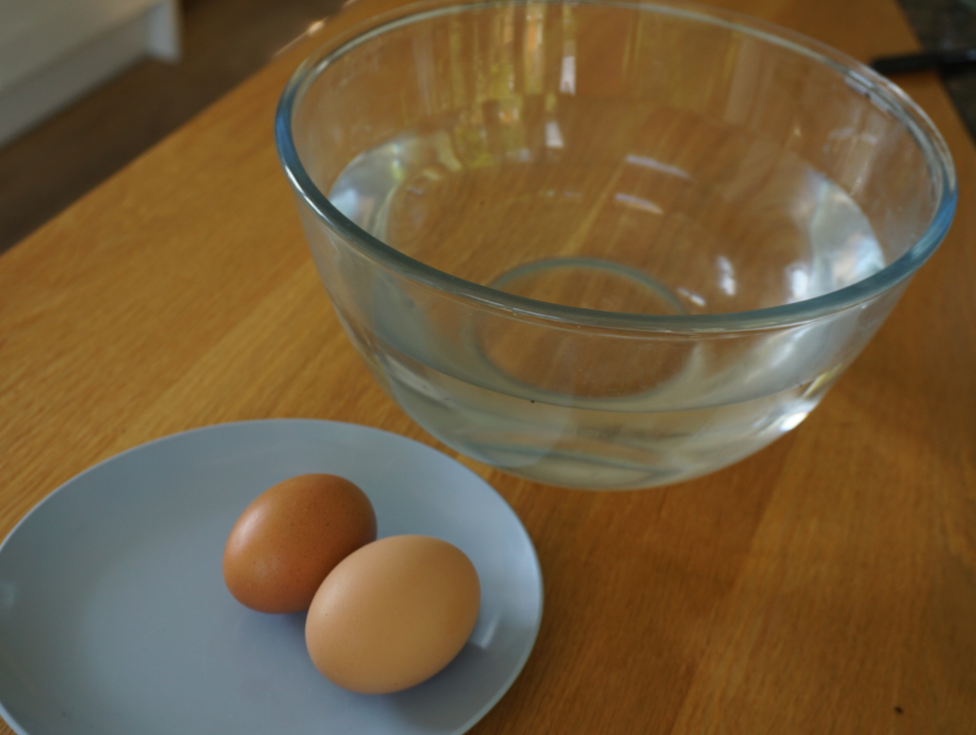
Find out more…
Find out more about the properties of salty water
(20 – 30 minutes)
What is the difference between normal water and salty water?
Use the link to this PSTT ‘Science Fun at Home’ activity for exploring this question.
https://pstt.org.uk/application/files/6115/8633/7142/3._EGG-CITING_SCIENCE.pdf
Take photographs or design a poster to show what you found out!
Alternatively find out more about our salty seas and oceans:
Why is the sea salty?
Do all seas and oceans have the same amount of salt?
Explore these and your own questions using the following links:
https://www.dkfindout.com/uk/earth/oceans-and-seas/
https://www.wildlifetrusts.org/why-sea-salty-and-why-sea-blue
https://www.nhm.ac.uk/discover/quick-questions/why-is-the-sea-salty.html

Slide 8
Glossary of terms
Material: Material is the matter from which a thing is or can be made.
Dissolve: Some materials will dissolve in a liquid. For example, sugar dissolves in water to form a clear, transparent solution.
Solution: When a material dissolves in a liquid it forms a clear solution. A solution can be transparent or coloured. For example, brown sugar forms a clear, coloured solution.
Soluble: A material is soluble in a liquid if it dissolves in that liquid.
Insoluble: A material is insoluble in a liquid if it does not dissolve in that liquid.
Sediment: Some insoluble materials sink quickly and form a sediment at the bottom of a liquid.
Suspended: Some insoluble materials do not sink quickly so the liquid looks cloudy. The sediment is suspended in the liquid.

Slide 9
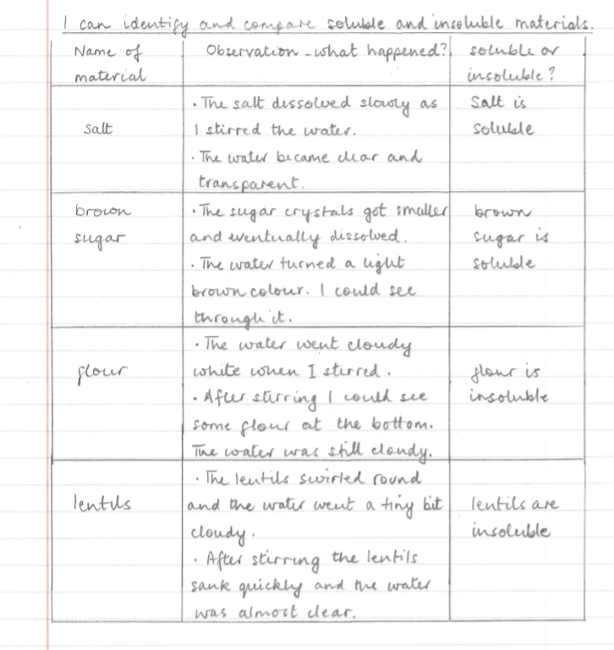
Possible learning outcome for reviewing your work:
Salt and white sugar both dissolve in water to form a clear, transparent solution.
Flour does not dissolve in water. Grains of flour are small, so some will stay suspended in the water, making the water cloudy.
The flour grains are called a sediment.
Brown sugar dissolves in water to form a slightly brown coloured solution.
All solutions are clear so you can see through them.
Lentils do not dissolve in water. Lentil grains are quite large so they fall quickly to the bottom as a sediment.
Dust from the lentils may make the water slightly cloudy.

