Slide 1
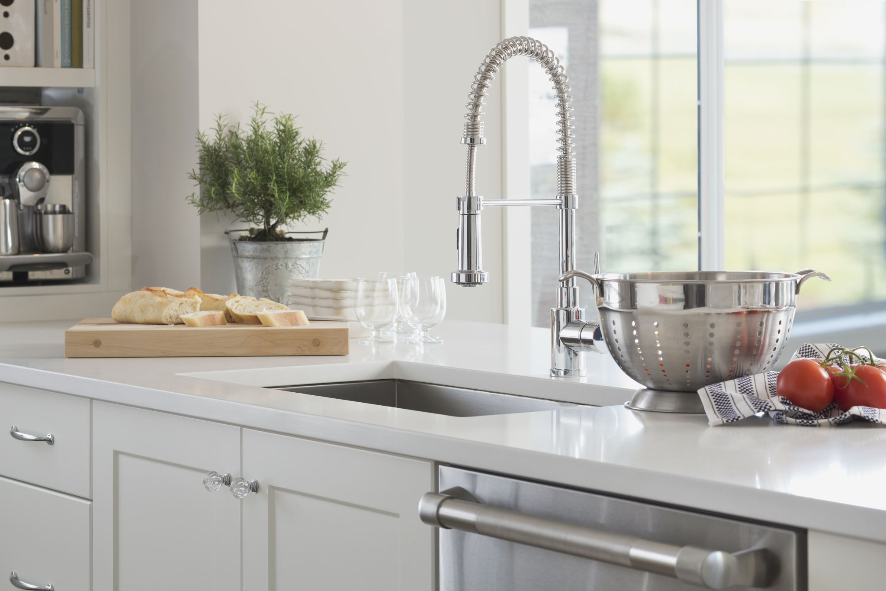


For parents
Thank you for supporting your child’s learning in science.
Before the session:
Please read slide 2 so you know what your child is learning and what you need to get ready.
As an alternative to lined paper, slide 7 may be printed for your child to record on.
During the session:
Share the learning intentions on slide 2.
Support your child with the main activities on slides 3 - 7, as needed.
Slide 8 has further, optional activities.
Slide 9 has a glossary of key terms.
Reviewing with your child:
Slide 10 gives an idea of what your child may produce.
Properties and changes of materials
Investigating reversible changes by separating materials
Year 5
Age 9 - 10

Slide 2
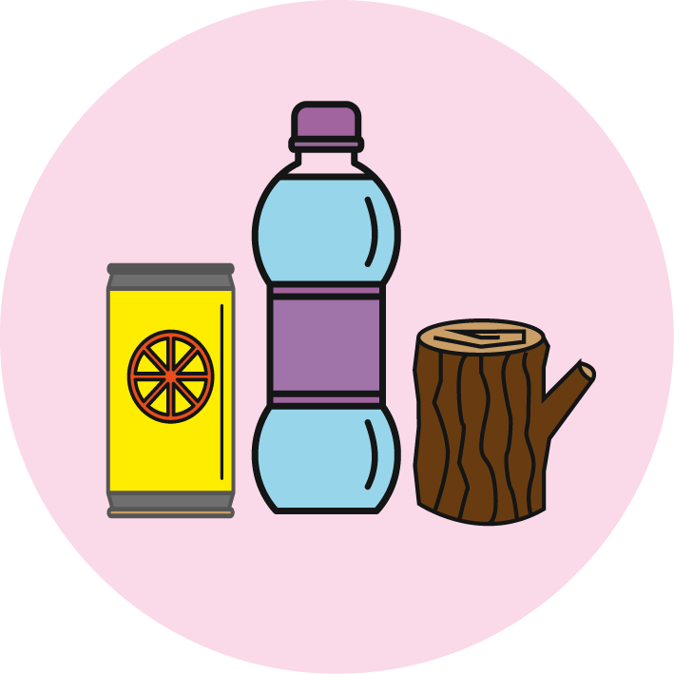

Properties and changes of materials
Investigating reversible changes by separating materials
Key Learning
Some changes to materials such as dissolving and mixing are reversible. The materials can be separated, as no new materials have been formed.
Insoluble materials can be separated from a liquid by sieving or filtering.
Soluble materials can be separated from a liquid by the process of evaporation.
Activities (pages 3-7): 30 - 45 mins, plus evaporation time!
Household items to support learning:
Kitchen paper, sieve, bowls, cups.
Salt, flour and uncooked rice (or other dried grain/pulse).
Teaspoon and water.
Use lined paper and a pencil for recording. Alternatively you may wish to print page 7
as a worksheet.
Taking it further… (page 8): 20 - 30 mins
You may like to try mixing and separating other insoluble materials. Alternatively, explore more about evaporating salty water.
I can…
select equipment to separate two or more materials by sieving, filtering and/or evaporating.

Slide 3
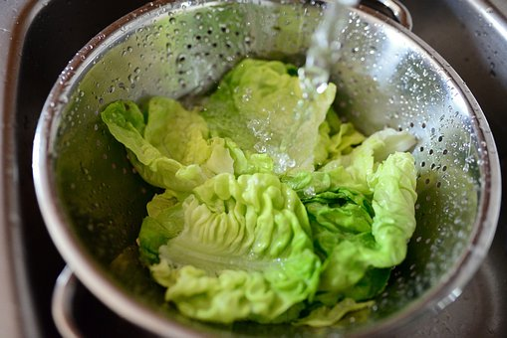
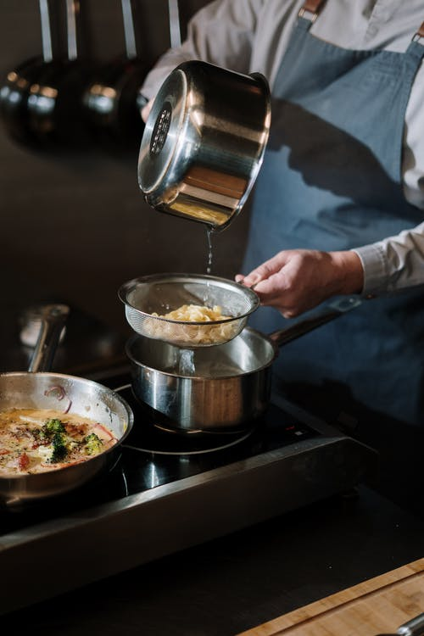
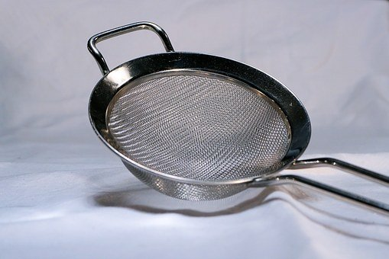
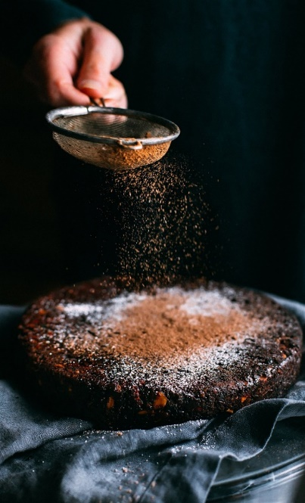
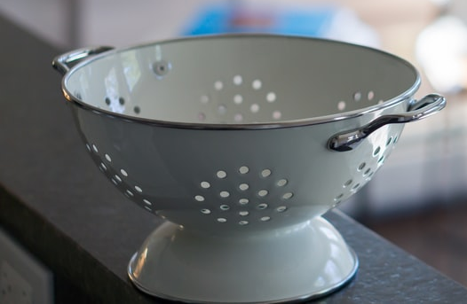
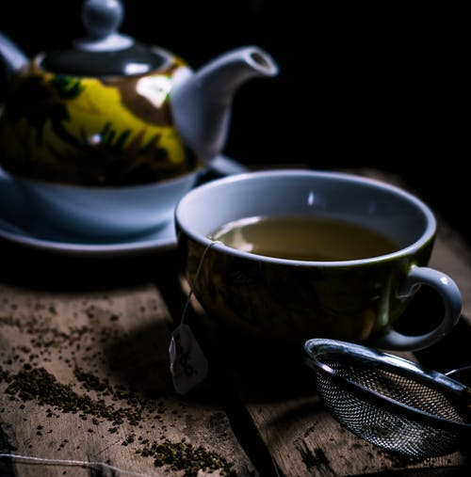
Explore, review, think, talk…
How do we use sieves and colanders in the kitchen?
(5 minutes)
Sieves and colanders are useful pieces of kitchen equipment.
Think or talk about some different ways sieves or colanders are used.
washing salad
removing lumps
draining cooked food
straining tea
sprinkling

Slide 4
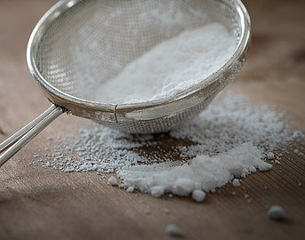
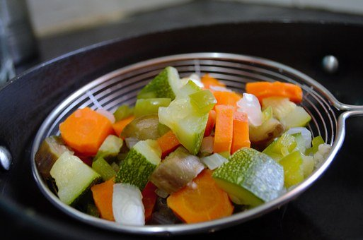
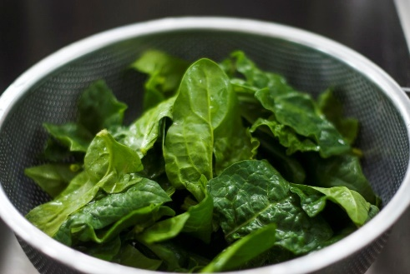
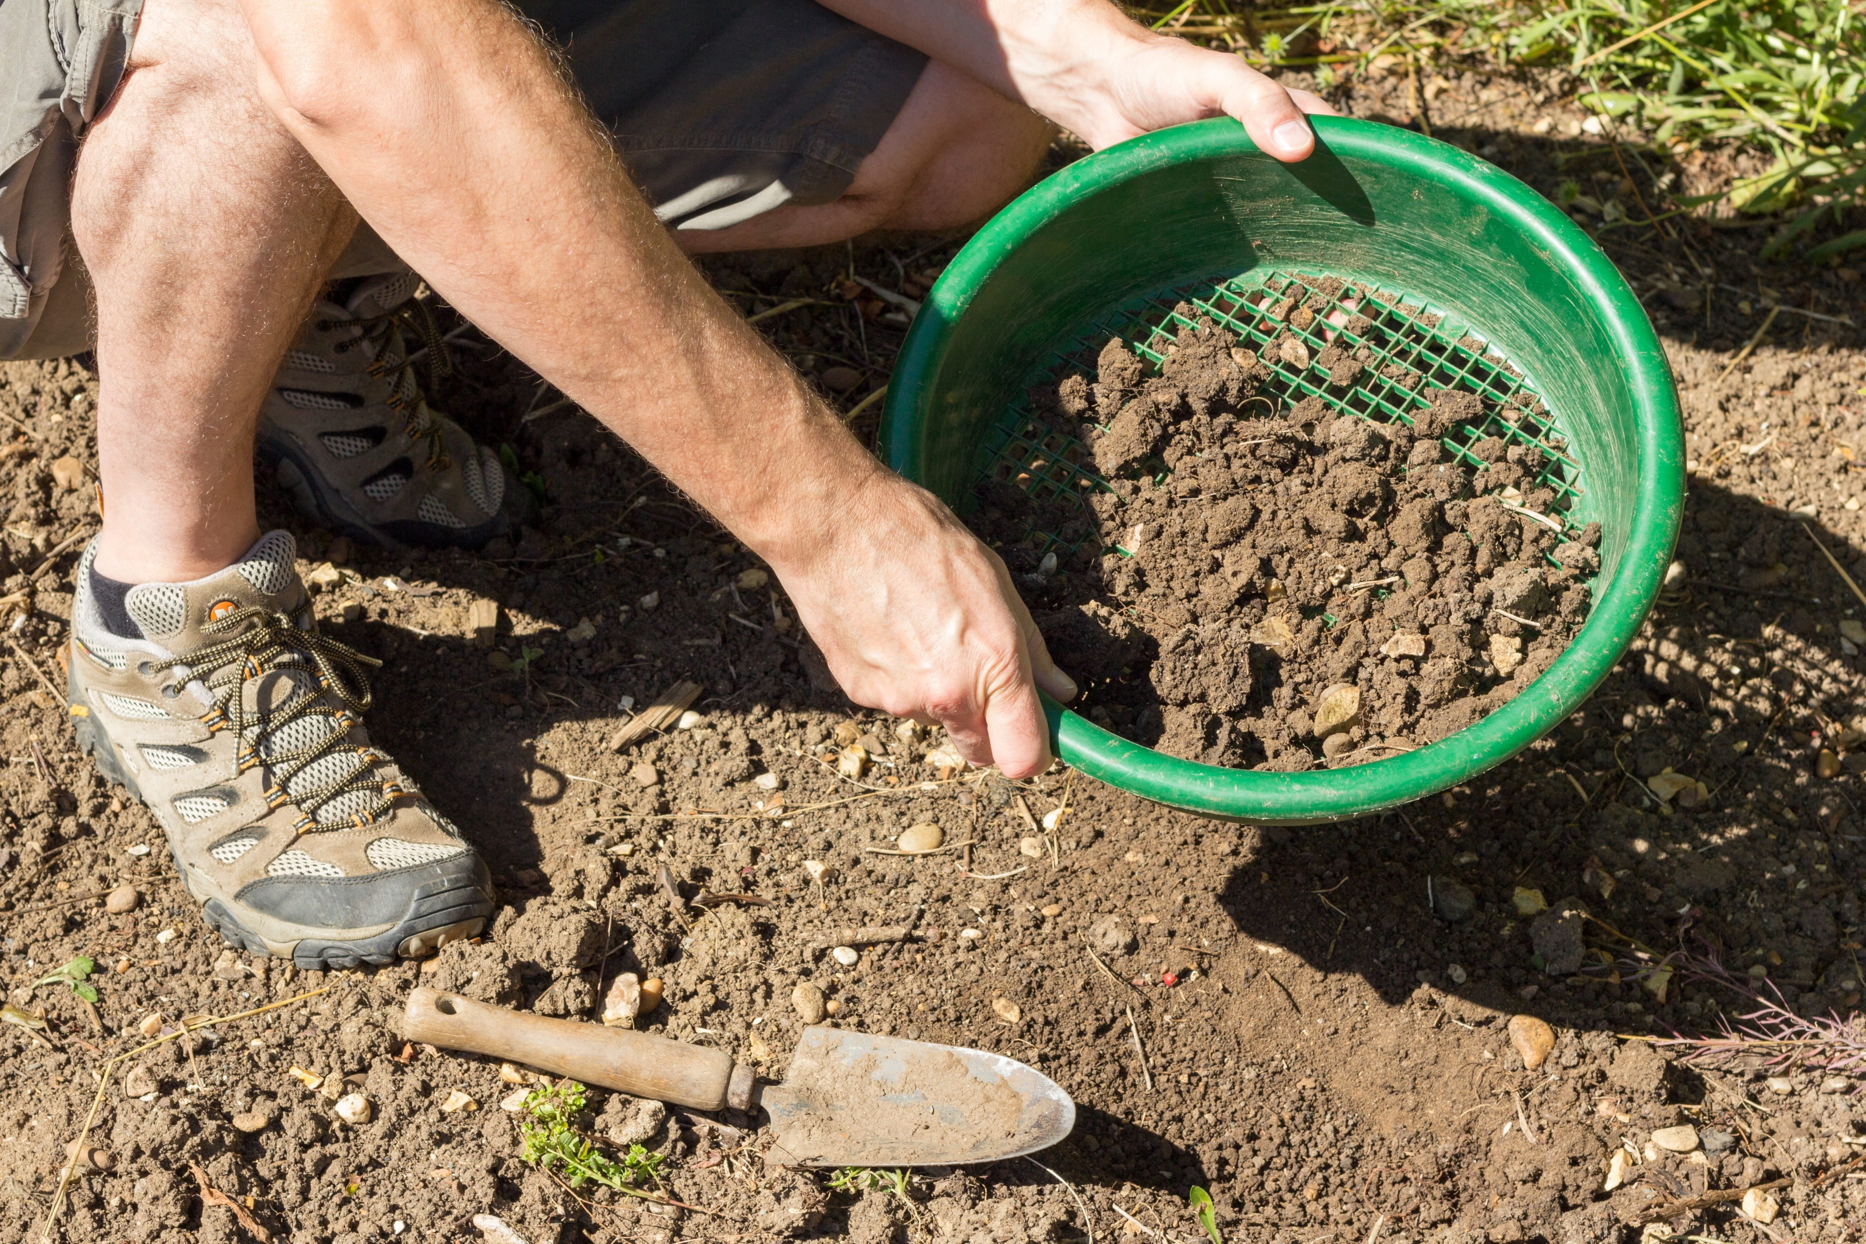
Separating materials
How do you separate materials that are mixed together?
(pages 4-7: 30 - 40 minutes)
Sieves have a mesh
or small holes.
Different sized meshes
are used depending
on the size of the grains
being separated.
Fine grained solids or
powders can pass
through a small mesh.
Sometimes more than
one sieve size may be needed, for example, removing different sized stones from soil.
Sieves can also separate many solids from a liquid.
Think or talk about when a sieve might not be suitable for separating a solid from a liquid.
Watch these two clips: https://www.bbc.co.uk/bitesize/clips/z9jd7ty
https://www.bbc.co.uk/bitesize/topics/zcvv4wx/articles/zw7tv9q

Slide 5
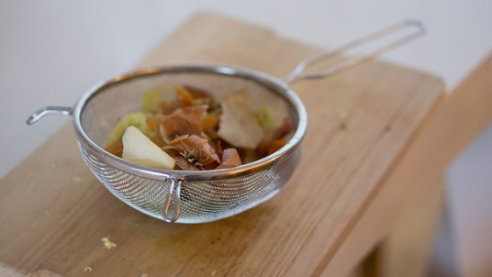
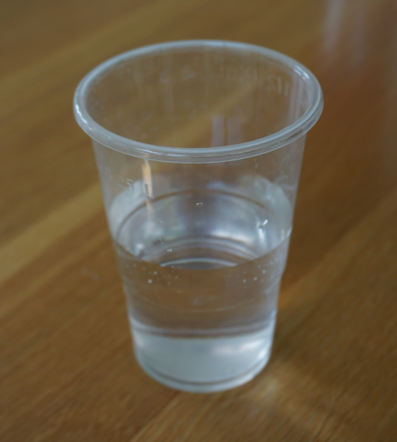
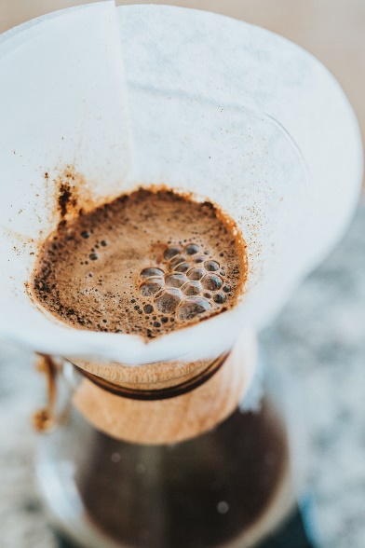
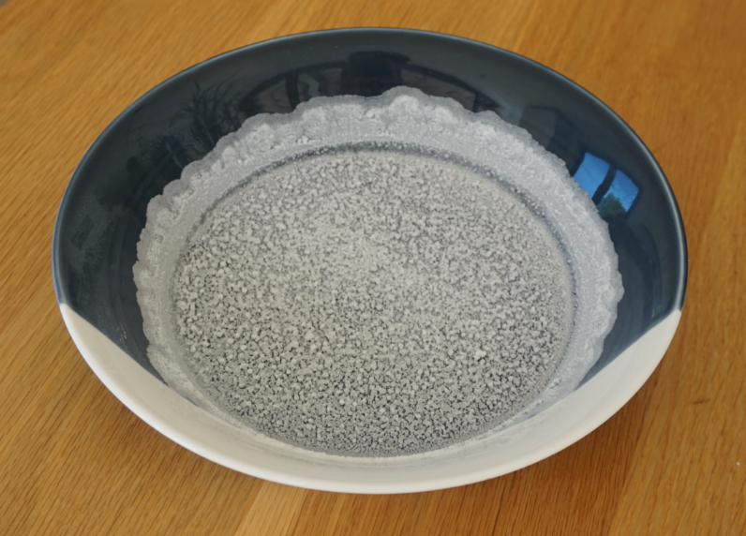
Separating materials
How do you separate insoluble and soluble materials from a liquid?
Insoluble materials can be separated from a liquid by sieving or filtering.
Sieving is suitable for
larger-sized objects or
grains, such as cooked
vegetables or rice.
Filtering can separate
small grains of an
insoluble material from
a liquid.
For example, a filter
separates coffee grains
from liquid coffee.
Soluble materials can be separated from a liquid by the process of evaporation.
Soluble solids like salt
dissolve in water to make
a clear solution which will
pass through a filter.
The salt can still be
separated because the
water can be allowed to
evaporate, leaving the
salt behind.
Insoluble and soluble solids can be separated from a liquid when no new material has formed.
Mixing and dissolving are reversible changes.

Slide 6
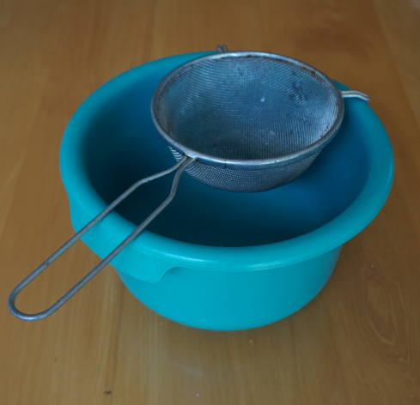
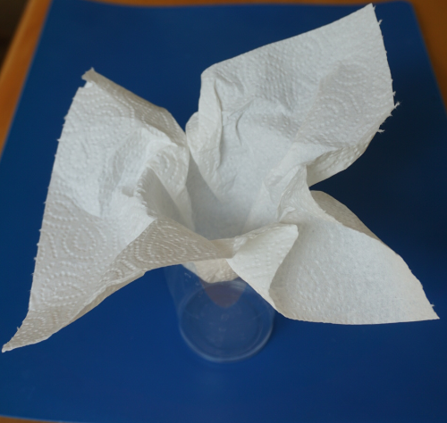
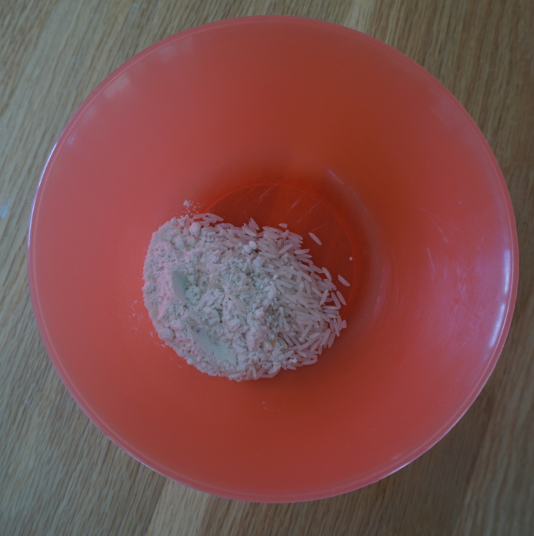
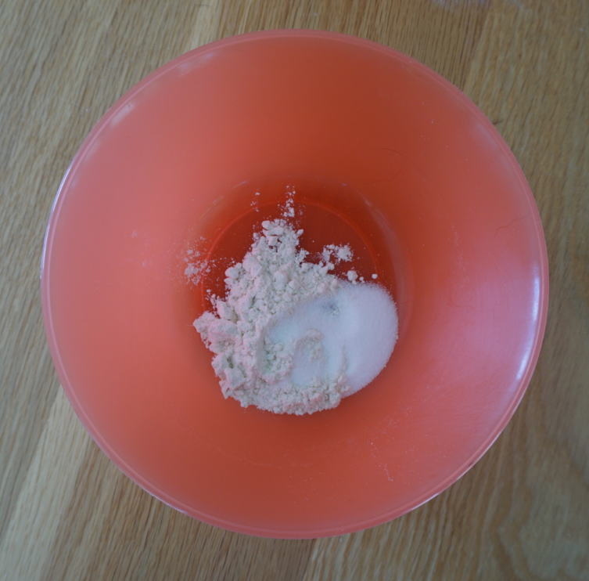
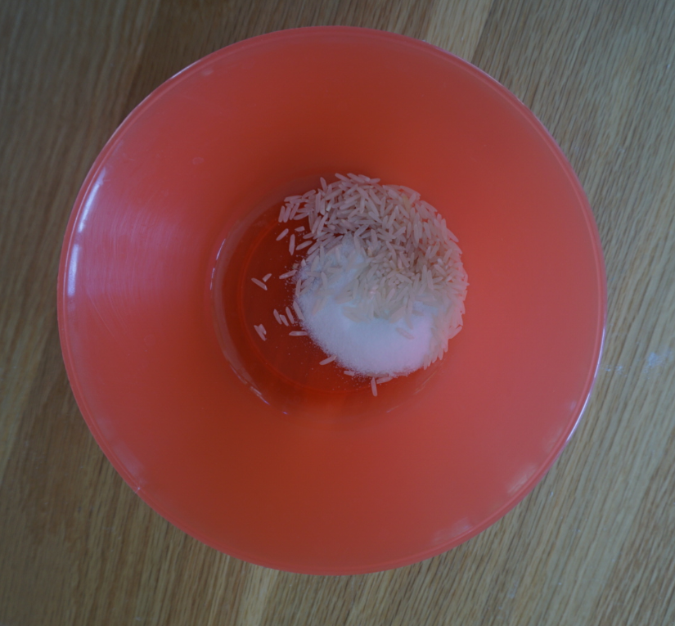
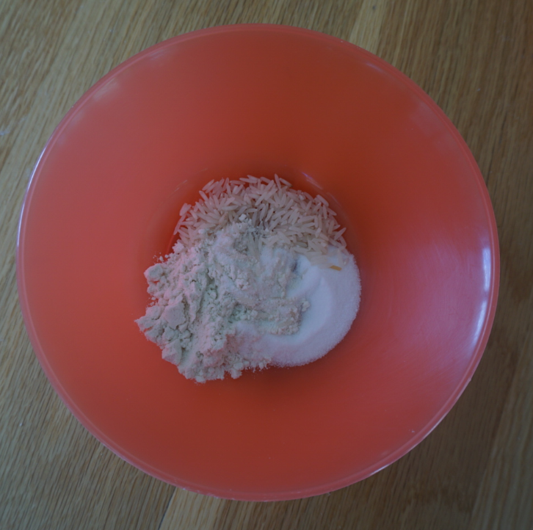
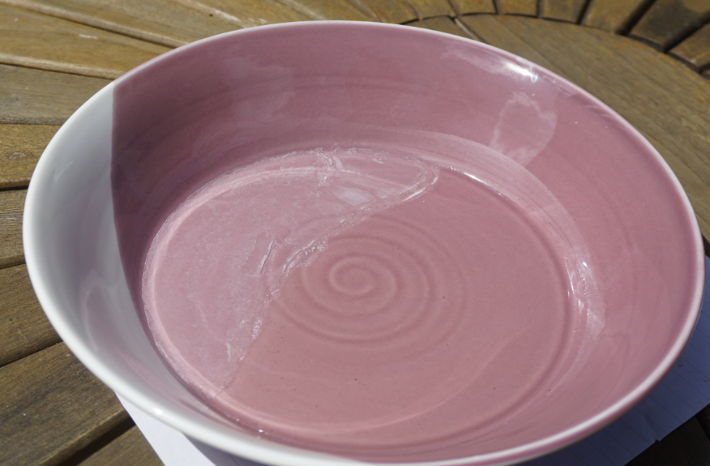
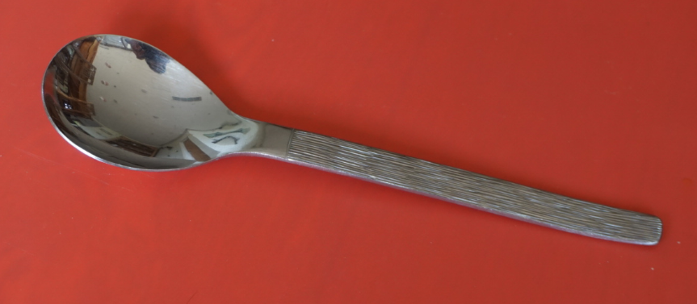
Separating materials by sieving, filtering and evaporating.
Ask an adult to work with you.
You will need
salt, flour, uncooked rice (or other dried grain/pulse) and a cup/bowl
(to make your mixtures).
a sieve over
a bowl
(for sieving).
kitchen paper
over a cup
(for filtering).
a wide bowl
or plate
(for evaporating).
a teaspoon
and some water.
I can select equipment to separate two or more materials.
Mix one teaspoon of rice and flour in a cup or bowl.
Select your separation method or methods:
  dry sieving only
  filtering only
  sieving and filtering
  filtering and evaporating
  sieving, filtering and evaporating
Choose your equipment to separate the mix of solids.
Record what happens (see suggested results table on page 7).
  Remember you will need to add water for some of the methods.
  If you decide to evaporate the water, leave the plate in a warm place.
  It may take a few hours for the water to evaporate.
Make different mixes of solids and try separating them.
Rice and flour
Salt and flour
Rice and salt
Rice, salt & flour

Slide 7
I can select equipment to separate two or more materials.
Mix of solid materials | Equipment selected for separating the solid materials | Separating method (or methods) | Observations What happened? Was it successful?

Slide 8


Find out more…
Try mixing and separating other materials or explore more about ‘salty water’
(20 – 30 minutes)
Ask an adult to work with you.
There are many different types of sieves and filters which you can use to separate insoluble materials.
Watch the link to the RSC’s Chemistry in your Cupboard ‘Separating techniques’ activity.
https://www.youtube.com/watch?v=sgRnDK4CFX4
Try mixing and then separating some different insoluble materials using sieves and filters.
Alternatively, explore more about the evaporation of water from a salt solution:
Use the link to PSTT ‘Science Fun at Home’.
https://pstt.org.uk/resources/curriculum-materials/Science-Fun-at-Home
Download activity 9: ‘Salty Science’

Slide 9
Glossary of terms
Dissolve: Some materials will dissolve in a liquid. For example, salt dissolves in water to form a clear, transparent solution.
Soluble: A material is soluble in a liquid if it dissolves in that liquid.
Insoluble: A material is insoluble in a liquid if it does not dissolve in that liquid.
Sieve/sieving: A sieve has a mesh or holes so it can separate different sized solids. Sieving can also separate an insoluble material from a liquid - for example, rice and water.
Filter/filtering: Filtering can separate small grains of an insoluble material from a liquid. For example, a filter separates coffee grains from liquid coffee.
Evaporation: Evaporation is a change of state from liquid to gas. Water can evaporate from a salt solution, leaving the salt behind.
Reversible: A reversible change can be undone or reversed; no new materials are formed. Some changes to materials such as dissolving and mixing are reversible.

Slide 10
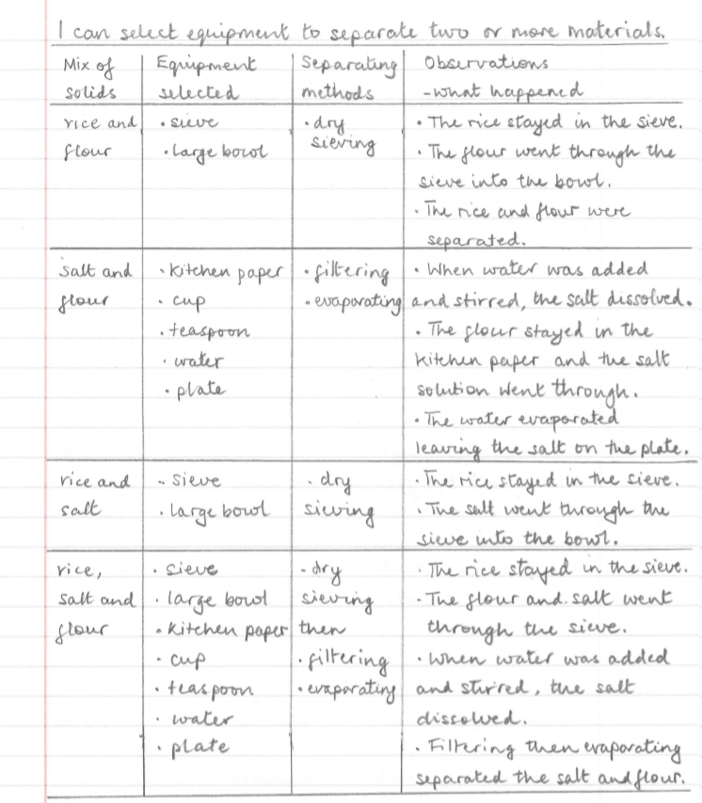
Possible learning
outcome for
reviewing
your work:
The kitchen paper acts as a filter. It can take quite a long time for all the salt solution to drip through, leaving the flour behind.
Don’t worry if you use a method that does not work!
Record what happened and then try a different method.
The rice and salt can also be separated by dissolving the salt and then sieving or filtering. In this case, the salt solution needs evaporating too.
It can take a few hours for the water to evaporate and leave the salt behind. Put the plate on a sunny windowsill to help speed up the evaporation.

