Slide 1



Properties and changes of materials
For parents
Thank you for supporting your child’s learning in science.
Before the session:
Please read slide 2 so you know what your child is learning and what you need to get ready.
As an alternative to lined paper, slide 7 may be printed for your child to record on.
During the session:
Share the learning intentions on slide 2.
Support your child with the main activities on slides 3-7, as needed.
Slide 8 has further, optional activities.
Slide 9 has a glossary of key terms.
Reviewing with your child:
Slides 10-11 give an idea of what your child may produce.
Understanding that changes of state
are reversible
Year 5
Age 9 - 10

Slide 2
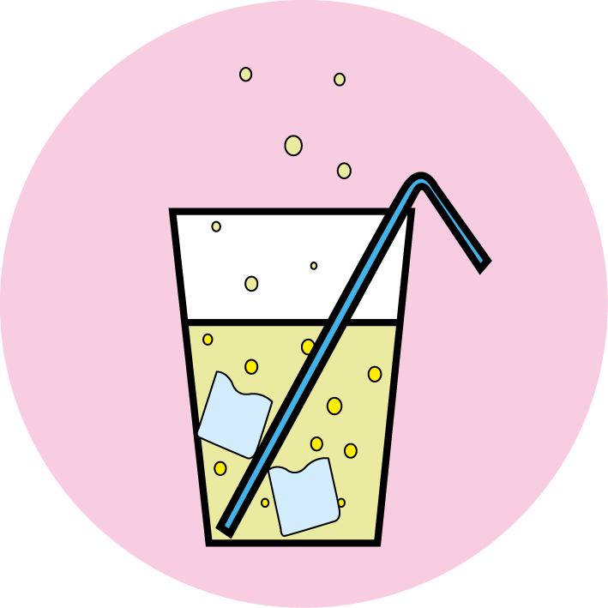

Properties and changes of materials
Understanding that changes of state are reversible
Key Learning
Melting is a change of state from solid to liquid. Freezing is a change of state from liquid to solid.
Boiling and evaporation are both a change of state from liquid to gas. Condensation is a change of state from gas to liquid.
All changes of state are reversible.
Activities (pages 3-7): 30 - 40 mins
Household items to support learning:
Chocolate drops or small chocolate bar
Clear plastic or glass cup
Kitchen foil
Hot water* (*hot tap water - no more than 50ºC)
Use lined paper and a pencil for recording. Alternatively you may wish to print page 7
as a worksheet.
Find out more… (page 8)
Find out more about how chocolate is made or try making chocolate ice cream!
I can…
observe and describe changes of state, including melting, freezing, evaporating and condensing.

Slide 3
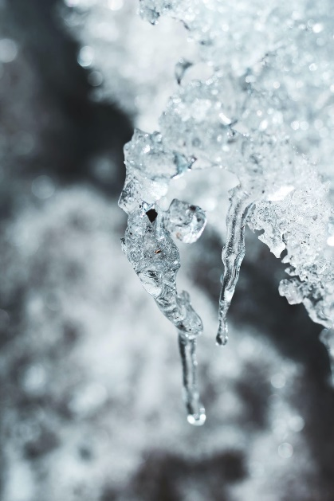
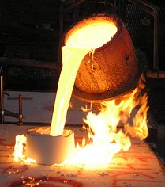
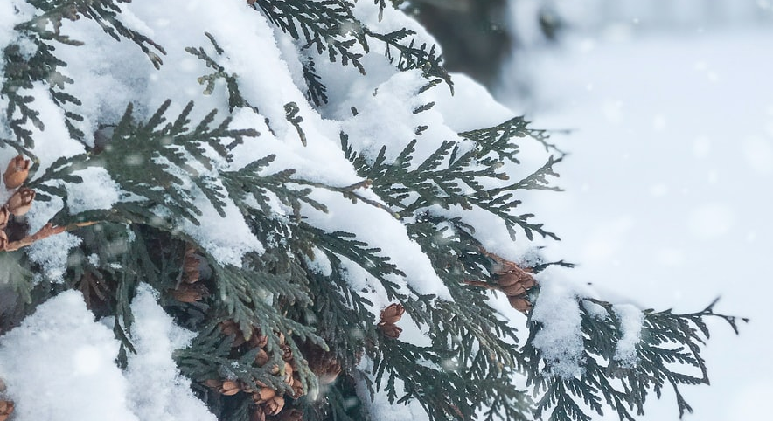
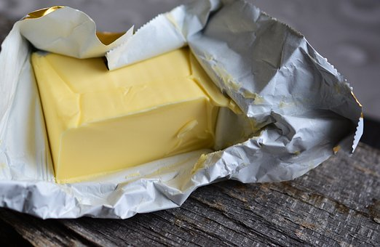
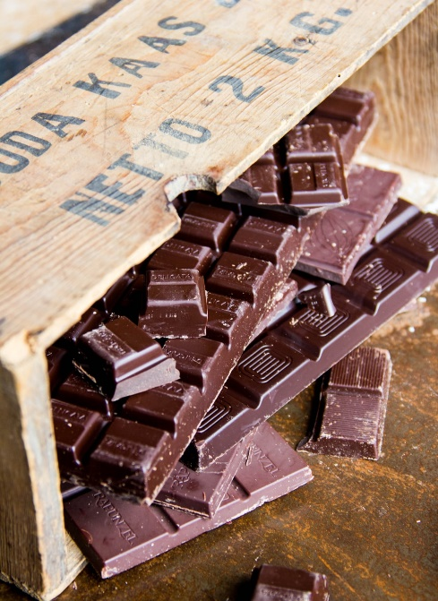
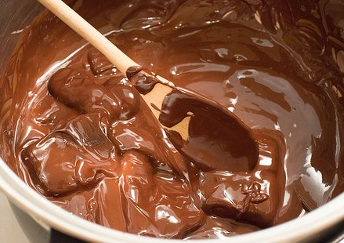
Explore, review, think, talk…
What do you already know about melting and freezing?
(5 minutes)
Talk or think about these questions:
Can you name some substances that melt easily?
What does ‘melting point’ mean?
Now watch this BBC clip: https://www.bbc.co.uk/bitesize/topics/zkgg87h/articles/z9ck9qt
Melting is a change of state. A solid material is heated and becomes a liquid.
Ice melts at zero degrees Celsius (0ºC). This is the melting point.
Chocolate melts at about 30ºC.
Iron melts at about 1500ºC!
Freezing is also a change of state. A liquid is cooled down and changes to a solid.
melting
solid
freezing
liquid
Solid chocolate can be melted to a liquid and then frozen to a solid. The change is reversible.

Slide 4
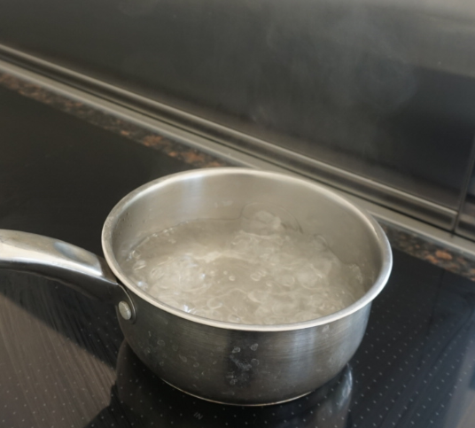
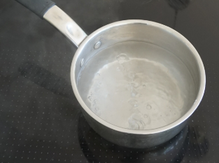
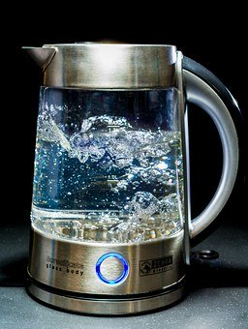
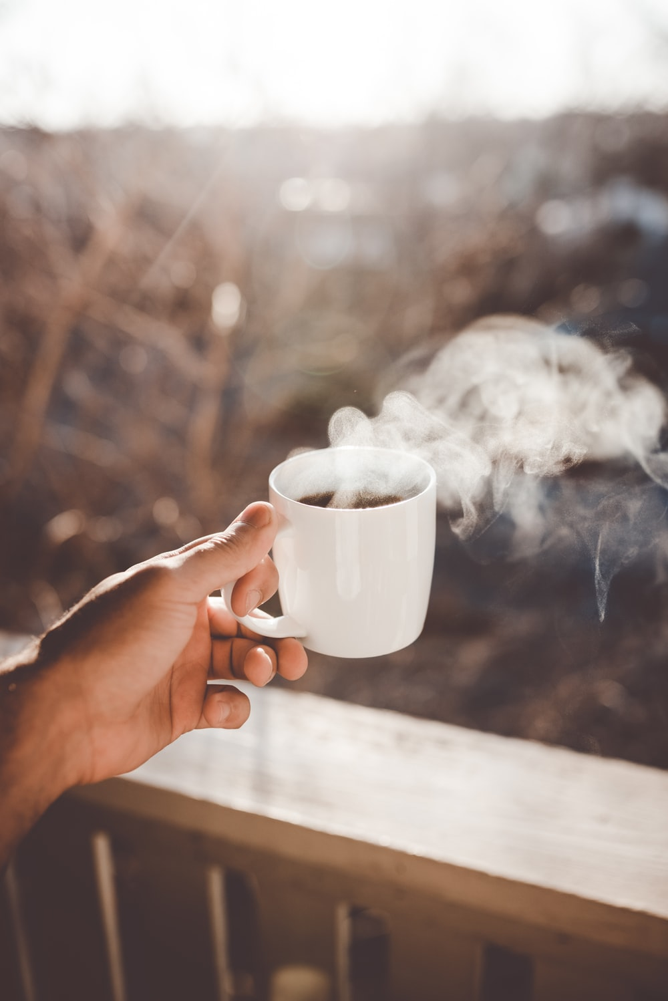
Explore, review, think, talk…
What do you already know about boiling, evaporating and condensing?
(5 minutes)
What is happening in these pictures?
When liquid water is heated it turns into a gas called water vapour.
Think or talk about what you see when you heat water in a pan.
What do you think is in the bubbles at the bottom of the water in this kettle?
Water evaporates from the surface of the liquid as it is warmed.
In boiling water you can see bubbles of water vapour forming in the liquid.
Water vapour is invisible
but it often condenses in the cool air above a pan, a kettle or cup of tea, forming tiny droplets of steam.

Slide 5
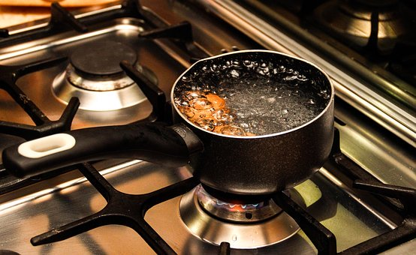
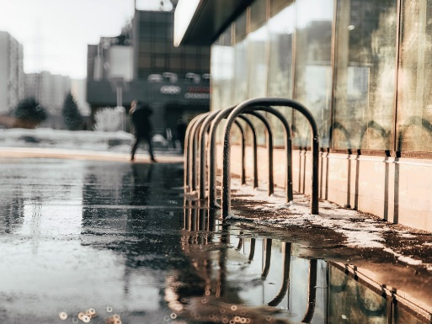
Changes of state are reversible
Understanding why a change of state is a reversible change
(10 minutes)
Boiling and evaporation are both changes of state when a liquid changes into a gas.
Boiling happens when
a liquid is heated to a
specific temperature
and bubbles of the gas
can be seen in the liquid.
Water boils at 100ºC.
Watch this clip: https://www.bbc.co.uk/bitesize/topics/zkgg87h/articles/zydxmnb
evaporating
gas
liquid
condensing
Evaporation can happen at any temperature.
Gas evaporates from the surface of the liquid,
for example from the surface of puddles after rain.
Evaporation and condensation are examples of a reversible change.
Liquid water is warmed up and changes to an invisible gas, water vapour.
Water vapour can cool down and change back to water droplets.

Slide 6
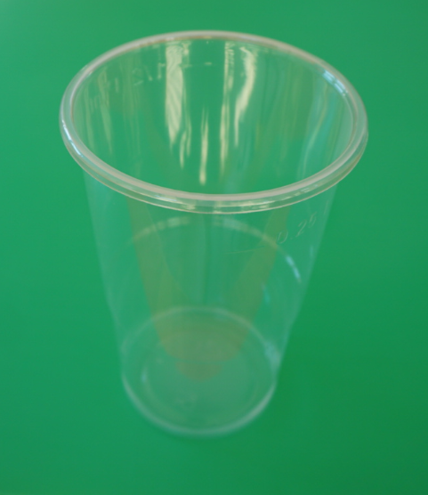
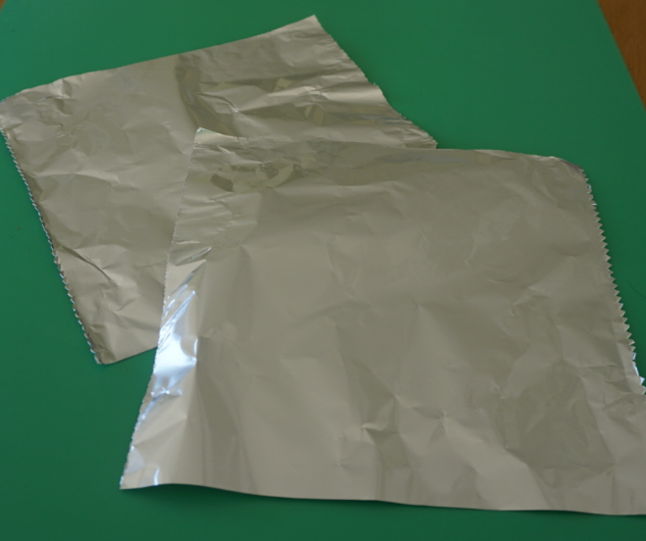
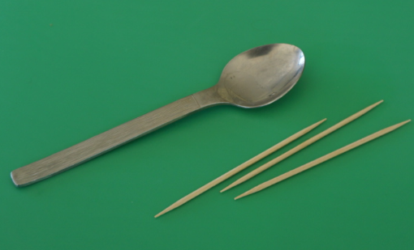
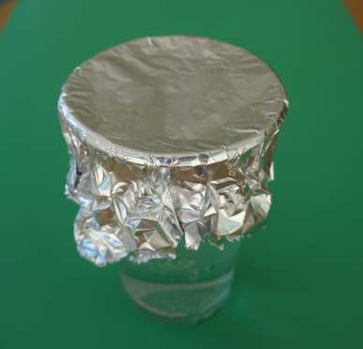
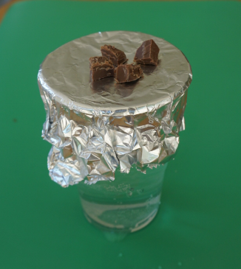
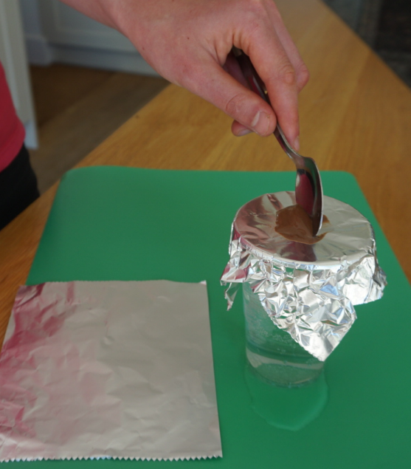
Observe and describe changes of state by investigating melting chocolate. Ask an adult to work with you.
You will need:
Chocolate drops (or a small chocolate bar & knife)
A clear plastic or glass cup
Kitchen foil
A cocktail stick or teaspoon
Hot water* (*hot tap water, no more than 50ºC)
Step 1:
Cut a square of kitchen foil large enough to fit over your cup.
Fill the cup about ¾ full with hot water*. Place it on a flat surface.
Put the foil carefully over the top of the cup and fold down the sides to make a lid.
Step 2:
Cut one cube of your chocolate into 4-6 pieces (or use chocolate drops).
Put the pieces onto the foil lid.
Watch for a few minutes. You may like to touch the foil gently.
Stir the chocolate carefully with a cocktail stick or teaspoon.
Step 3:
Scoop the melted chocolate off the lid and transfer it to another fresh piece of foil.
Take the foil lid off the cup and turn it over. What can you see?
Put the chocolate in a fridge/cool place for an hour then look at it again.

Slide 7
The water and the chocolate have both changed state!
Some of the warm water evaporates.
The water vapour spreads out and some condenses on the underneath of the foil lid. This warms the foil.
The chocolate melts on the warmed foil.
The chocolate freezes again in the fridge/cool place.
Use this worksheet or your own labelled diagrams to describe and explain each change of state taking place.
I can observe and describe changes of state.
Draw the chocolate on the diagrams and add labels.
Explain what happened to some of the water.
Explain what happened to the chocolate.
Word bank: evaporate, condense, melt, freeze, liquid, solid, gas, heat, warm, cool.
During the investigation
After an hour in a cool place

Slide 8


Find out more…
Find out more about melting chocolate or try making chocolate ice cream!
In this Royal Society clip, Brian Cox explores chocolate making:
https://www.youtube.com/watch?v=OnE_84GtPdU&list=PLg7f-TkW11iV563gfcXjRlafm2jlklQOc&index=12&t=0s
Ask an adult if you can try freezing chocolate milk to make ice cream with them:
Use the link to the RSC’s Chemistry in your Cupboard ‘Making ice cream’ activity.
https://www.youtube.com/watch?v=-JcNMN0uvvE
Why does the chocolate maker check the temperature of the liquid chocolate?
How do you make a ‘perfect bar’ of creamy chocolate?

Slide 9
Glossary of terms
States of matter: There are three states of matter: solid, liquid and gas.
Change of state: Changes of state can occur when solids, liquids and gases are heated or cooled. For example, a solid can be heated and change to a liquid.
Melting: Melting is a change of state from solid to liquid.
Freezing: Freezing is a change of state from liquid to solid.
Boiling: Boiling is a change of state from liquid to gas which happens at a specific temperature. When a liquid is boiling, bubbles of the gas can be seen inside the liquid. Water boils when it is heated to 100ºC.
Evaporation: Evaporation is a change of state from liquid to gas which can happen at any temperature and only at the surface of the liquid.
Condensation: Condensation is a change of state when a gas is cooled and changes to a liquid.
Reversible: A reversible change can be undone or reversed; no new materials are formed. A change of state is a reversible change.

Slide 10
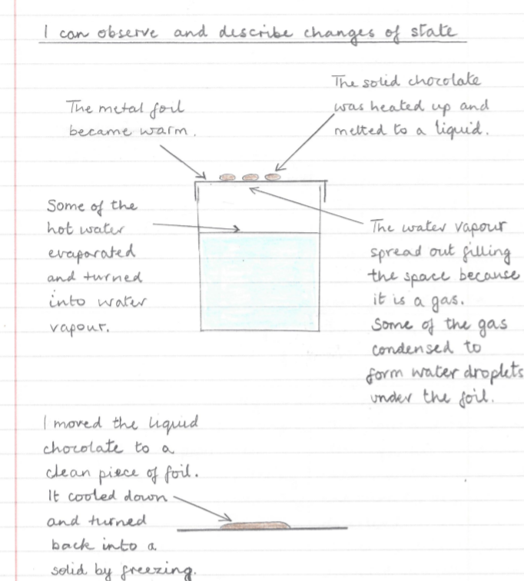
Some of the hot water will evaporate. The water vapour spreads out. It reaches the foil and condenses, warming the foil.
Possible learning outcome for reviewing your work:
The liquid chocolate can be transferred to a clean piece of foil for cooling down.
When you take off the foil lid, you can see water droplets on the under side of the foil. The water vapour has condensed to form liquid water.
The foil is metal,
a good thermal conductor. The warmth can travel through the foil and start to melt the chocolate.
When chocolate is stirred gently, it makes a ‘pool’ of liquid chocolate which spreads over the foil.
The liquid chocolate will freeze on the cool foil. It will freeze faster in a fridge.

Slide 11
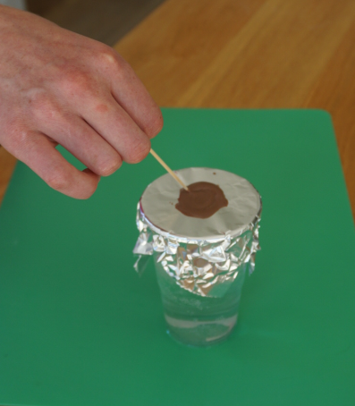
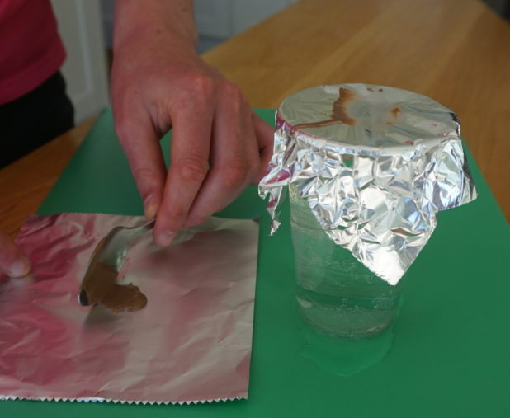
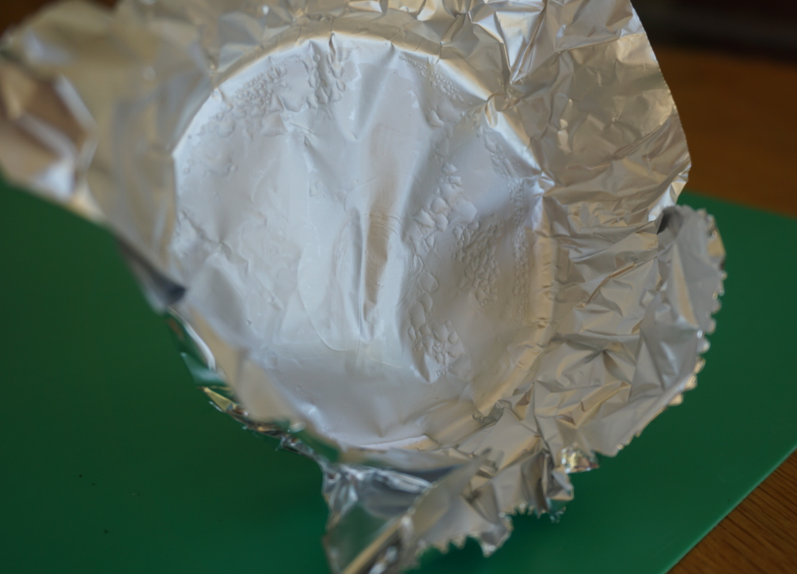
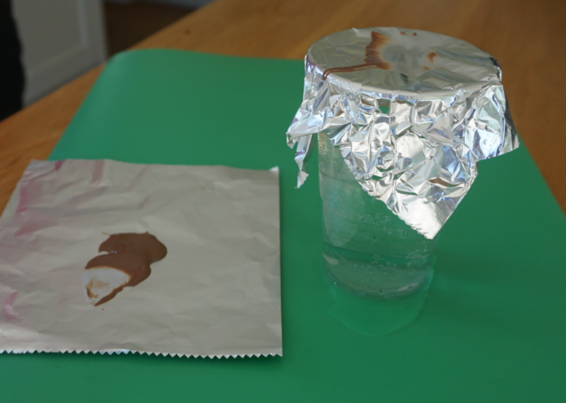
Additional pictures and notes for reviewing your investigation
Some of the hot water will evaporate. The water vapour spreads out. It reaches the foil and condenses, warming the foil.
The foil is metal, a good thermal conductor. The warmth travels through the foil and starts to melt the chocolate.
Eventually all the solid chocolate melts to form liquid chocolate. It can be stirred gently to make a ‘pool’.
The liquid chocolate can be scooped off the top. The foil feels warm if you touch it.
The liquid chocolate can be transferred to a clean piece of foil for cooling down.
When you take off the foil lid, you can see water droplets on the underneath of the foil. This is condensed water.
The chocolate will freeze on the cool foil. Freezing can be speeded up by putting the chocolate in a fridge.

