Slide 1



For parents
Thank you for supporting your child’s learning in science.
Before the session:
Please read slide 2 so you know what your child is learning and what you need to get ready.
As an alternative to lined paper, slide 6 may be printed for your child to record on.
During the session:
Share the learning intentions on slide 2.
Support your child with the main activities on slides 3 - 6, as needed.
Slide 7 is a further, optional activity.
Slide 8 has a glossary of key terms.
Reviewing with your child:
Slide 9 gives an idea of what your child may produce.
Properties and changes of materials
Exploring irreversible changes
Year 5
Age 9 - 10

Slide 2
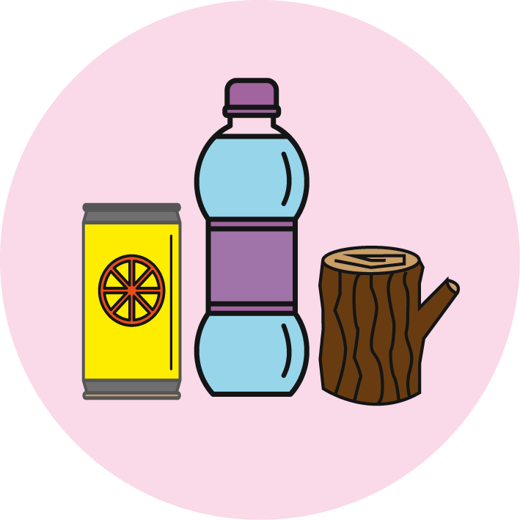

Properties and changes of materials
Exploring irreversible changes
Key Learning
Some changes to materials are not reversible. New materials are formed. These are called irreversible changes.
Burning wood, rusting, cooking food and mixing vinegar with bicarbonate of soda are examples of irreversible changes.
Activities (pages 3-6): 30 - 40 mins
Household items to support learning:
Vinegar
Bicarbonate of soda
A cup and teaspoon
Use lined paper, a ruler and a pencil. Alternatively, print page 6 as a worksheet.
Find out more… (page 7)
You may like to explore more irreversible changes. There are links to a variety of alternative activities.
I can…
compare reversible and irreversible changes.
recognise that new materials are formed during an irreversible change.

Slide 3
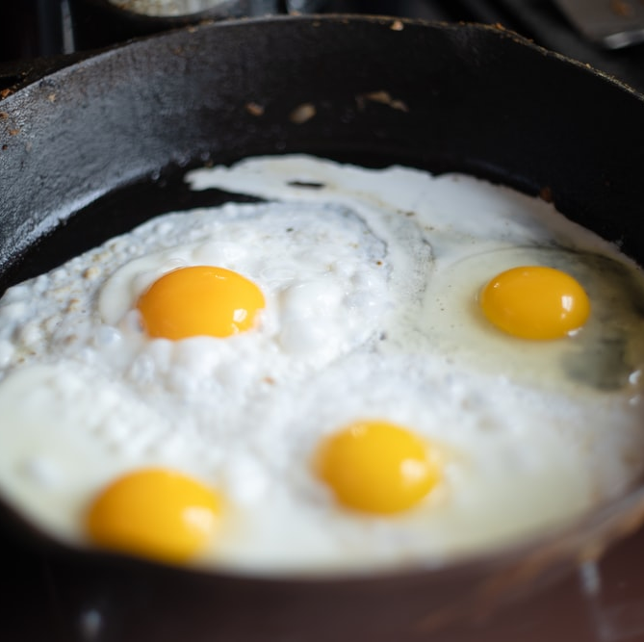
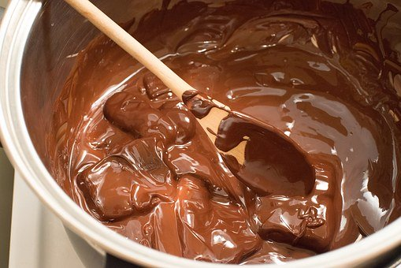
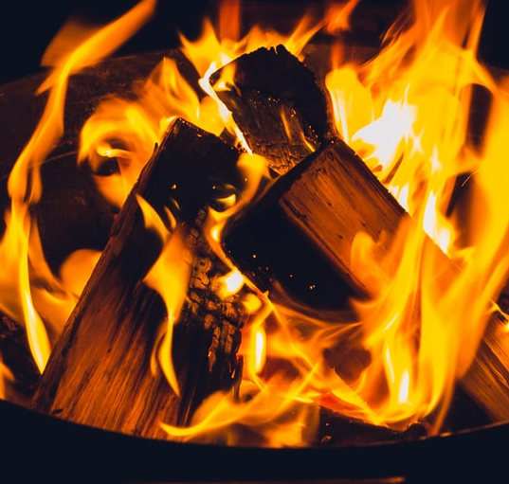
Explore, review, think, talk…
How do we change materials?
(5 – 10 minutes)
Look at these pictures.
Which one do you think is the odd one out?
Explain your reasons.
You may have selected ‘making food’ to choose the odd one out.
Another way is to compare the type of change taking place. Can you get the original material back again?
Watch this clip and think about the changes you see happening.
https://www.bbc.co.uk/bitesize/clips/zc84d2p
frying some eggs
burning a bonfire
melting chocolate

Slide 4
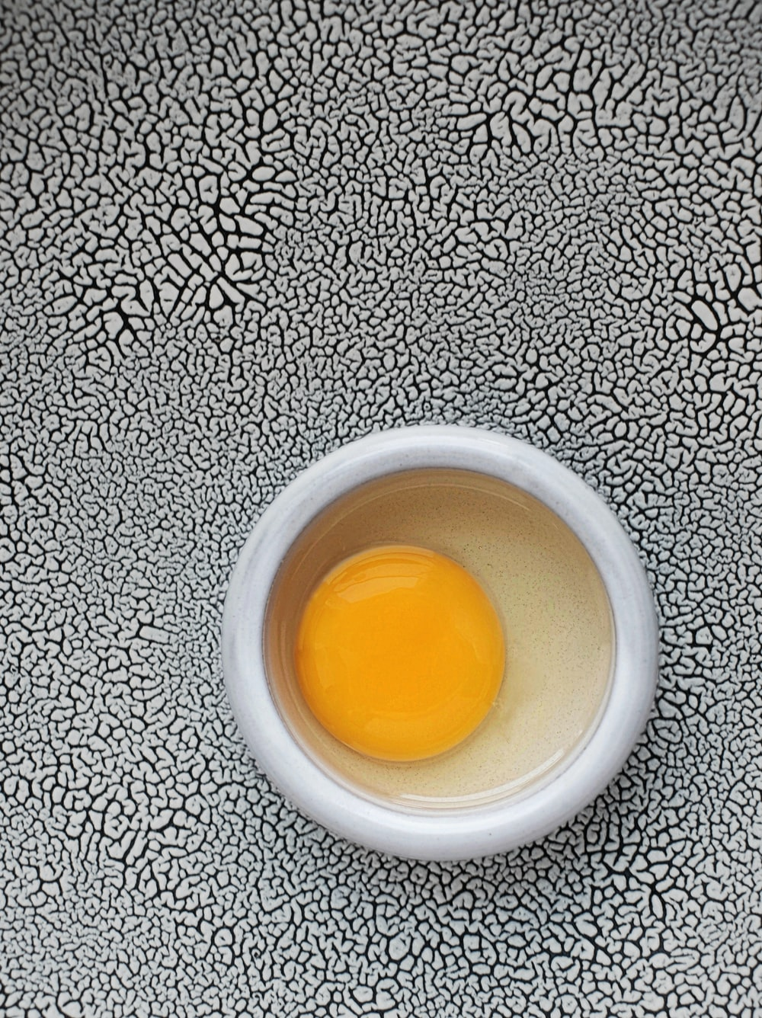
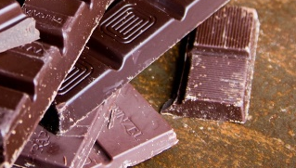
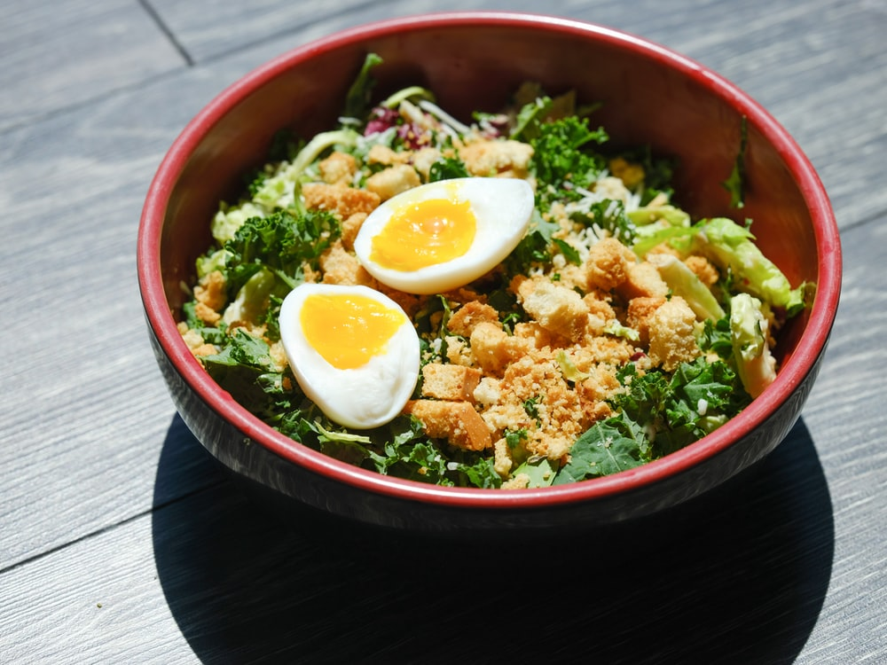
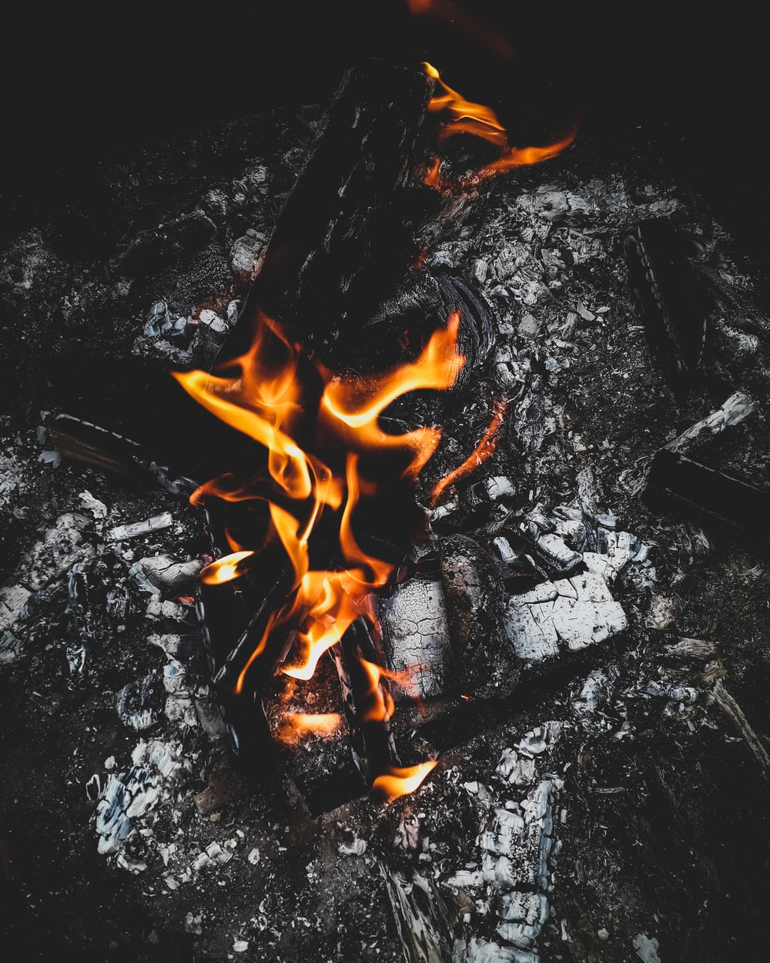
Reversible and irreversible changes
Comparing reversible and irreversible changes
(10 minutes)
Cooking an egg and burning a bonfire are irreversible changes.
New materials are formed. You cannot reverse the change.
Watch this clip about irreversible changes: https://www.bbc.co.uk/bitesize/topics/zcvv4wx/articles/z9brcwx
Melting chocolate is a reversible change.
No new material is formed. You can reverse the change by freezing.
Think or talk about other reversible changes you have learnt about:
  Mixing materials
  Dissolving
  Evaporation
melting
solid
freezing
liquid

Slide 5
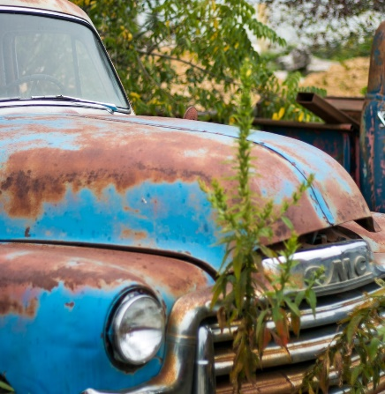
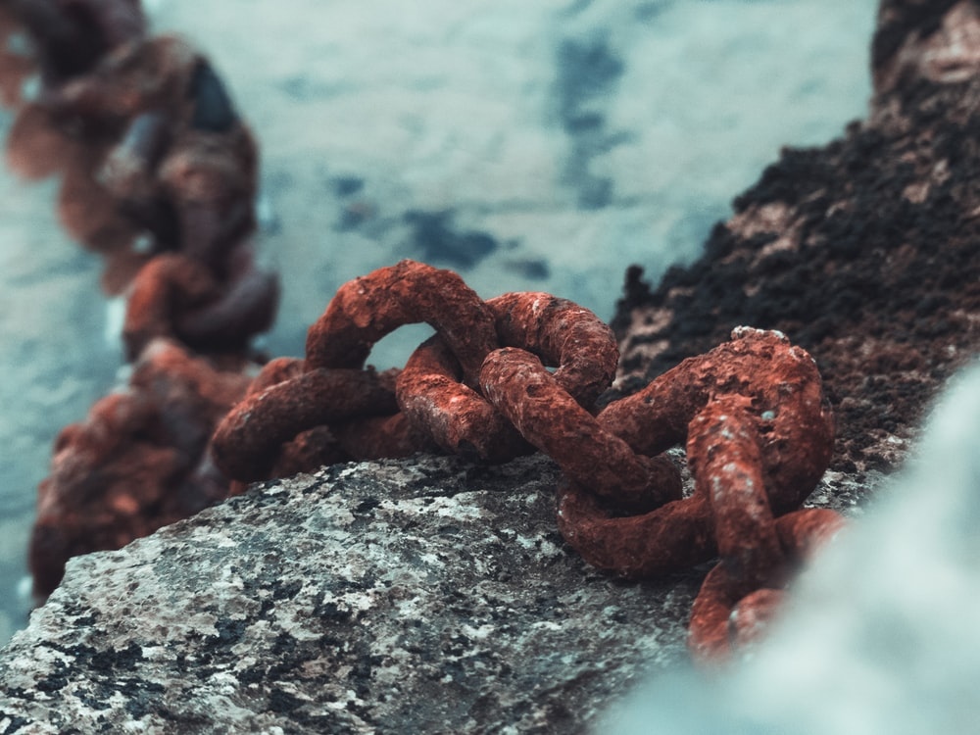
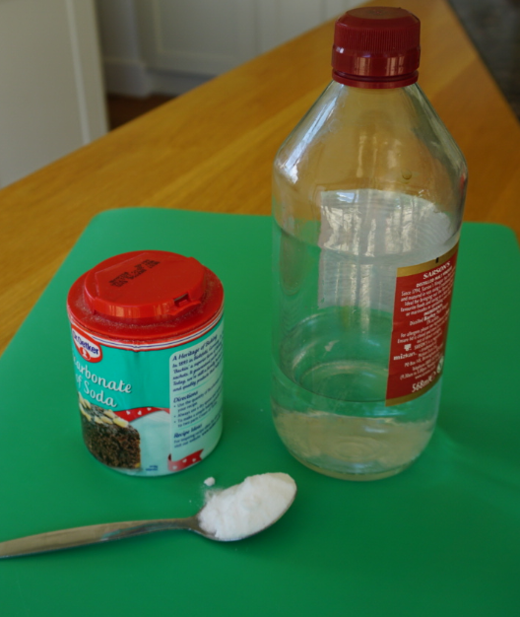
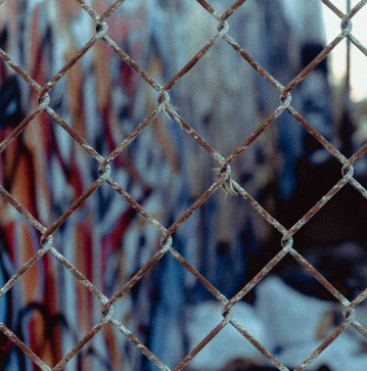
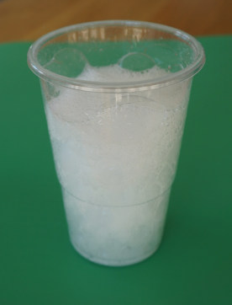
Irreversible changes
Exploring different types of irreversible change
(10 minutes)
Some irreversible changes happen slowly, like rusting. Watch this clip:
https://www.bbc.co.uk/bitesize/clips/zc89wmn
We can sometimes see rust on the iron and steel parts of old cars, fences or chains.
Other irreversible changes happen more quickly! Watch this clip:
https://www.bbc.co.uk/bitesize/clips/z9wkjxs
Mixing vinegar with bicarbonate of soda produces new materials – including carbon dioxide gas.
You can try this with an adult:
Put one teaspoon of
bicarbonate of soda
into a cup.
Pour on a small amount
of vinegar.
Watch what happens.

Slide 6
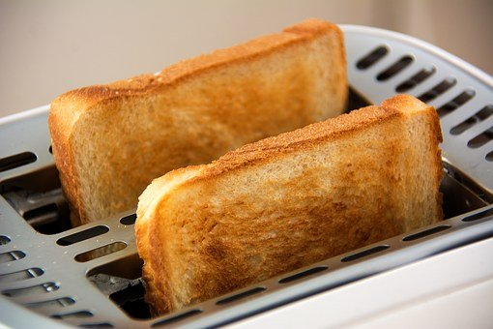
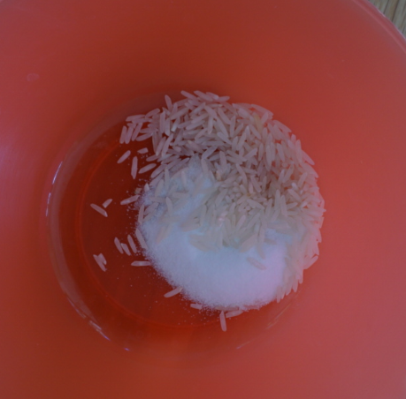
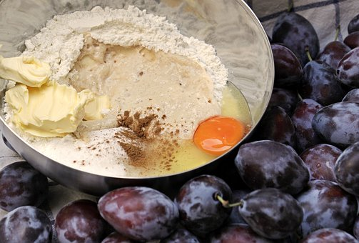
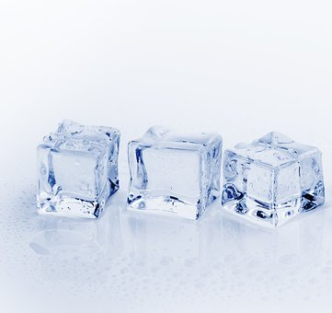
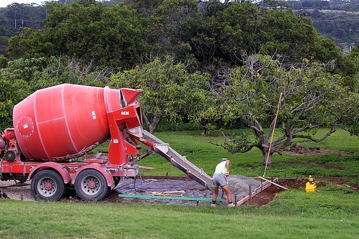
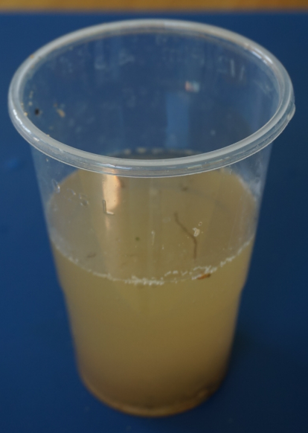
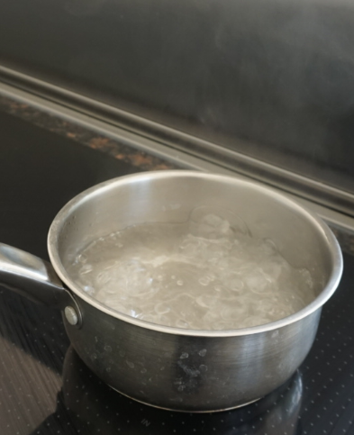
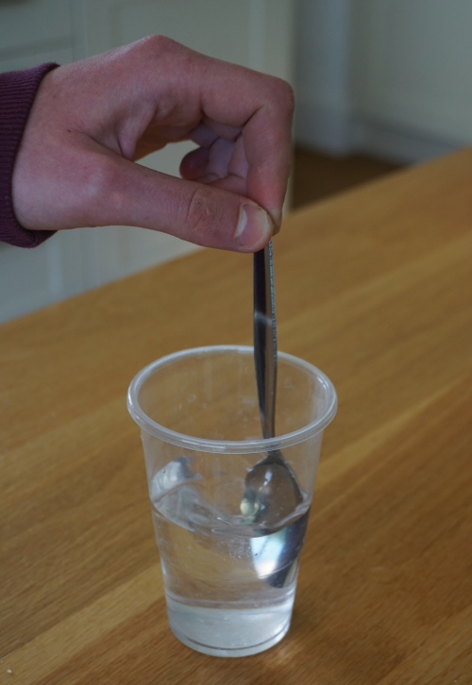
Sort these examples of changes into ‘reversible’ and ‘irreversible’. Explain your reasons.
Add more of your own examples.
I can compare reversible and irreversible changes.
Reversible changes | Irreversible changes
frying eggs
toasting bread
mixing rice and salt
melting chocolate
burning wood
making a cake
freezing ice cubes
rusting iron
making cement
mixing sand and water
boiling water
dissolving sugar

Slide 7


Find out more…
You may like to explore more irreversible changes
Ask an adult if you can investigate more irreversible changes with them:
Use this link to the PSTT
Science Fun at Home
‘What a gas!’ activity.
https://pstt.org.uk/application/files/8615/8814/8781/Science_Fun_at_Home_6_Gases.pdf
Use this link to the RSC’s
‘Building a rocket’ activity
- this is only for trying
outside!
https://bit.ly/3avocm1
Alternatively, you can try making bath bombs or a lava lamp.
Use this link for bath bombs:
https://www.youtube.com/watch?v=wieE0wSVXOQ&list=PLLnAFJxOjzZu0QhykI_sCKp05sDaa00kT&index=10&t=0s
Use these links for a lava lamp:
https://www.youtube.com/watch?v=v5a408V1BB4&feature=emb_logo
https://bit.ly/3aJLcOe

Slide 8
Glossary of terms
Reversible: A reversible change can be undone or reversed; no new materials are formed. Examples of reversible changes include dissolving, mixing, melting, freezing, evaporating and condensing.
Irreversible: An irreversible change cannot be undone or reversed; new materials are formed. Examples of irreversible changes include burning wood, rusting and cooking food.
Dissolve: Some materials will dissolve in a liquid. For example, salt dissolves in water to form a clear, transparent solution. Water can evaporate from a salt solution, leaving the salt behind. It is a reversible change.
Mix: Some materials can be mixed and then separated again. When no new material is formed, mixing is a reversible change.
Melting: Melting is a change of state when a solid is heated and changes to a liquid.
Freezing: Freezing is a change of state when a liquid is cooled and changes to a solid.
Evaporation: Evaporation is a change of state when a liquid is heated and changes to a gas.
Condensation: Condensation is a change of state when a gas is cooled and changes to a liquid.

Slide 9
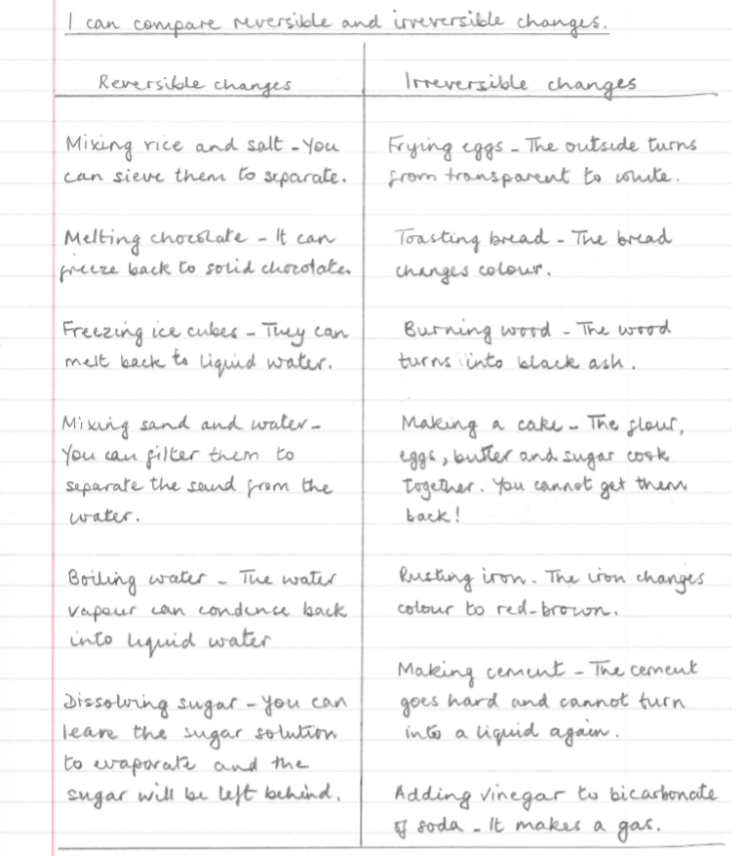
Possible learning
outcome for
reviewing
your work:
Irreversible changes can often be recognised by a change of colour.
For example, an ‘egg white’ changes from colourless to white when it is cooked.
Changes of state are reversible.
For example:
- Solid chocolate can melt and then freeze again.
- Water can freeze and then melt again.
- Water can also evaporate or boil and then condense again.
New materials are formed in an irreversible change.
For example, a cake is a new material made from eggs, flour, butter and sugar.
Mixing and dissolving are reversible. The materials can be separated by sieving, filtering or evaporating.
Irreversible changes sometimes produce a gas.

