Slide 1



Year 5: Properties and changes of materials
This topic overview is based on the PLAN knowledge matrix (for England). Please use link: https://www.planassessment.com/properties-changes-of-materials-y5
The matrix includes:
National Curriculum learning objectives
Key learning
Key vocabulary
Common misconceptions
Possible activities & evidence
Topic overview for teachers
Age 9-10

Slide 2
Year 5 – Properties and changes of materials
Topic | Key Learning | page
Exploring properties and uses of materials | Materials have different uses depending on their properties. Properties include hardness, flexibility, absorbency, strength, transparency, electrical and thermal conductivity and attraction to magnets. | 4
Investigating thermal insulators | Thermal insulators do not allow heat to pass through them easily. Materials which trap air inside them are good thermal insulators. | 5
Comparing soluble and insoluble materials | Some materials will dissolve in a liquid and form a solution. They are soluble materials. Other materials do not dissolve in a liquid. They form a sediment. These materials are insoluble. | 6
2

Slide 3
Year 5 – Properties and changes of materials
Topic | Key Learning | page
Investigating reversible changes by separating materials | Some changes to materials such as dissolving and mixing are reversible. The materials can be separated, as no new materials have been formed. Insoluble materials can be separated from a liquid by sieving or filtering. Soluble materials can be separated from a liquid by the process of evaporation. | 7
Understanding that changes of state are reversible (see Year 4 topic for a more detailed set of lessons) | Melting is a change of state from solid to liquid. Freezing is a change of state from liquid to solid. Boiling and evaporating are both a change of state from liquid to gas. Condensing is a change of state from gas to liquid. All changes of state are reversible. | 8
Exploring irreversible changes | Some changes to materials are not reversible. New materials are formed. These are called irreversible changes. Burning wood, rusting, cooking food and mixing vinegar with bicarbonate of soda are examples of irreversible changes. | 9
3

Slide 4
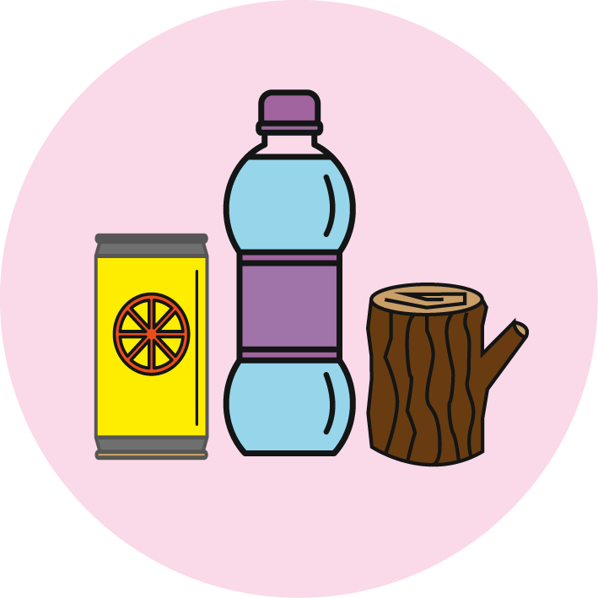
Properties and changes of materials
Exploring properties and uses of materials
Key Learning
Materials have different uses depending on their properties.
Properties include hardness, flexibility, absorbency, strength, transparency, electrical and thermal conductivity and attraction to magnets.
Activities and websites
Exploring prior knowledge about properties of materials.
https://www.bbc.co.uk/bitesize/topics/z4339j6/articles/zx8hhv4
Using Carroll diagrams to classify household items/materials by their properties.
Optional activity to investigate an object made of two or more materials, such as a bike or skateboard.
https://www.dkfindout.com/uk/science/materials/
I can…
use Carroll diagrams to classify materials by their properties.

Slide 5
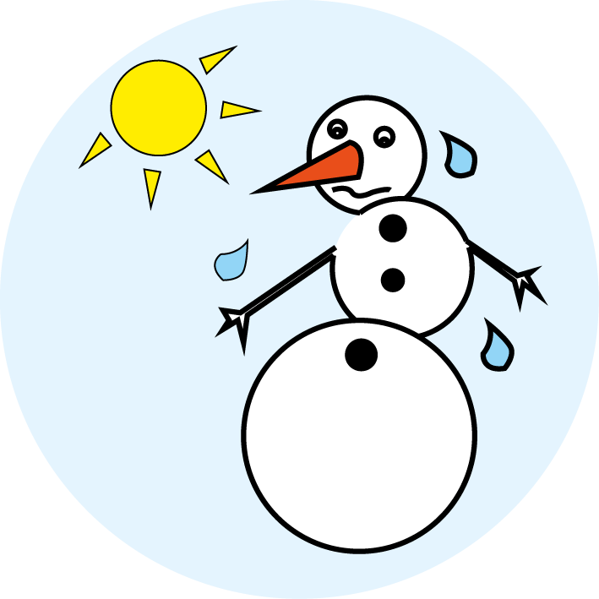
Properties and changes of materials
Investigating thermal insulators
Key Learning
Thermal insulators do not allow heat to pass through them easily.
Materials which trap air inside them are good thermal insulators.
Activities and websites
Exploring ideas about how you might stop a snowman from melting.
Investigating how quickly an ice cube melts with or without a ‘jacket’ on. This is a comparative test.
Plotting a bar chart or a line graph.
Optional activity to try a further investigation: How else could you investigate the time it takes for a ‘snowman’ to melt?
I can…
investigate how to stop a snowman melting using a comparative test.
plot a bar chart or a line graph with my results.

Slide 6
Properties and changes of materials
Comparing soluble and insoluble materials
Key Learning
Some materials will dissolve in a liquid and form a solution. They are soluble materials.
Other materials do not dissolve in a liquid. They form a sediment. These materials are insoluble.
Activities and websites
Exploring what happens when you add sugar to a warm drink.
https://www.bbc.co.uk/bitesize/topics/zcvv4wx/articles/zpbdpbk
Comparing soluble and insoluble materials we use in the kitchen.
Optional activities to find out more about the properties of salty water.
https://pstt.org.uk/application/files/6115/8633/7142/3._EGG-CITING_SCIENCE.pdf
https://www.dkfindout.com/uk/earth/oceans-and-seas/
https://www.wildlifetrusts.org/why-sea-salty-and-why-sea-blue
https://www.nhm.ac.uk/discover/quick-questions/why-is-the-sea-salty.html
I can…
identify and compare soluble and insoluble materials.

Slide 7
Properties and changes of materials
Investigating reversible changes by separating materials
Key Learning
Some changes to materials such as dissolving and mixing are reversible. The materials can be separated, as no new materials have been formed.
Insoluble materials can be separated from a liquid by sieving or filtering.
Soluble materials can be separated from a liquid by the process of evaporation.
Activities and websites
Exploring how sieves and colanders are used in the kitchen.
Considering how you can separate materials that are mixed together.
https://www.bbc.co.uk/bitesize/clips/z9jd7ty
https://www.bbc.co.uk/bitesize/topics/zcvv4wx/articles/zw7tv9q
Separating materials using sieving, filtering and evaporating.
Optional further activities to explore separating mixtures.
https://www.youtube.com/watch?v=sgRnDK4CFX4
https://pstt.org.uk/resources/curriculum-materials/Science-Fun-at-Home
I can…
select equipment to separate two or more materials using sieving, filtering and/or evaporating.

Slide 8

Properties and changes of materials
Understanding that changes of state are reversible
Key Learning
Melting is a change of state from solid to liquid. Freezing is a change of state from liquid to solid.
Boiling and evaporating are both a change of state from liquid to gas. Condensing is a change of state from gas to liquid.
All changes of state are reversible.
Activities and websites
Exploring prior knowledge about melting, freezing, boiling, evaporating and condensing.
https://www.bbc.co.uk/bitesize/topics/zkgg87h/articles/z9ck9qt
https://www.bbc.co.uk/bitesize/topics/zkgg87h/articles/zydxmnb
Observing and describing changes of state including melting, freezing, evaporating and condensing.
Optional activities to find out more about how chocolate is made or to try making chocolate ice cream.
https://www.youtube.com/watch?v=OnE_84GtPdU&list=PLg7f-TkW11iV563gfcXjRlafm2jlklQOc&index=12&t=0s
https://www.youtube.com/watch?v=-JcNMN0uvvE
I can…
observe and describe changes of state, including melting, freezing, evaporating and condensing.

Slide 9
Properties and changes of materials
Exploring irreversible changes
Key Learning
Some changes to materials are not reversible. New materials are formed. These are called irreversible changes.
Burning wood, rusting, cooking food and mixing vinegar with bicarbonate of soda are examples of irreversible changes.
Activities and websites
Exploring different types of change which can be made to materials.
https://www.bbc.co.uk/bitesize/clips/zc84d2p
Identifying and comparing reversible and irreversible changes.
https://www.bbc.co.uk/bitesize/topics/zcvv4wx/articles/z9brcwx
https://www.bbc.co.uk/bitesize/clips/zc89wmn
https://www.bbc.co.uk/bitesize/clips/z9wkjxs
Optional further activities to explore irreversible changes. (See website links on page 7 of this lesson.)
I can…
compare reversible and irreversible changes.
recognise that new materials are formed during an irreversible change.

