Slide 1
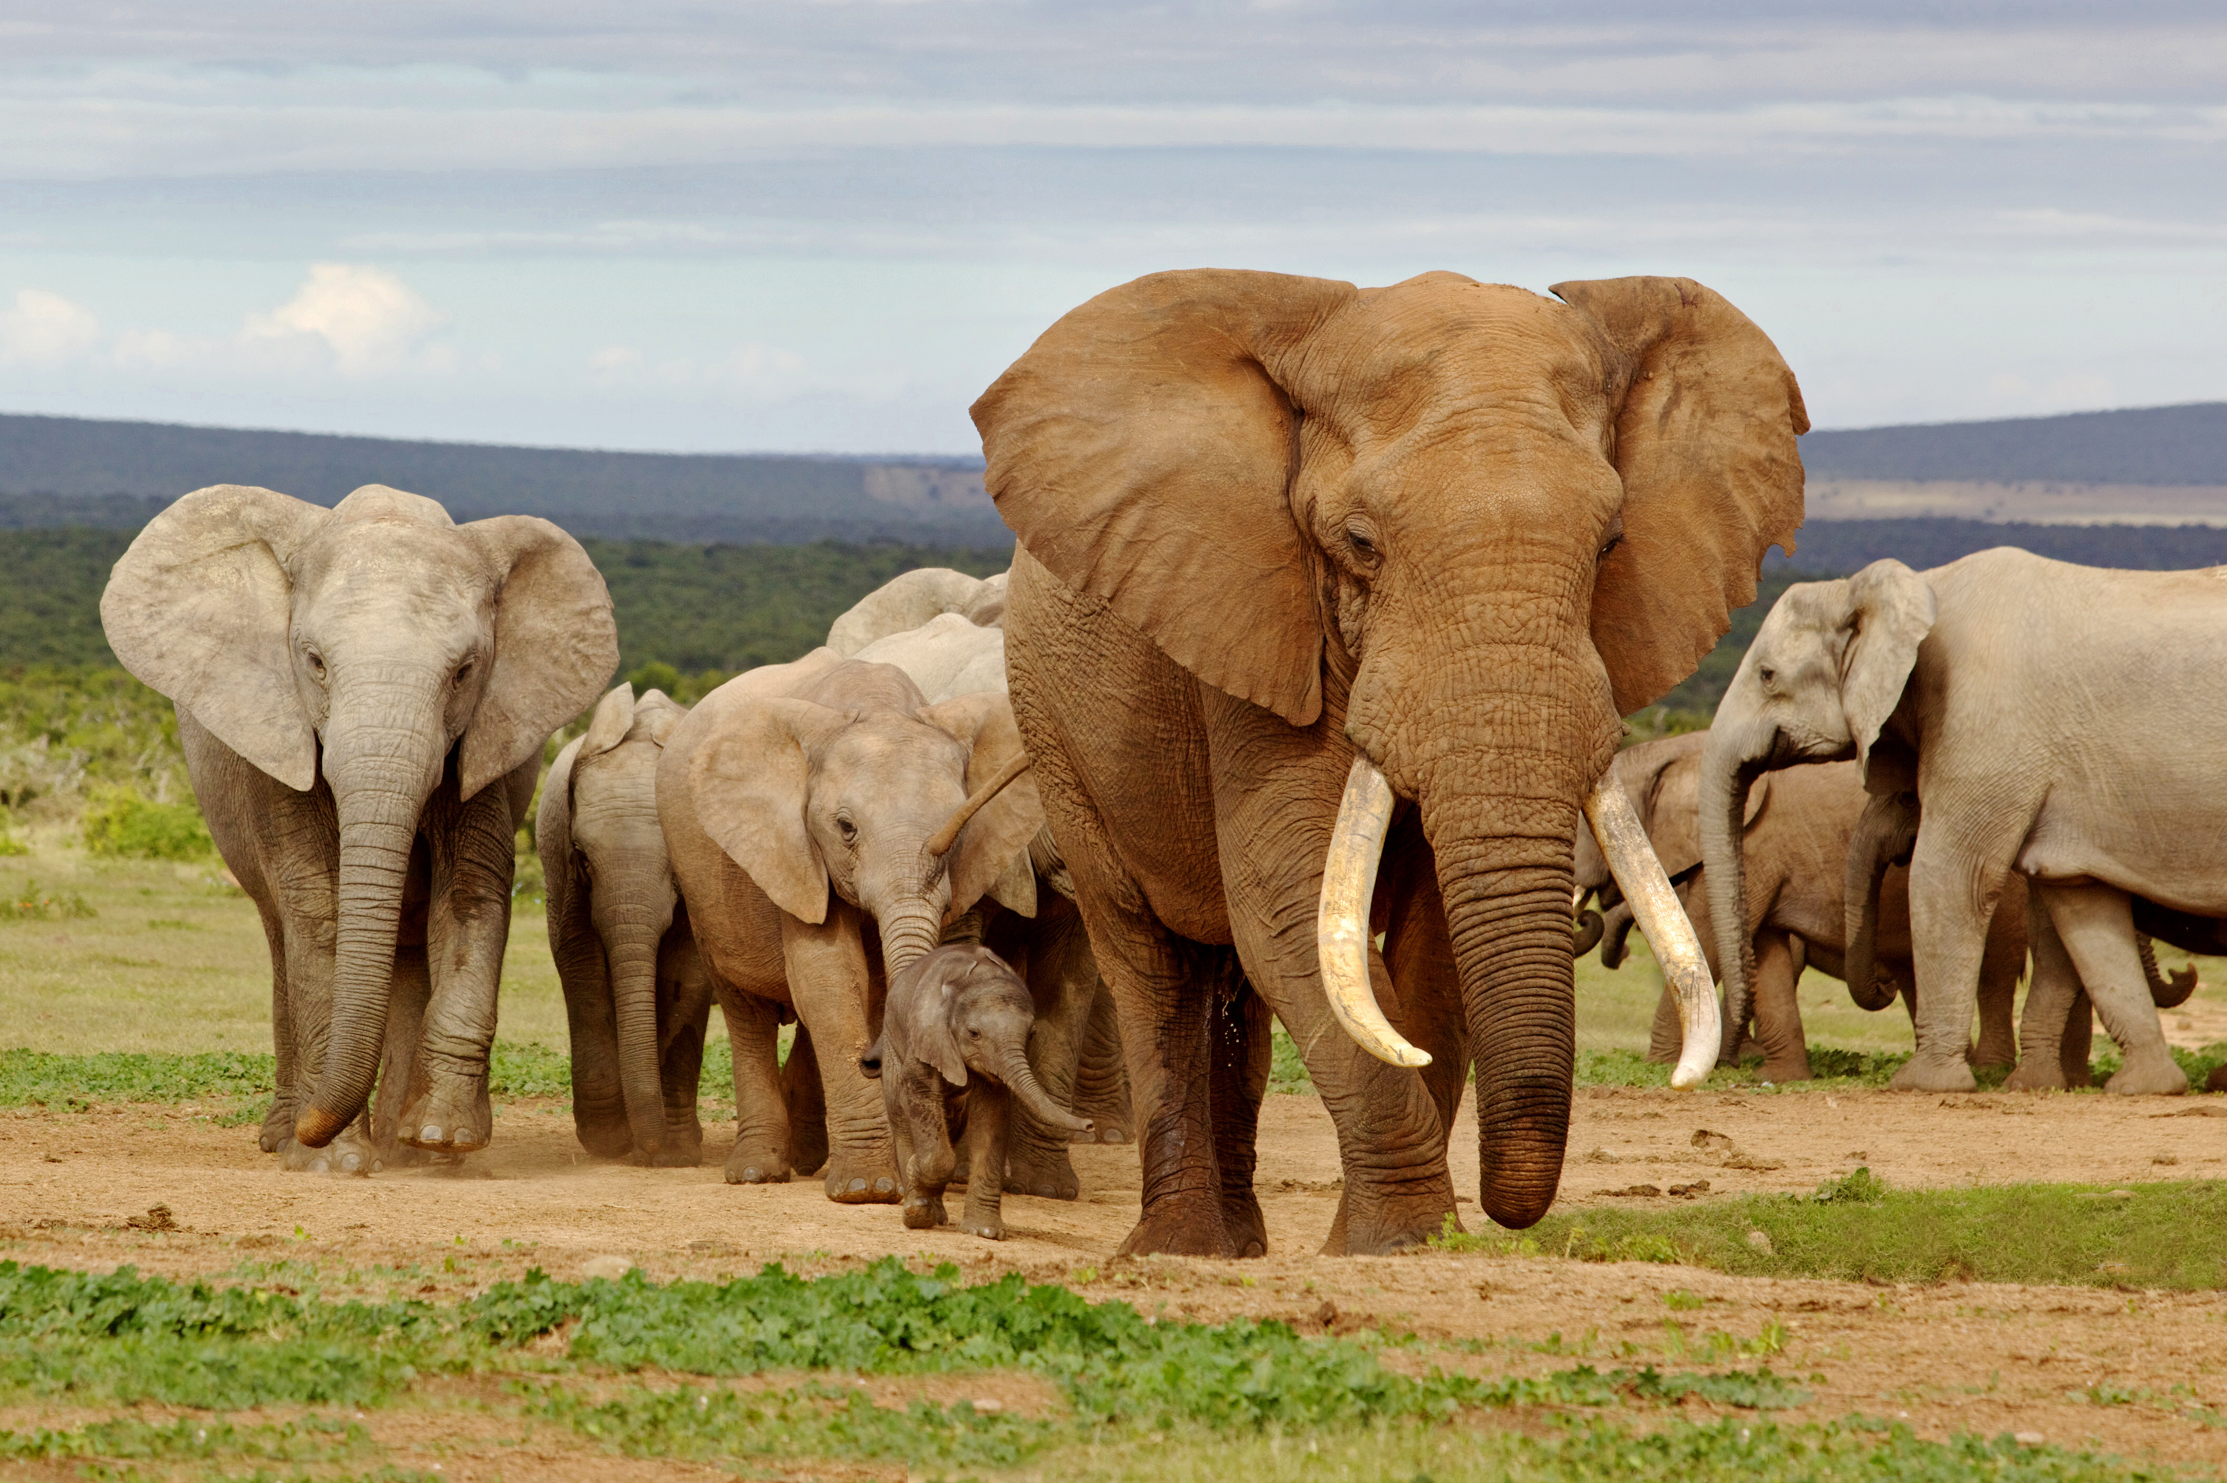


Year 6: Living things and their habitats
This topic overview is based on the PLAN knowledge matrix (for England). Please use link:
https://www.planassessment.com/living-things-y6
The matrix includes:
National Curriculum learning objectives
Key learning
Key vocabulary
Common misconceptions
Possible activities & evidence
Topic overview for teachers
Age 10-11

Slide 2
Year 6 – Living things and their habitats
Topic | Key Learning | page
Classification of living things and the work of Carl Linnaeus | Living things can be grouped according to characteristics. The two main groups are animals and plants. Other living things include fungi and micro-organisms (such as mushrooms, yeast and bacteria). Carl Linnaeus devised a formal classification system for all living things, which is still used today. | 4
Animals with a backbone: Vertebrates | Animals can be divided into two main groups: vertebrates (animals with backbones) and invertebrates (animals without backbones). Vertebrates can be divided into five main groups: Fish, Reptiles, Amphibians, Birds and Mammals. Each vertebrate group has distinctive characteristics. | 5
Making branching keys and classifying vertebrates | Branching keys are useful for classifying things, using descriptions of features or characteristics. Vertebrates can be divided into five main groups: Fish, Reptiles, Amphibians, Birds and Mammals. Each vertebrate group has distinctive characteristics. | 6
2

Slide 3
Year 6 – Living things and their habitats
Topic | Key Learning | page
Making a mythical animal | Living things can be grouped according to characteristics. Some animals can be hard to classify when they appear to have features from more than one group. | 7
Animals without a backbone: Invertebrates | Animals can be divided into two main groups: vertebrates (animals with backbones) and invertebrates (animals without backbones). Invertebrates can be divided into many groups. These groups include insects, slugs & snails (molluscs), spiders (arachnids) and worms. | 8
Plant classification: characteristics of flowering and non-flowering plants | Plants can be divided broadly into two main groups: flowering plants and non-flowering plants Flowering plants reproduce with seeds which are protected by a flower or fruit. Non-flowering plants include conifers, ferns, and mosses. | 9
3

Slide 4
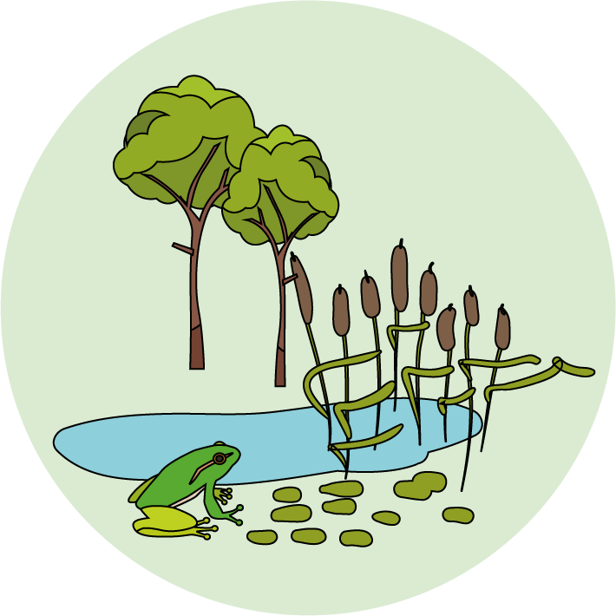
Living things and their habitats
Logo for section to sit inside roundel
Classification of living things and the work of Carl Linnaeus
Key Learning
Living things can be grouped according to characteristics.
The two main groups are animals and plants.
Other living things include fungi and micro-organisms (such as mushrooms, yeast and bacteria).
Carl Linnaeus devised a formal classification system for all living things, which is still used today.
Suggested activities and website links
Explore prior knowledge about classifying animals and plants.
BBC clip about plants https://www.bbc.co.uk/bitesize/clips/z2k4d2p
Find out about Carl Linnaeus and grouping living things by characteristics. https://www.tigtagworld.co.uk/film/carl-linnaeus-PRM00688/
Make a table to classify animals, plants, fungi and microorganisms
Optional: Find out more about micro-organisms and fungi (see lesson plan page 6).
I can…
Group examples of animals, plants and fungi/ micro-organisms.
4

Slide 5
Living things and their habitats
Logo for section to sit inside roundel
Animals with a backbone: Vertebrates
Key Learning
Animals can be divided into two main groups: vertebrates (animals with backbones) and invertebrates (animals without backbones).
Vertebrates can be divided into five main groups: Fish, Reptiles, Amphibians, Birds and Mammals.
Each vertebrate group has distinctive characteristics.
Suggested activities and website links
Odd one out – ladybird, crab, tortoise.
BBC clips on vertebrates & invertebrates https://www.bbc.co.uk/bitesize/topics/zn22pv4/articles/z8mbqhv
https://www.bbc.co.uk/bitesize/topics/zn22pv4/articles/zp6g7p3
Describing characteristics of vertebrates
BBC clip on features of vertebrates https://www.bbc.co.uk/teach/class-clips-video/science-ks2--ks3-classification-of-organisms/zh7g92p
Optional: Find out more about a vertebrate of your choice (see lesson plan page 6).
I can…
Describe the characteristics of Fish, Reptiles, Amphibians, Birds and Mammals.
5

Slide 6
Year 6 Living things and their habitats
Logo for section to sit inside roundel
Making branching keys and classifying vertebrates
Key Learning
Branching keys are useful for classifying things, using descriptions of features or characteristics.
Vertebrates can be divided into five main groups: Fish, Reptiles, Amphibians, Birds and Mammals.
Each vertebrate group has distinctive characteristics.
Suggested activities and links to websites
Learning to make a branching key with liquorice allsorts (packet of sweets or cut out sweets).
Thank you to SAPS for this activity – more details on p.19 of their guide: www.saps.org.uk/attachments/article/1377/SAPS%20book%205%20-%20Grouping%20and%20Classification%20-%202016.pdf
Making a branching key to classify four vertebrates.
Optional: Making a key for all five vertebrate groups.
I can…
Make a branching key to classify a group of objects.
Make a branching key to classify vertebrates (animals with a backbone).
6

Slide 7
Living things and their habitats
Logo for section to sit inside roundel
Making a mythical animal
Key Learning
Living things can be grouped according to characteristics.
Some animals can be hard to classify when they appear to have features from more than one group.
Suggested activities and links to websites
Find out about the platypus and why scientists found it difficult to classify.
https://www.tigtagworld.co.uk/film/why-do-we-classify-PRM00146/
https://www.bbc.co.uk/programmes/p004jl2c
Discuss the features of mythical creatures, such as the dragon.
Find out about Carl Linnaeus and the Hydra https://youtu.be/lmQVnEMWtFc
Design, draw and label a mythical vertebrate creature.
I can…
Explain why classifying some animals, like a platypus, can be difficult.
Make up a mythical (fictional) animal with features from two or more different vertebrate groups.
7

Slide 8
Living things and their habitats
Logo for section to sit inside roundel
Animals without a backbone: Invertebrates
Key Learning
Animals can be divided into two main groups: vertebrates (animals with backbones) and invertebrates (animals without backbones).
Invertebrates can be divided into many groups. These groups include insects, slugs & snails (molluscs), spiders (arachnids) and worms.
Suggested activities and links to websites
Odd one out – millipede, earthworm, beetle.
BBC clip on exoskeletons https://www.bbc.co.uk/bitesize/clips/zmj8q6f
NHM clip on earthworms https://www.nhm.ac.uk/discover/earthworm-heroes.html
Survey of garden invertebrates
Using an identification key.
Making a tally chart and plotting a bar graph.
Woodland Trust website page on invertebrates https://www.woodlandtrust.org.uk/trees-woods-and-wildlife/animals/other-invertebrates/
Optional: Great Bug Hunt run by ASE. http://www.schoolscience.co.uk/bughunt
I can…
Describe some characteristics of invertebrates found in gardens, parks and woodland.
Use a tally chart to record data.
Plot a bar graph.
8

Slide 9
Living things and their habitats
Logo for section to sit inside roundel
Plant classification: characteristics of flowering and non-flowering plants
Key Learning
Plants can be divided broadly into two main groups: flowering plants and non-flowering plants
Flowering plants reproduce with seeds which are protected by a flower or fruit.
Non-flowering plants include conifers, ferns, and mosses.
Suggested activities and links to websites
Explore prior knowledge about flowering and non-flowering plants.
https://www.bbc.co.uk/bitesize/clips/zsdkjxs
https://www.youtube.com/watch?v=cgVlrtGnG6s
Discuss features of flowering plants, conifers, ferns and mosses.
https://www.dkfindout.com/uk/animals-and-nature/plants/
https://www.woodlandtrust.org.uk/trees-woods-and-wildlife/plants/
Make a paired-statement key to classify six plants.
Optional: Find out more about local trees (see lesson plan page 6).
I can…
Describe the characteristics of flowering and non-flowering plants.
Use a statement key to classify a group of plants.
9

