Slide 1
play this interactive presentation in
reading view or slide show mode

Slide 2



JAMES films

Slide 3
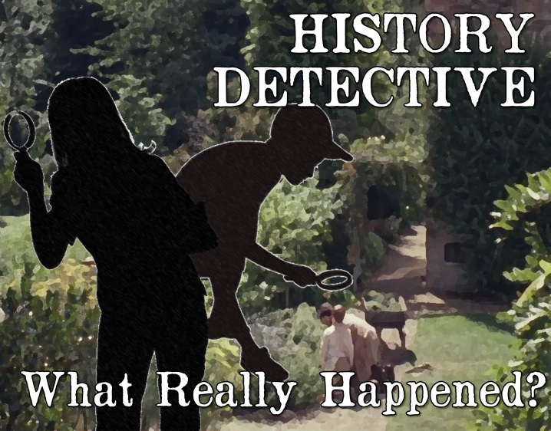
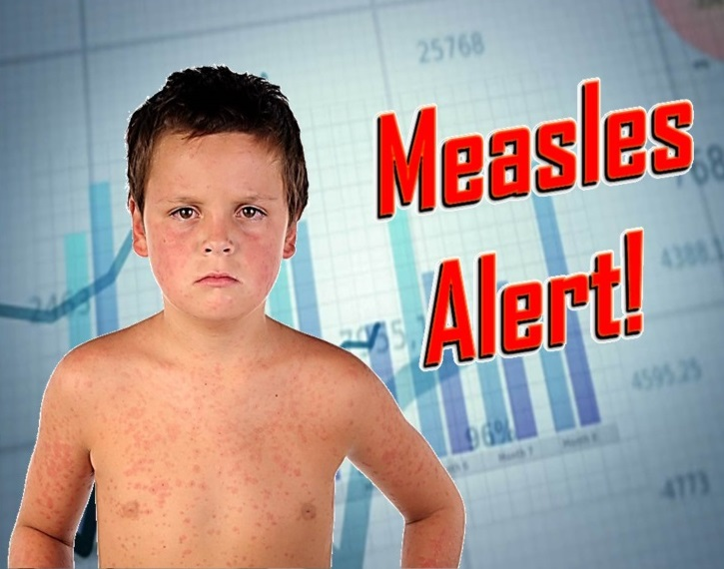
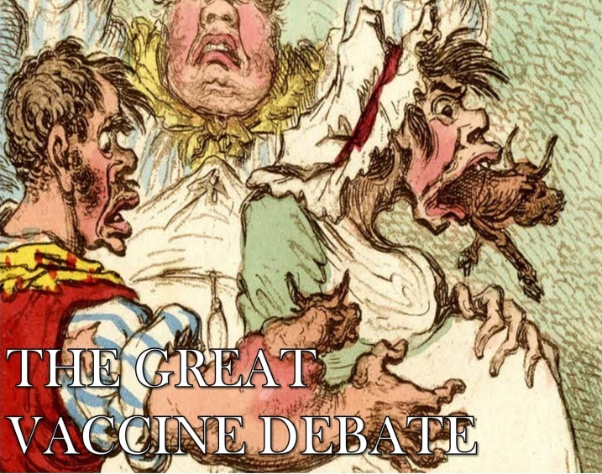
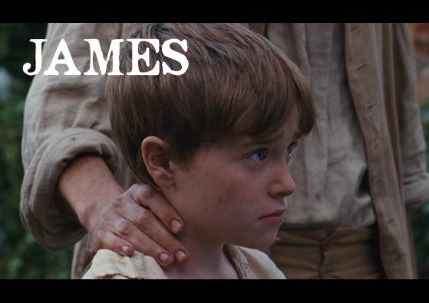
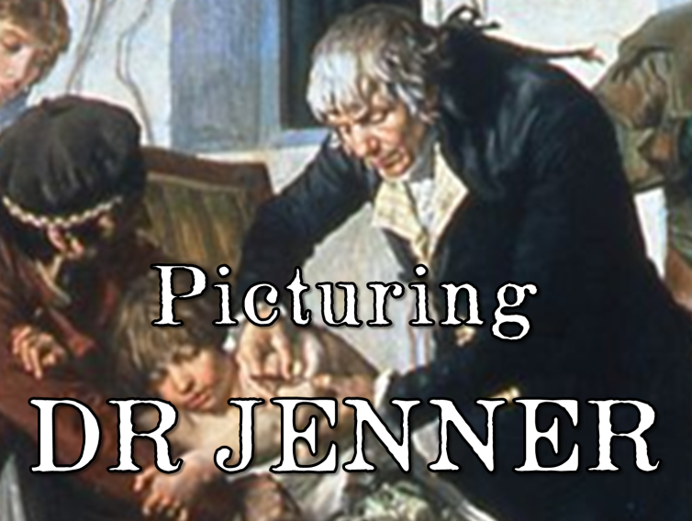
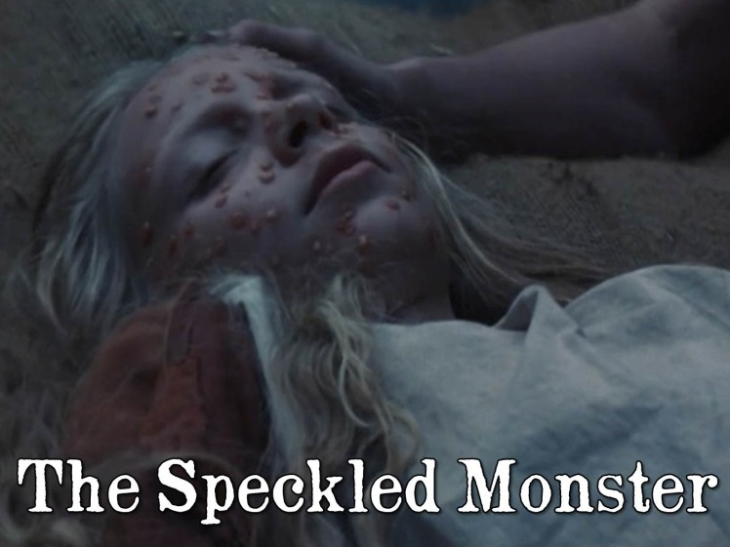

Slide 4
four core resources
plus five enrichment resources
for children aged 9-11
using and developing skills in
‘working scientifically’, maths, English, history and ethics
while exploring one of the most important
scientific discoveries of all time

Slide 5
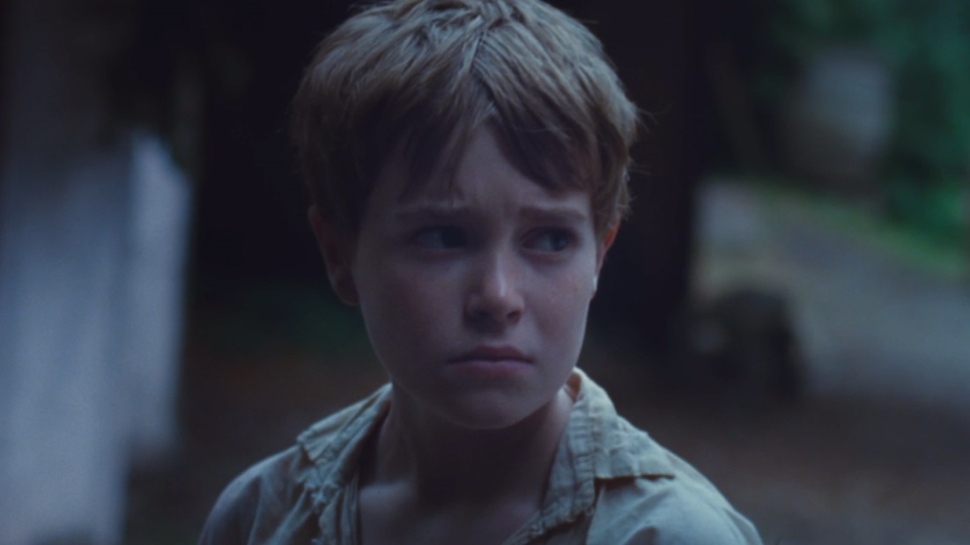
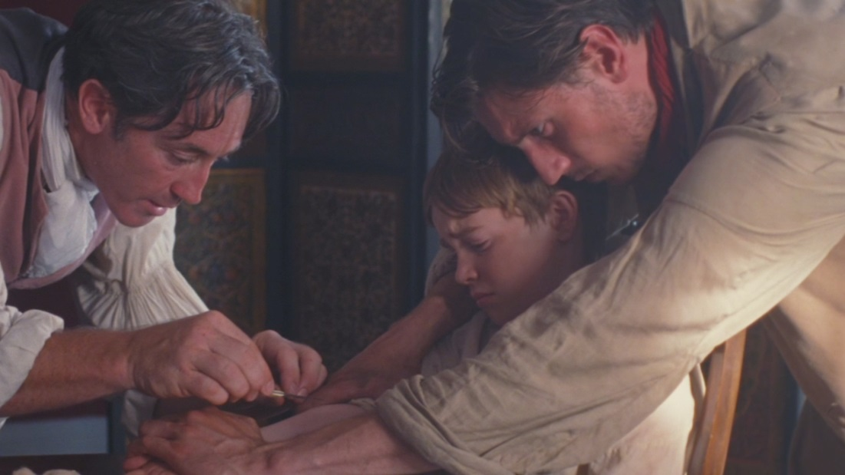
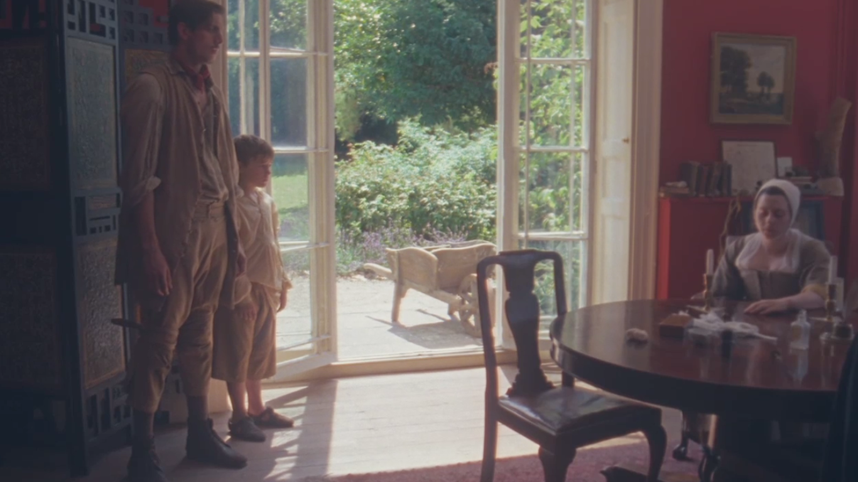
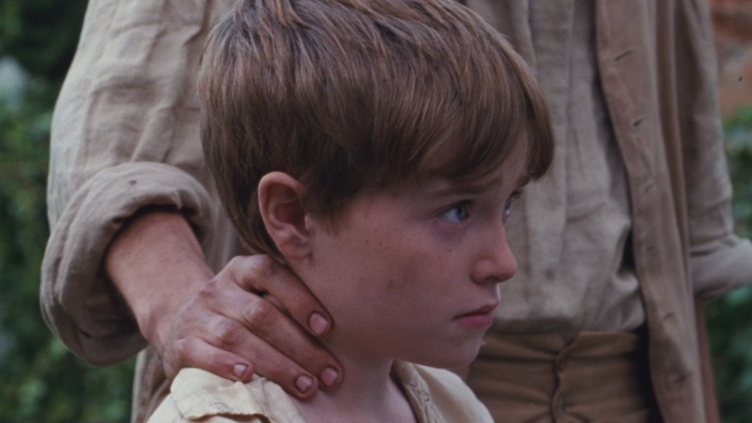
Immediately engage children with the 15-minute drama film JAMES
Transport them back to a time when smallpox stalked the world and introduce them to Dr Jenner, James, and the experiment that has probably saved their lives

Slide 6
You can select from the enrichment resources to choose a pathway that emphasises different parts of the curriculum…
Science & Maths
English
History

Slide 7

JAMES film & The Speckled Monster
Each resource blends different areas of the curriculum
History Detective: What Really Happened?
Strength of Character
Picturing Dr Jenner
Making Movies!
The Great Vaccine Debate
Dr Edwina Jenner – Immunologist
Measles Alert!
Science & Maths English History
Why You’ll Never Catch Smallpox

Slide 8
JAMES film & The Speckled Monster
Core Pathway
History Detective: What Really Happened?
Strength of Character
Picturing Dr Jenner
Making Movies!
The Great Vaccine Debate
Dr Edwina Jenner – Immunologist
Measles Alert!
Science & Maths English History
Why You’ll Never Catch Smallpox

Slide 9
JAMES film & The Speckled Monster
Science & Maths enrichment
History Detective: What Really Happened?
Strength of Character
Picturing Dr Jenner
Making Movies!
The Great Vaccine Debate
Dr Edwina Jenner – Immunologist
Measles Alert!
Science & Maths English History
Why You’ll Never Catch Smallpox

Slide 10
JAMES film & The Speckled Monster
English
enrichment
History Detective: What Really Happened?
Strength of Character
Picturing Dr Jenner
Making Movies!
The Great Vaccine Debate
Dr Edwina Jenner – Immunologist
Measles Alert!
Science & Maths English History
Why You’ll Never Catch Smallpox

Slide 11
JAMES film & The Speckled Monster
Or choose your own combination… or do all nine!
History Detective: What Really Happened?
Strength of Character
Picturing Dr Jenner
Making Movies!
The Great Vaccine Debate
Dr Edwina Jenner – Immunologist
Measles Alert!
Science & Maths English History
Why You’ll Never Catch Smallpox

Slide 12
JAMES film & The Speckled Monster
Click on a resource to find out more
History Detective: What Really Happened?
Strength of Character
Picturing Dr Jenner
Making Movies!
The Great Vaccine Debate
Dr Edwina Jenner – Immunologist
Measles Alert!
Science & Maths English History
Why You’ll Never Catch Smallpox

Slide 13
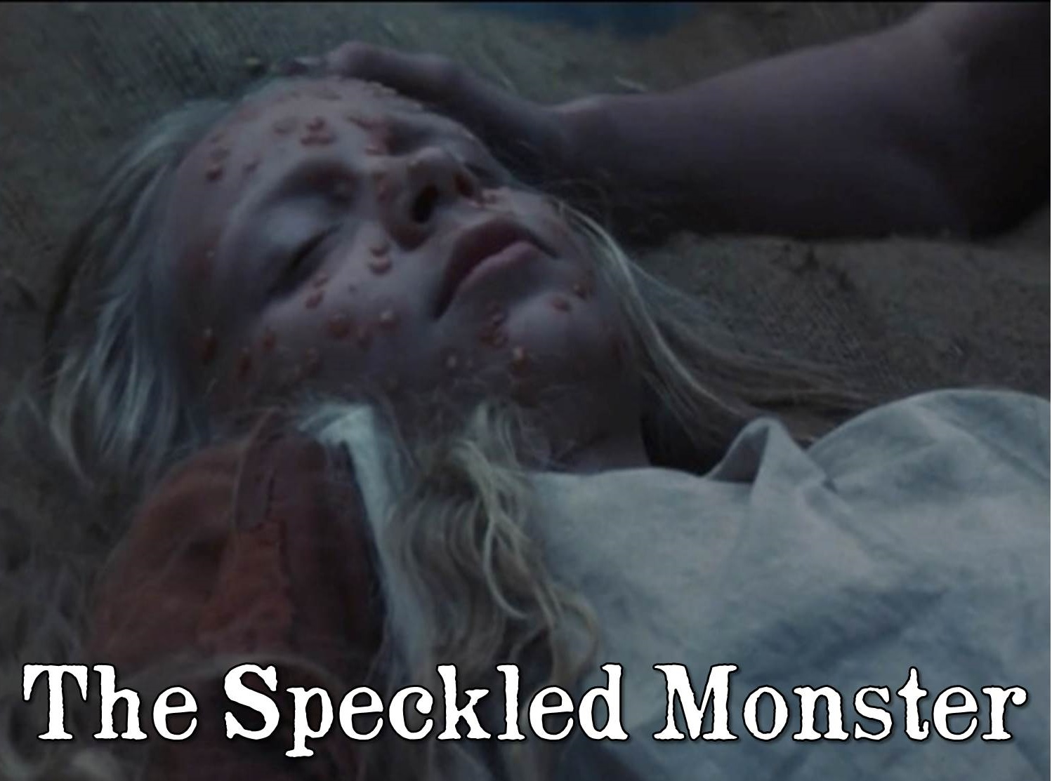

Slide 14
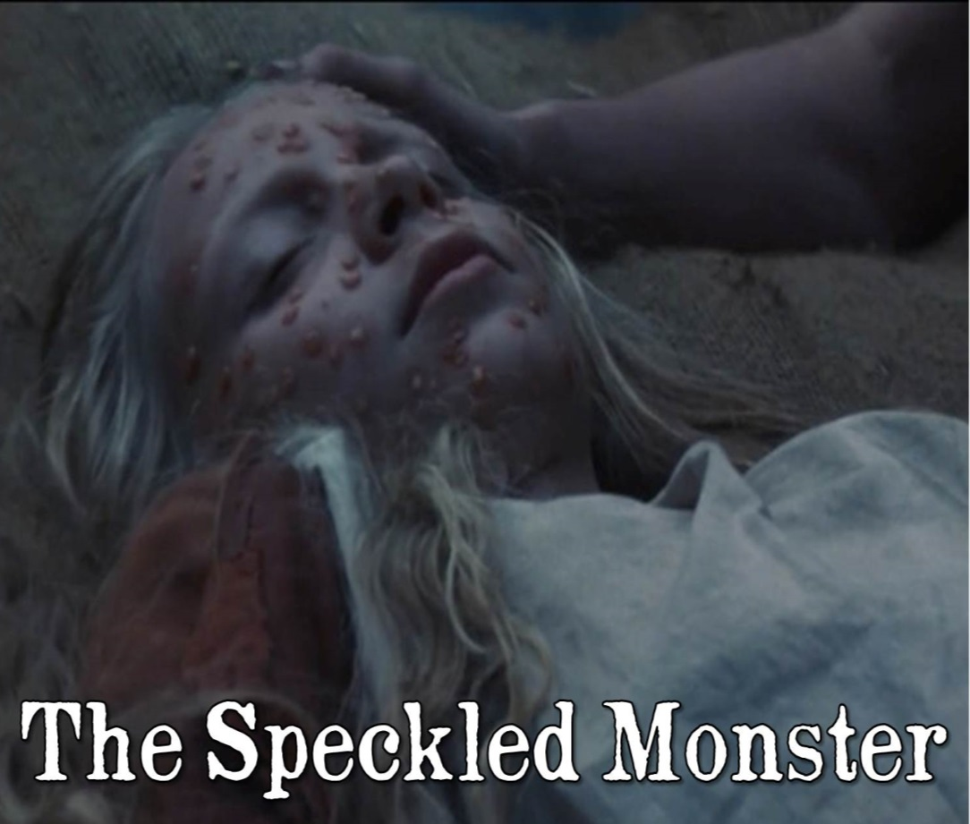
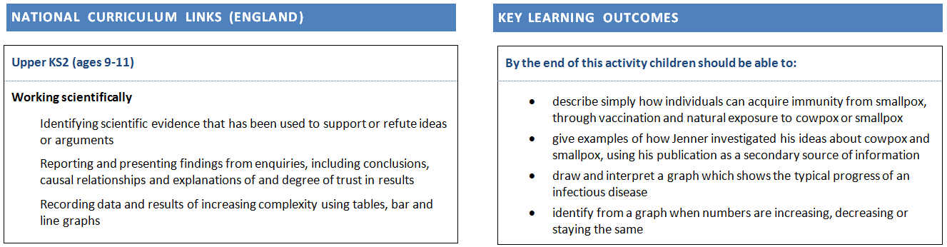
The Speckled Monster (core resource) 4-5 hours total SCIENCE, MATHS, English
Children take part in a simulation of a smallpox outbreak which introduces them to the observations that led Edward Jenner to his world-changing discovery that cowpox gives immunity to the dreaded ‘Speckled Monster’. Children also draw and analyse a graph for a real smallpox outbreak, and use extracts from Jenner’s publication to explore the scientific processes he used to investigate and test his hypothesis.

Slide 15


Slide 16

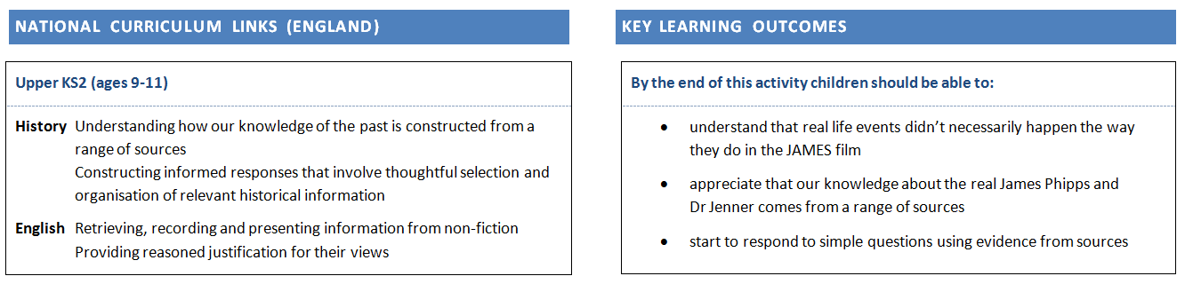
History Detective: What really happened? (core resource) 2-3 hours HISTORY, ENGLISH, Science
Children investigate the historical evidence about Edward Jenner and James Phipps to find out whether real life events happened the way they do in the film. This history and English activity develops children’s ability in the key skills of historical enquiry, helping them start to use primary and secondary sources to answer simple history questions.

Slide 17
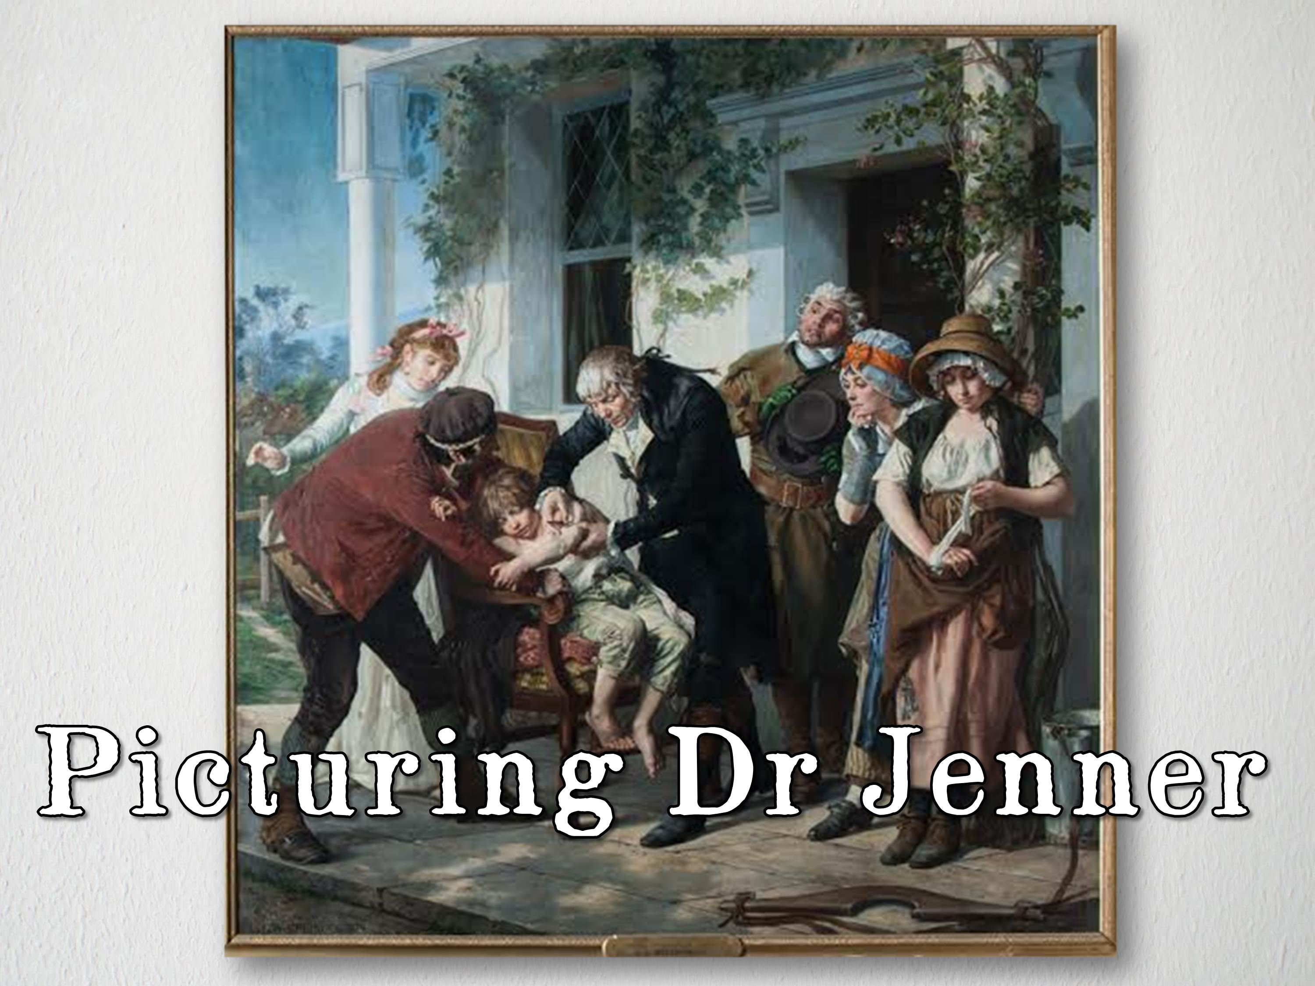

Slide 18
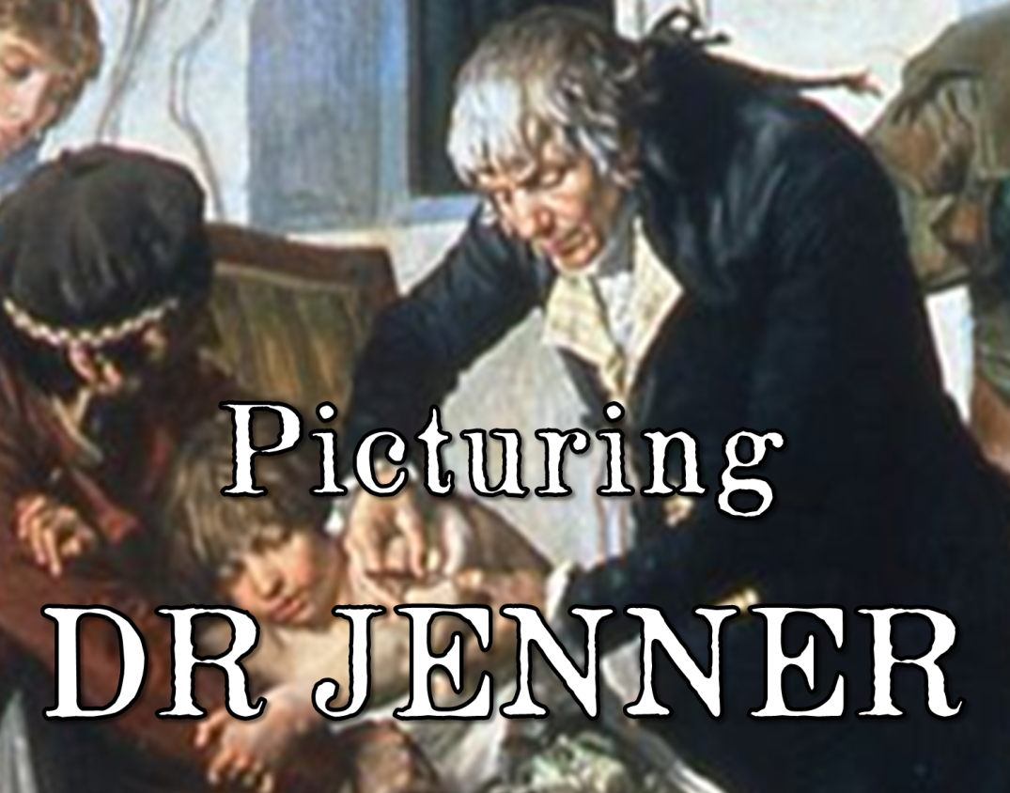
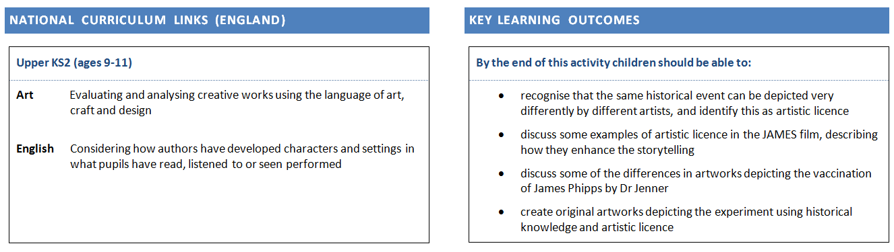
Picturing Dr Jenner 1-2 hours plus practical art time ENGLISH, ART, History
Children explore some of the most famous paintings depicting Dr Jenner’s revolutionary experiment on James Phipps. Using the concept of artistic licence, they discuss why the paintings of the same event are so different. They use the paintings and their learning as inspiration to create their own pieces of art depicting the experiment

Slide 19
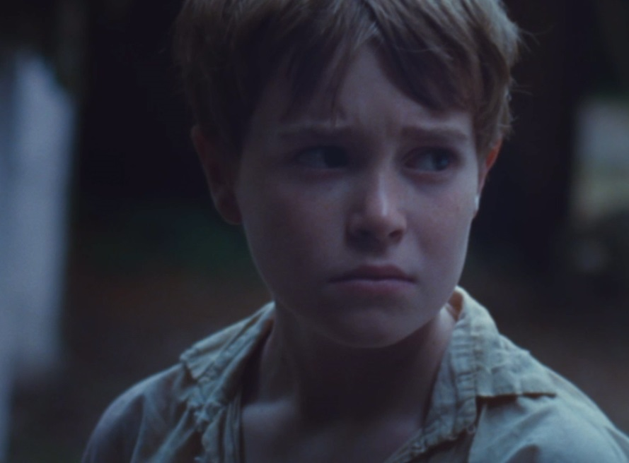
Strength of
Character

Slide 20
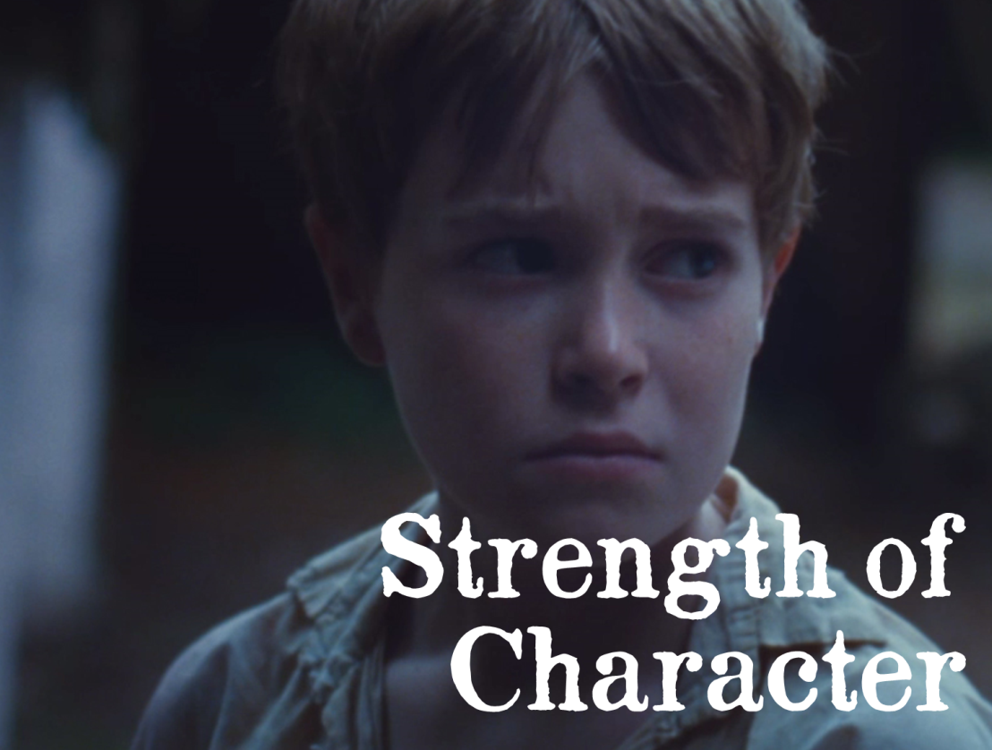
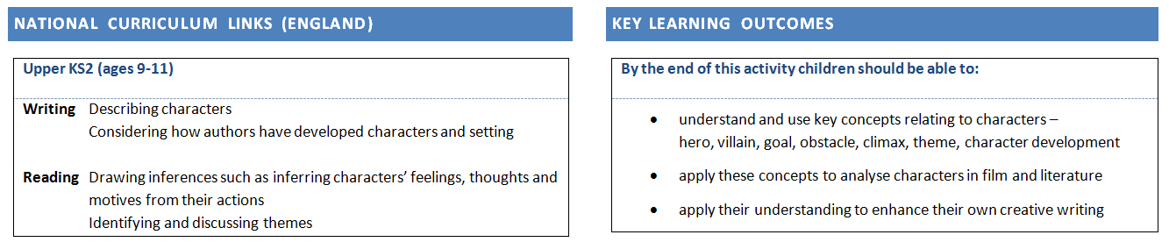
Strength of Character 2 hours ENGLISH, History
An English-focused activity about the importance of characters in storytelling. Children discuss some key concepts and terminology relating to characters, and use them to explore the characters of James and Dr Jenner in the JAMES film, to discuss other characters they have met in film and literature, and to enhance their own creative writing.

Slide 21
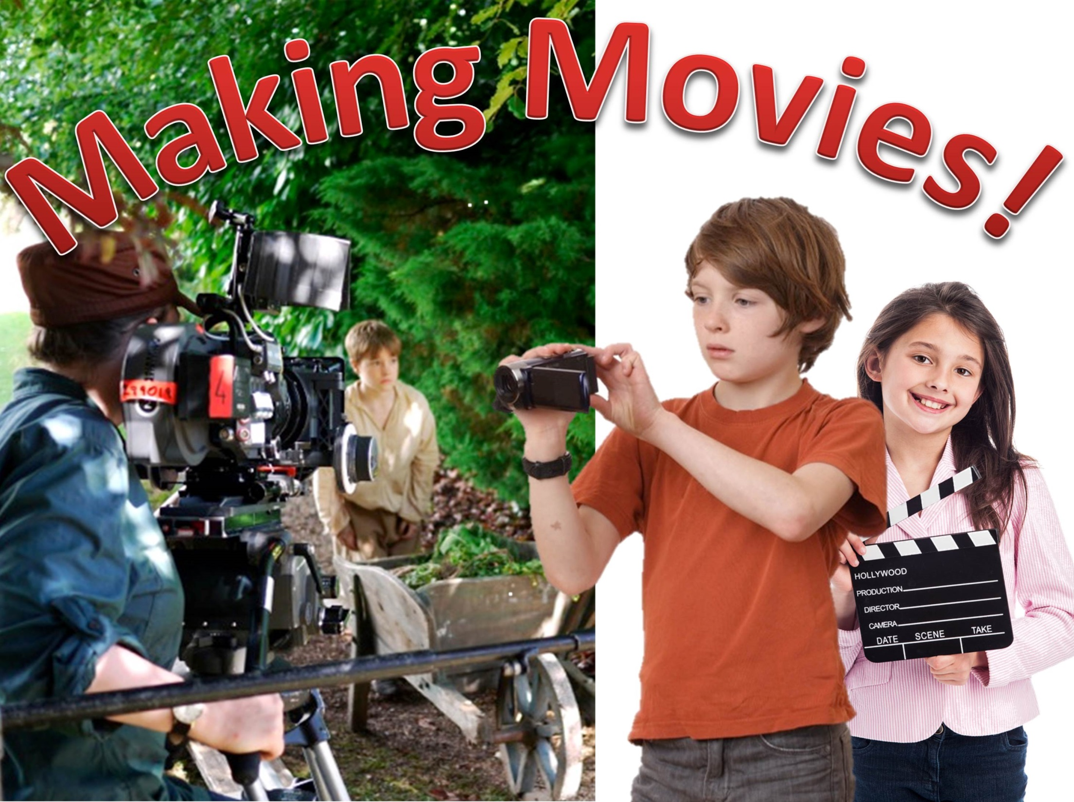

Slide 22
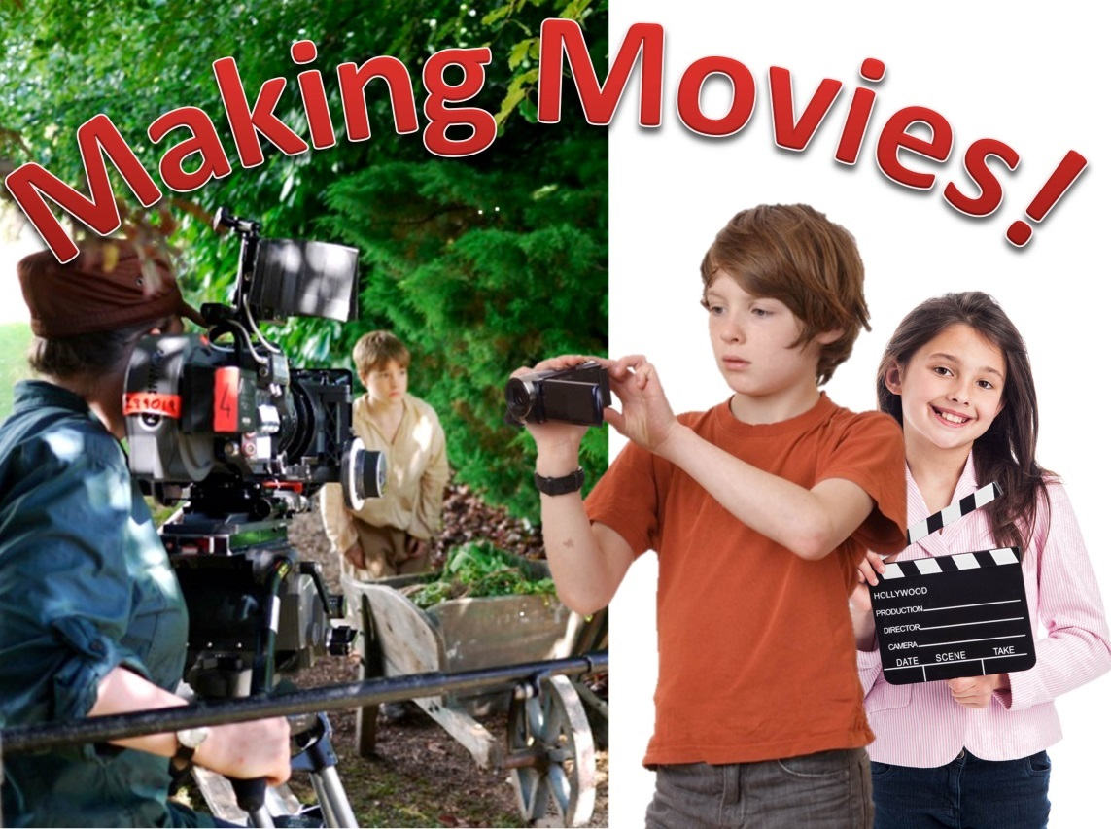
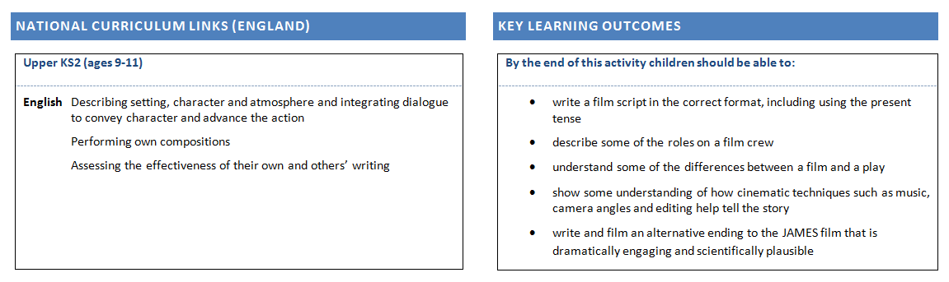
Making Movies! 2 hours plus filmmaking ENGLISH, Drama, Science
Children learn about some of the main creative and technical roles that go into making a film, and use the JAMES film to explore some key creative techniques such as music and basic camera angles. They draw on their learning in this activity and their scientific understanding to write and film a new scene for the JAMES film.

Slide 23
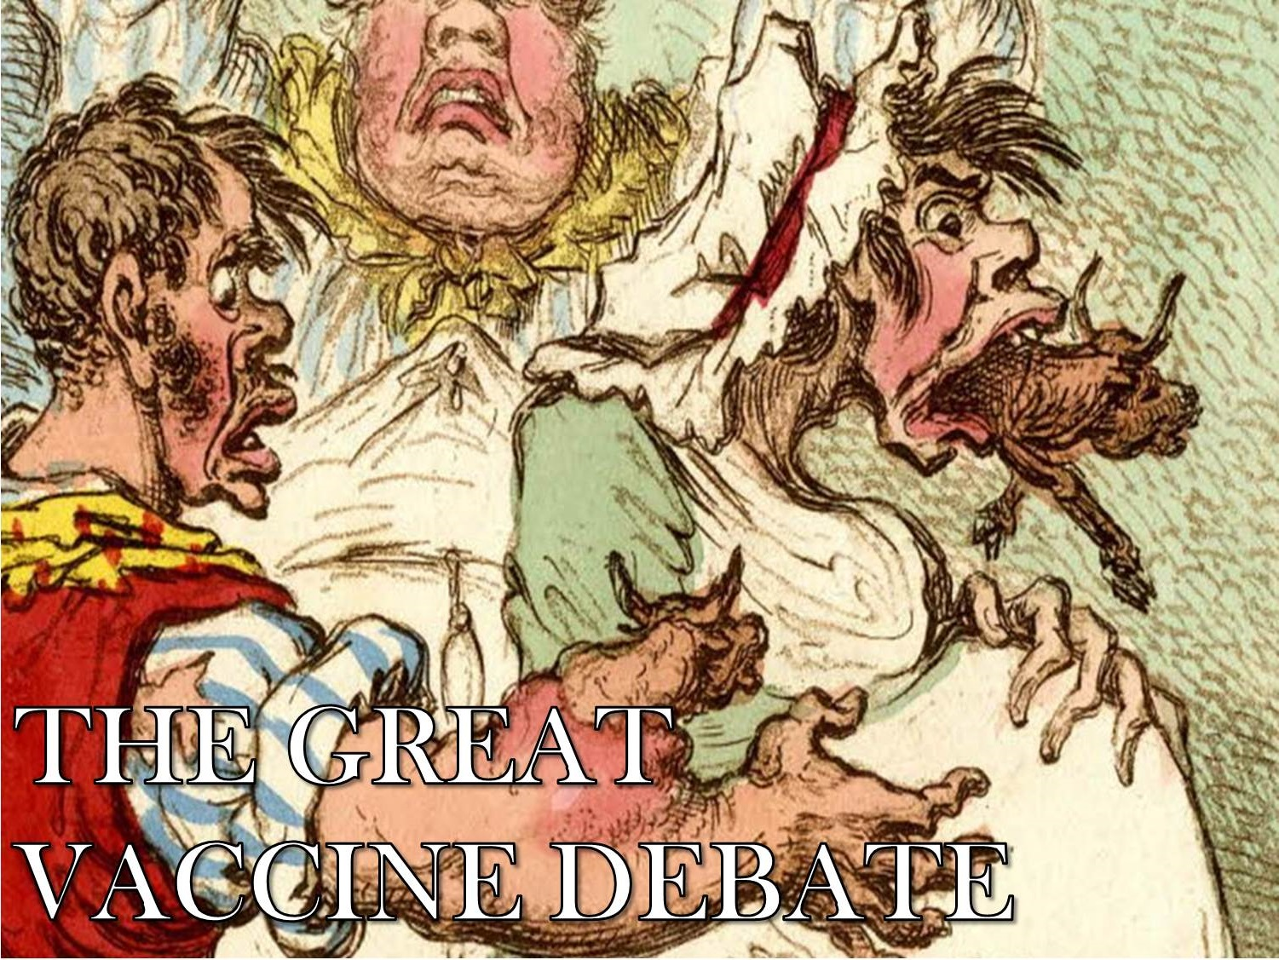

Slide 24
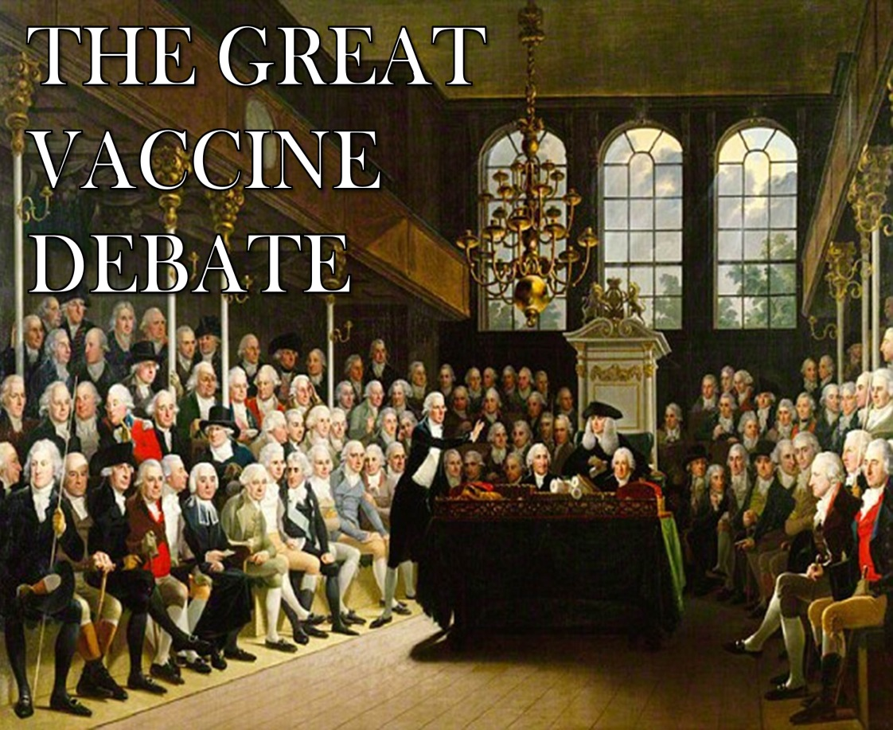
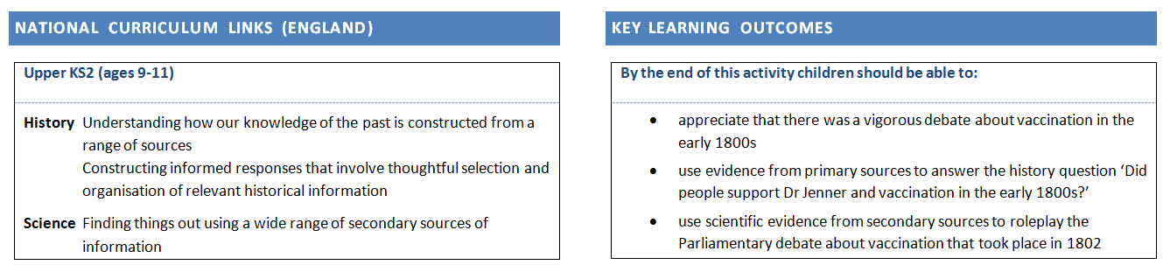
The Great Vaccine Debate 2-3 hours HISTORY, SCIENCE, English
A two-part history and science activity that develops children’s ability to understand and use sources to answer history and science questions. First, children imagine themselves as historians writing a biography of Edward Jenner. Then they imagine themselves as MPs from Jenner’s time and take part in a debate about vaccination that took place in Parliament in real life in 1802.

Slide 25
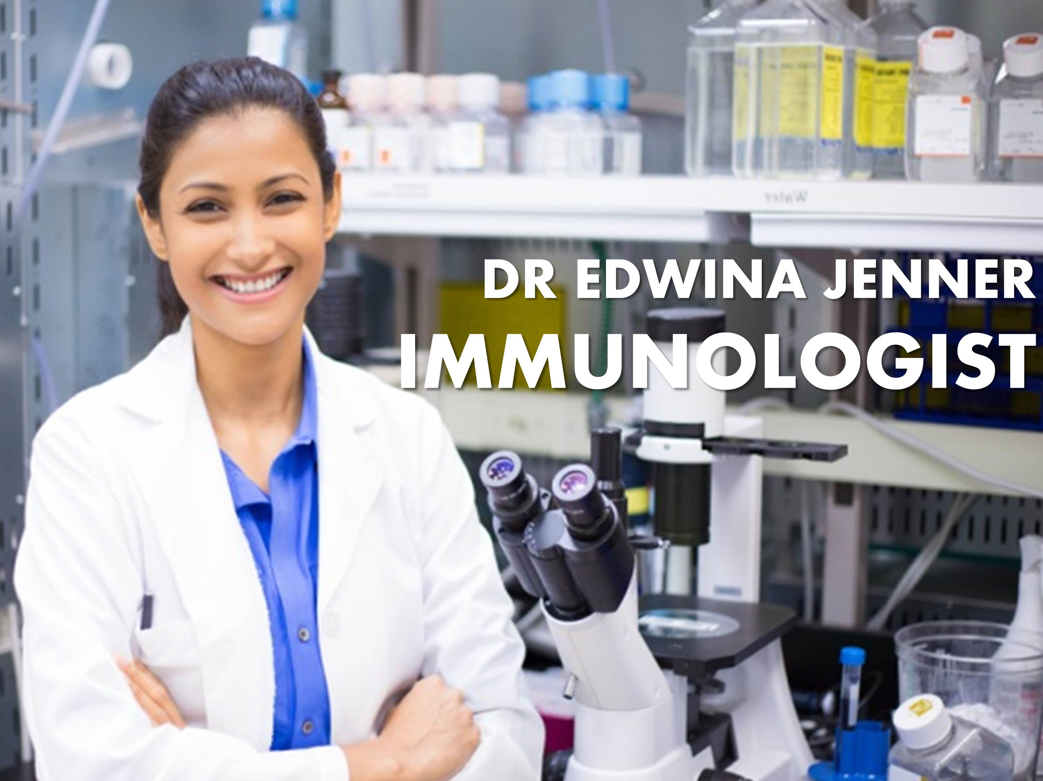

Slide 26

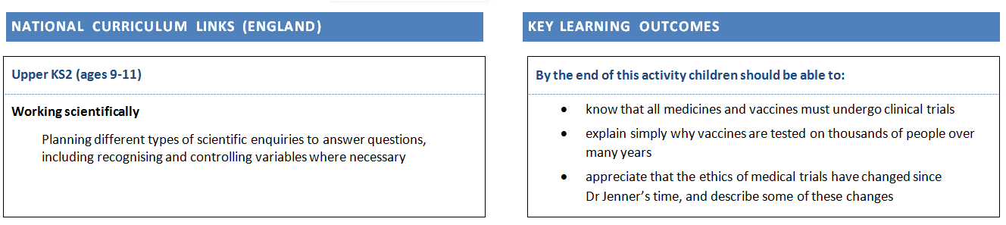
Dr Edwina Jenner – Immunologist 1-2 hours SCIENCE, ETHICS, history
A discussion-based activity comparing the ethics and scientific processes of Dr Jenner’s work with those of modern clinical trials.

Slide 27




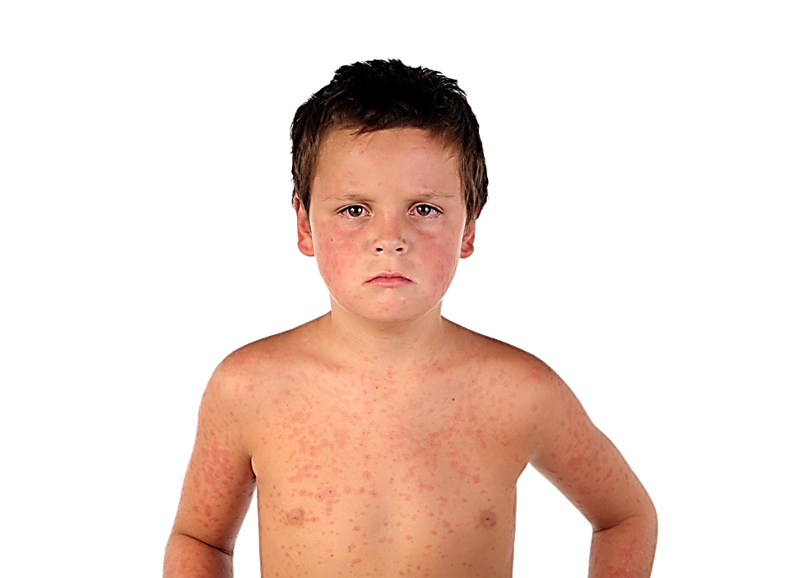


Slide 28

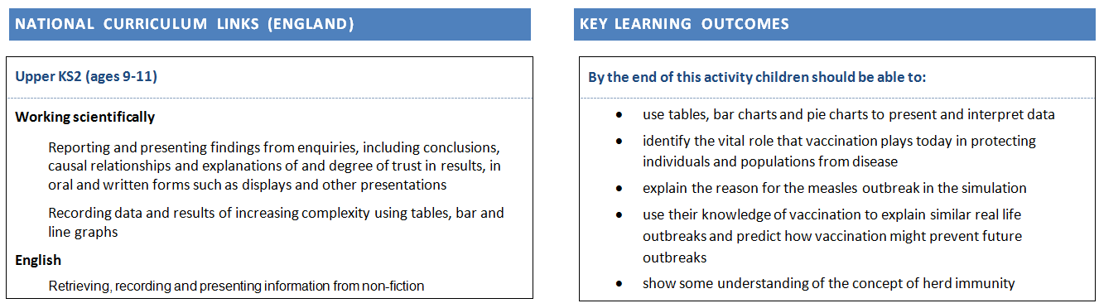
Measles Alert! (core activity) 6 hours total MATHS, SCIENCE, ENGLISH
A dramatic multimedia simulation of a modern measles outbreak, using real data from the 2013 Swansea epidemic. Children take on roles in an Outbreak Control Team and use their maths and science skills to analyse and fight the outbreak, and their English skills to communicate with the media and persuade the public to vaccinate their children.

Slide 29


Slide 30

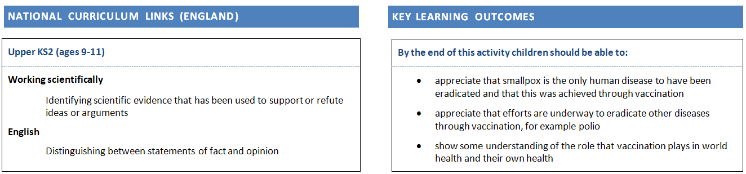
Why You’ll Never Catch Smallpox (core) 1 hour SCIENCE, ENGLISH, history
Children revise key learning from across the activities and explore how Jenner’s discovery has changed the world, and its crucial role in their own health. They learn how, through vaccination, smallpox became the first and only human disease to be eradicated. They look at what other vaccines exist today and the current battles to eradicate other diseases through vaccination.

Slide 32
© ASE & James Films

